Slide 1
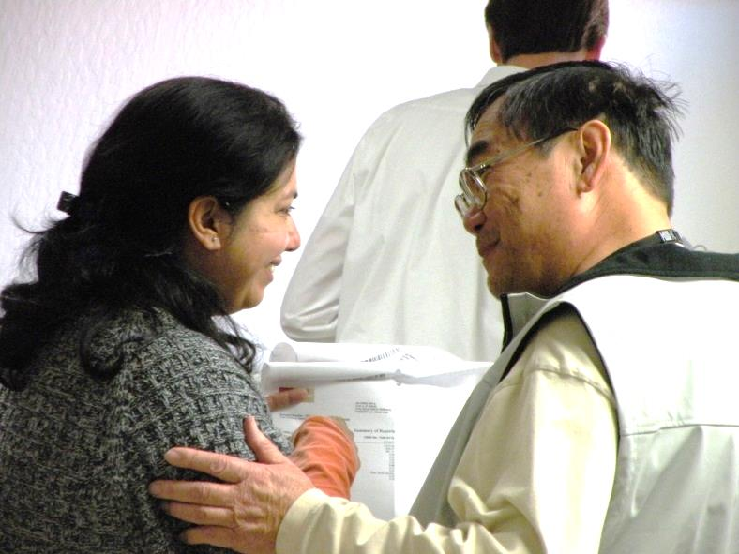
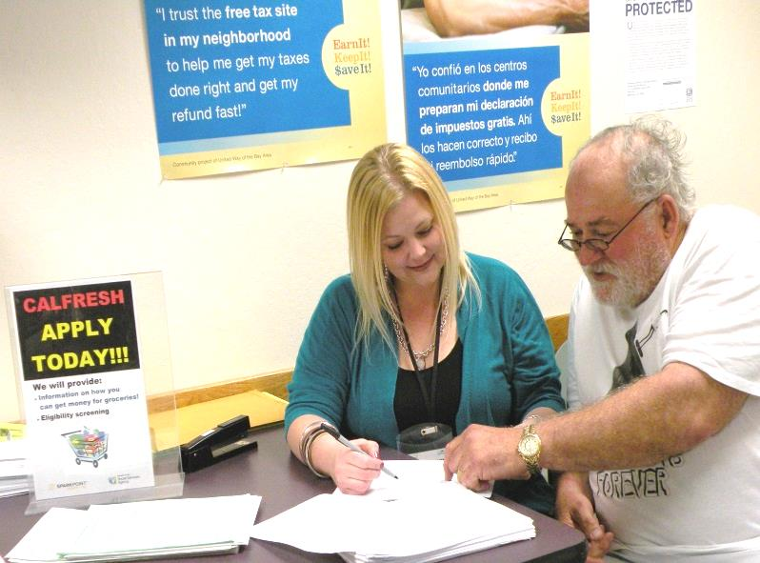
Alameda County-Oakland Community Action Partnership
2018-19 CAP PLAN Presentation www.AC-OCAP.com

Slide 2
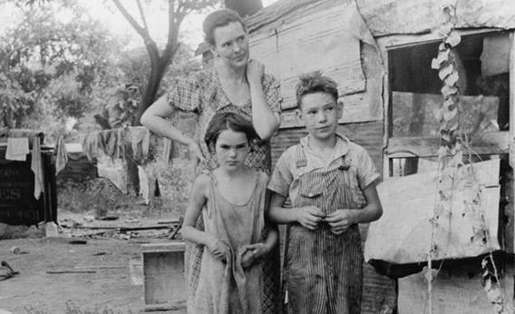
The Start of Community Action in Oakland
1964 President Johnson signs the Economic Opportunity
Act of 1964, creating Community Action Agencies, Head
Start and many other programs
1965 - 1971 The Oakland Economic Development Council,
Inc. (OEDCI), a non-profit, is formed to run the City of
Oakland’s Community Action Program and Head Start
1971 Responsibility for the Community Action Agency
(CAA) and Head Start is transferred to the City of Oakland
As a result, the City of Oakland’s Department of Human
Services was formed
2018-19 CAP PLAN Presentation www.AC-OCAP.com

Slide 3
What is the Community Services Block Grant (CSBG)?
Federal funding to support local Community Action
Agencies which are governed by the principle of
community self help
Funding is based on a calendar year (Jan-Dec)
Funds are block granted to the States for oversight
and administration
States calculate and distribute funds to local Community
Action Agencies based on the number of people
documented in the US Census as living in poverty
(Governed by State Government Code Section 12725-12729)
2018-19 CAP PLAN Presentation www.AC-OCAP.com

Slide 4
2017 Federal Poverty Guidelines
48 Contiguous States & the District of Colombia
Size of Family Unit | 100% of Federal Poverty Level Monthly Income | 100% of Federal Poverty Level Annual Income
1 | $1,005.00 | $12,060
2 | $1,353.33 | $16,240
3 | $1,701.67 | $20,420
4 | $2,050.00 | $24,600
5 | $2,398.33 | $28,780
6 | $2,746.67 | $32,960
7 | $3,095.00 | $37,140
8 | $3,443.33 | $41,320
For Families/households with more than 8 persons, add $4,180 for each additional person.
2018-19 CAP PLAN Presentation www.AC-OCAP.com

Slide 5
AC-OCAP: “helping people and changing lives”
Meeting the needs of Oakland and Alameda County residents:
1971 Community Action brought Head Start to the City
1977 Community Action helped start the Oakland Paratransit for the Elderly (OPED)
1979 Community Action served as an advocate to start the City’s Multi-Senior Service Program (MSSP)
1998 Community Action received $2 million dollars to implement a Welfare-to-Work program
2003 Community Action helped secure a $1 million dollar grant for Project Choice
2005 Community Action secured $250,000 from USDA for Food Stamp Outreach
2007 Community Action secured $250,000 from HHS for IDA’s
2009 OCAP received $1.2 million in ARRA funding
2011 OCAP expanded throughout Alameda County creating AC-OCAP
2018-19 CAP PLAN Presentation www.AC-OCAP.com

Slide 6
Alameda County - Oakland Community Action Partnership (AC-OCAP)
VISION STATEMENT
To end poverty within the City of Oakland and throughout Alameda County
MISSION STATEMENT
To improve our community by creating pathways that lead to economic empowerment and prosperity
PURPOSE
The Community Action Partnership has the responsibility to plan,
develop, and execute efforts to alleviate poverty and work toward systemic change to enhance the opportunities for families of low-income throughout Alameda County to achieve self-sufficiency
AC-OCAP’s Self-Sufficiency Definition
Having the means and opportunity to meet a range of individual needs
2018-19 CAP PLAN Presentation www.AC-OCAP.com

Slide 7
Tripartite Governance of Community Action Partnership (CAP)
Mandated Three Part Administering Board Structure
(18 members)
Public Official Representatives (6)
Oakland City Council Members
Councilmember Lynette McElhaney (District 3)
Councilmember Noel Gallo (District 5)
Councilmember Larry Reid (District 7)
City of Oakland Mayor
Mayor Libby Schaaf
Alameda County Board of Supervisors
Supervisor Wilma Chan (District 3)
Supervisor Nate Miley (District 4)
2018-19 CAP PLAN Presentation www.AC-OCAP.com

Slide 8
Tripartite Governance of Community Action Partnership (CAP) cont’d
Mandated Three Part Administering Board Structure
(18 members)
Representatives of private groups and interests (3)
Oakland Rotary
Alameda County Social Services
United Seniors
“Not fewer” than 1/3 are democratically elected/selected
representatives from the low-income community (9)
(7) Low-income residents from Oakland
(2) Low-income Alameda County residents
2018-19 CAP PLAN Presentation www.AC-OCAP.com

Slide 9
Alameda County - Oakland Community Action Partnership (AC-OCAP)
 | AC-OCAP’s 2017-2019 Strategic Focus Areas
Family | Job Training & Employment Placement | Support employment focused programs and services that address job training and employment placement which include education/GED and internships for adults, youth 16 and older, seniors, re-entry population, and the homeless; and Provide wraparound/bundle services that assist low-income individuals and families with support in the areas such as Behavioral Health/Covered CA, Food Security/Cal Fresh, Bank on Oakland, Earned Income Tax Credit, and other income support services as it relates to job training & employment placement.
Family | Housing & Community Development | Support programs and services that provide shelter/transitional, stable and affordable housing or home ownership or assets building or financial empowerment or micro enterprise opportunities; and Provide wraparound/bundle services that assist low-income individuals and families with support in the areas such as Behavioral Health/Covered CA, Food Security/Cal Fresh, Bank on Oakland, Earned Income Tax Credit, and other supportive services as it relates to housing & community economic development.
2018-19 CAP PLAN Presentation www.AC-OCAP.com

Slide 10
Alameda County - Oakland Community Action Partnership (AC-OCAP)
 | AC-OCAP’s 2017-2019 Strategic Focus Areas
Community | Civic Engagement | Support programs and services that increase public awareness and expand partnerships with small businesses, Chambers of Commerce, as well as engaging non-profit and public agencies in the issue of poverty and other issues that affect Alameda County’s low-income population
Community | Advocacy | Support programs and services that mobilize, empower and promote low-income individuals and the community to take action in the areas of housing, transportation, seniors, education, employment, veterans, immigration, and other areas that impact low-income families.
Agency | Capacity Building | Support programs and services that foster agency capacity-building in the areas of fund development, board development, social media outreach, and community building.
2018-19 CAP PLAN Presentation www.AC-OCAP.com

Slide 11
Alameda County’s Community Demographics
2018-19 CAP PLAN Presentation www.AC-OCAP.com

Slide 12
Alameda County’s Community Demographics
2018-19 CAP PLAN Presentation www.AC-OCAP.com

Slide 13
Alameda County & Oakland’s Low-Income Community Profile
 | 2000 Below Poverty Level | % | 2010 Below Poverty Level | % | 2011-2015 ACS Poverty Level | % | % Change from 2000
Alameda County | 156,804 | 11.0% | 172,348 | 11.7% | 194,639 | 12.5% | +1.5%
Oakland | 76,489 | 19.4% | 74,335 | 19.3% | 82,165 | 20.4% | +1.%
Berkeley | 19,495 | 20.0% | 18,470 | 18.4% | 21,666 | 20.4% | +0.4%
AC w/o Oakland or Berkeley | 60,820 | 6.4% | 79,543 | 8.1% | 88,763 | 8.7% | +2.3%
2017 HHS Poverty Guidelines for an individual is $12,060
(around $5.80 per hr.); $20,420 for a family of 3 (around
$9.82 per hr.)
Source: US Census 2000, 2008-2010 3 Year Estimates, and 2011-2015 ACS 5 Year Estimates – S1701
2018-19 CAP PLAN Presentation www.AC-OCAP.com
Notes:
The poverty level is based on the number of those below poverty divided by the population whom poverty status is determined. Not necessarily the entire population.

Slide 14
Source: US Census Bureau, 2011-2015 ACS 5-Year Estimates - S1701
2018-19 CAP PLAN Presentation www.AC-OCAP.com

Slide 15
Alameda County’s Community Indicators
Income
Employment
Education
Health
Food Security
Housing
Homelessness
Public Safety
2018-19 CAP PLAN Presentation www.AC-OCAP.com

Slide 16
Household Income
Alameda County median income: $75,619
City of Oakland median income: $54,618
Household Income by Race
Source: US Census Bureau, 2011-2015 ACS 5-Year Estimates – S1903
2018-19 CAP PLAN Presentation www.AC-OCAP.com

Slide 17
Income – 1 adult & 2 kids
Source: Insight Center for Community Economic Development 2015
2018-19 CAP PLAN Presentation www.AC-OCAP.com

Slide 18
Employment – Unemployment Rates
2018-19 CAP PLAN Presentation www.AC-OCAP.com

Slide 19
Education – High School Drop Out Rates
2018-19 CAP PLAN Presentation www.AC-OCAP.com

Slide 20
Education – Educational Attainment & Median Income
Source: US Census Bureau, 2011-2015 ACS 5-Year Estimates – S1501
2018-19 CAP PLAN Presentation www.AC-OCAP.com

Slide 21
Health – Life Expectancy by City in Alameda County
Source: Alameda County Vital Statistic Files, 2010-2012
2018-19 CAP PLAN Presentation www.AC-OCAP.com

Slide 22
Food Security
The USDA’s Low Income-Low Access 2015 food access map
shows that West Oakland, Hayward, Union City, and Eden are
considered food deserts since they are more than one mile
or 10 rural miles from a supermarket.
(Source: USDA Economic Research Service, ERSI, 2015)
65% of Food Bank clients’ incomes are below the poverty
level; 74% purchase inexpensive, unhealthy food; 85% of
households are food insecure; don’t know where their next meal will come from.
(Source: Alameda County Community Food Bank, 2014)
In Alameda County, 112,000 individuals (45% are children) receive CalFresh in the County, however only 59% of those who are eligible
actually receive food assistance.
(Source: Alameda County Social Services Agency, 2016)
In Alameda County – 43.7% students qualify for free/reduced cost school meals.
(Source: California Dept. of Education, March 2016)
In Oakland – 72% of OUSD students qualify for free/reduced cost school meals.
(Source: California Dept. of Education, March 2016)
2018-19 CAP PLAN Presentation www.AC-OCAP.com

Slide 23
Housing
Income Before Taxes for Full-time Worker @$15/hr = $2,400 Average Social Security Retirement Income = $1,340 Maximum CalWORKs Aid for a Family of 4 = $936 Supplemental Security Income (SSI) in California = $889.40 General Assistance (GA) Grant in Alameda County = $336
# Full-time Minimum Wage Earners needed: | 3.8 | 3.4 | 4.0
Source: National Low Income Housing Coalition, HUDUser.gov 2016
2018-19 CAP PLAN Presentation www.AC-OCAP.com

Slide 24
Homelessness
2018-19 CAP PLAN Presentation www.AC-OCAP.com

Slide 25
Public Safety
Alameda County had 9,679 violent offenses in 2015, a 6.5% decrease from 2014
(CA Dept. of Justice, Crime & Clearances Data 2006-2015)
There were 2,274 juvenile arrests in the county in 2014
(CA Dept. of Justice, Arrest Dispositions 2005-2014)
There were 12,096 individuals on probation in 2016
(Public Safety Realignment in Alameda County, October 2016)
In 2015, adult recidivism rate in Alameda County = 20.3%
(Public Safety Realignment in Alameda County, October 2016)
2018-19 CAP PLAN Presentation www.AC-OCAP.com
Notes:
This is the most current dataset that shows Alameda County cities. In 2009, there were 11,189 violent crimes. The City of Oakland’s crime statistics are remarkably high compared to other jurisdictions in Alameda County, constituting 60% of the violent crimes in the entire county. The Oakland Police Department report that in 2012, there were 131 homicides. Of these homicides, 60% are age 30 and under, and mostly male (86%).

Slide 26
2017 Funded Programs
AC-OCAP Grantees
Job Training & Employment Placement
Hack the Hood
Civicorps
Downtown Streets, Inc.
Roots Community Health Center
Rubicon Programs, Inc.
La Familia Counseling Service
Youth Employment Partnership
Housing & Community Development
AnewAmerica Community Corporation
St. Mary’s Center
Eden Information and Referral, Inc.
Family Emergency Shelter Coalition
Satellite Affordable Housing Associates
Unity Council
AC-OCAP Programs
Asset Building & Financial Education
Housing and Economic Rights
Advocates (HERA)
Earned Income Tax Credit (EITC)
Bank on Oakland (BOO)
Legal Assistance
Bay Area Legal Aid
Hunger
Oakland Community Housing Services’
Annual Holiday Dinner
Oakland Fund for Children & Youth
Summer Lunch Program
2018-19 CAP PLAN Presentation www.AC-OCAP.com

Slide 27
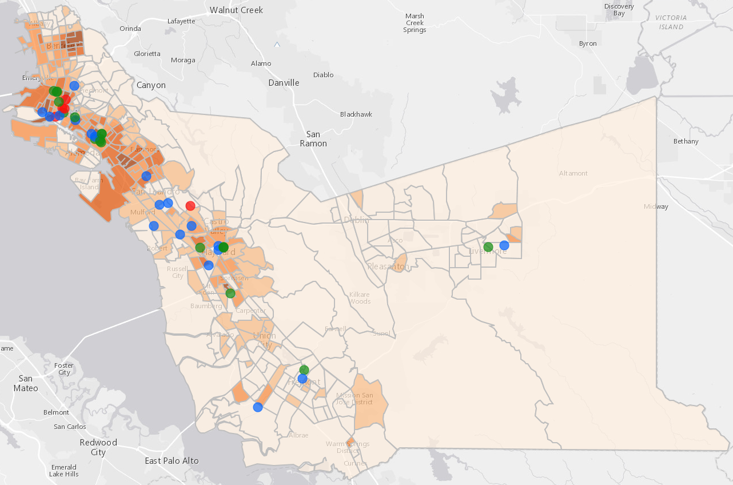
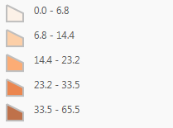
Alameda County & Oakland’s Low-Income Community Profile Map
North County:
Alameda, Albany, Berkeley, Emeryville, Piedmont, Oakland
St. Mary’s Center (4 sites)
Bay Area Legal Aid (3 sites)
Housing & Economic Rights Advocates
Roots
Satellite Affordable Housing Associates, Hack the Hood
Youth Employment Partnership
AnewAmerica Community Corporation (4 sites)
Unity Council (1 site)
Roots Community Health Center
Civicorps (2 sites)
Hack the Hood
Bay Area Legal Aid
Roots Community Health Center
Bay Area Legal Aid
Family Emergency Shelter Coalition (3 sites)
Downtown Streets Team (2 sites)
La Familia Counseling Service
East County:
Dublin, Livermore, Pleasanton, Sunol
Hack the Hood (5 sites)
Unity Council
Central County:
Ashland, Castro Valley, Cherryland, Hayward, San Leandro, San Lorenzo
Rubicon Programs, Inc.
AnewAmerica Community Corporation
Percent of Population Below Poverty
AnewAmerica Community Corporation
La Familia Counseling Service
Bay Area Legal Aid
Program Service Area
Roots Community Health Center
Housing & Community Development
Legal Assistance
Job Training & Employment Placement
Source: US Census 2010 Poverty Statistics
data.acgov.org
South County:
Fremont, Newark, Union City
2018-19 CAP PLAN Presentation www.AC-OCAP.com
Notes:
This is the most current dataset that shows Alameda County cities. In 2009, there were 11,189 violent crimes. The City of Oakland’s crime statistics are remarkably high compared to other jurisdictions in Alameda County, constituting 60% of the violent crimes in the entire county. The Oakland Police Department report that in 2012, there were 131 homicides. Of these homicides, 60% are age 30 and under, and mostly male (86%).

Slide 28
Future CSBG Funding
CSBG Reauthorization/Legislation
2017 CSBG Funding: $1.347 million
Challenges
Lack of Funding for Safety Net (ACA, HUD, Immigration)
Provides $6.92 per person
($1.347mil/194,639 individuals in poverty)
2018-19 CAP PLAN Presentation www.AC-OCAP.com

Slide 29
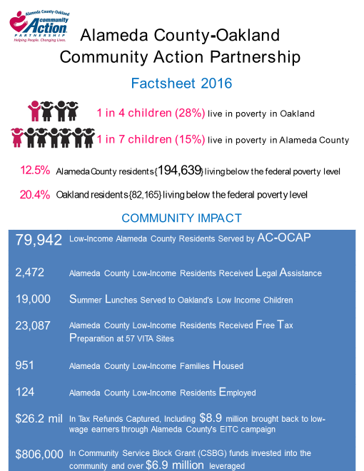
Alameda County Factsheet 2016
Source: US Census Bureau, 2011-2015 ACS 5-Year Estimates
2018-19 CAP PLAN Presentation www.AC-OCAP.com
Source: 2011-2015 American Community Survey, AC-OCAP Plan

Slide 30
The Promise of Community Action
“Community Action changes people’s lives, embodies the spirit of hope, improves communities, and makes Oakland and Alameda County a better place to live. We care about the entire community, and we are dedicated to helping people help themselves and each other”
2018-19 CAP PLAN Presentation www.AC-OCAP.com

Slide 31
Community Needs
1. What are some of the challenges in providing for your family?
2. What kind of support would help you get or stay Employed/Housed?
3. What’s missing from existing services that you would like to see
added or improved?
4. Lastly, in your opinion, what do we need to do to work towards ending
poverty?
2018-19 CAP PLAN Presentation www.AC-OCAP.com

