Slide 1
SPEAKER 主講嘉賓
● 三藩市加州大學法律學博士 U.C. Hastings (SF) Juris Doctor
● 依利諾州事業 會計師 Certified Public Account (C.P.A.)
● 柏克來加大 工商管理最高榮譽學士
U.C. Berkeley Hass Business School Highest Honor
莫秀寧 律師 Frannie Mok, Esq.
Attorney at Law

Slide 2
Small Business Accounting 小商業會計
Cash Basis 現 金 系統
(simple 簡單, conservative保守)
2. Accrual Basis 應 計 系統
(easy future forecast 未來預測)

Slide 3
Tax Credit Incentives 所得稅抵免
EITC (Earned Income Tax Credit)
B. SETC(Self emplyement Tax Credit)
2021 self-employment income
$3,000 IF has < 18 years old child
$20,000 IF no children

Slide 4
SMALL BUSINESS PROGRAM
S O L A R I N C E N T I V E S
太 陽 能

Slide 5
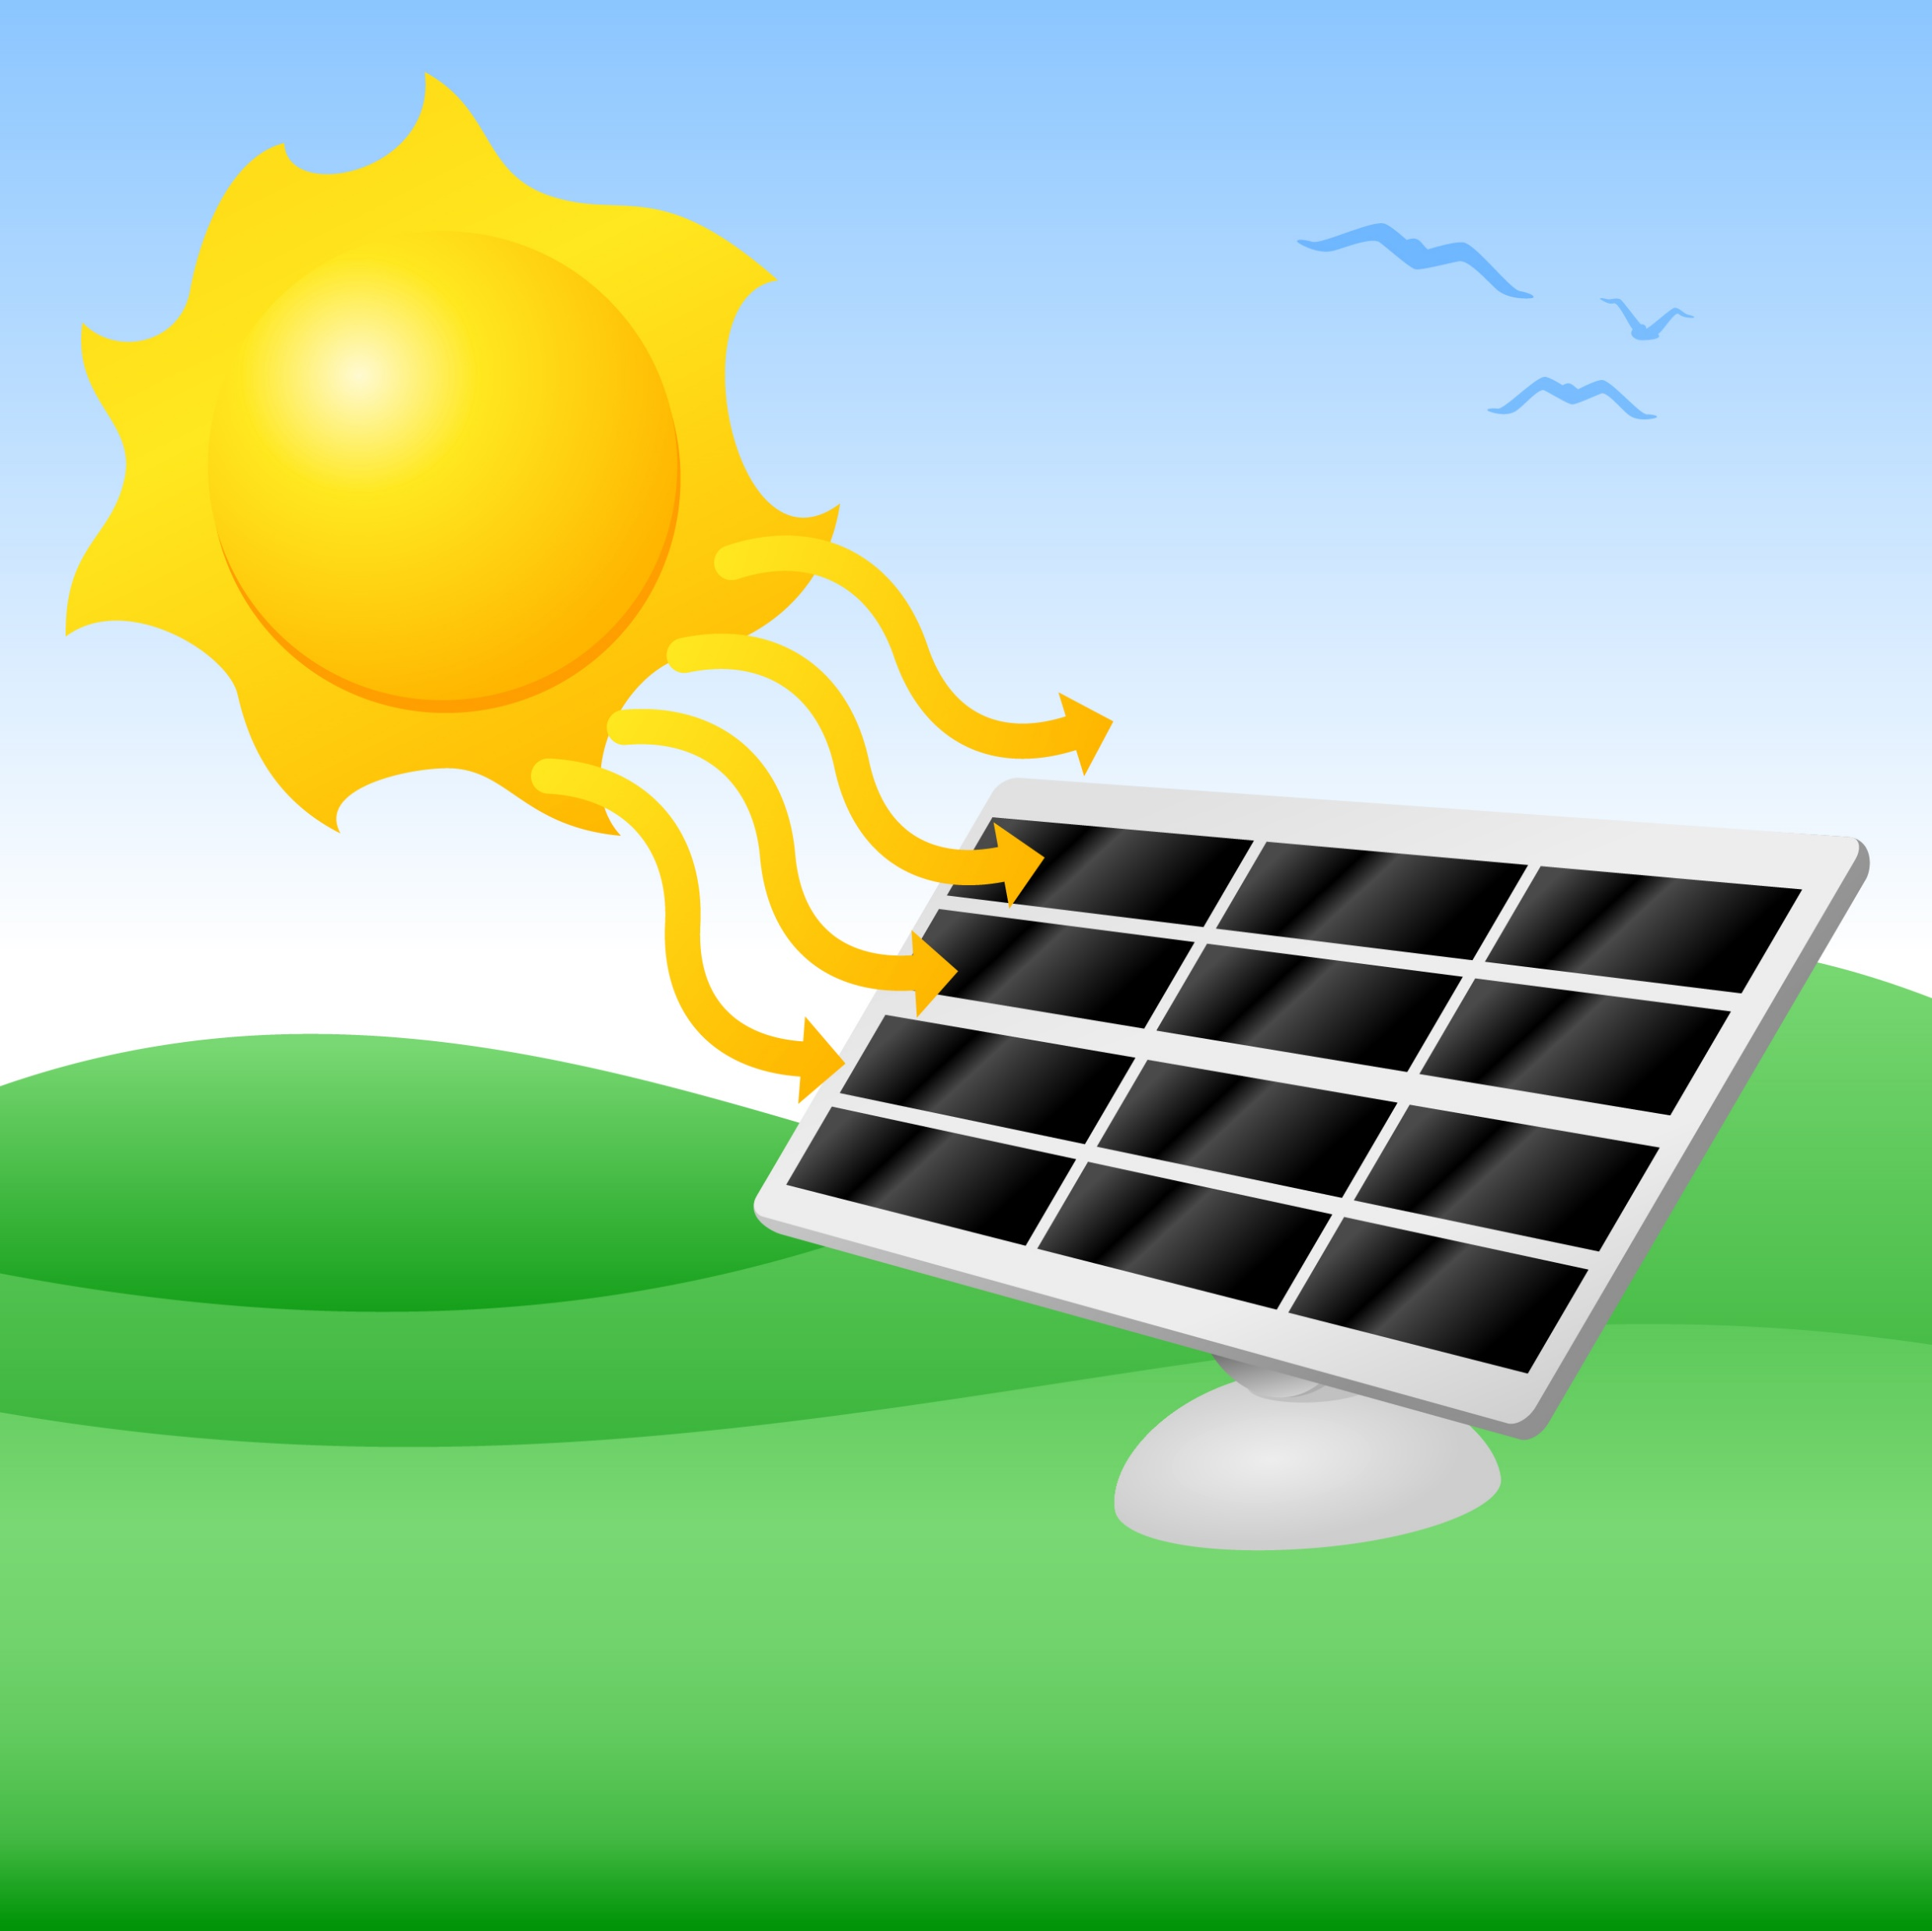
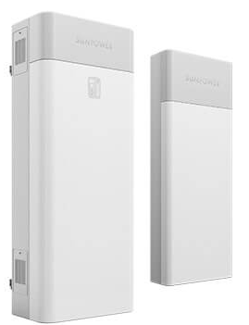
新高效太陽能系统 節省高达 60% 电费 Solar Energy Save up to 60% Electricity Cost FREE Battery 免费 $16,500储电池！ Limited Quantity, First come first serve 数量有限 先到先得 Best Full System Warranty & Production Guaranty 系統 + 產电量 全面100% 保証
提供电费單, 免费获取人造衛星设计
FREE Satellite Design & Proposal
Uprising Solar 精英太阳能公司
(510) 463-4898 國/粤/英 語
服務全美國 Serving all States
$18,500
13 kwh

Slide 6
Small Business Program:
E D U C A T I O N
教 育

Slide 7
加州大学 青少年 夏令营活动
主办: UCLA 加州大学 6/3/2024 to 8/16/2024
每 周 报 名 weekly programs
Grade 1-10 年 级 学 生
2 Camps to pick from

Slide 8
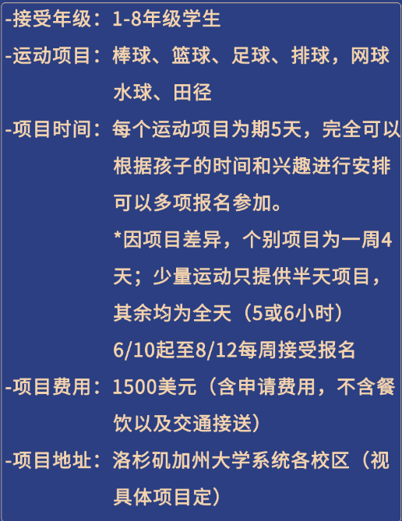
Camp 1
Camp 2

Slide 9
SMALL BUSINESS PROGRAM:
IMMIGRATION
移 民

Slide 10
Small Business Immigration
投资移民EB5 喜讯！
投资 U$80万不需排期, 5 年歸还 !
$800,000 investment, no quota. Repay in 5 years.
只 $12 萬费用 Fees 左右. 全家移民
$120,000 fees, full family immgration.
全美国仅12名额！Only 12 slots in U.S.

Slide 13
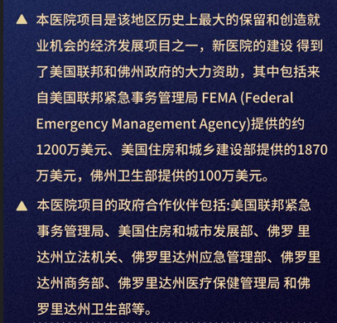

Slide 15
SBA, 7A & 504 Loans
The maximum loan amount for a 7(a) loan is $5 million
The maximum loan amount for a 504 loan is $5.5 million

Slide 16
SBA 504 Loans
Q: What are SBA 504 loans designed to do?
A: SBA 504 loans are designed to provide financing
for the purchase or construction of owner-occupied
Commercial real estate.
51% owner occupied
60% construction
Long-term, fixed rate financing of up to $5 million for major fixed assets

Slide 17
Business Financing | SBA Financing
Q: What is the typical financing structure for an SBA 504 loan?
A: Typically, a borrower
injects 10% of the eligible
project costs, with 90%
financing coming from two
sources: Banks provides
a loan of 50% in a first
lien position, while the
SBA, in conjunction with
a certified development
company (CDC), provides
40% in a second lien position.

Slide 18
SBA Guaranty Fee:
90% financing for real estate loans (owner user)
Fixed and variable rates available
Up to 25-year term SBA 504 CRE, 10-Year term SBA 7a Biz
SBA 7a loan, single loan
SBA 504 loan, two loans
SBA loan limit $5M
SBA 7a loan amount under $1M has no SBA guaranty fee

Slide 19
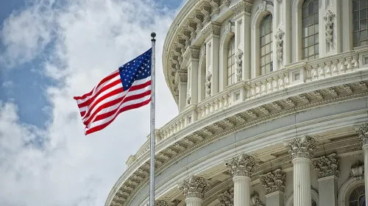
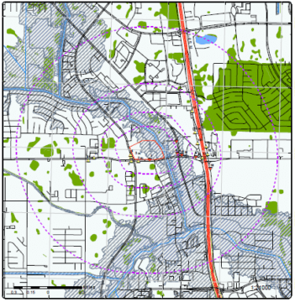
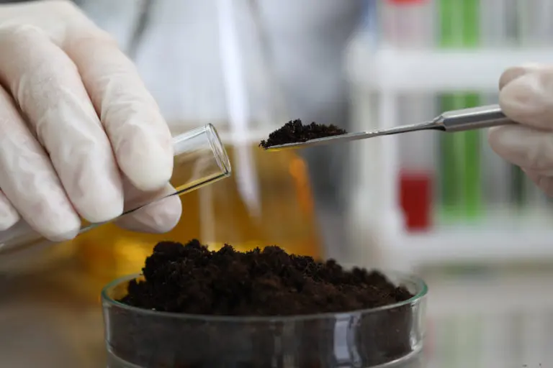
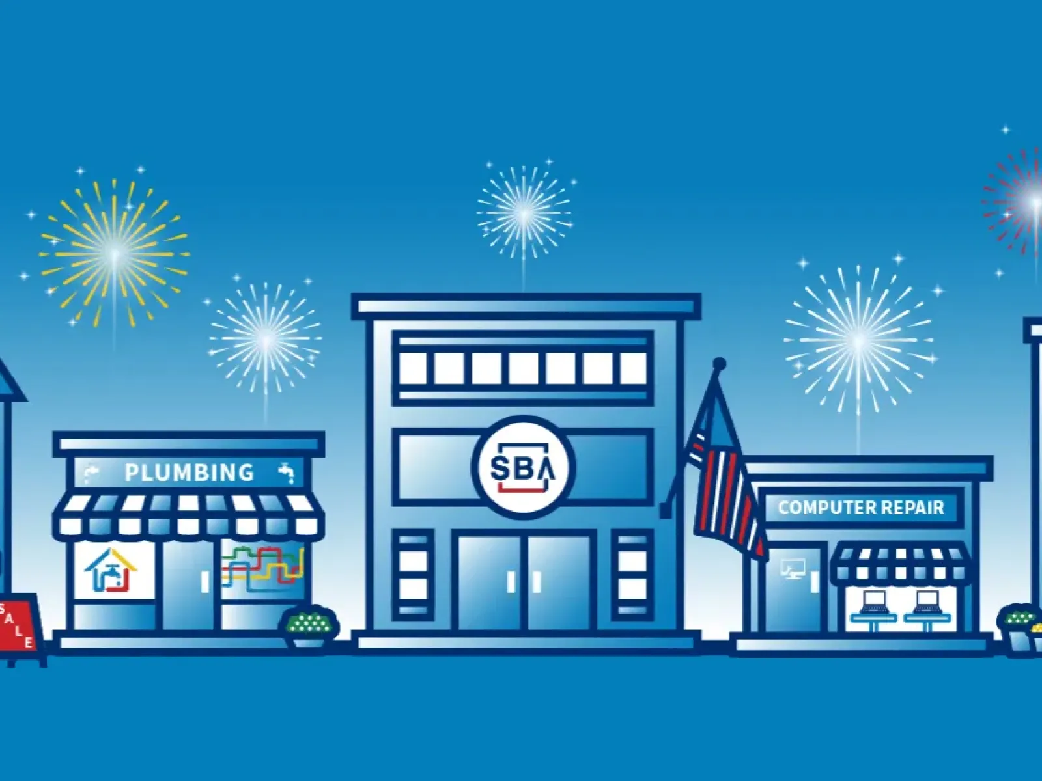
Costs: SBA, 7A & 504 Loans
There is $2,500 SBA packaging fee and 3rd party cost such as appraisal, environmental and etc.
Cost of Commercial Real Estate Appraisals. A borrower can expect to pay between $2,000 and $4,500 for an appraisal
Phase 1 Environmental Site Assessment Cost $1,700 to $2,500
Typical Escrow Costs in the Bay Area On average, you can expect escrow fees to range from 1% to 2% of the total property value.

Slide 20
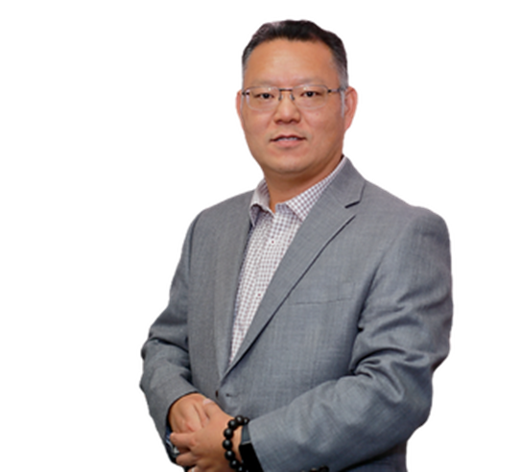
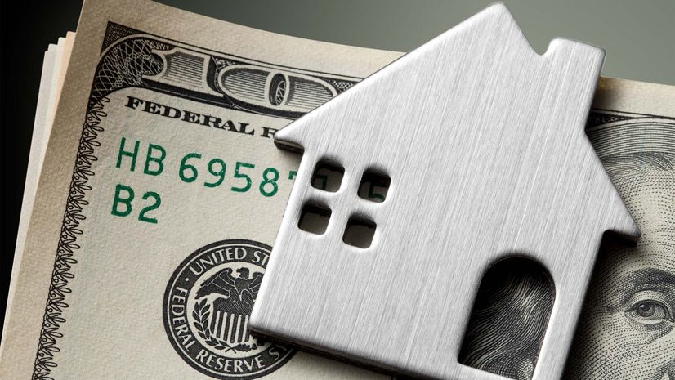
Thank you, Q & A ?
No two commercial loans are the same. We work with clients to ensure we understand their needs and to offer our network the best rates and terms.
David Dai – Mortgage Broker
OneGlobal Lending
333 Gellert Blvd, Suite 228
Daly City, CA 94015
www.MyOneLending.com
20

Slide 21
SMALL BUSINESS PROGRAM ADU
Project engineer
Construction manager
DESIGN TEAM

Slide 22
Discussion Item
1. California ADU laws
2. SB 9 sub-division
3. Construction Cost Budgeting

Slide 23
ADU TYPES 類型
3
1
4
2

Slide 24
State Ordinance Summary
ADU:
Detach max 1000 sqft (2+ bedrm), 16’ height
4’ side/rear setback
NO parking needed
Room Width 房間寬度 > 7’
Ceiling Height 室內天花板高度 > 7’
Solar required unless within main house conversion
Fire sprinkler requirement lifted in state law, not yet adopt to local code.
Condo conversion (up to local jurisdiction)

Slide 25
State Ordinance Summary
ADU:
Attach max 850sqft/50% unit area (1 bedroom)
Attach max 1000sqft/50% unit area (2+ bedrm)
JADU: 500 sqft, min 1 bathroom (share ok), dedicated unit entry

Slide 26
SB 9
Residential Single Family Home Lot
can Divide into 2 lots
1 or 2 Primary Units (SFR, non ADU),
- at least 800 Sq Ft
Each can build ADUs, total 4 units

Slide 29
Detach ADU

Slide 30
Thank you

