Slide 1
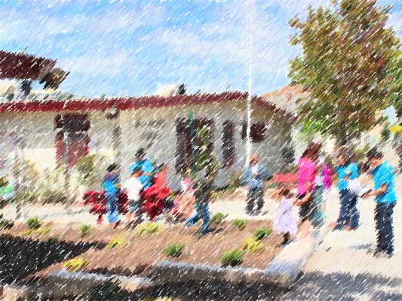

Franklin Elementary School
Safety Improvement Project
Notes:
Hello and thank you for this opportunity to talk with you all. My name is Nicole Ferrara, and I’m the Vision Zero Project Manager with the City of Oakland’s new dept of transportation.

Slide 2

Goals of Today’s Meeting:
Share an overview of the City’s plans to improve E 15th St. and Foothill Blvd.
Discuss next steps
After Today’s Meeting:
I will keep everyone informed
Notes:
This slide articulates our department’s mission. I’m going to read it word for word, because it’s so important: Our work in the DOT is to envision, plan, build, operate and maintain a transportation system for the City of Oakland—in partnership with local transit providers and other agencies—and assure safe, equitable, and sustainable access and mobility for residents, businesses, and visitors.

Slide 3
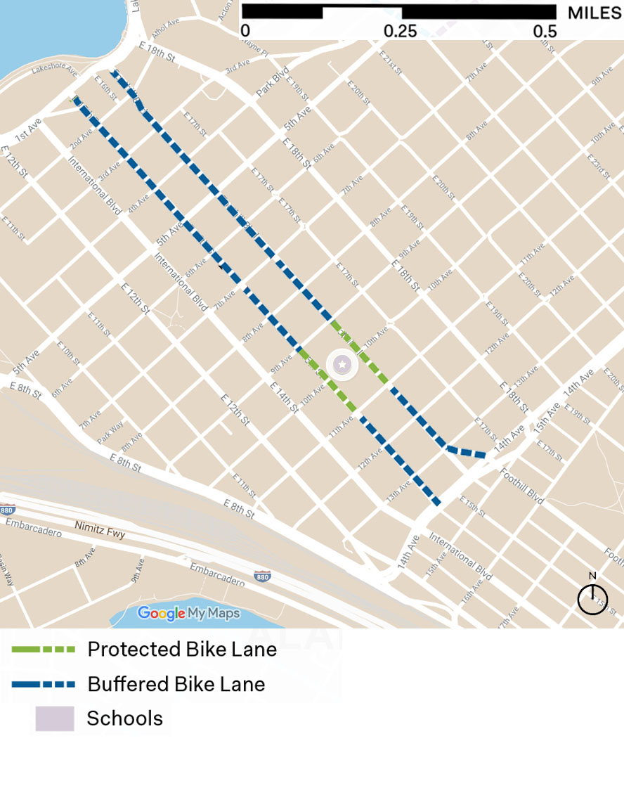
Project Goals
School Zone:
  Franklin Elementary School & Recreation center, 2nd largest school in OUSD
Community Zone:
  Several churches and dense housing
Transit Street:
  AC Transit line 40 runs every 12 min during rush hour
Foothill Blvd
E 15th St
Franklin Elementary School

Slide 4
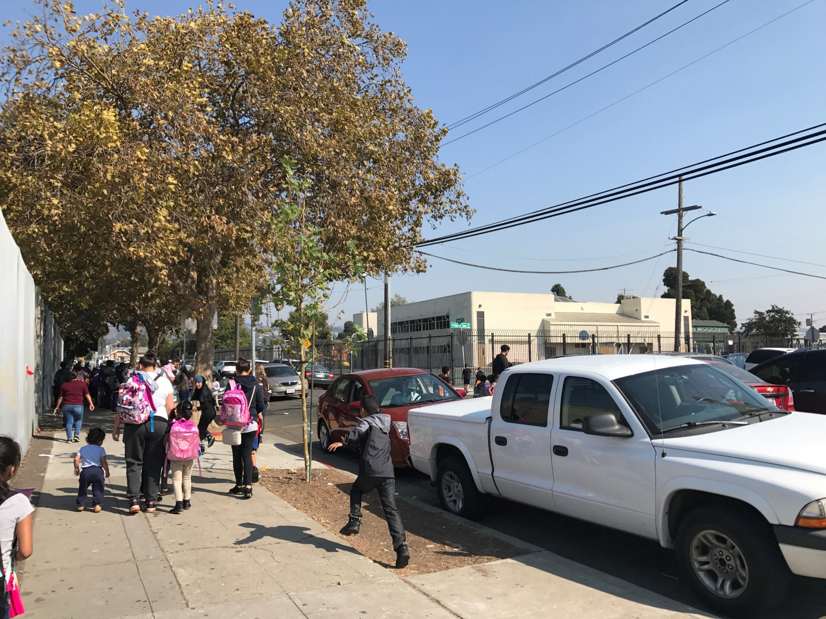
Project Goals
Calm traffic to make the corridors more delightful and vibrant
Improve traffic safety, especially for children and seniors
Encourage more people to walk, scoot, bicycle and take transit
Notes:
This project is an opportunity to bring safety and vibrancy that every community deserves

Slide 5
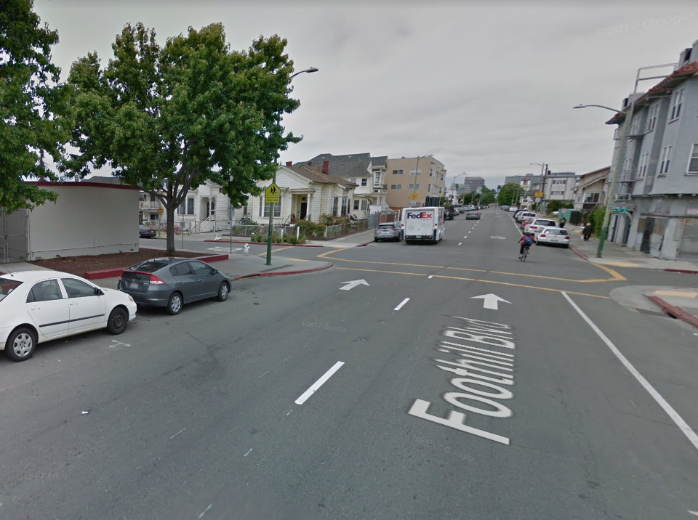
Current Conditions
Two lanes traffic with limited visibility
No safe place to bike
Low visibility crosswalks
Foothill Blvd at 9th Ave

Slide 6
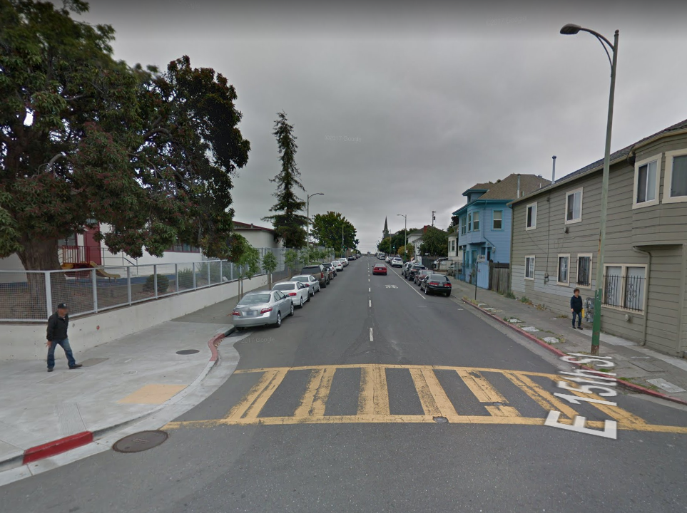
Current Conditions
Typical Crash Causes:
Speeding
E15th & 9th Ave

Slide 7
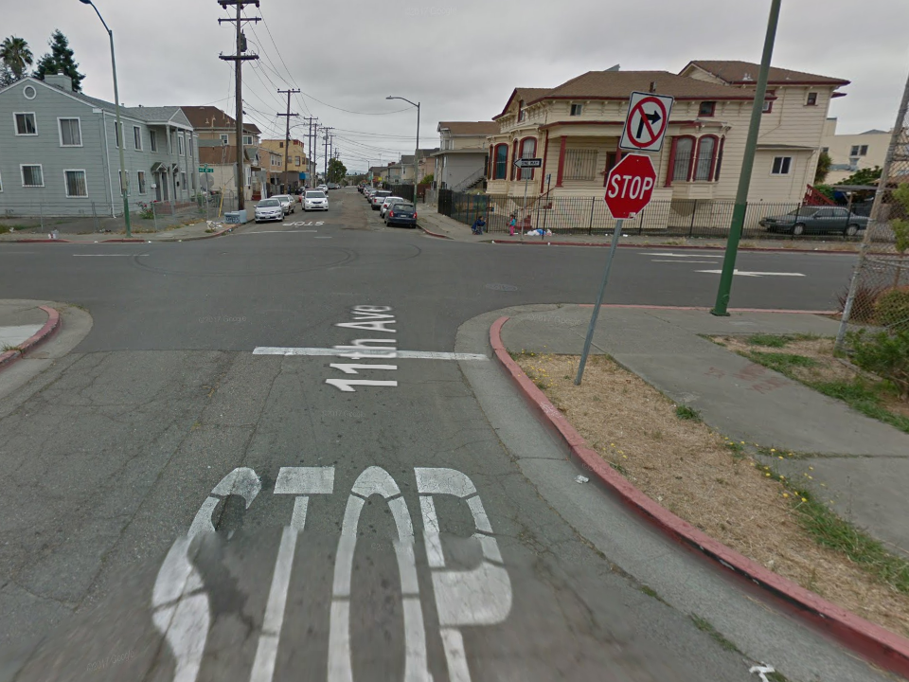
Current Conditions
Typical Crash Causes:
Right-of-way violations
Stop sign & signal violations
E15th & 11th Ave

Slide 8
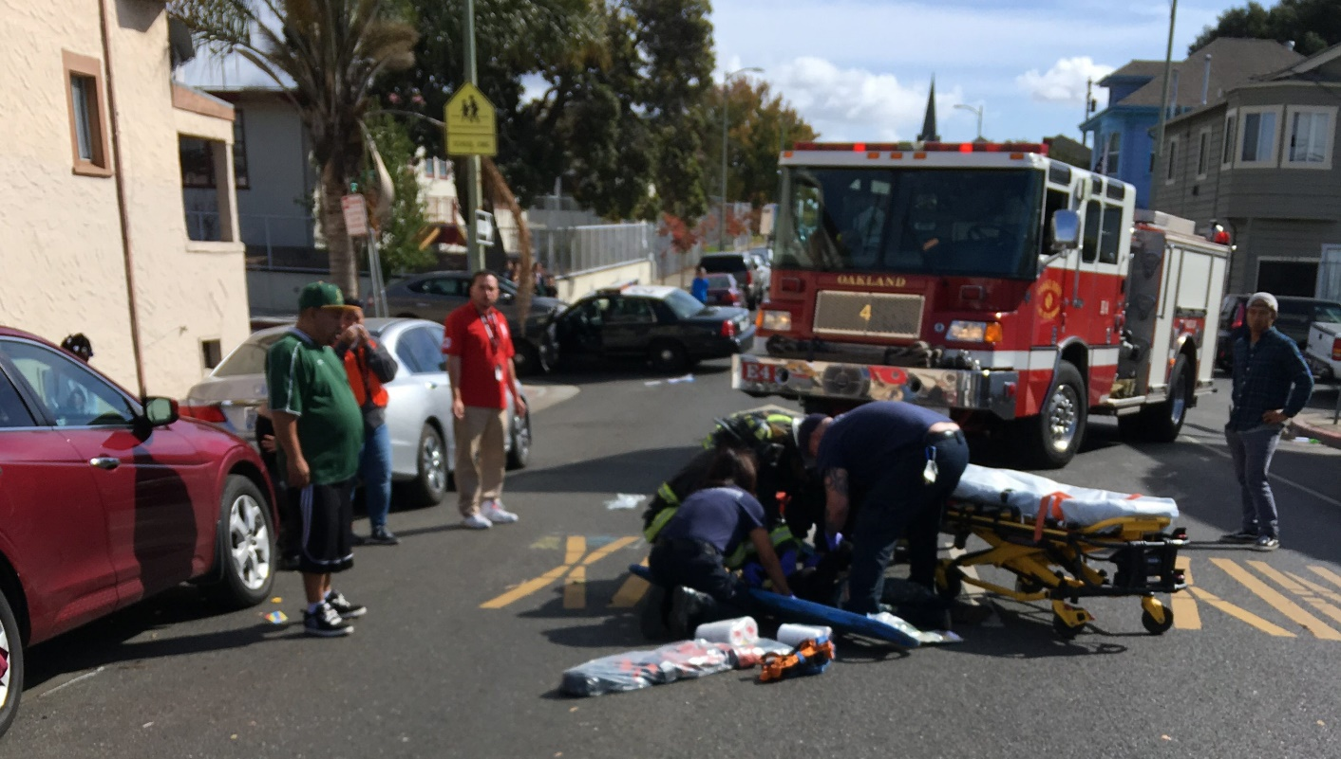
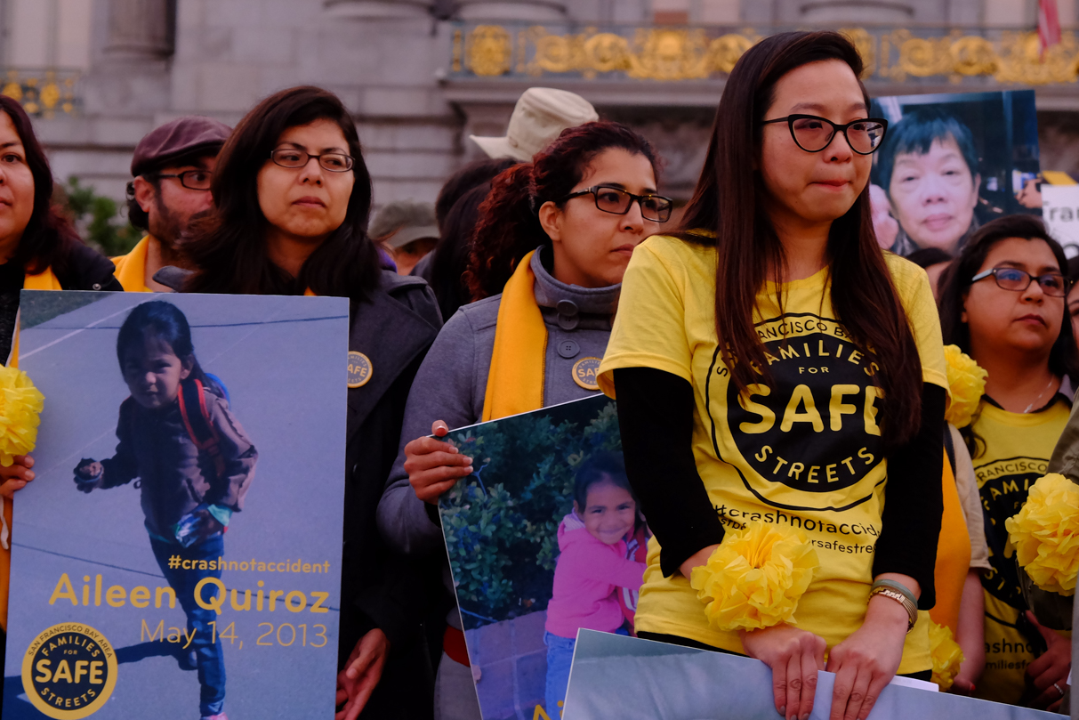
In every situation a human may fail.
The road system should not.
Photo: Mercury News
Zero serious and deadly traffic injuries.
Notes:
Vision Zero. Ambitious goal, but the only acceptable number. We know that crashes are preventable, and its our job as road designers to design roads that are safe

Slide 9
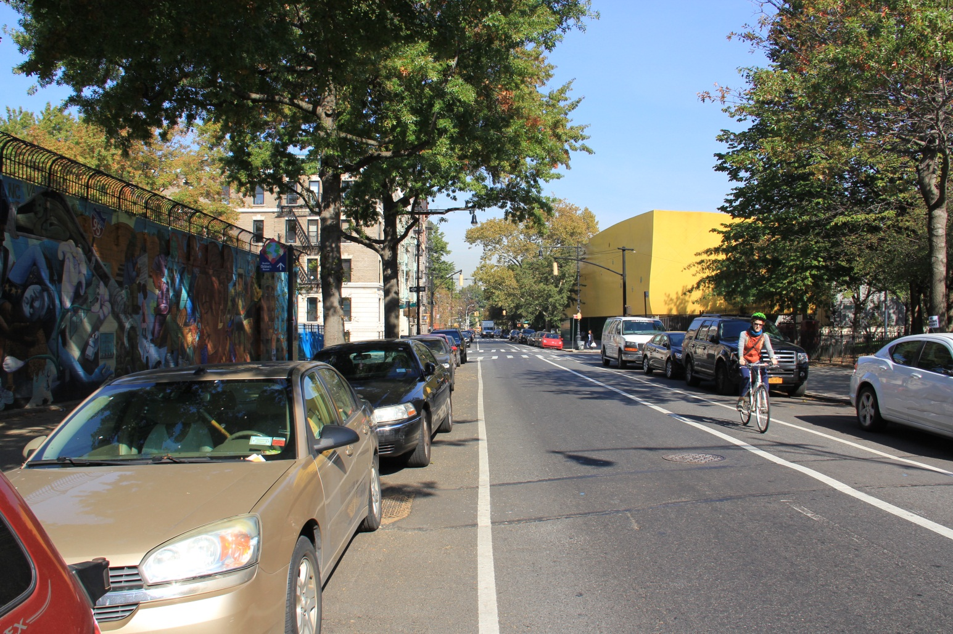
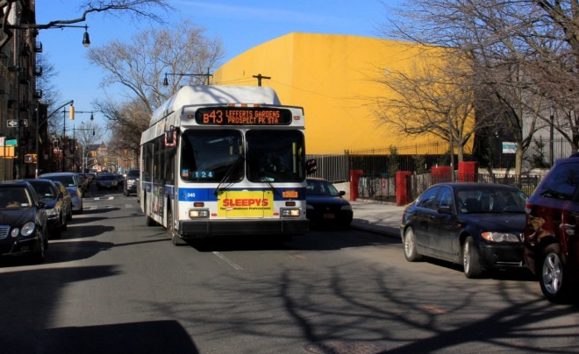
Tools: Lane reduction
Before
Before
Approximately 30% fewer crashes
Increases visibility to reduce right-of-way crashes
Lowers speeds

Slide 10
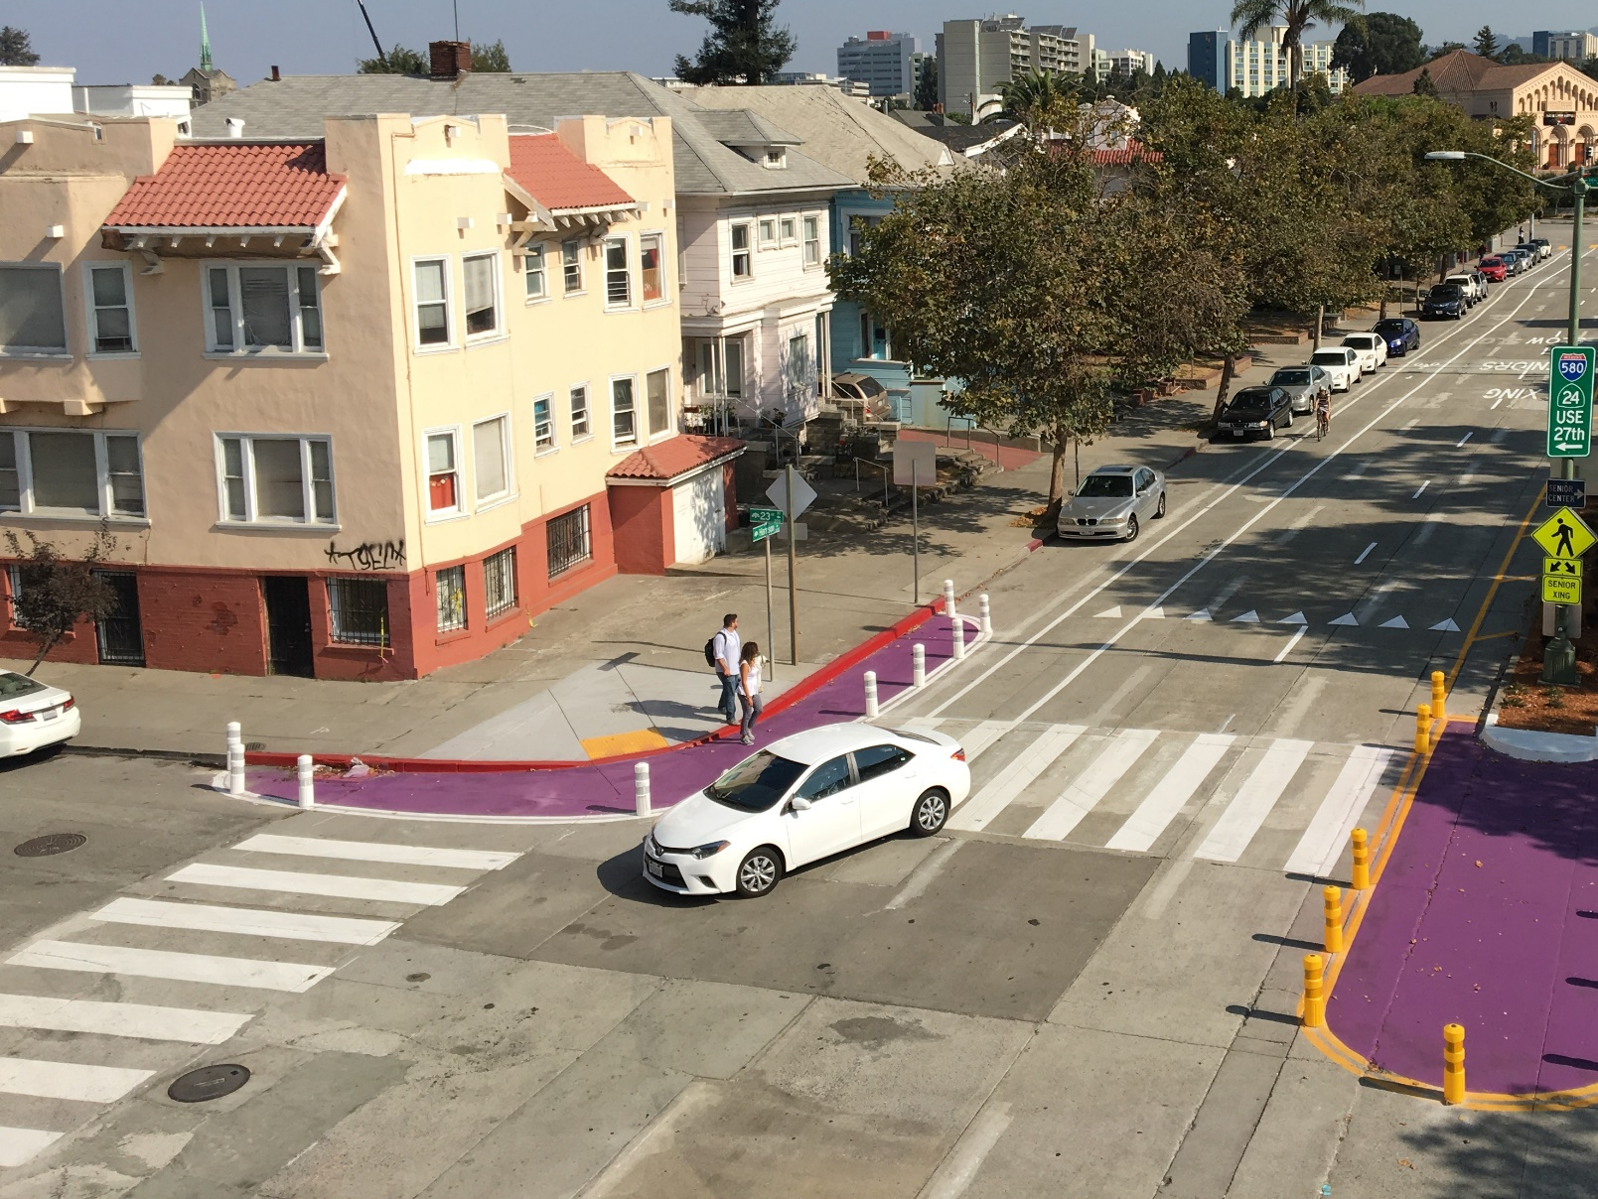
Tools: High Visibility Crosswalks and Painted Sidewalk Extensions
High-visibility crosswalks reduce crashes by 37-48%
Extensions narrow crossing for pedestrians, slow turns, and increase visibility

Slide 11
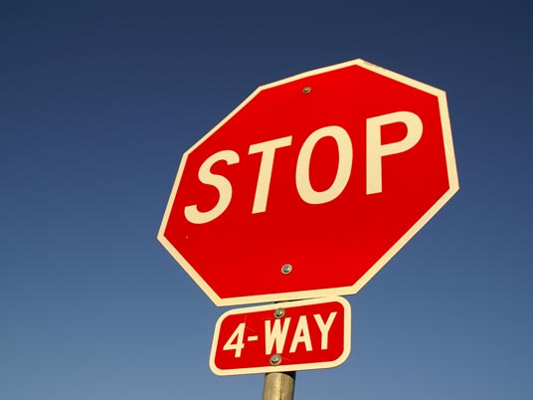
Tools: Stop Signs
We’ll evaluated intersections for additional stop signs

Slide 12
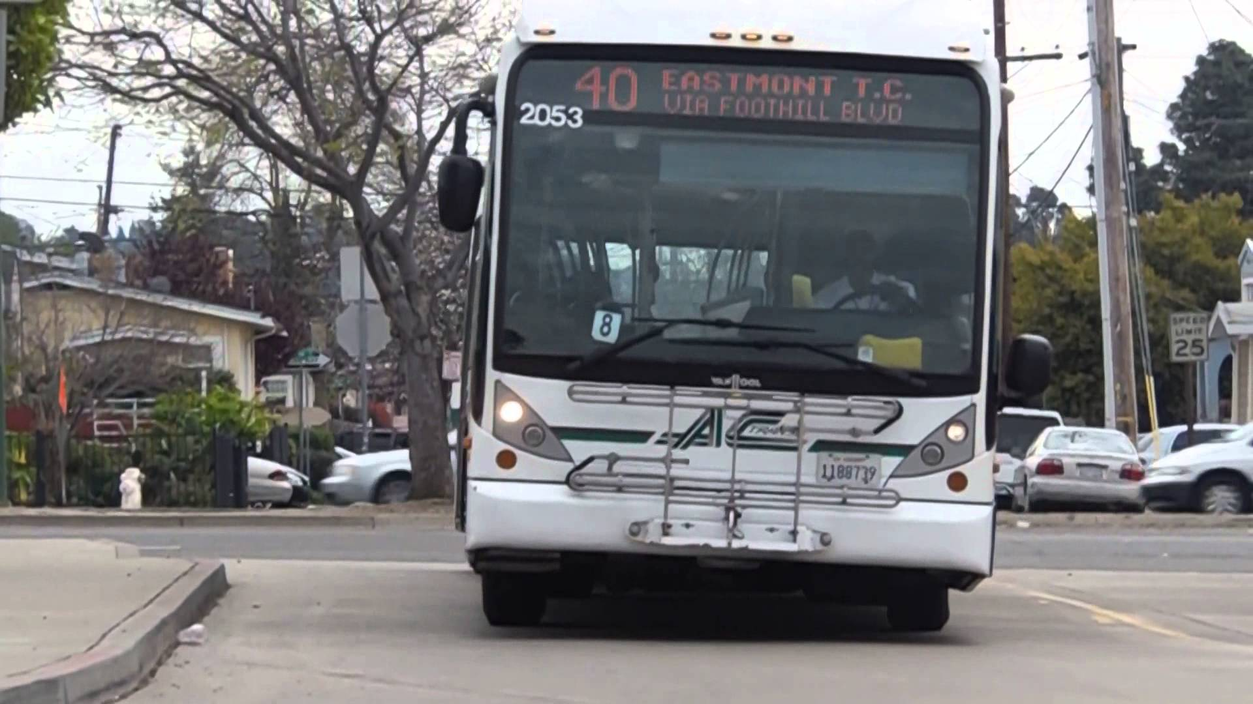
Tools: Changes to the Curb
Bus stop adjustments
Loading zones for school

Slide 13
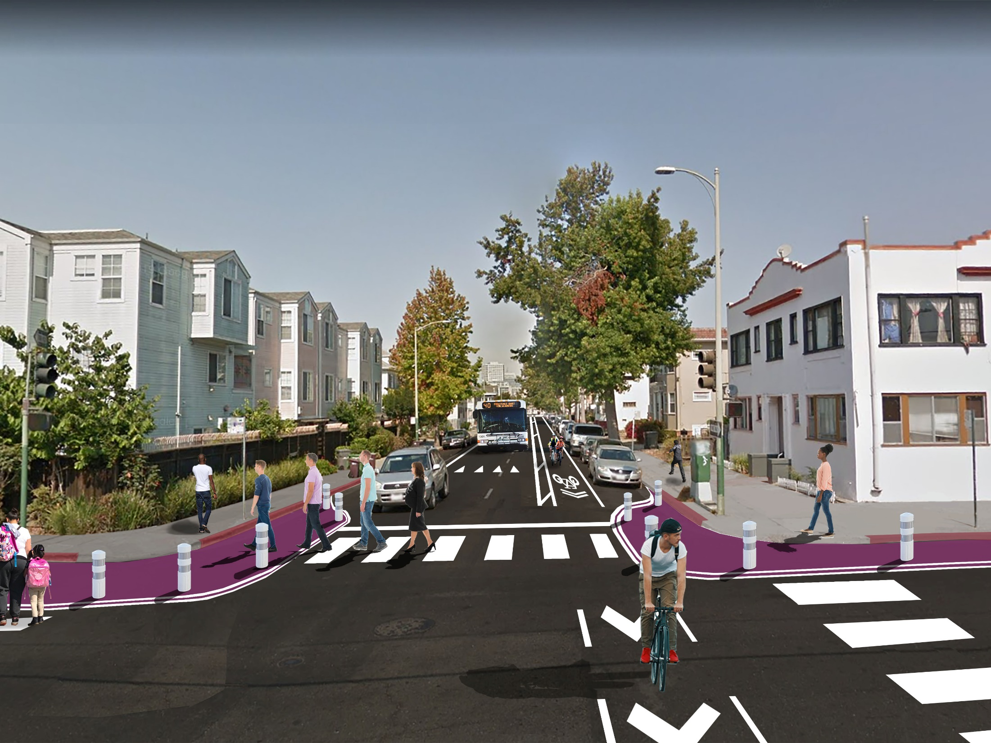
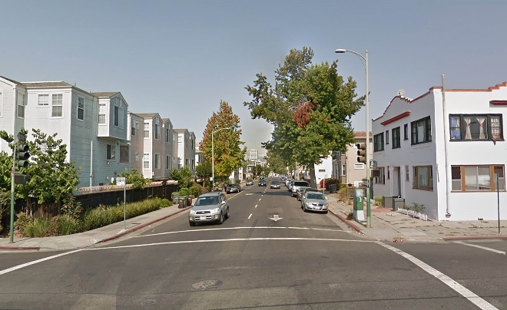
Tools: buffered bike lane
Before
East 15th St at 10th Ave
One-way buffered bike lane next to the parked cars along corridor
Creates a safer place to bike & scoot for children going to school/park
After (Rendering)

Slide 14
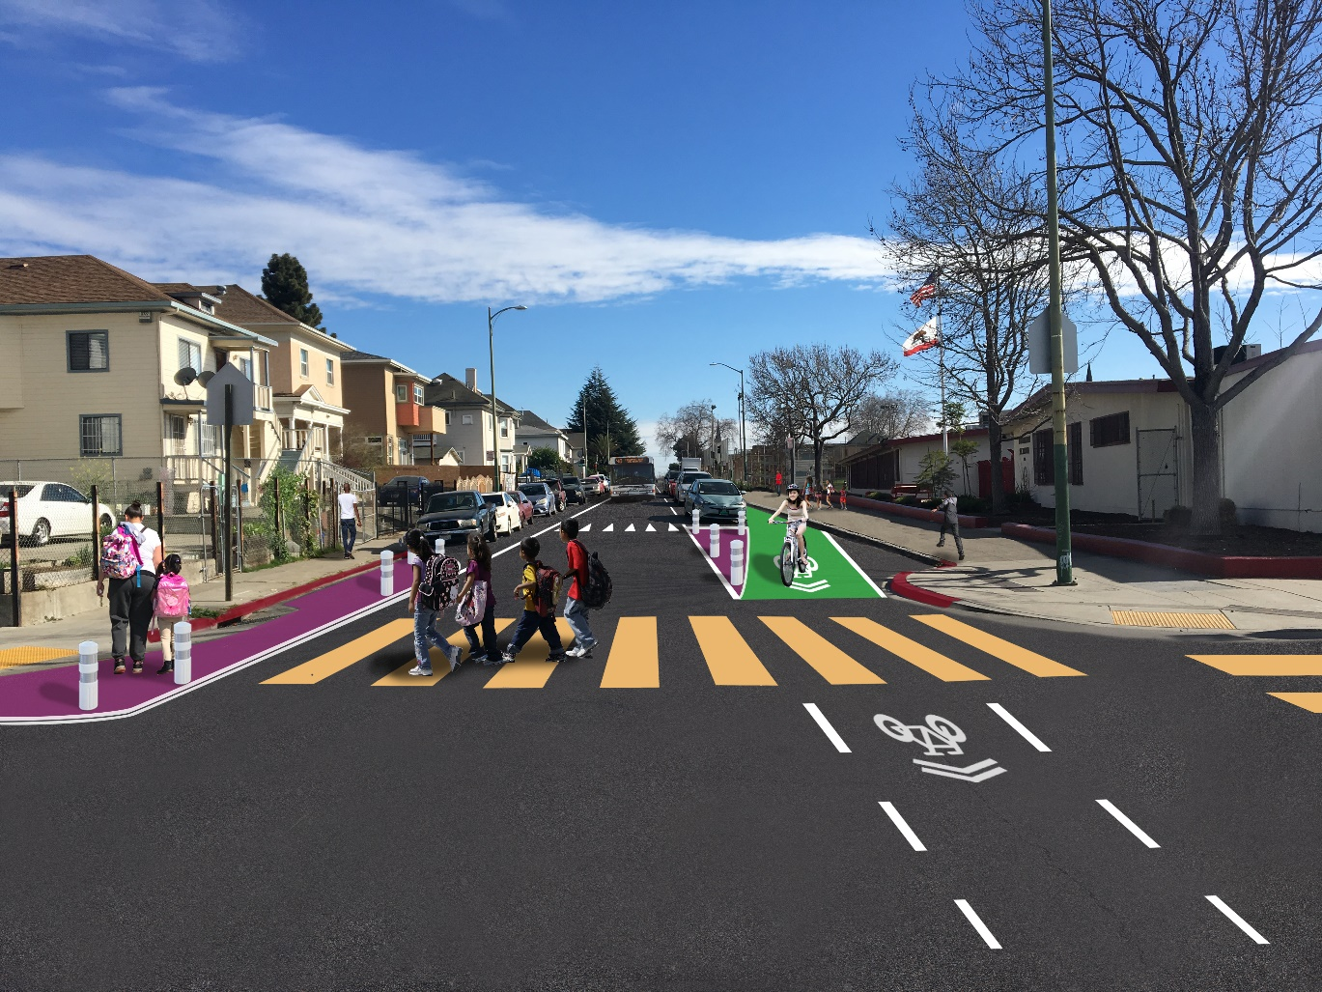
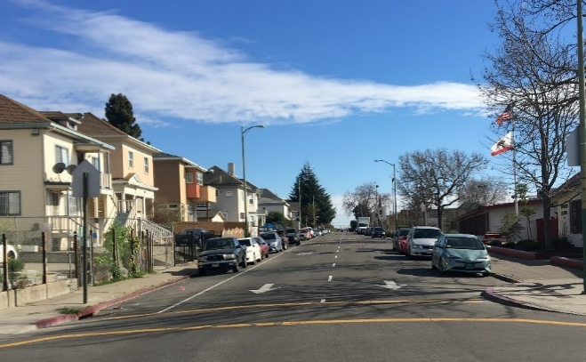
Tools: protected bike lane
Before
East 15th St at 5th Ave
One-way bike lane next to the sidewalk along the school/park segments
Prevents conflicts with the school loading zone
Creates a safer place to bike & scoot for children going to school
After (Rendering)

Slide 15
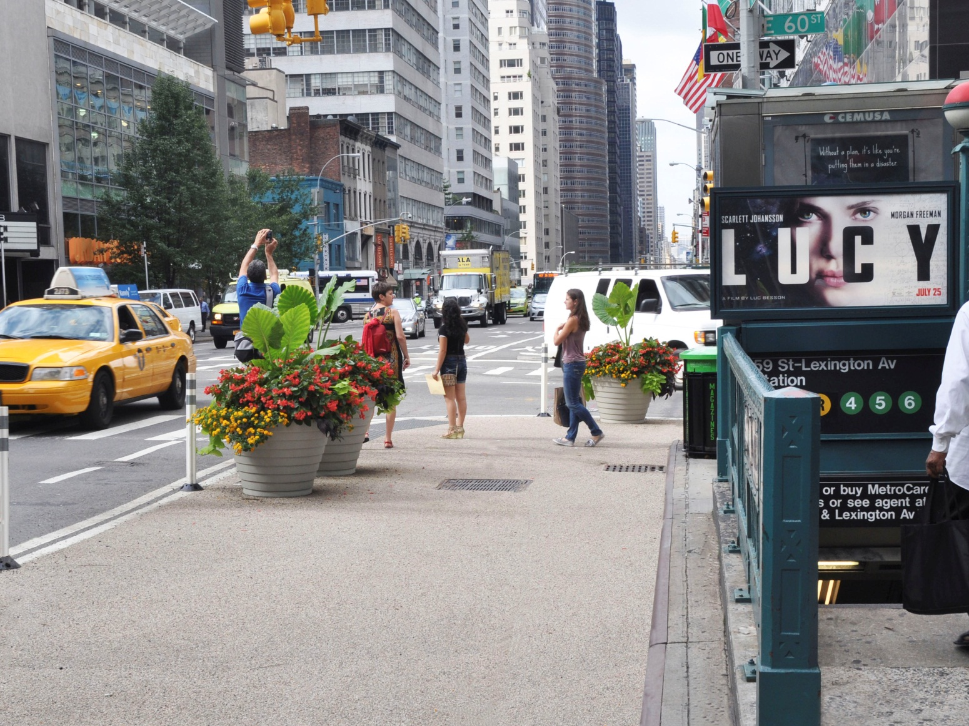
Potential Tool: Planters
Reinforce Painted Sidewalk Extensions
Need maintenance partner(s)

Slide 16

Parking Protected Bicycle Path from 9th – 11th Aves
One-way bike lane next to the sidewalk along the school/park segments
Prevents conflicts with the school loading zone
Creates a safer place to bike & scoot for children going to school

Slide 17
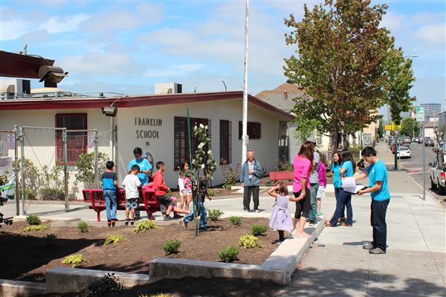
A Safer Franklin Elementary
OakDOT prioritizing this street for improvements in 2018-19
Currently evaluating options for improvements and gathering input from community members
We’ve heard support for the project, interest in the bicycle path, volunteers for planters

Slide 18
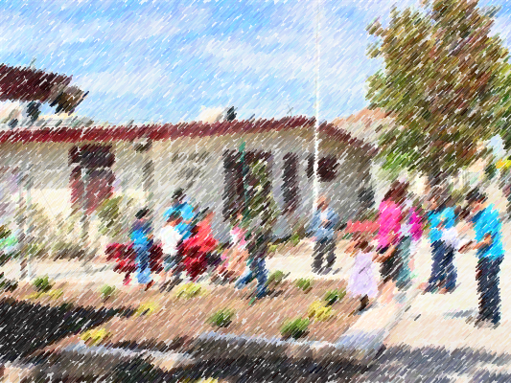
Thank you!
Manuel Corona, OakDOT
mcorona@oaklandca.gov
510-238-6330
Notes:
That’s it, thank you for your attention! I’m happy to answer questions.

