Slide 1

2024 New Construction Notice Of Funding Availability (NOFA)
Stakeholder Listening Session
Housing Development Services
Department of Housing & Community Development
July 16, 2024

Slide 2
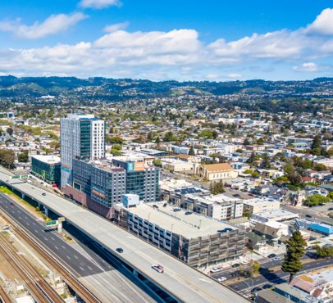
Agenda
  Welcome & Introductions
  NOFA Overview
  Timeline & Process
  Potential HCD Changes
  Stakeholder Feedback
  Q & A

Slide 3

Welcome & Introductions
  Ali Gaylord, Deputy Director
  Housing & Community Development
  Christia Katz Mulvey,
  Housing Development Services Manager
  Arlecia Durades, Housing Development Coordinator
  & New Construction Program Manager

Slide 4

NOFA Overview
Competitive application process for awarding City of Oakland funds for development of affordable housing
Funding awards will be based on ranking and funding availability​

Slide 5


Capital Investment Equity Framework
START
Homeless Units/
Permanent Housing
Protection
Production
(Non-capital dollars)
Prioritizing homeless exits
Homelessness
Prevention
+Interim
solutions
Low-Income Units
(30-80% AMI)
Approach:
fund as many areas as possible starting with priority strategies
Preservation of Existing City Portfolio
Preservation via Acquisition/
Conversion
Eviction protection
Preservation
Anti-displacement
Low/Moderate-Income Owner-Occupied Rehab
First-Time Homebuyer Support
Rent Adjustment Program

Slide 6
NOFA Timeline (tentative dates)
  NOFA release date: September 23, 2024
  Pre-Bidder's Meeting date: October 7, 2024
  City of Oakland HCD Office Hours: October 11th & 18th, 2024
  NOFA application deadline: November 4, 2024, at 5 p.m.
  Award Date: Early January 2025 (Initial awards)
  Q&A Email #1 – due October 10th
  Q&A Email #2 – due October 17th
  *No application questions will be allowed after October 18, 2024.

Slide 7
Scoring / Threshold Changes
  CDLAC/TCAC
  Readiness vs Pipeline Projects
  Planning Approvals
  Leverage vs Funding Commitments
  Public Land
  Geographic Equity
  Amenities
  Emerging Developer
  Joint Venture

Slide 8
Programmatic Changes
  Permanent Supportive Housing – align with MHP Guidelines
  Financial Workbook - going back to 2020 –era workbook, with some revisions
  Application limit – how many a developer can submit
  Incomplete Applications – incomplete applications will be rejected
  HCD – Building a Better Pipeline

Slide 9
NOFA Feedback
  What changes would you like to see to help strengthen the City’s New Construction NOFA?
  What are key challenges you face with the NOFA application?
  How can we improve this program?
Notes:
Ask audience for feedback (edit suggested questions per content)

Slide 10
LEARN MORE
Please visit our website to find the latest information about the City’s New Construction NOFA application, guidelines, and resources:
https://www.oaklandca.gov/departments/department-of-housing-and-community-development
Contact: Arlecia Durades at adurades@oaklandca.gov

Slide 11
Q & A

