Slide 1
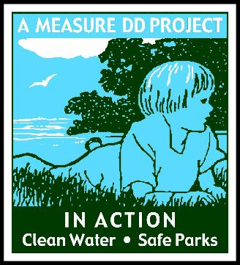
Measure DD (2002), the Oakland Trust for
Clean Water and Safe Parks
Project updates
November 20, 2023

Slide 2

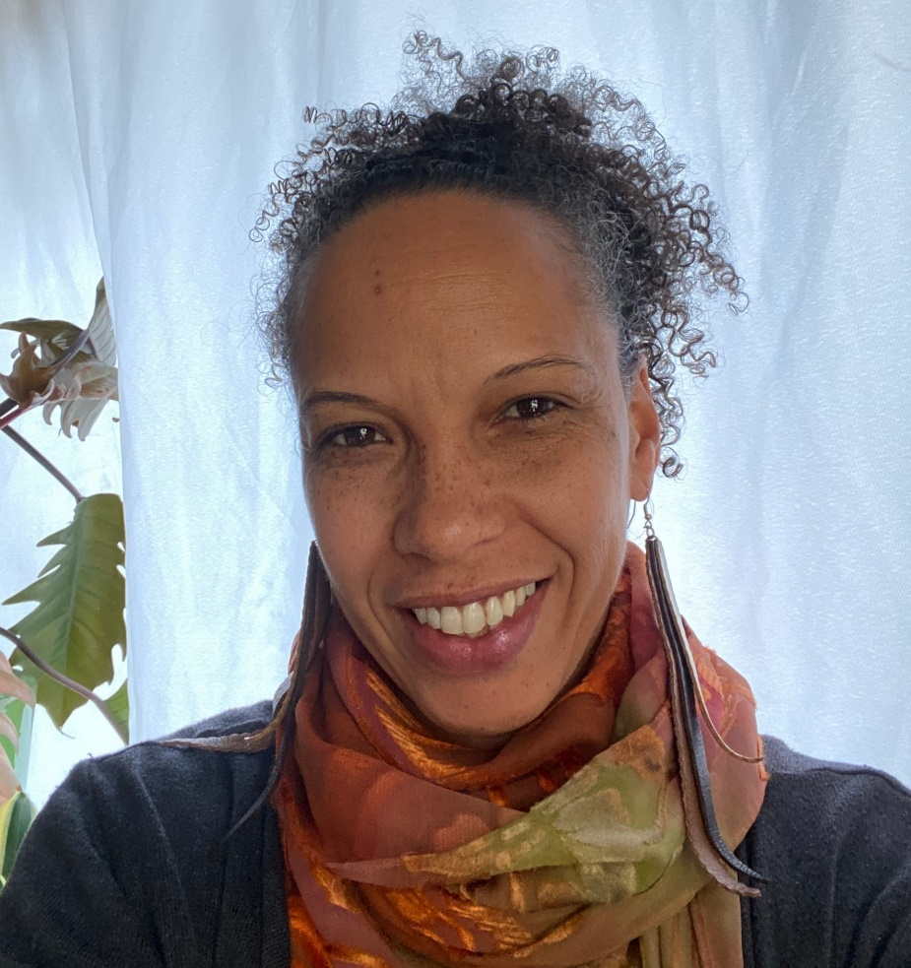
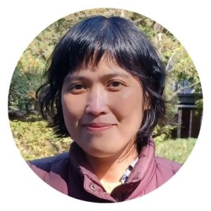
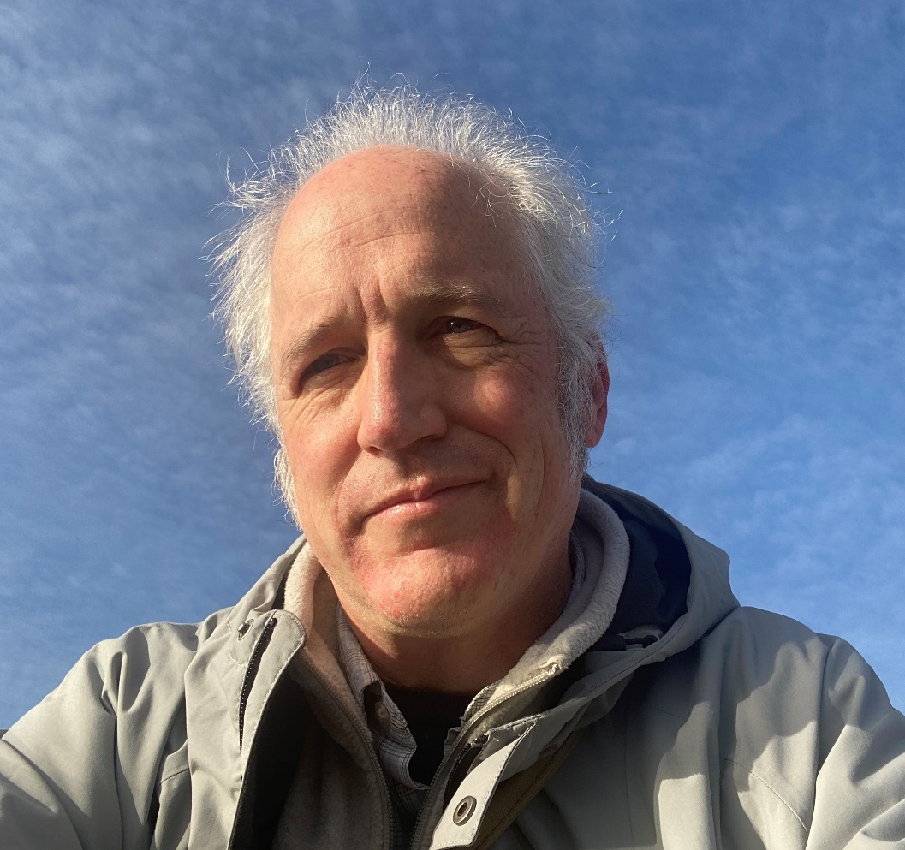
Administration
Continued contract support from Oakland Parks and Recreation Foundation. Thank you to Mandolin, Hazel!
Thanks Adrian for volunteer support!
Mike will catch up on map work this winter
Mandolin Kadera-Redmond
Hazel Tesoro
Adrian Cotter

Slide 3
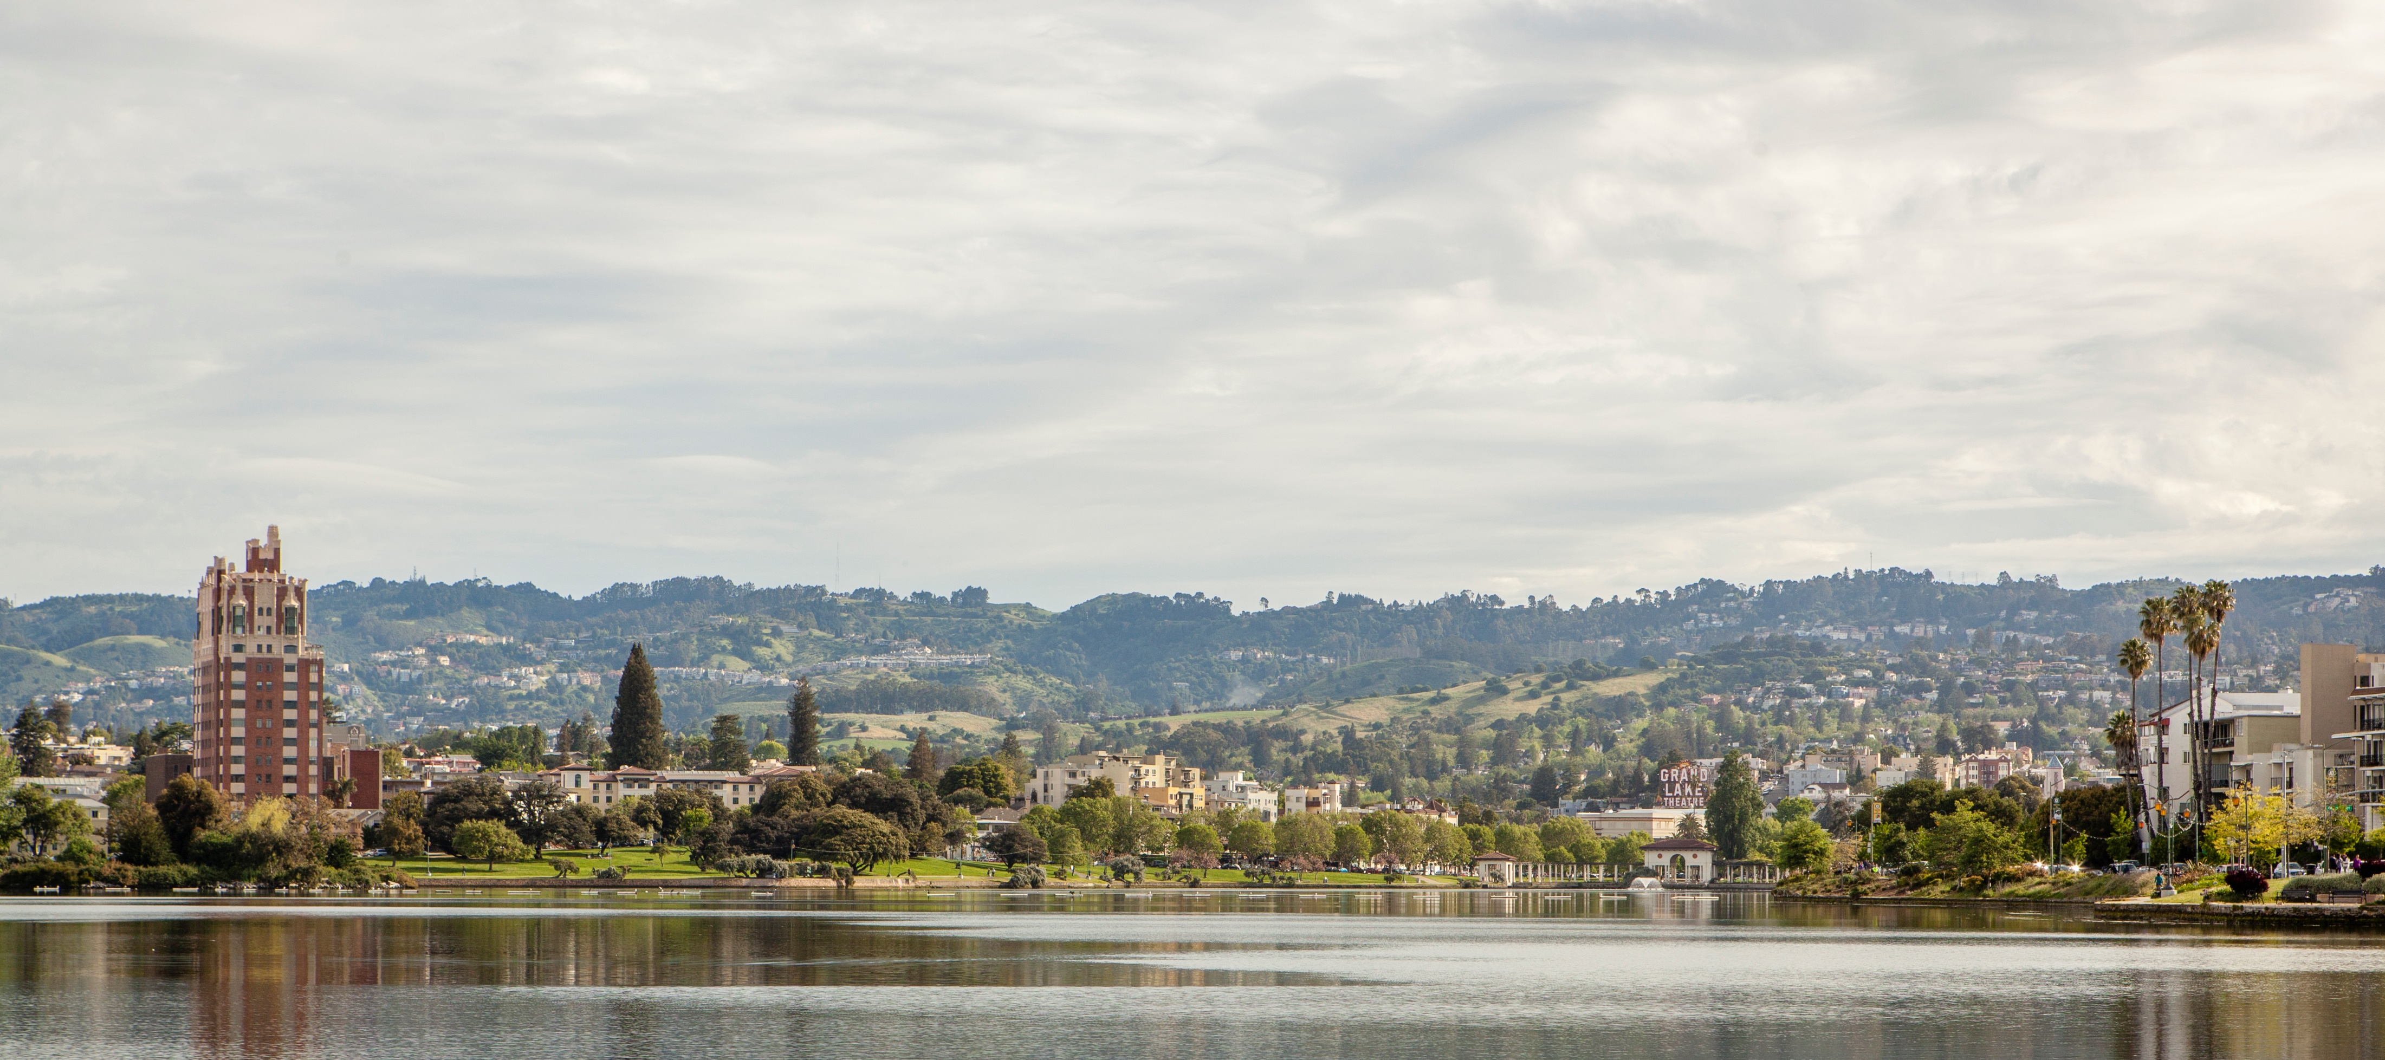
Lake Merritt Water Quality and Restoration and Channel

Slide 4
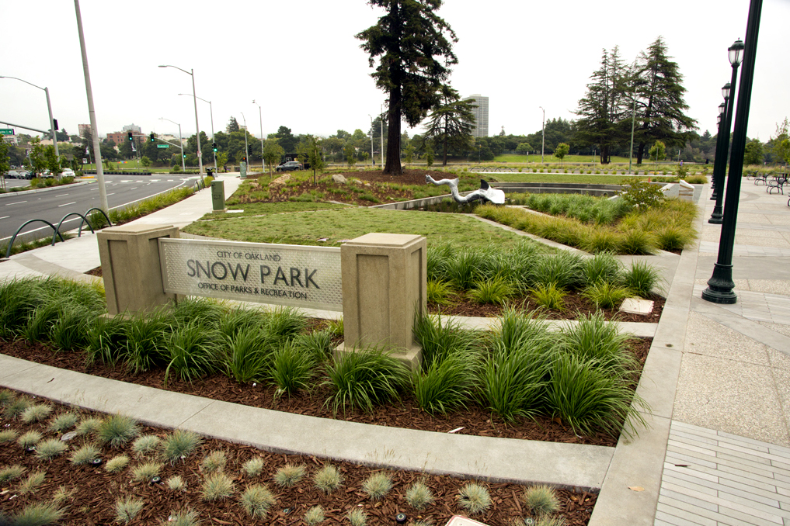
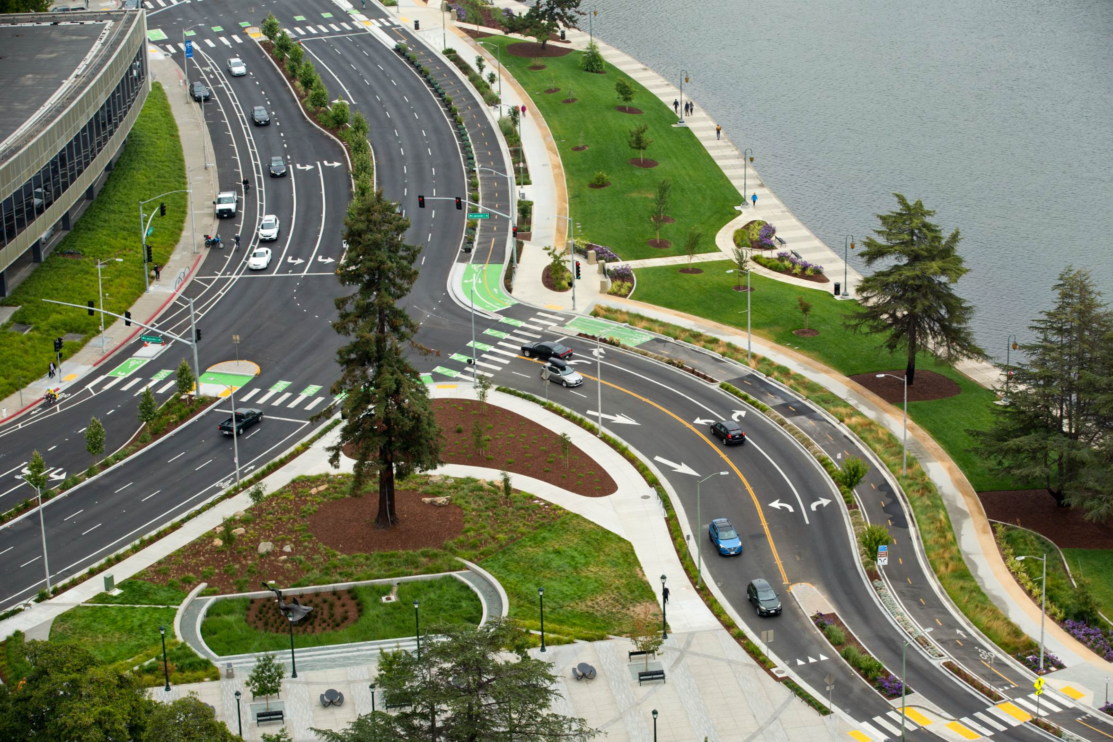
NN
Snow Park/Lakeside Green Street Project
Last update 3/20/2023: remaining funds being used for post-construction irrigation work (remote capability) and close-out items
Green Street
Snow Park

Slide 5
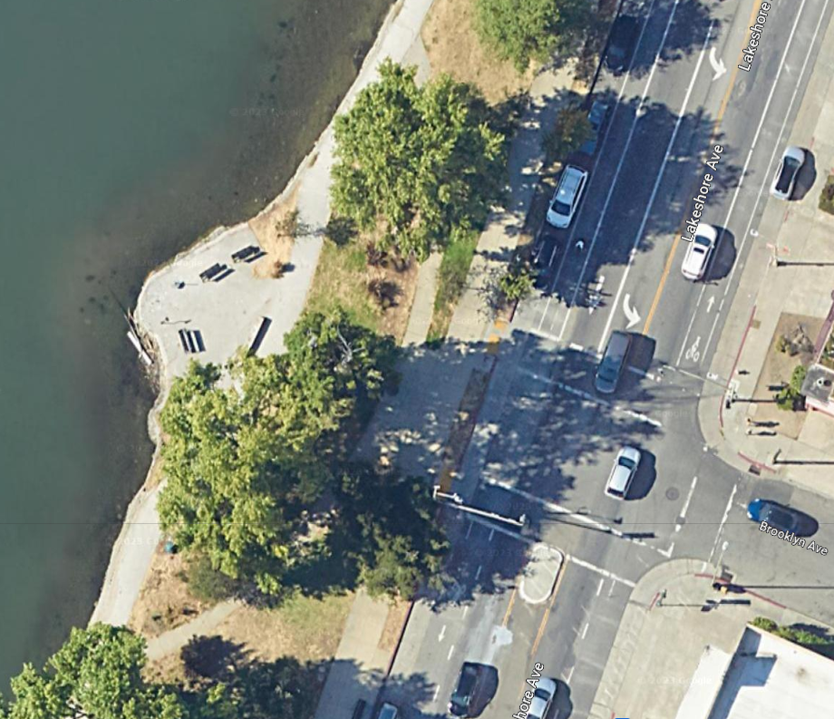
Decomposed Granite
Path Around Lake Merritt
No update since last meeting.
Project manager working to secure contract to complete the work.
Subcontractor quote exceeds available funding.
Working to resolve contracting blockages to advance project.

Slide 6
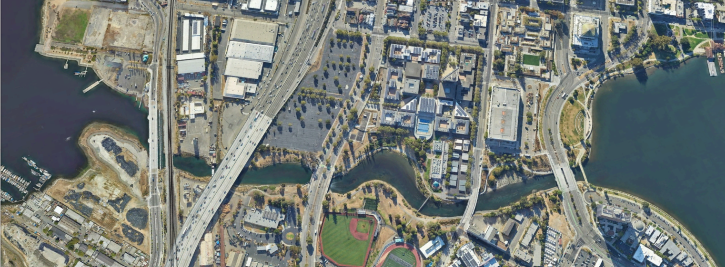
Lake Merritt Channel
N

Slide 7
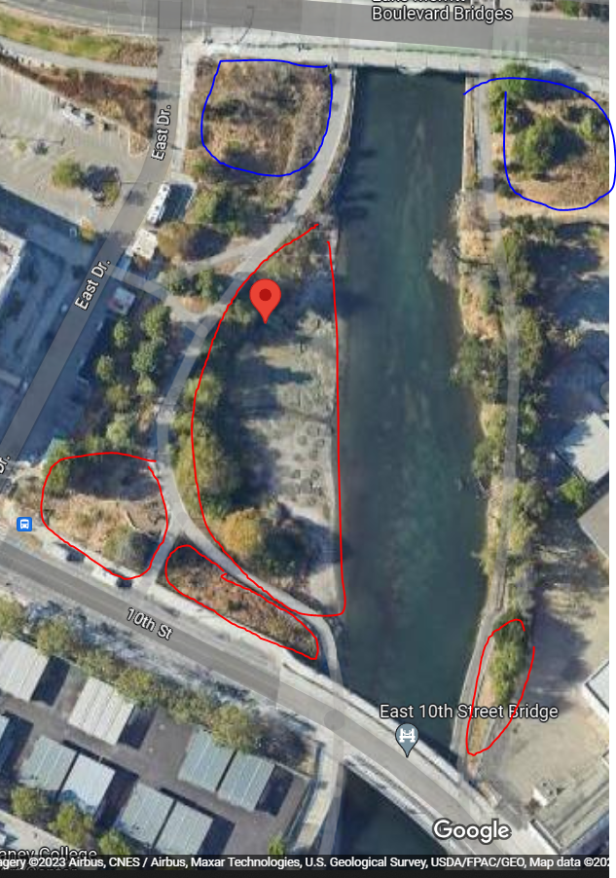
Lake Merritt Channel
Improvements at 10th Street
Close out of regulatory agency permits and issuance of water quality certification by the regulatory agencies is contingent on replanting, monitoring and reporting.
On hold until plan can be developed to prevent impacts to mitigation areas from encampments.
Bioswale areas circled in blue
replanting areas circled in red

Slide 8
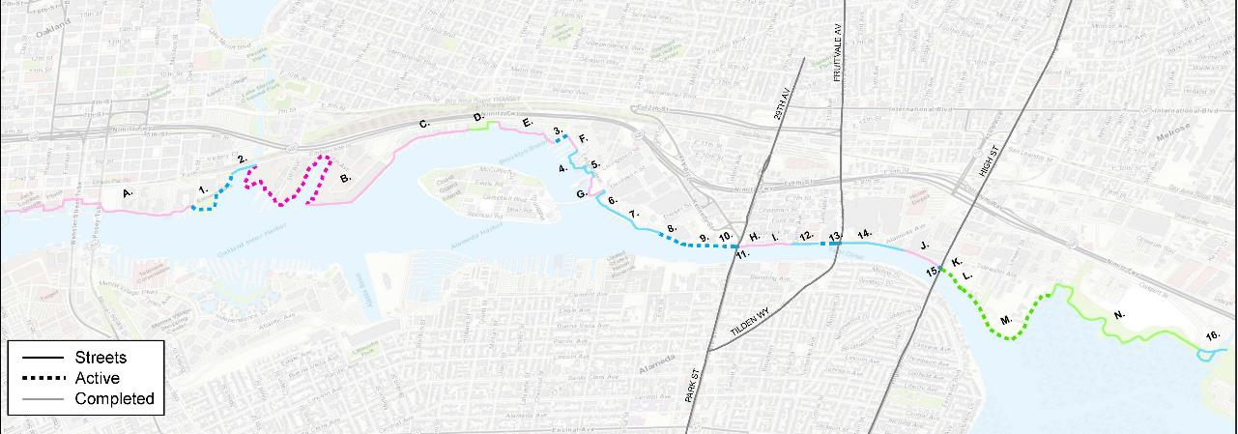
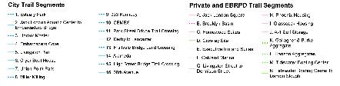
Oakland Waterfront Access, Parks, and Cleanup
https://cao-94612.s3.amazonaws.com/documents/Info-Memo-Waterfront-Trails-Update.pdf

Slide 9
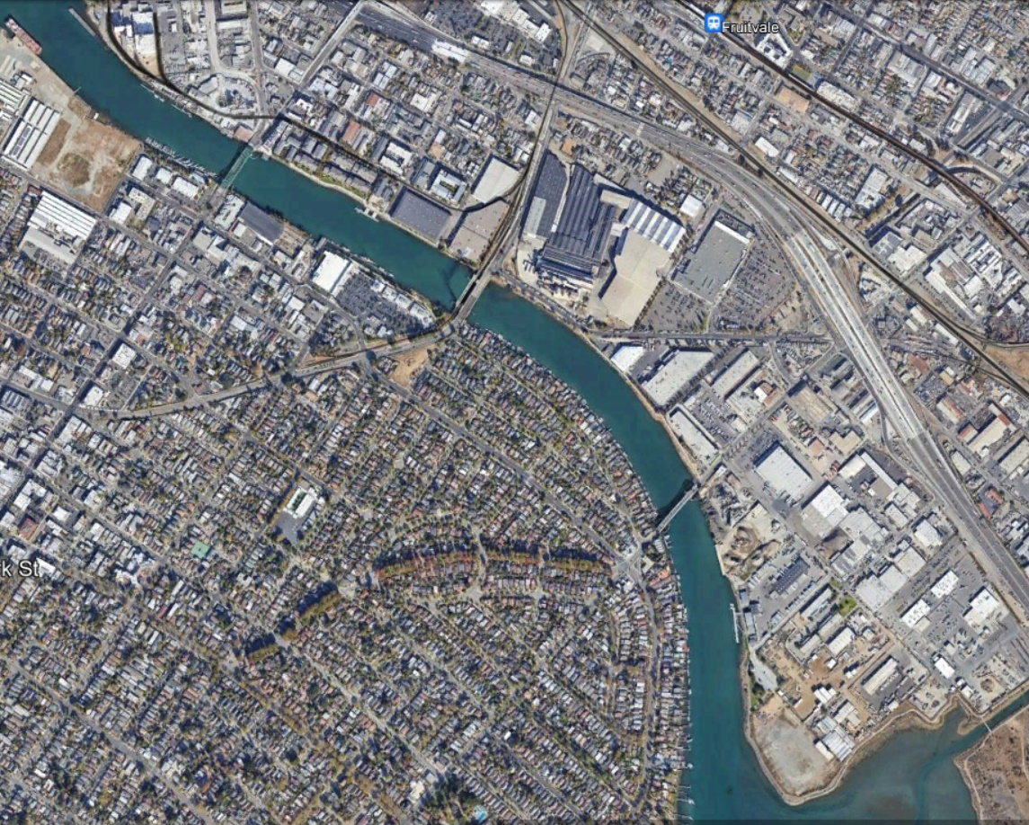
Waterfront Trail Connection at Park Street Bridges
On hold while City works out easement acquisitions of land on the north side of the bridge.
Park Street Bridge
Oakland
Fruitvale
Bridge
High Street Bridge
Alameda

Slide 10
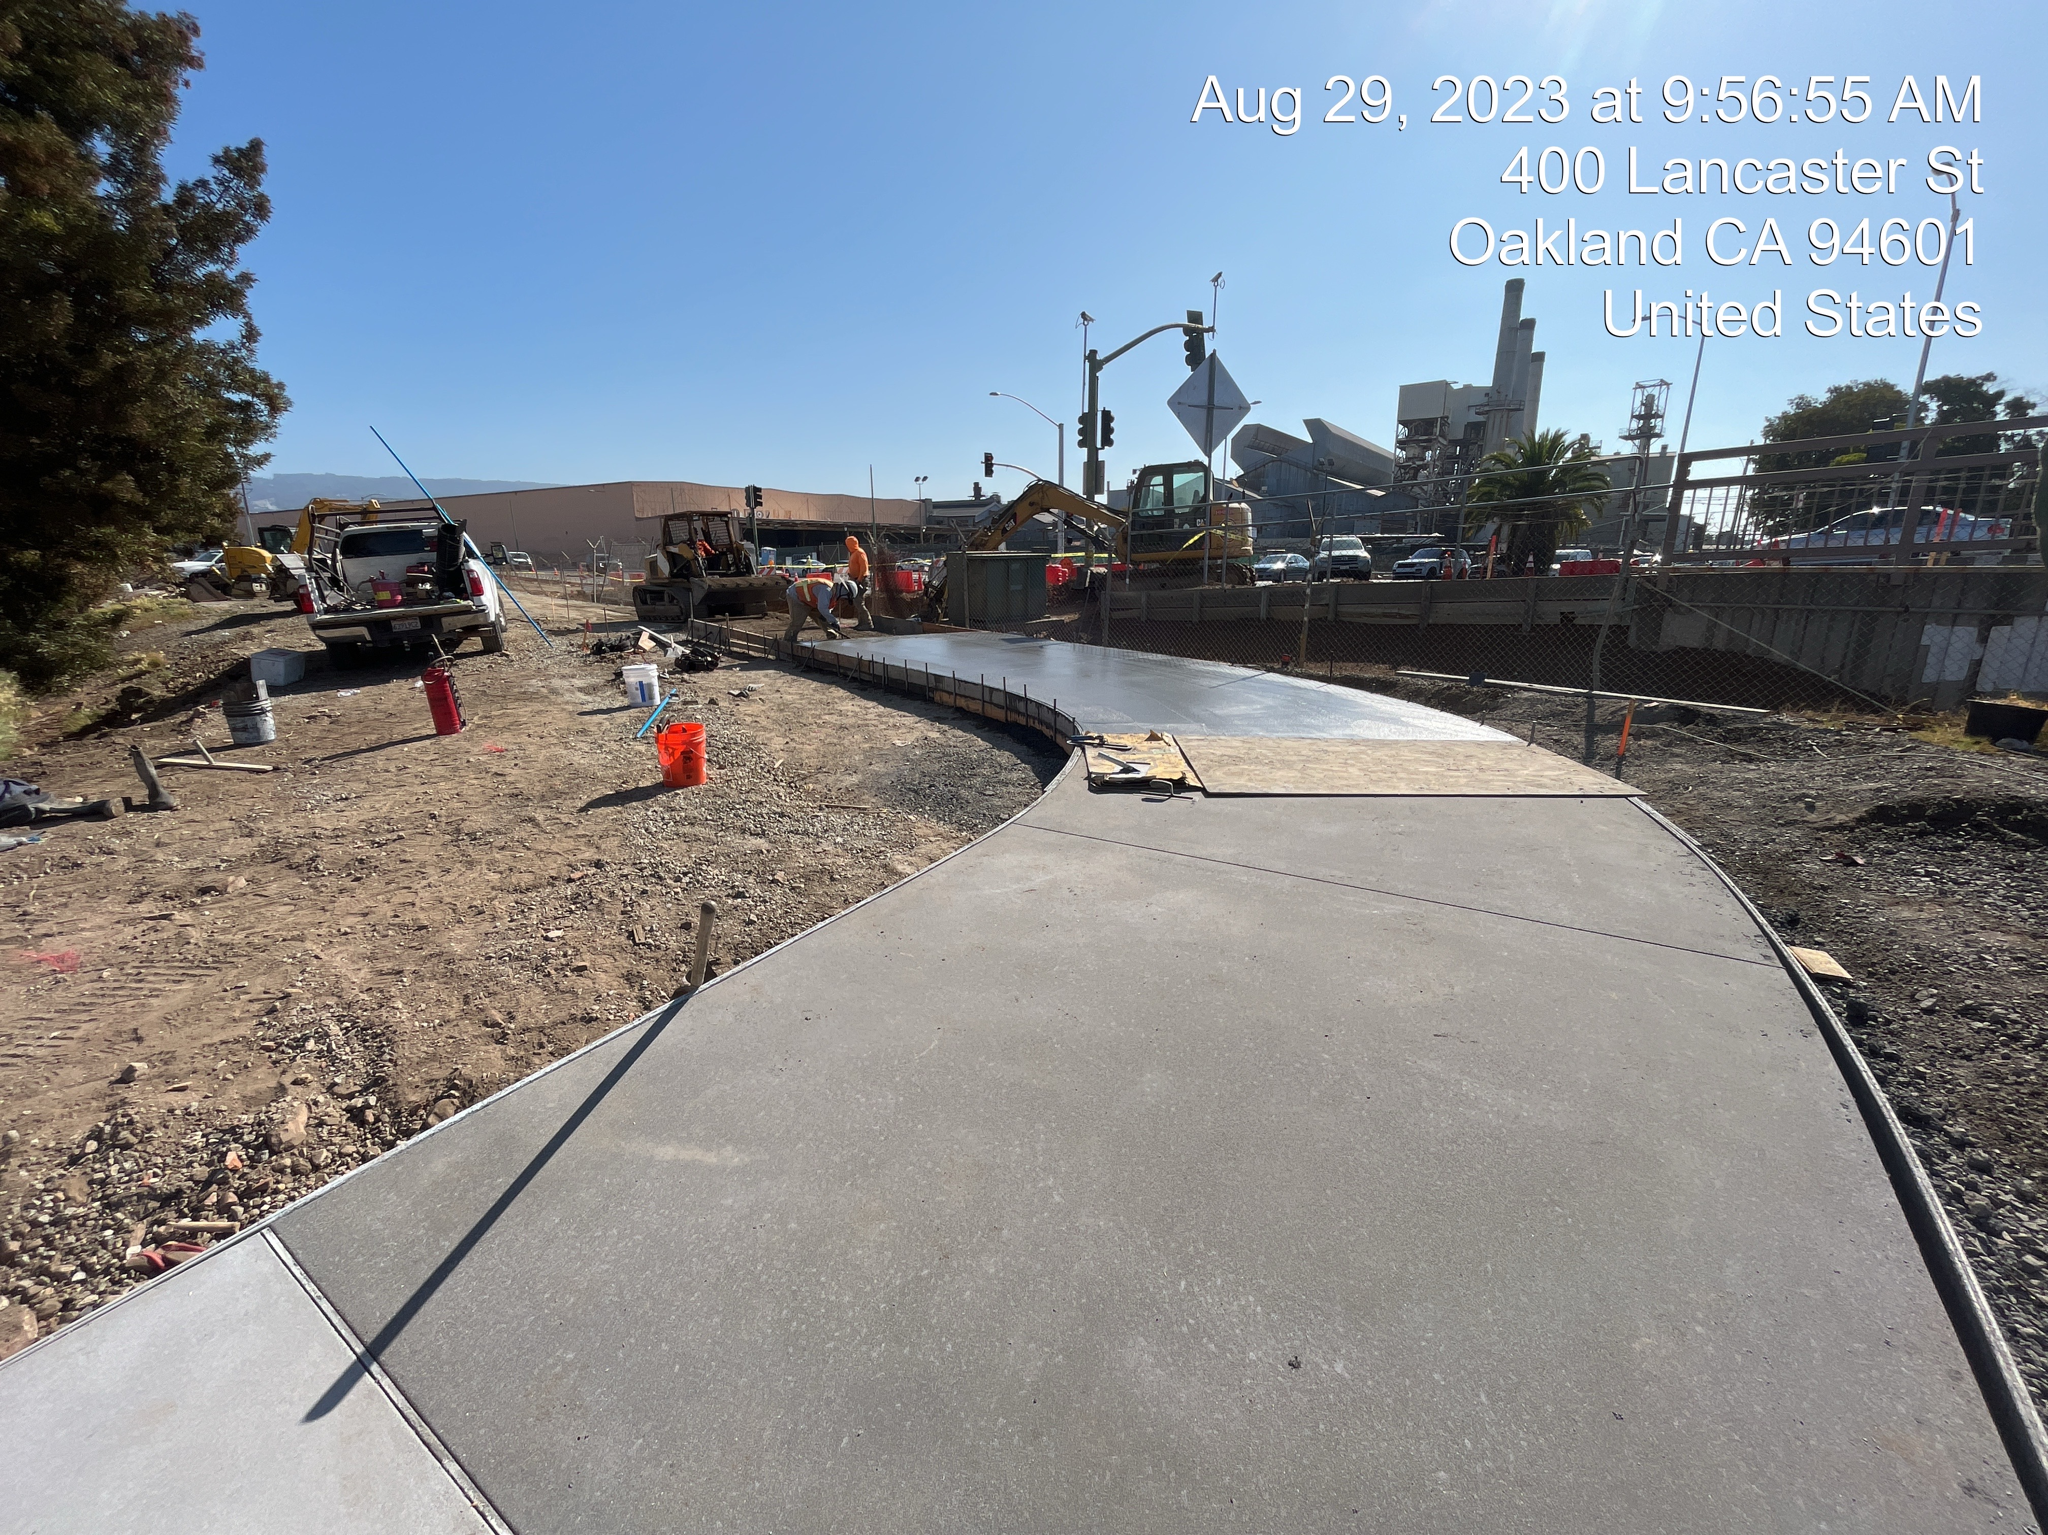
Fruitvale Land Crossing
Bay Trail Segment
Construction anticipated to continue through Nov, 2023.
All paving work is complete.
Only the guardrail installation and planting work remain.

Slide 11
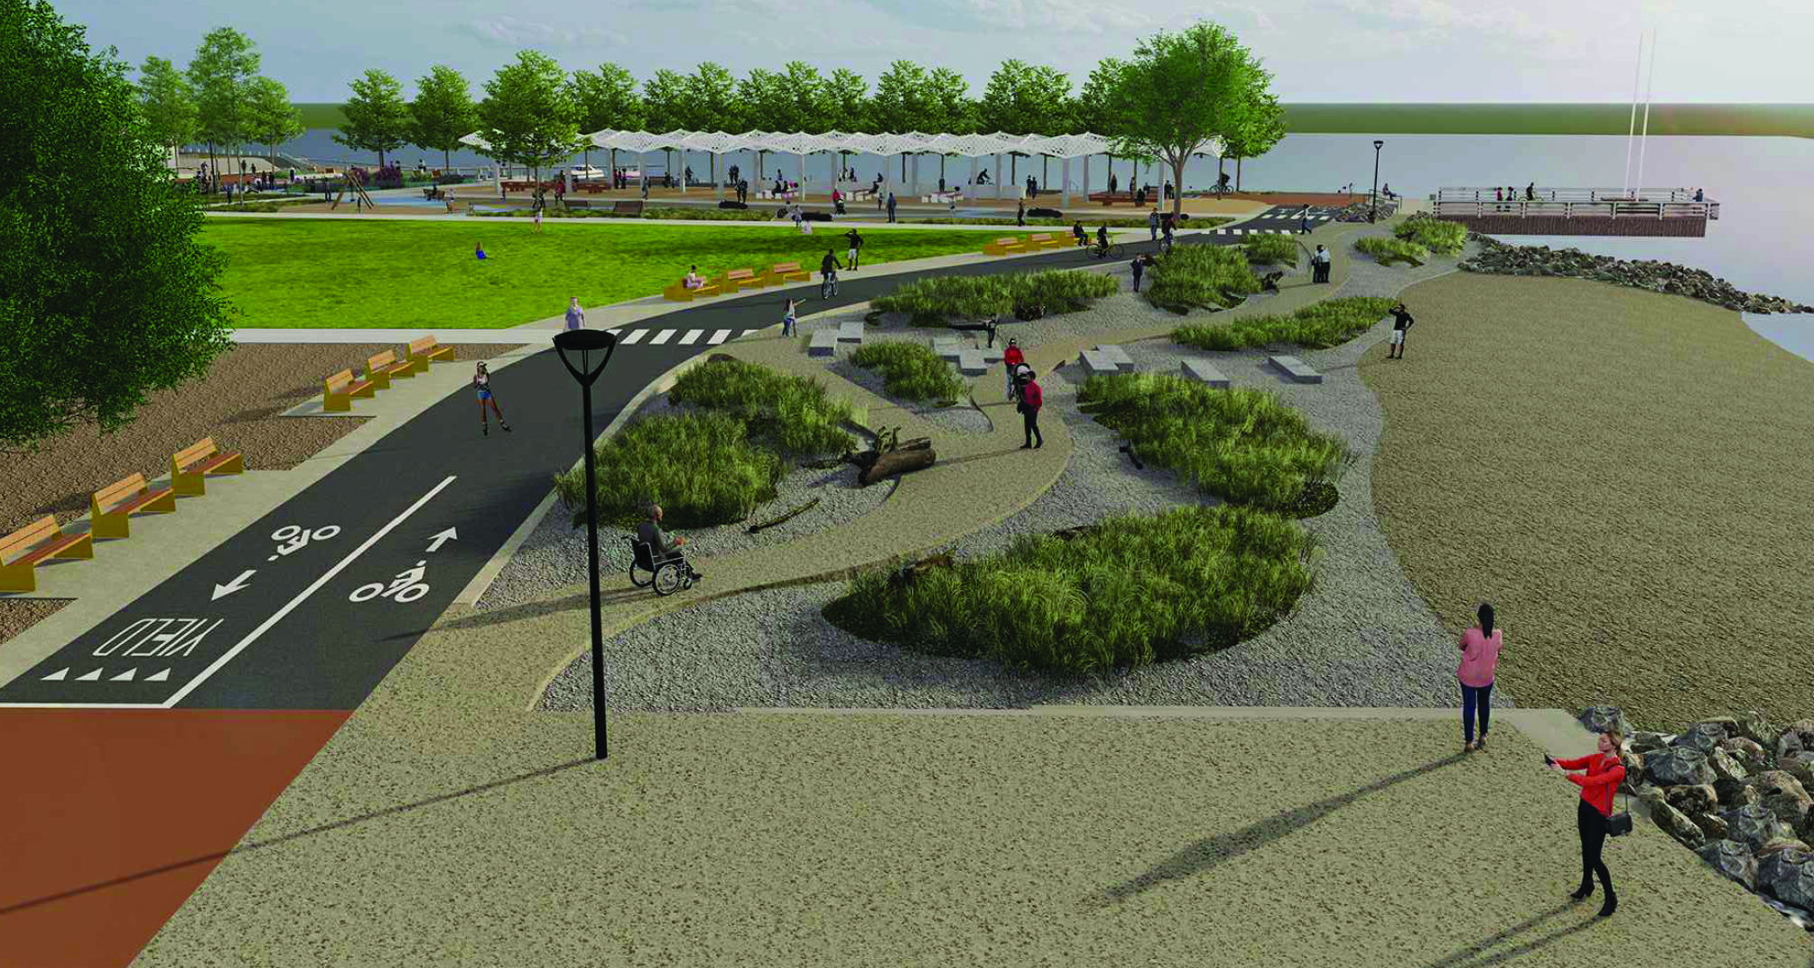
Estuary Park
Project awarded CA Coastal Conservancy Climate Adaptation fund grant for enhanced design of the living shoreline.
Draft California Environmental Quality Act Environmental Impact Report Addendum and 95% Documentation paused to allow time for the enhanced shoreline design to advance/catch up.
Technical work continuing
Planning for funding project construction with Series D Measure DD funds:
  See Parks & Open Spaces (opengov.com)
  www.oaklandca.gov/projects/estuary-park

Slide 12
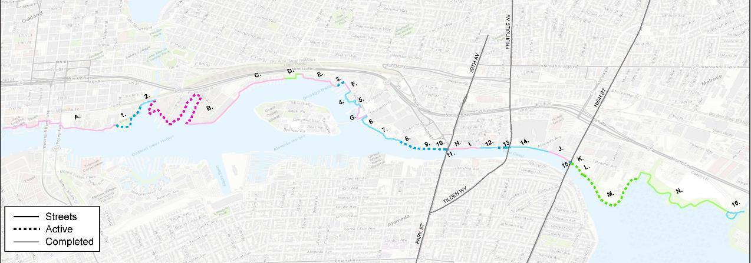
Union Point Park to 23rd Avenue Trail aka
Miller Milling to Cemex
E. 7th St to 23rd/29th Aves

Slide 13
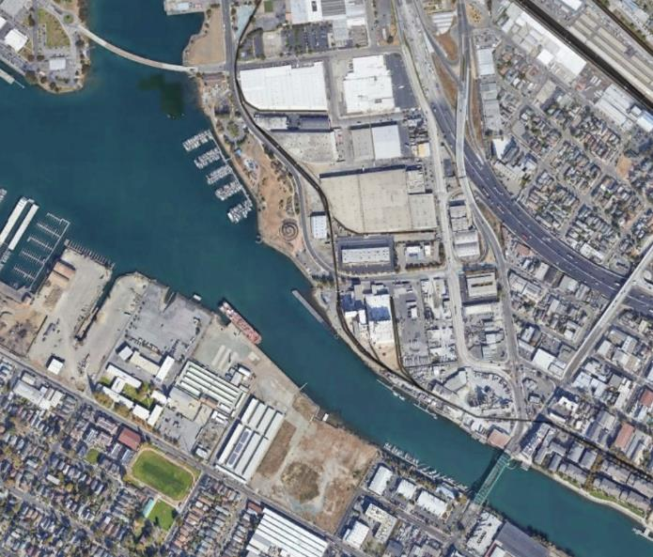
Union Point Park to 23rd Avenue Trail aka Miller Milling to Cemex
E. 7th St to 23rd/29th Aves
Completed: Phase II Environmental Site Assessment Report, order-of-magnitude cost estimate for easement acquisitions, geotechnical report.
Project costs estimated at $50 million over 9 years, and includes extensive permitting, and complicated access through private industrial properties.
Due to staff resources availability and competing project priorities, project behind schedule. Public Works Project and Grants Management Division seeking alternative delivery path to move the project forward.
Union Point Park
Oakland
E 7th St
Miller Milling
Company
29th Ave
23rd Ave
Outboard Motor
Cemex
Alameda
Park St
Bridge
Notes:
For Union Point Park to 23rd Ave, are the Permissions to Enter just for the site research? Yes. We are gathering basic information that is required to properly design, and then complete contract documents: geotechnical borings, topographic survey and environmental site assessment Are the permissions time limited? Only in that we assured the property owners that we would come in and do everything as quickly as possible, staying between 3-5 days max on any given property. Will future access permissions be needed? No. We intend to get everything we need at each property with just one mobilization.

Slide 14

East Bay Regional Park District (EBRPD) Waterfront Trail Sites
(past DD funding, now transferred to EBRPD)
Crowley Site – EBRPD is in preliminary design phase, gathering site information. They will be applying for US Department of Transportation and RAISE program funds for the trail extension across this property.
Gallagher & Burk (344 High Street – Oliver De Silva Inc., owner) – No discussions currently underway
Hanson Aggregates (4501 Tidewater Avenue) – Home Dock Properties – Negotiations underway for a trail easement
Waterfront trail connection at High Street Bridge. – EBRPD to investigate other options to connect to High Street; a waterfront trail connection underneath High Street determined to be infeasible due to navigational hazards for ship captains

Slide 15
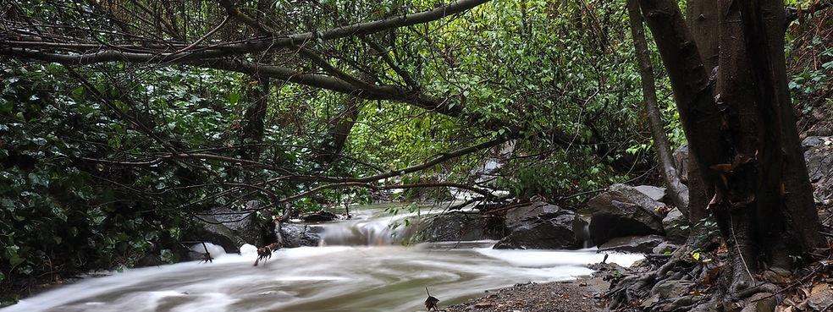
Creek and Waterway Restoration

Slide 16
Courtland Creek Restoration
  Creek restoration
    Construction underway; to be completed in Spring 2024
    All channel work completed by October 31, 2023
    Revegetation is underway and will be complete in January 2024
    Trails, benches, fences and signs to be installed in early 2024

Slide 17
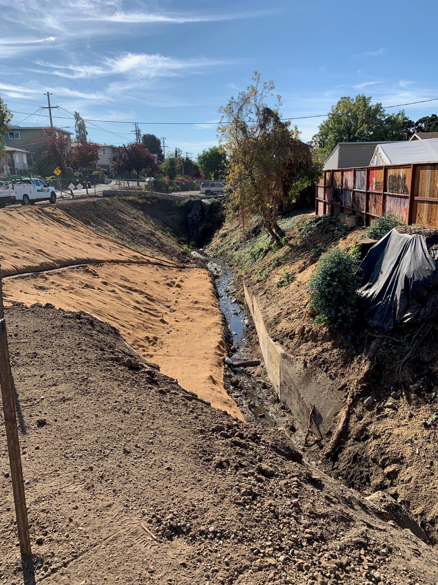
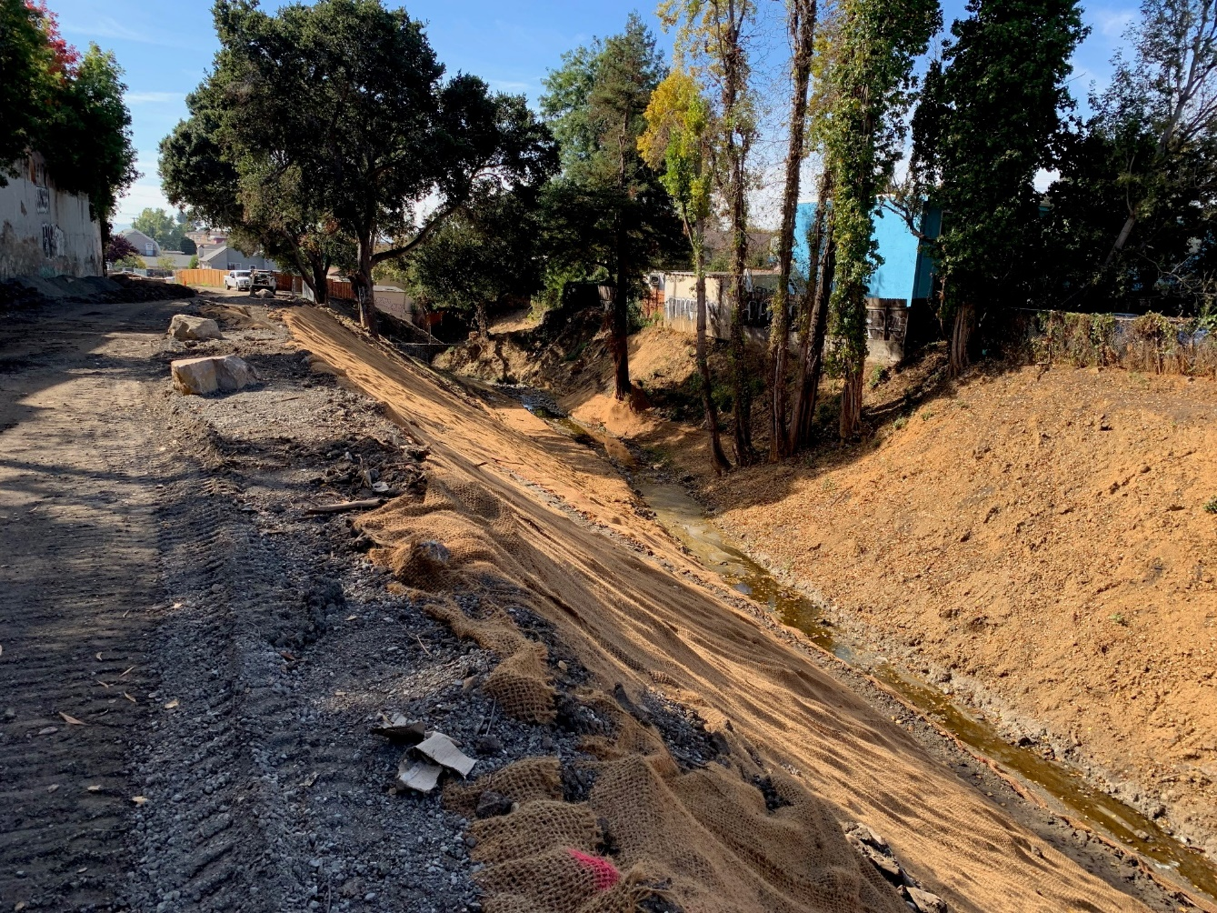
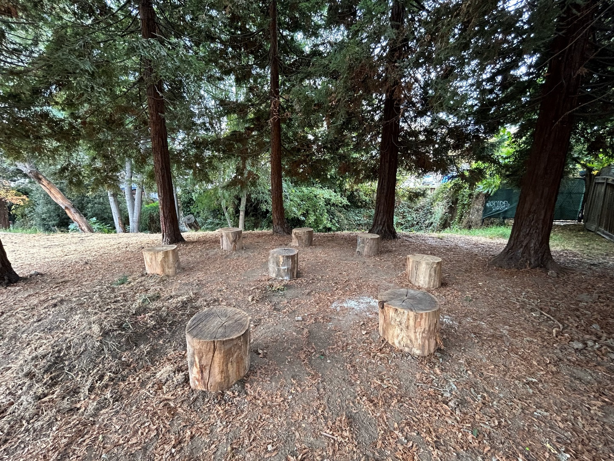
Courtland Creek Restoration
  Brookdale reach: view from future Creekside trail.
  Thompson reach: new seating along creek.
  Congress reach: view from future creek overlook.

Slide 18
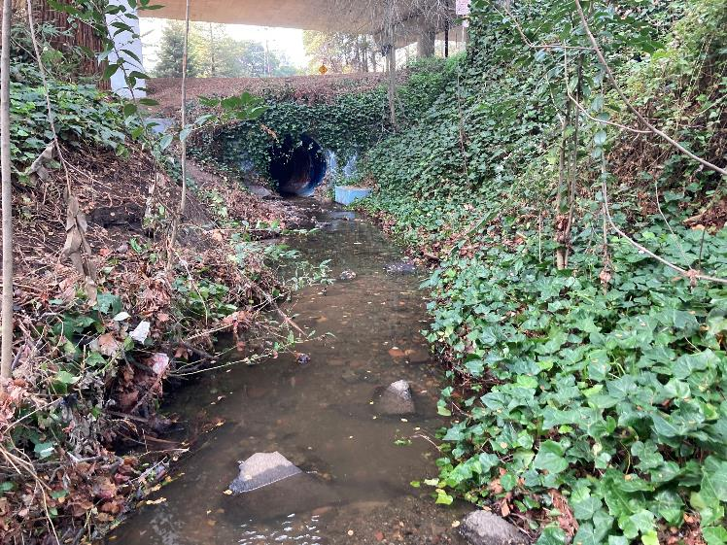
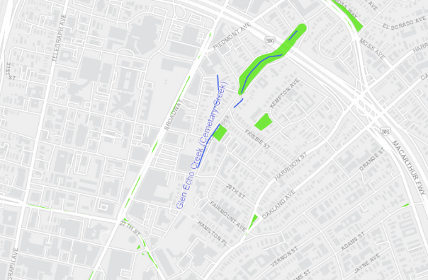
Glen Echo Creek
Restoration
Due to staffing shortages this project is paused.
Public stakeholder meetings may start in fall of 2024.
Pre-project conditions downstream of HWY 580.
Natural channel with invasive ivy and native overstory vegetation.

Slide 19
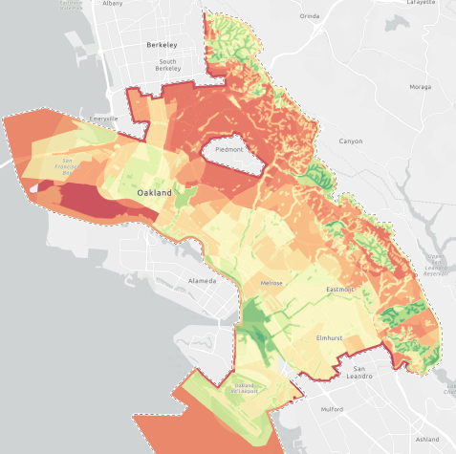
Acquisitions
  Consultant to soon deliver model of prioritized parcels for acquisition.
  Staff will then pursue acquisition opportunities.
  Conservation easement monitoring planned for January.

Slide 20
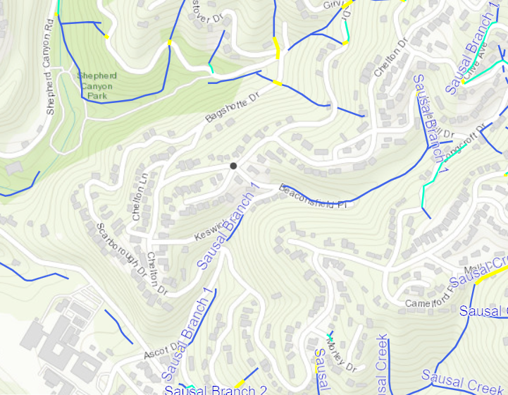



Creek Restoration of
Beaconsfield Branch Sausal Creek
No movement on this project from pre-design and funding research due to competing priorities/lack of staffing.

