Slide 1
Local Roadmaps to Community Resilience Community Assessment Workshop Primer
Bay Area UASI
Meredith Terrell & Christophe Arnold
Bay Area UASI Management Team
February 8th, 2024

Slide 2
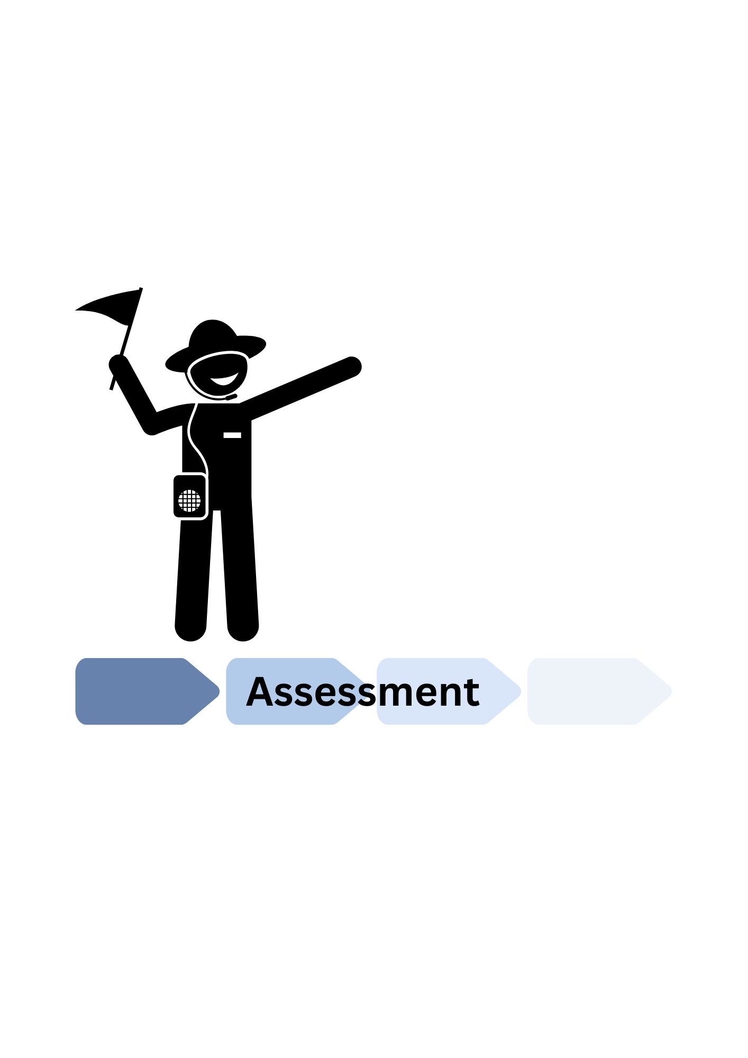
Local Roadmaps to Community Resilience
Objectives & Expectations
1.
2.
Notes:
Objectives:
Establish shared understanding of terminology / concepts (Apples to apples).
Walk-through example of Community Assessment
Expectations:
Setting the foundations, so providing you the information to allow you to productively participate in your community’s assessment

Slide 3
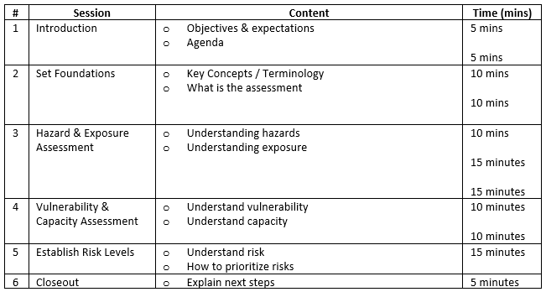
Local Roadmaps to Community Resilience
Agenda

Slide 4
Local Roadmaps to Community Resilience Session 2: Setting the Foundations
Bay Area UASI

Slide 5
Local Roadmaps to Community Resilience
Session 2: Setting the Foundations
Key Concepts
-Capacity
The combination of all the strengths, attributes, and resources available within a community to manage and reduce disaster risks and strengthen resilience.
-Community* within chosen census tract
The “Whole Community” refers to individuals, community based organizations, faith based organizations, as well as law enforcement, fire, medical response, local government and private sector.
-Disaster
A disruption in the community involving human, material, economic or environmental losses or impacts, which exceeds the ability of the community to manage the event using its own resources.
-Exposure
People, property, and systems located in areas with hazards, making them vulnerable to potential harm/loss.
Notes:
Say that they have a handout with this

Slide 6
Local Roadmaps to Community Resilience
Session 2: Setting the Foundations
Key Concepts
-Hazard
Natural or man-made sources or causes of harm and difficulty.
-Resilience
A community’s ability to prepare for, adapt to, and recover from hazards.
-Risk
The potential for damage, loss, or other impacts created by the interaction of hazards with the community. Risk is often expressed in relative terms such as high, medium, low.
-Vulnerability
The conditions determined by physical, social, economic and environmental factors or processes that increase the likelihood of a community to experience the impacts of hazards.
Notes:
Say that they have a handout with this

Slide 7
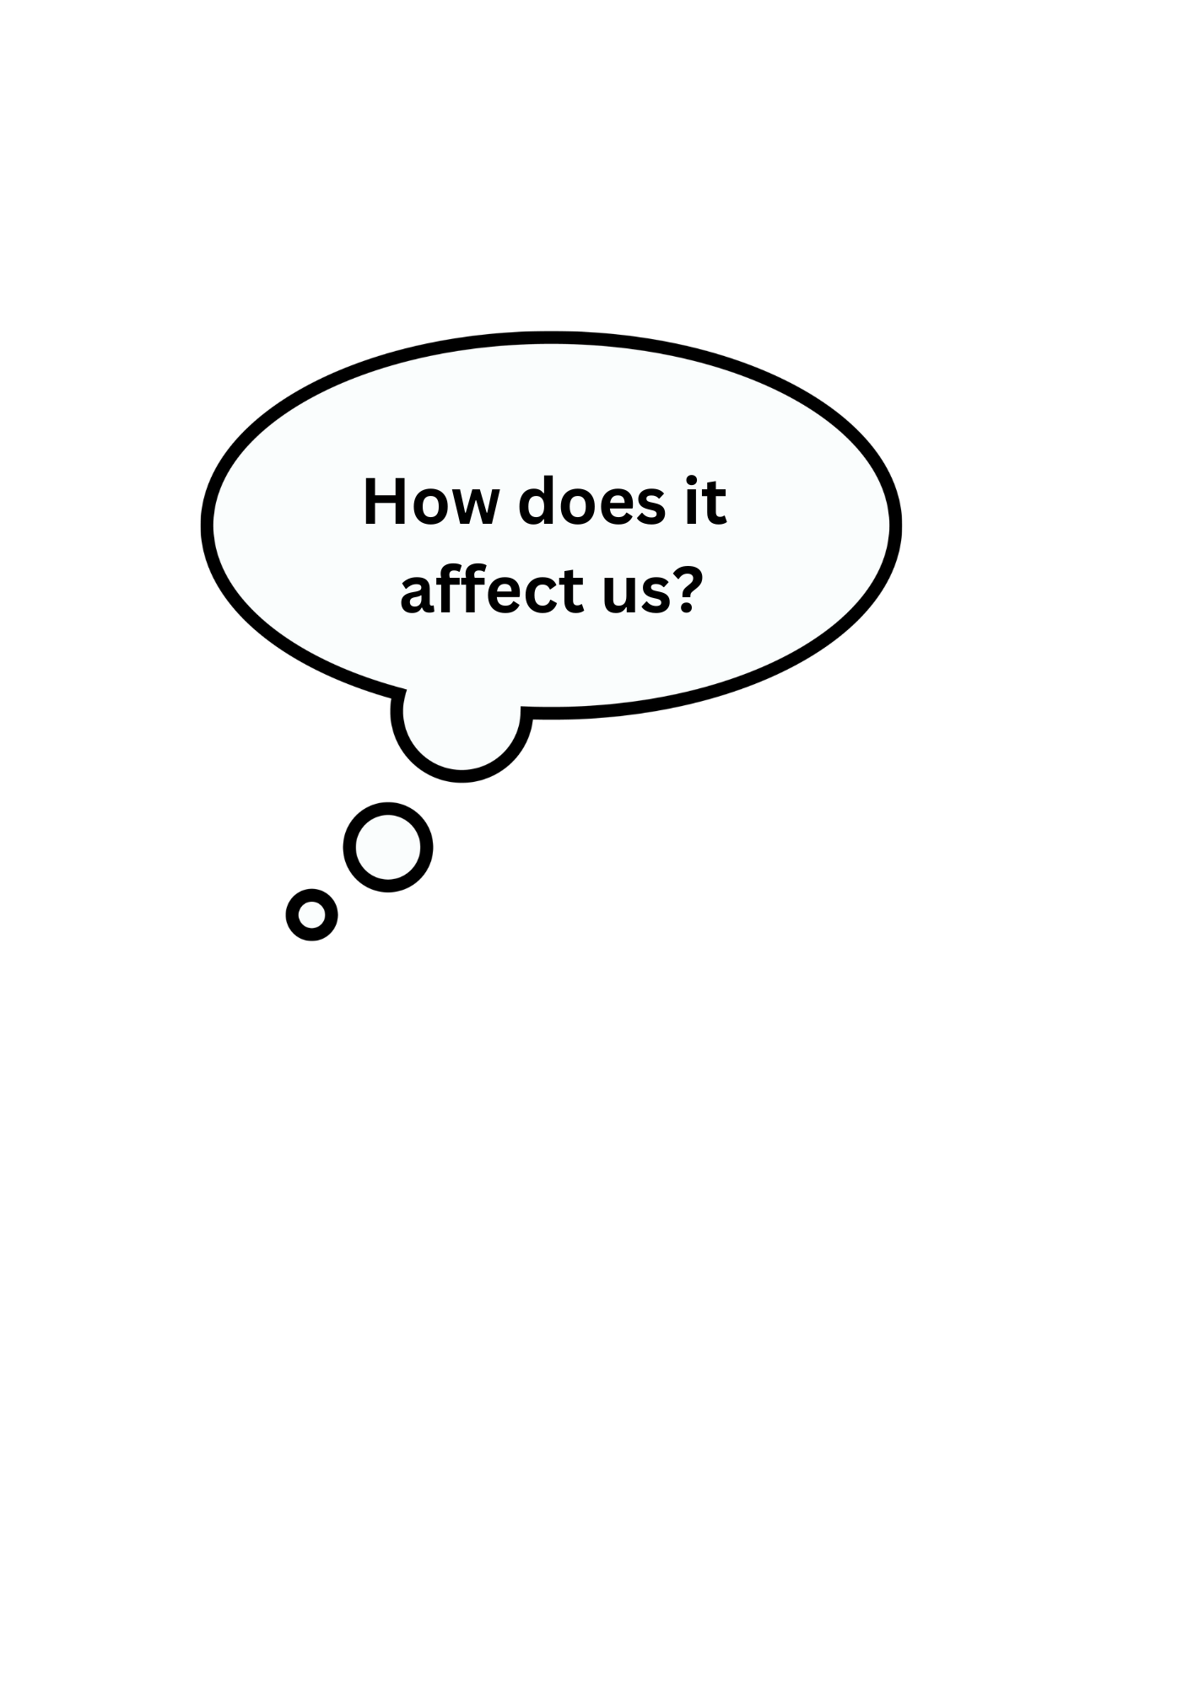
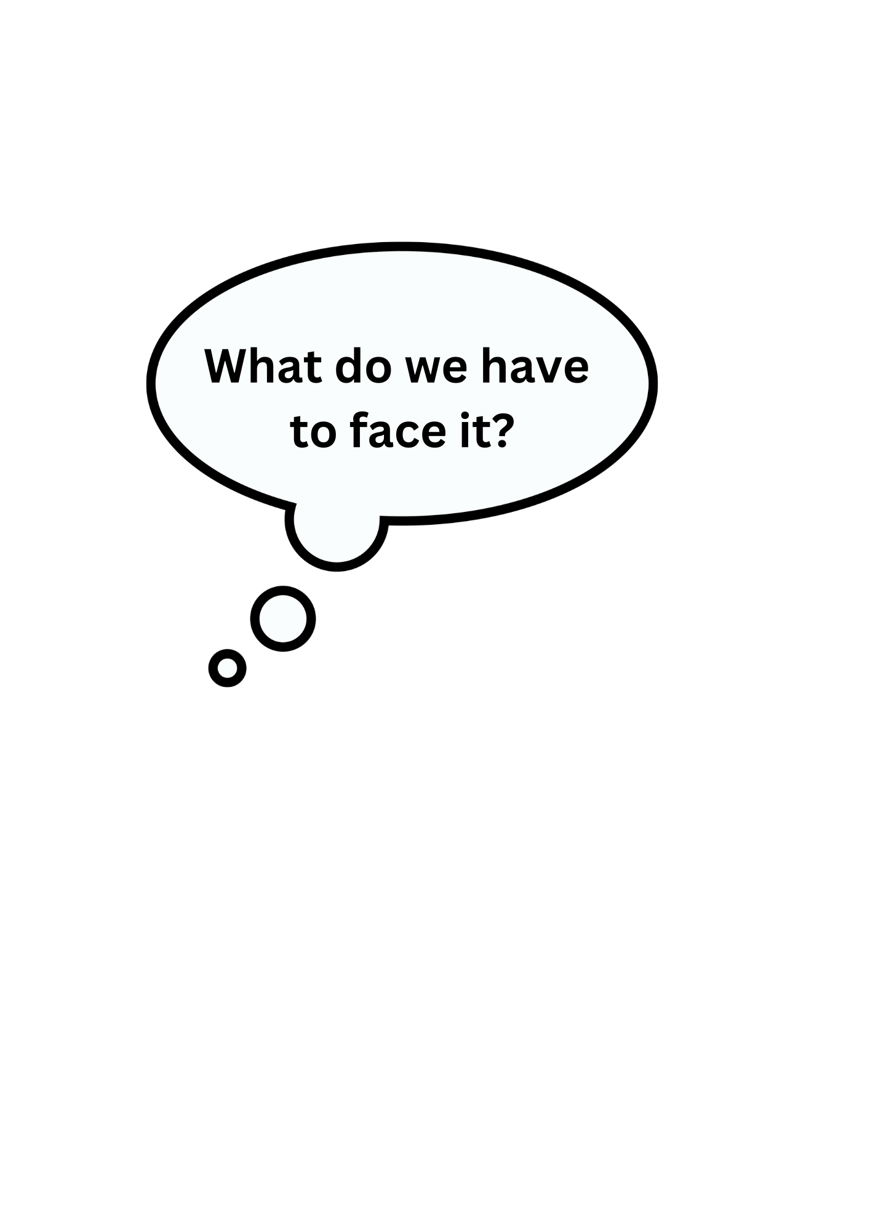
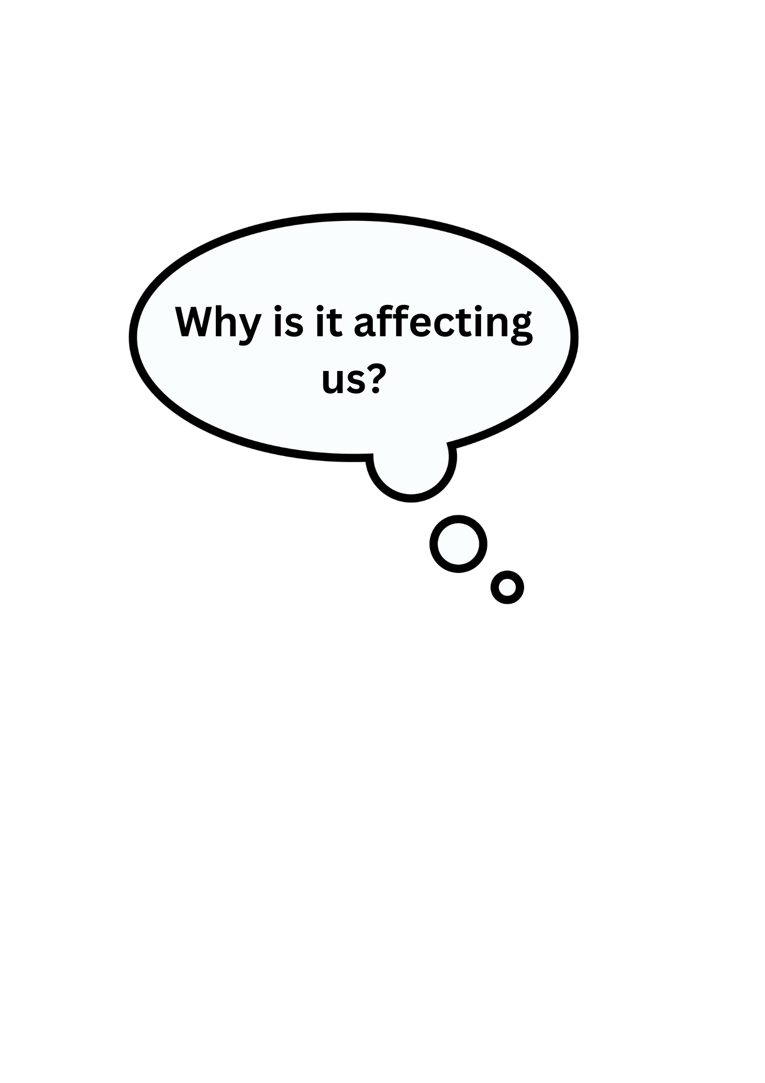
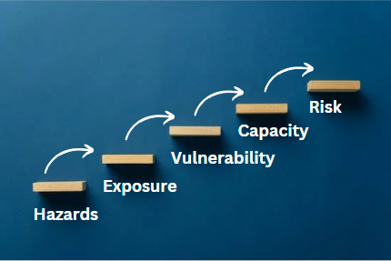
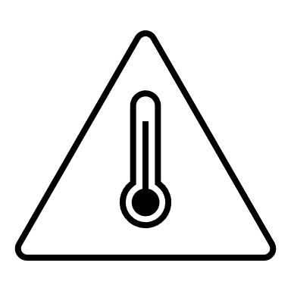
Local Roadmaps to Community Resilience
Session 2: Setting the Foundations
Assessment
Notes:
Assessing vulnerability and capacity in at-risk communities is critical to determine how to most effectively reduce disaster risk and foster community resilience.
Vulnerability and Capacity Assessment (VCA). It is a participatory process developed for communities to become more resilient through the assessment and analysis of the risks they are facing and the identification of solutions to address these. It enables communities, to explore where these risks come from, which members of the community will be the worst affected, what is available at all levels to reduce the risks, and what initiatives can be undertaken to strengthen the capacity of people at risk and reduce the risks they face.
Explain how we are going to prioritize hazards
- Probability (meteor vs heavy rains)
- A lot of financial resources and trainings already allocated towards a specific hazard in your community (ex: Wildfires)
- or if Wildfires is what you as a group choose to focus on, perhaps look at aspects that aren’t covered by current funding / equity barriers (ex: alerts & warnings in multiple languages)

Slide 8
Local Roadmaps to Community Resilience Session 3: Hazard & Exposure Assessment
Bay Area UASI

Slide 9
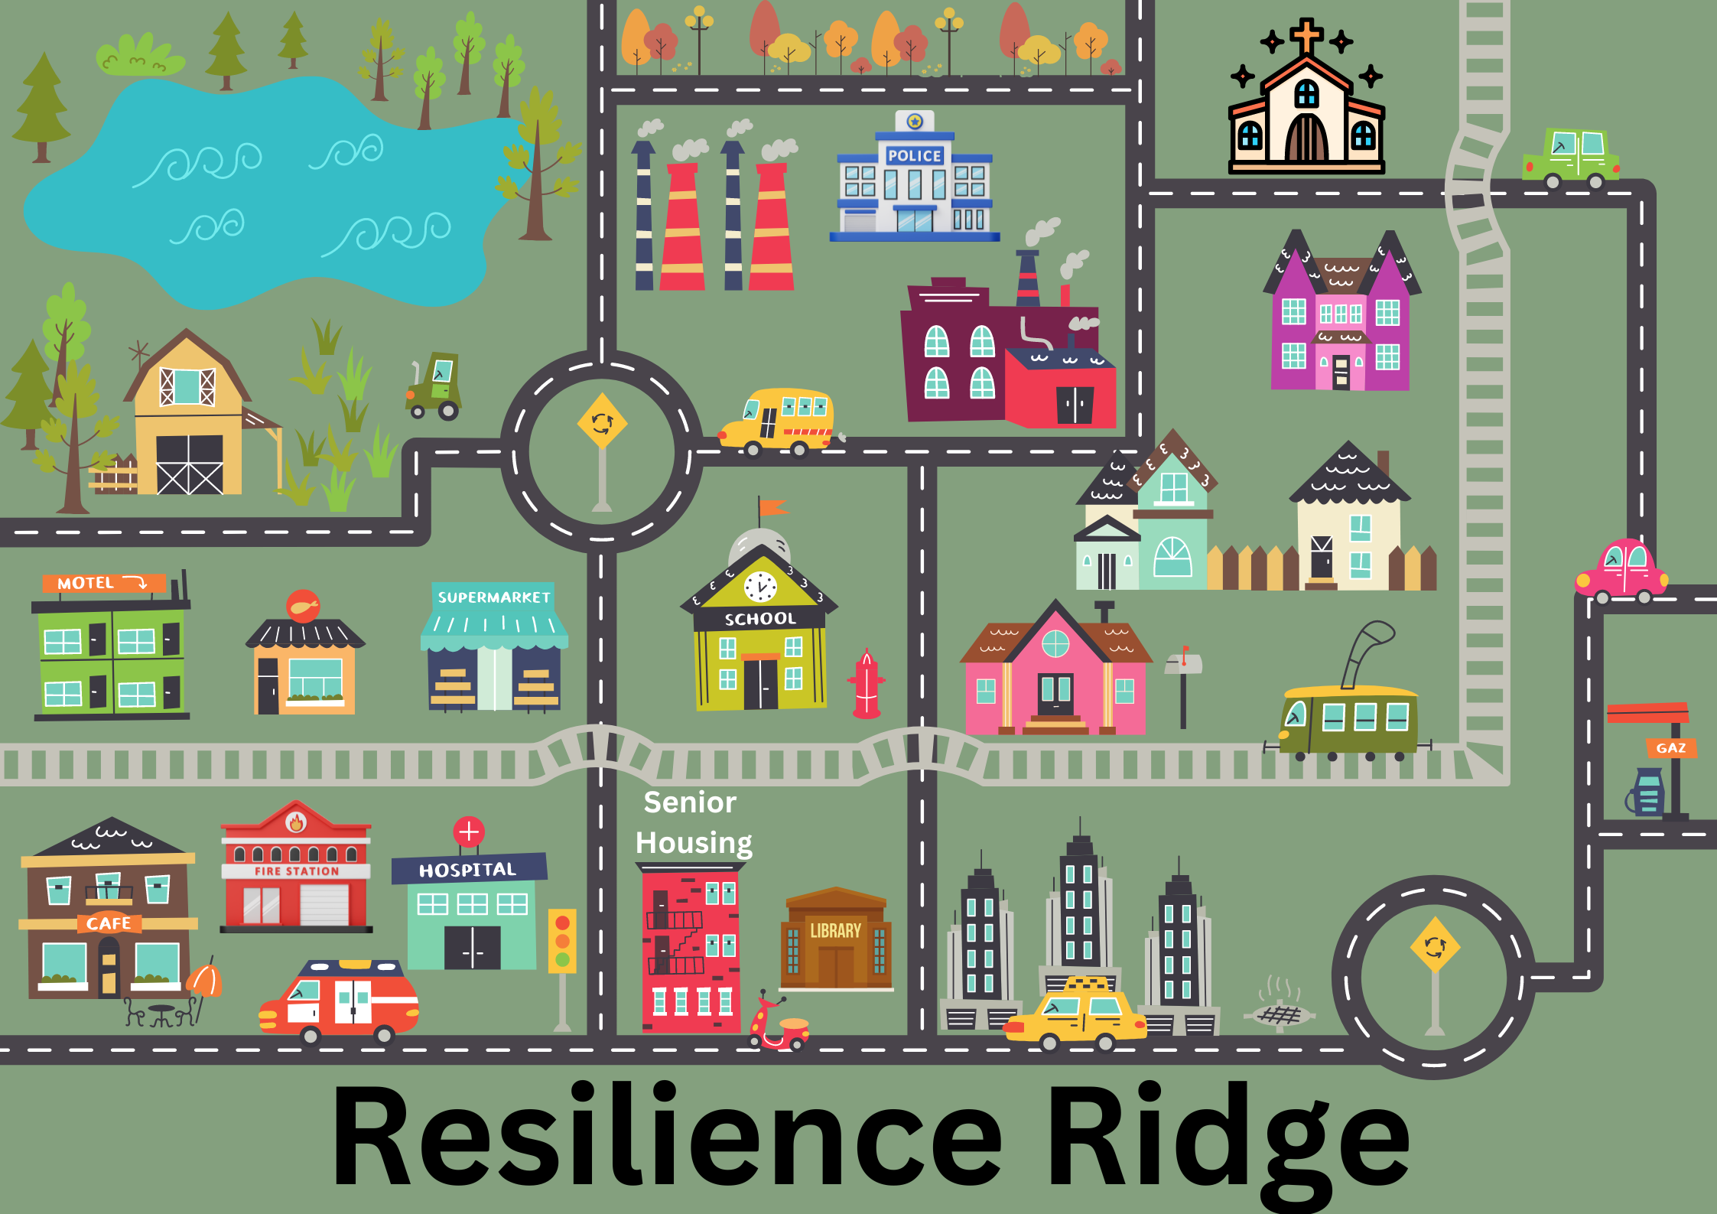
Local Roadmaps to Community Resilience
Session 3: Hazard & Exposure Assessment

Slide 10
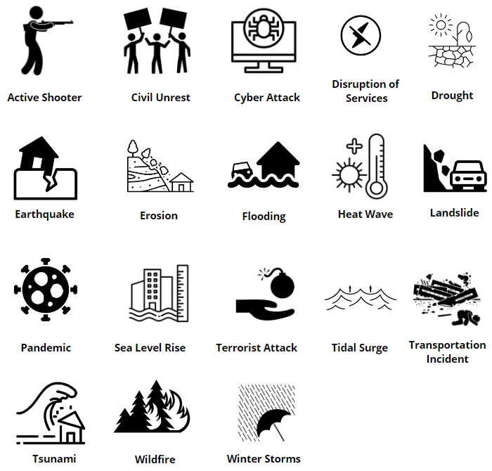
Local Roadmaps to Community Resilience
Session 3: Hazard & Exposure Assessment
Hazards
Notes:
Video Training Participant Script
Participant 1: Earthquake
Participant 2: Flooding
Participant 3: Heat Wave

Slide 11
Local Roadmaps to Community Resilience
Session 3: Hazard & Exposure Assessment
Hazards
Notes:
Video Training Participant Script
Participant 1: NA
Participant 2: Wildfire
Participant 3: Winter Storms

Slide 12
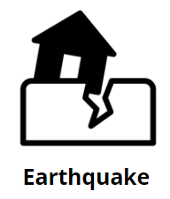
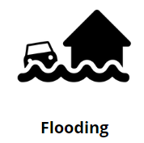
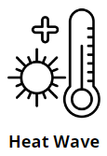
Local Roadmaps to Community Resilience
Session 3: Hazard & Exposure Assessment
Selected Hazards

Slide 13
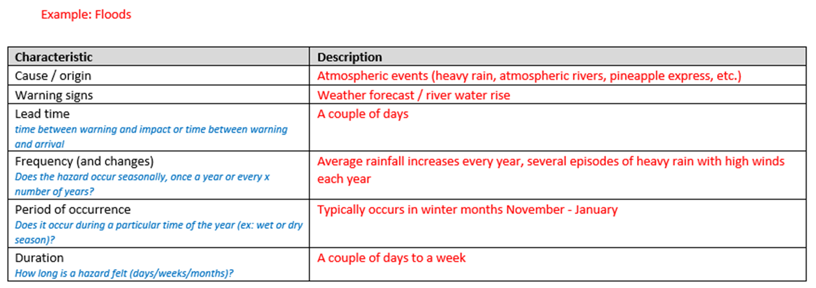
Local Roadmaps to Community Resilience
Session 3: Hazard & Exposure Assessment
Hazards
Notes:
Video Training Participant Script
Participant 1:
Cause/origin: heavy rain
Frequency: each year it seems there is more rain
Duration: it can last anywhere from a couple of days to a couple of weeks
Participant 2:
Cause/origin: pineapple express
Warning signs: river water rise
Frequency: several times a year we have episodes of heavy rain with high winds
Participant 3:
Cause/origin: atmospheric rivers
Warning signs: weather forecast
Period of Occurrence: We typically get this type weather in the winter months November - January

Slide 14
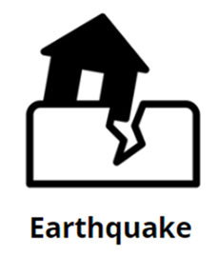
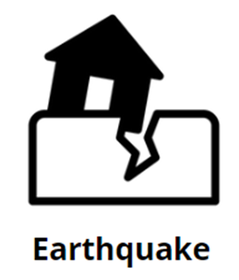
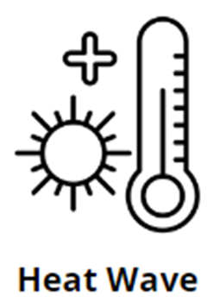
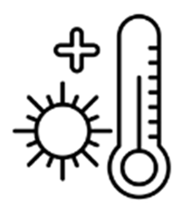
Local Roadmaps to Community Resilience
Session 3: Hazard & Exposure Assessment
Notes:
Video Training Participant Script
Participant 1: Flooding in our town typically affects agricultural areas and the commercial district just below it where the hotel and supermarket are.
Participant 2: Heat Waves hit downtown the hardest with the high-rises and senior housing.
Participant 3: If an Earthquake struck, it would affect our entire town!

Slide 15
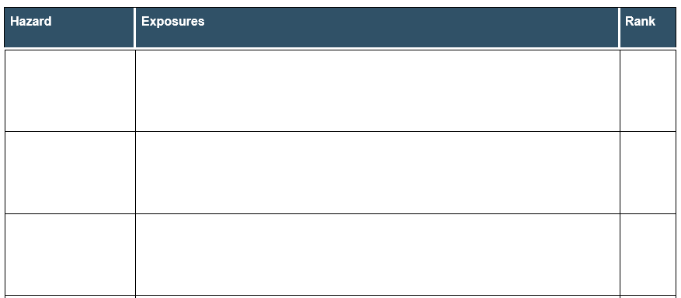
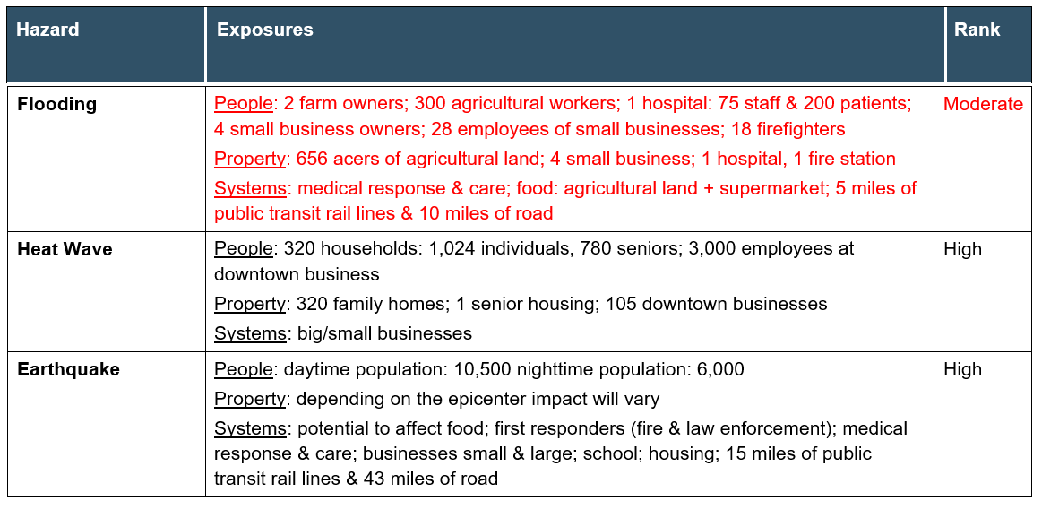
Local Roadmaps to Community Resilience
Session 3: Hazard & Exposure Assessment
Exposure
Notes:
Video Training Participant Script
Participant 1:
Property: In the defined area we have about 656 acers of agricultural land, 4 small businesses, a hospital and the fire station.
Participant 2:
People: It affects a lot of people; there are 2 farm owners that employee about 300 workers; there is the hospital that has 75 staff and 200 beds; the small businesses are 4 owners and 28 employees; the fire station has 18 firefighters.
Participant 3:
Systems: Flooding would affect the medical response and care systems; food systems + land grow food on as the supermarket; then there is transportation = about 5 miles of rial lines and 10 miles of roads.

Slide 16
Local Roadmaps to Community Resilience Session 4: Vulnerability & Capacity Assessment
Bay Area UASI

Slide 17
Local Roadmaps to Community Resilience
Session 4: Vulnerability and Capacity Assessment
Vulnerability
The conditions determined by physical, social, economic and environmental factors or processes that increase the likelihood of a community to experience the impacts of hazards.
identify groups in the community, assets, services/systems, etc. in our fictive community “Resilience Ridge”
Notes:
Compare it to the exposure (layer) on your map to see if any of the individuals, assets, or systems are withing the layer (circled areas).

Slide 18
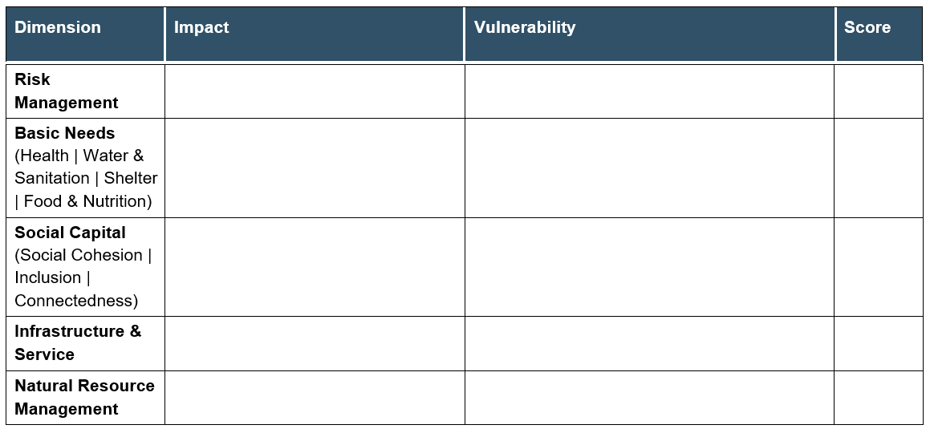
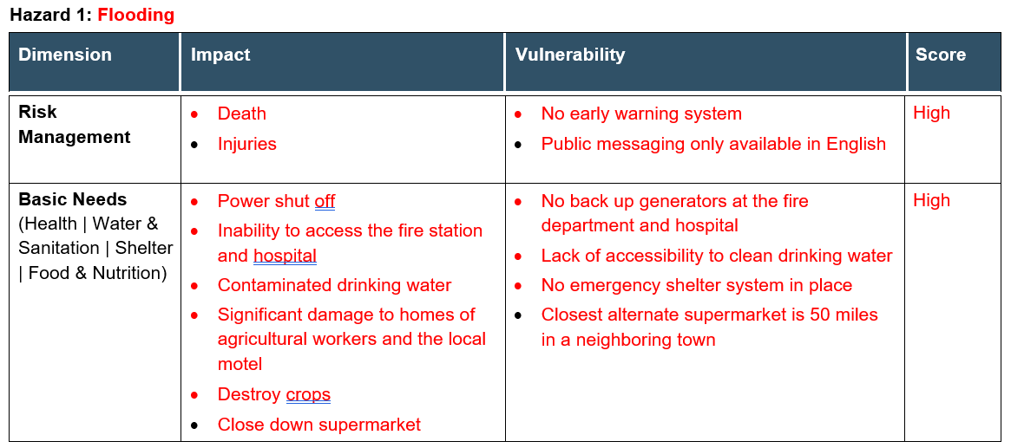
Local Roadmaps to Community Resilience
Session 4: Vulnerability & Capacity Assessment
Vulnerability
(Life & safety)
Notes:
Video Training Participant Script
Participant 1:
Risk Management Impact: death of residents
Basic Needs Impact: we experience frequent power shutoffs and flooding can block roads so we can’t get to the fire station and hospital
Basic Needs Vulnerability: we don’t have backup generators at the fire station or the hospital
Participant 2:
Risk Management Vulnerability: there is no early warning system in place in our town
Basic Needs Impact: sometimes we have to boil water because drinking water gets contaminated; in the past we have had major damage to the homes of people who work on the farms and also the motel
Basic Needs Vulnerability: if the water system gets contaminated, we don’t have an option for clean drinking water
Participant 3:
Risk Management Impact: injuries to residents
Risk Management Vulnerability: the public messages are only available in English and not all our community members speak and read English fluently
Basic Needs Impact: flooding has destroyed crops and has closed down the supermarket
Basic Needs Vulnerability: there is no shelter system in place that I know of and if our supermarket is closed, the closest one is 50 miles away in El Cielo

Slide 19
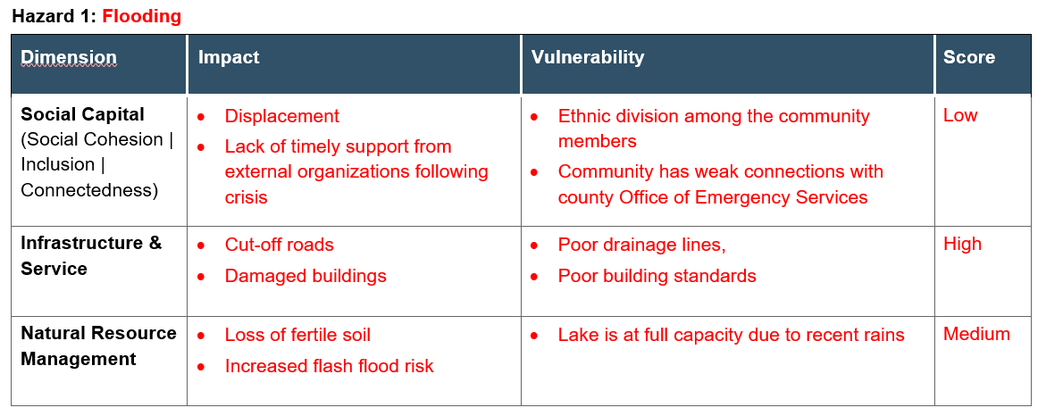
Local Roadmaps to Community Resilience
Session 4: Vulnerability & Capacity Assessment
Vulnerability
Notes:
Video Training Participant Script
Participant 1:
Social Capital Impact: If people can’t stay in their homes or go to work because of flood damage, they have to move temporarily and sometimes they don’t come back.
Social Capital Vulnerability: NA
Infrastructure & Service Impact: our roads get cut off
Natural Resource Management Impact: we often get flash floods during these times and many people driving get stuck intheir cars
Participant 2:
Social Capital Impact: It takes a long time to get help when it floods here
Social Capital Vulnerability: Our town doesn’t have a strong relationship with our county emergency department
Infrastructure & Service Impact: flooding damages our buildings
Infrastructure & Service Vulnerability: our town does not have great drainage
Natural Resource Management Impact: with heavy rains we lose a lot of fertile soil
Participant 3:
Social Capital Vulnerability: If I’m being honest, our community tends to be divided among different ethnicities – we go to different churches and schools and live in different areas of town.
Infrastructure & Service Vulnerability: our building standards could be better
Natural Resource Management Vulnerability: right now our lake is at full capacity due to recent rains

Slide 20
Local Roadmaps to Community Resilience
Session 4: Vulnerability and Capacity Assessment
Capacity
The combination of all the strengths, attributes, and resources available within an organization, community or society to manage and reduce disaster risks and strengthen resilience. Which resources available to COPE with a hazard and reduce the impact? (ex: people – CERTS, Red Cross, etc., stockpiles of relief items, buses for evacuations/transportations, etc.).
identify what resources (human, organizational, assets, financial, etc.) available in our fictive community “Resilience Ridge”.
Notes:
Compare it to the exposure (layer) on your map to see if any of the individuals, assets, or systems are withing the layer (circled areas).

Slide 21
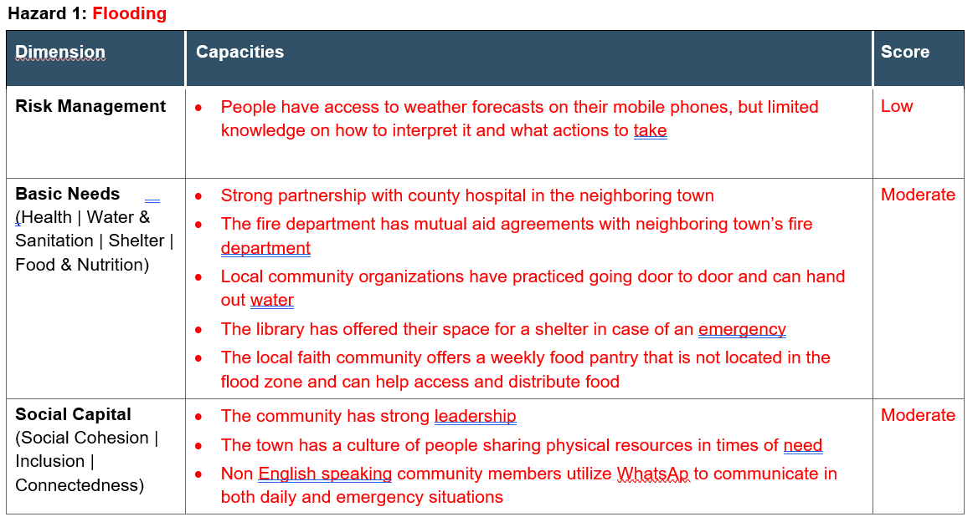
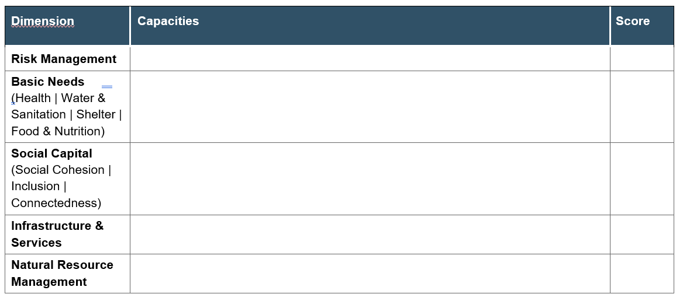
Local Roadmaps to Community Resilience
Session 4: Vulnerability & Capacity Assessment
Capacity
Notes:
Video Training Participant Script
Participant 1:
Risk Management Capacity: I think most people in town get weather forecasts on their phones, but I’m not sure that they know what to do with the information provided – what to do next.
Basic Needs Capacity: I work at the hospital, and we have a good relationship with the hospital in El Cielo – the next town over.
Social Capital Capacity: Our community has strong leadership that can rise to the occasion.
Participant 2:
Basic Needs Capacity: I work at the fire department and we have mutual aid agreements with El Cielo as well; I also know that a local community organization has practiced going door to door to check in on neighbors etc – they could hand out water if needed
Social Capital Capacity: In the past when we people are in nee, no matter where they are in town, we come together to make sure they have what they need.
Participant 3:
Basic Needs Capacity: I believe that the library has offered their building if we need it for an emergency shelter; if the grocery store is closed, we might be able to get food from the weekly food pantry held at St. Mary’s.
Social Capital Capacity: The Spanish speaking community has a large chat group on WhatAp that they use all the time – maybe that can be used in an emergency situation?

Slide 22
Local Roadmaps to Community Resilience Session 5: Determining Risk Levels
Bay Area UASI

Slide 23
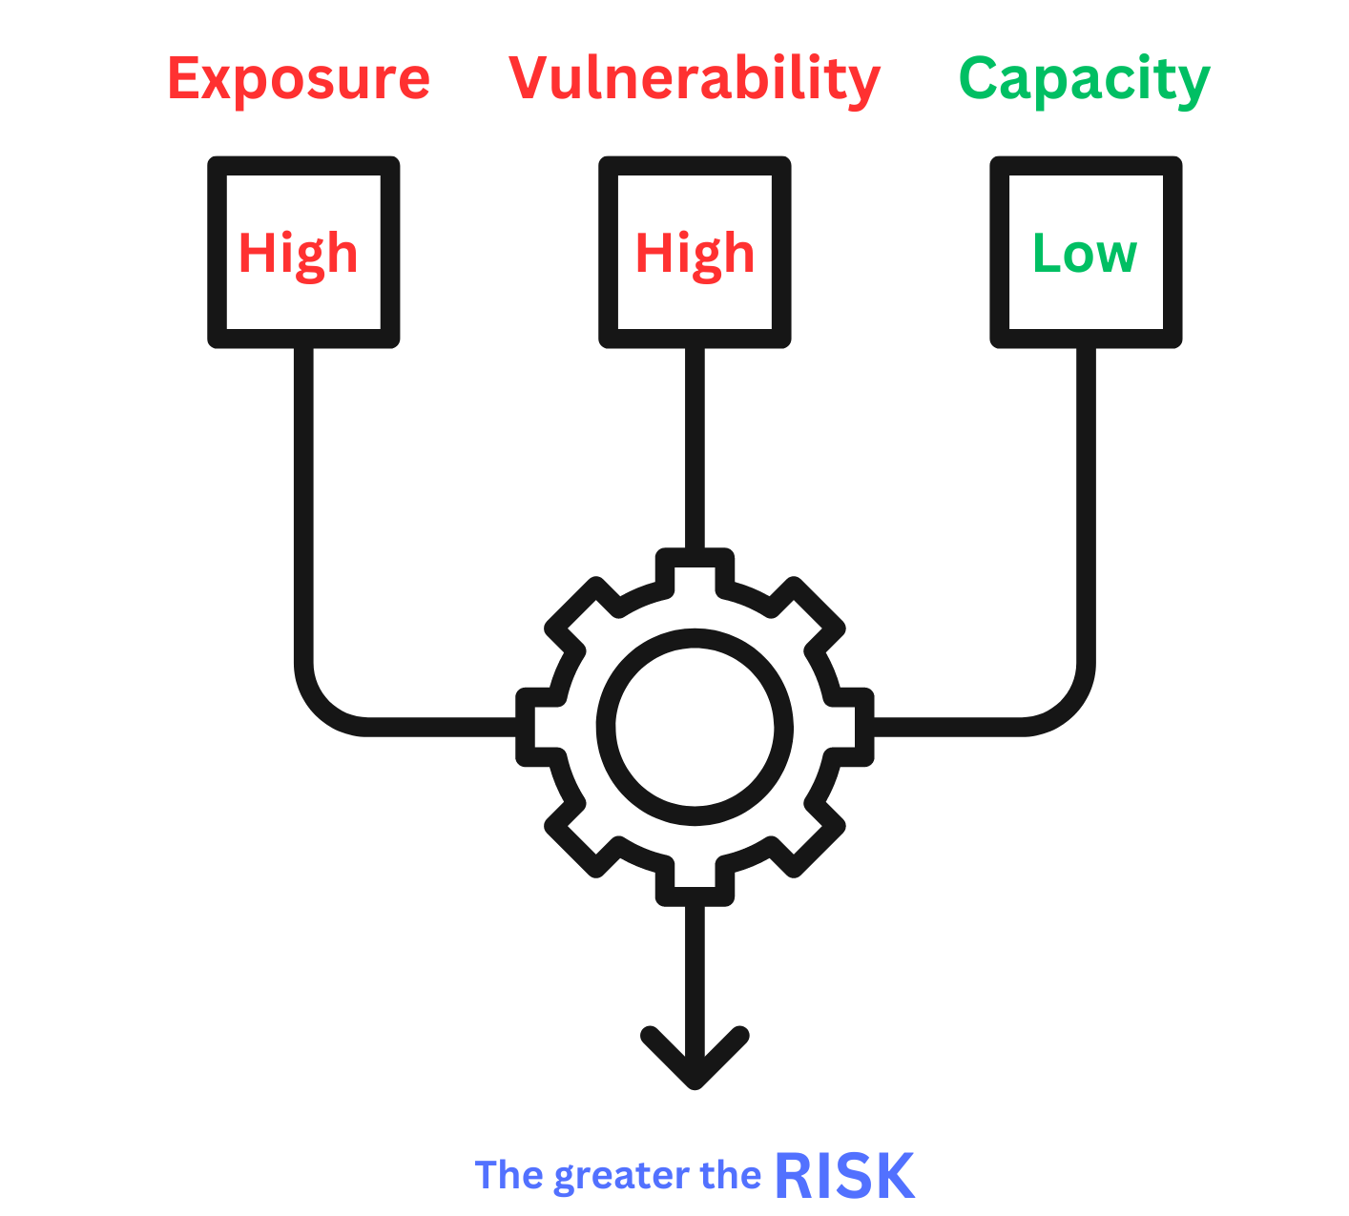
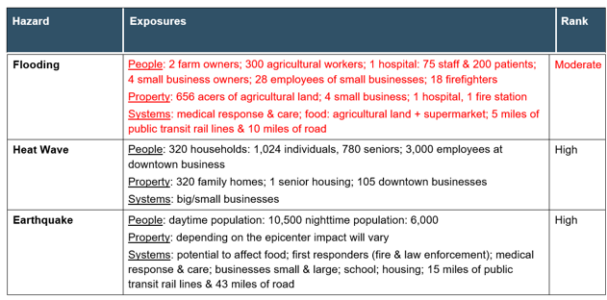
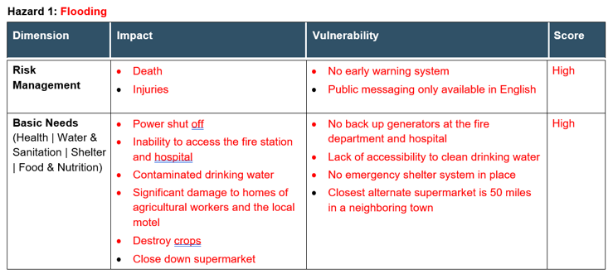
Local Roadmaps to Community Resilience
Session 5: Determining Levels of Risk
Risks
Notes:
All of your work in previous steps comes together
Video Training Participant Script
Participant 1:
Participant 2:
Participant 3:

Slide 24
Local Roadmaps to Community Resilience
Session 5: Determining Levels of Risk
Risks: Floods
Exposure:
- (People) 2 farm owners; 300 agricultural workers; 1 hospital: 75 staff & 200 patients; 4 small business owners; 28 employees of small businesses; 18 firefighters
Vulnerability:
- No early warning system
- Public messaging only available in English
Capacity:
- People have access to weather forecast on their mobile phones but have limited knowledge on how to interpret it and what actions to take
Risk:
- agricultural workers have limited English proficiency (monolingual indigenous language from Central America) with equally low literacy rates
- patients in hospital with AFN will need assistance to evacuate
Notes:
Video Training Participant Script
Participant 1: Agricultural workers have limited proficiency (monolingual indigenous language from Central America) with equally low literacy rates
Participant 2: Patients in hospital with access and functional needs will require assistance to evacuate
Participant 3:

Slide 25
Local Roadmaps to Community Resilience
Session 6: Next Steps
Assessment Workshop
of your own community
RISKS | STRATEGIC ACTIONS
Agricultural workers have limited English proficiency (monolingual indigenous language from Central America) with equally low literacy rates
Patients in hospital with AFN will need assistance to evacuate

