Slide 1
WELCOME!!! Oakland Youth Leaders & Allies City of Oakland COVID Budget Briefing
1. Please keep your video on at the beginning of the meeting, if possible.
2. AS YOU ENTER INTO THE MEETING: FOR OUR GROUP CHECK-IN, PLEASE ENTER THE FOLLOWING INFORMATION INTO THE CHAT:
YOUR NAME
YOUR AFFILIATION (INCLUDING YOUTH)
WHAT YOU HOPE TO TAKE AWAY FROM TODAY’S MEETING
YOUR INFORMATION WILL BE SHARED TO THE GROUP BY THE CO-FACILITATOR. Please note that this webinar is being recorded.
THANK YOU FROM YOUR PRESENTERS!
Youth Presenters: Barrett Valentine, Ally Mohar, Kimora Oliver, Brandon Frith, Natalie Dharmapalan, Aa’Jahlee Soleil-Long, Ivan Garcia, Ben Salop, Yarency Avelar
Adult Allies: Carolina Lieu and Margaretta Lin

Slide 3
Barrett Valentine OYAC, District 5

Slide 4
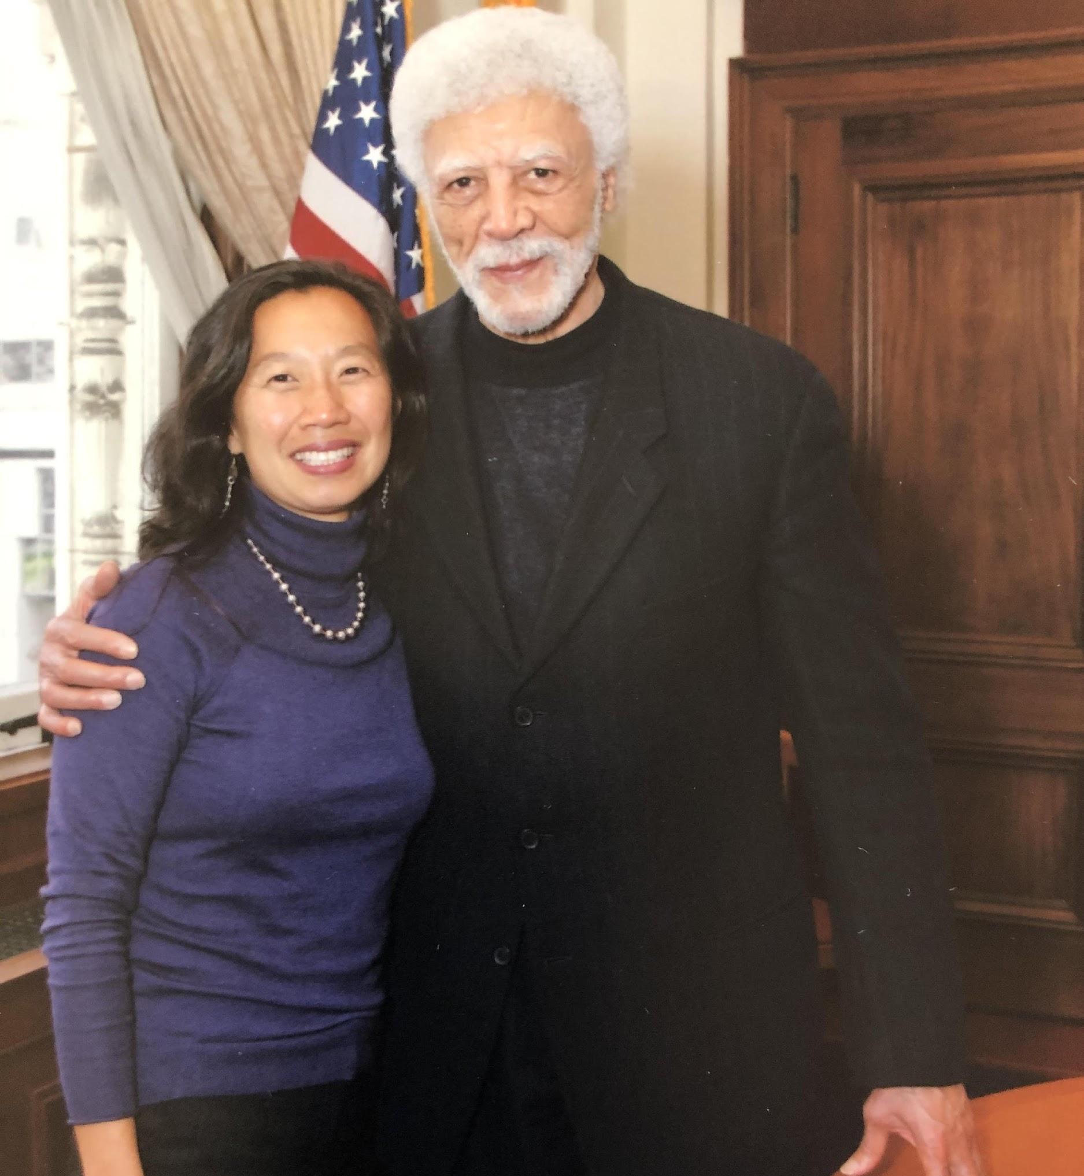
Margaretta Lin Former Oakland Deputy City Administrator & Founding Director of Youth Together Just Cities Executive Director

Slide 5
Ally Mohar, OYAC District 1 Summary of Check In Questions

Slide 6
Kimora Oliver OYAC, District 3
Community Agreements & Icebreaker

Slide 7
Brandon Frith OYAC, District 6 Meeting Objective
Participate in a youth-led Budget Webinar to empower youth advocates and adult allies to read a City budget and become effective advocates within the City by knowing where to go for information and how to advance their priorities.

Slide 8
Brandon Frith: Motivation & Agenda Review COVID Impacts to Oakland Budget
FY20-21: $96.54M projected deficit ($53.78M General Fund & $42.76M Non-General Fund) including:
Decline in Sales Tax (~$8M)
Decline in Business License Tax (~$15M)
Decline in Hotel (Transient Occupancy) Tax ($13M)
Decline in Service Charges ($8M)
Decline in Utility Consumption Tax (PGE, cell phones, etc) ($5M)

Slide 9
Natalie Dharmapalan OYAC District 2 BRAINSTORM What is a Budget? What does a family need to be safe, healthy, whole, and prosperous?

Slide 10
Where Do You Go to Find the City’s Budget?
https://www.oaklandca.gov/projects/fy-2019-2020-budget-process-1

Slide 11
Where Does the City of Oakland Get Its Money From? US $1.5 Billion Annual Budget

Slide 12
How Does the City of Oakland Spend Our $?
FY19-20 Budget: $1.5 Billion ($655 Million General Purpose Fund)
Do these Budget Values reflect your priorities?

Slide 13
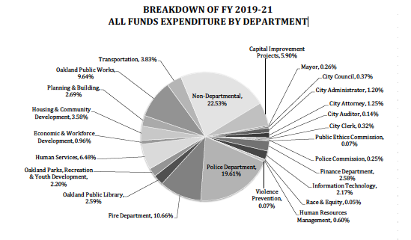

Slide 14
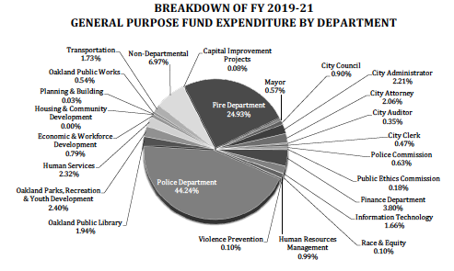

Slide 15
City Process for Deciding on Budget
Mayor/City Administration’s Proposed Budget Strategies, May 22nd
Mayor
COVID Impact on Normal Public/Community Meetings
Public
City Council Budget Changes by June 30th: June 16th & 30th Meetings
Council

Slide 16
How is City Administration Proposing to Balance the Budget? $96.54M ($53.78M GPF) Reductions
Main Strategies:
Hiring freeze ($20.3M including $7M General Fund)
$10M “concessions” to be negotiated with unions
Spend down rainy day reserve $14.7M
Cuts to some community programs
Other budgeting strategies $32M (i.e. move expenses, suspend payment to pension liability, reduce operations/maintenance)
Not accounted for: Federal/State CARES grant (~$10M)

Slide 17
Direct Impacts to Children & Youth Services Mayor/City Admin Proposed Cuts
$1M cut in Parks & Rec programs—ends planned programs:
East Oakland Sports Center Diabetes & Obesity Programs
Exercise equipment at parks (i.e. Lake Merritt, Lowell Park, Arroyo Viejo)
Town Camp programs for 5-12 year olds on fitness & nutrition
$250,000 cut in Head Start & Summer Parks & Rec lunch programs—ends planned services:
Increase in portion sizes
Increase quality of food
Serve more sites
$1.45M cut in Oakland UNITE & other violence prevention programs
$440,000 reduction each:
Chabot Space & Science Center
Oakland Museum
Oakland Zoo

Slide 18
Other Mayor/City Admin Proposed Cuts in Your Priority Areas
Economic Development: Reduces 3.5 City positions
Workforce Development: no cuts
Planning for the Future: Freezes 10 City positions
Police: Freezes 15 Civilian City positions
Fire: Freezes 7.6 City positions

Slide 19
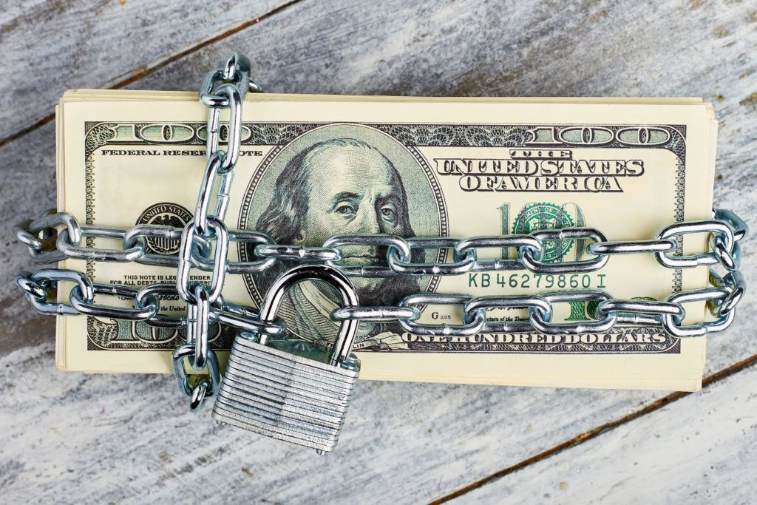
Good News—Mayor/City Admin Proposed Increased Funds for Affordable Housing, Homelessness & Park Maintenance
General Fund versus Restricted Funds
$8.24M increase for homeless services (Measure Q parcel tax & Measure W vacant parcel tax)
$12.3M for affordable housing (Impact Fees on developers, former Redevelopment $)
50 full-time workers + $2.55M for park maintenance

Slide 20
Your Voices Count! Councilmembers need to hear from YOU on your budget priorities June 16th & 30th Council Video Meetings
Power is about WHO shows up!
WE are the Ones we’ve been waiting for.
June Jordan

Slide 21
BREAK OUT SESSIONS
Facilitators:
OYAC: Ally Mohar, Kimora Oliver, Natalie Dharmapalan, Ivan Garcia, Ben Salop
Just Cities: Victoria Haworth

Slide 22
Q&A with MARGARETTA

Slide 23
Yarency Avelar OYAC
CHECK OUT
What’s one word to describe your current feeling?

Slide 24
THANK YOU! CONTACT THE ORGANIZERS WITH QUESTIONS youthcommission@oaklandca.gov

