Slide 1
ECAP Team
City Council
ECAP ad hoc Committee
City Staff Team
Climate Consultant
(Integral)
Equity
Facilitator
(OCAC)
BAU projections & scenario modeling
GHG analysis
Prioritization framework
Advanced financial analysis
Draft & final ECAP
Community engagement process
  Form & lead NLC, workshops, etc.
Equity Framework
Equity KPIs
Review ECAP for Equity considerations
Notes:
Take under advisement scarcity of staff time & resources
Focus on specific areas of advice and input so that we’ll be most likely able to act on it – e.g. Barbara Haya
This Committee was formed to advise staff
Process is established, consultants hired, still outstanding matters
Glad to have this amazing brain trust
Reso as put forth by Kalb an dadopted by Council was to ensure staff has access to best and brightest, and Mayor has decided that’s you.

Slide 2
ECAP Timeline
2017-2018: ECAP Administrative Update.
CURB analysis.
May 2018: Council Adopts 2030 GHG reduction target (56%)
Summer 2018: Council approves 2030 ECAP Community engagement process & timeline. ECAP ad hoc Community Advisory Resolution
January 2019: Consultants hired
2012:
Council adopts
2020 ECAP
October 2018: Climate Emergency & Just Transition Resolution
Notes:
Purpose

Slide 3
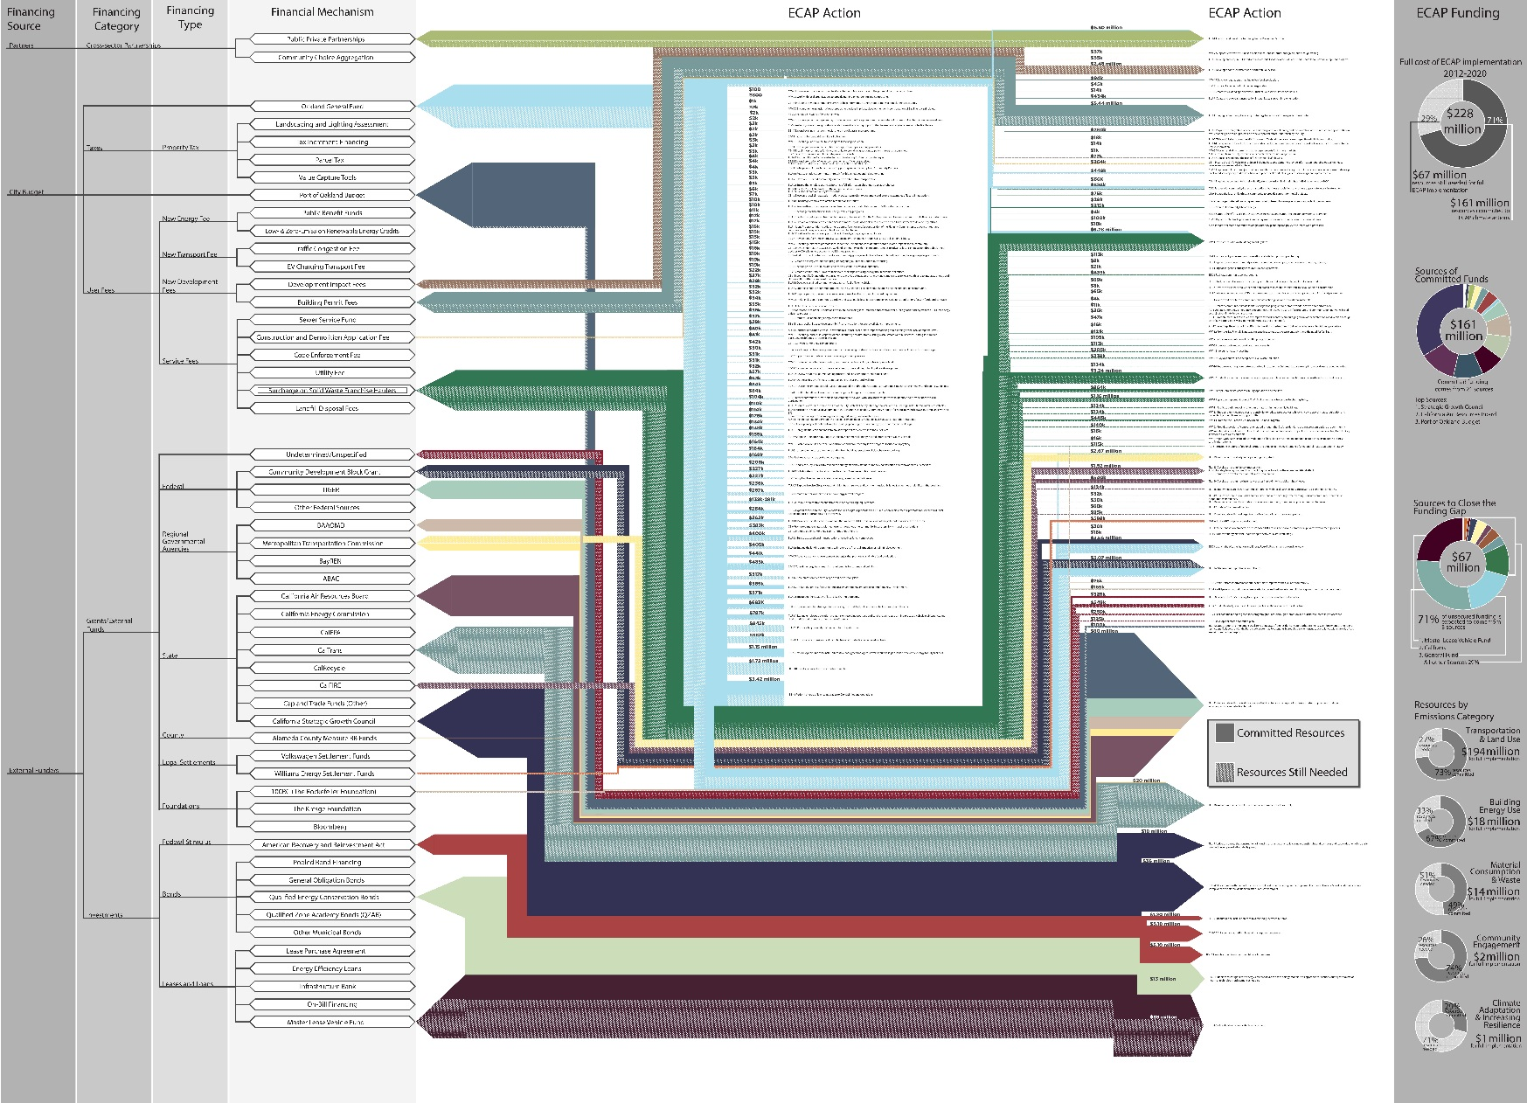
Understanding the True Cost of Actions
Map sources of financing to all ECAP Actions (2017)
$228M in total cost
$161M spent
$194M in transportation and land use
Dozens of funding sources (General Fund, fees, grants, philanthropy, partnerships)

Slide 4

Understanding How Costs are Met
Detailed review of climate action funding sources
Graphic support for decision makers
Comprehensive guide for American cities

Slide 5
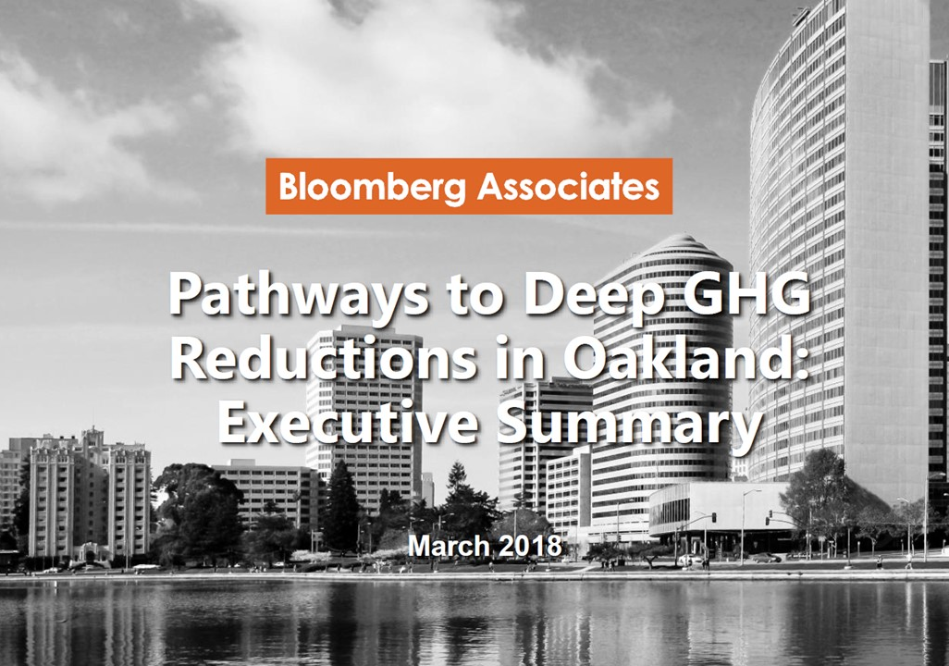
Prioritizing Actions: Deep Decarbonization
“CURB” report provides Top Five actions to reach targets:
Decarbonize the Grid
Eliminate Fossil Fuel from Building Heating
Improve Building Insulation & Windows
Move Away from Private Auto Trips
Electrify Remaining Vehicles

Slide 6
2030 ECAP Values
Realistic: Actionable, measurable, & verifiable.
Ambitious: Responsive to the Climate Emergency.
Equitable: Prioritize actions that benefit frontline communities and minimize burdens.
Balanced: Mitigation + adaptation; immediate + “moonshot” actions; core + consumption emissions.
Adaptive: Flexible to accommodate technological, political, and cultural shifts over 10 years.
Notes:
Realistic:
Staff time, funding, legal authority, sphere of control

Slide 7
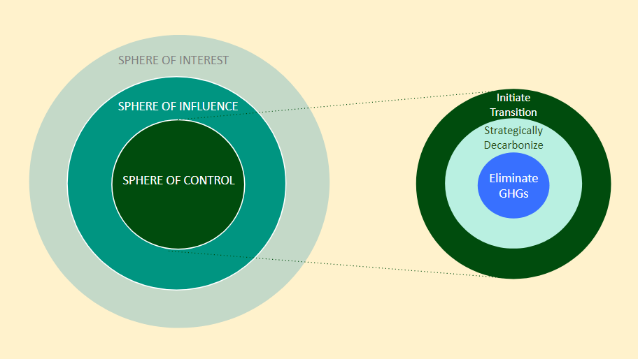
Focusing Where it Counts
Source: Adapted from Integral Group

Slide 8
Equity Principles
Priority
Community Needs
Equity in Governance: Democracy From the Ground Up
Equity Today Builds Equity for Tomorrow
A Connected & Resilient City
Civic Engagement for All
Health / Public Health
Adaptation / Resilience
Economic Security
Land Use

Slide 9
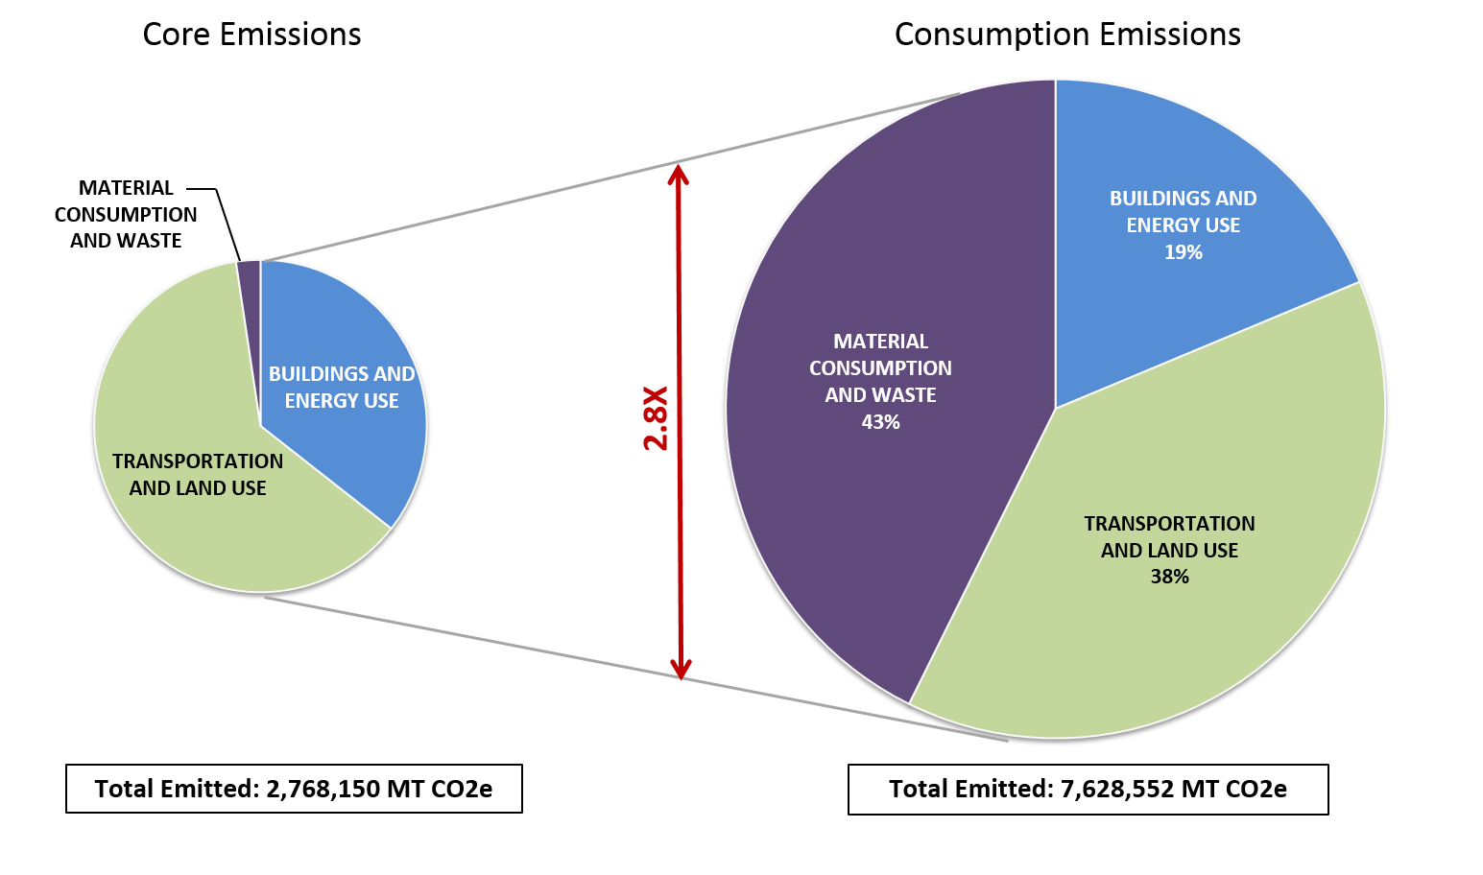
Notes:
On balancing core with consumption

Slide 10

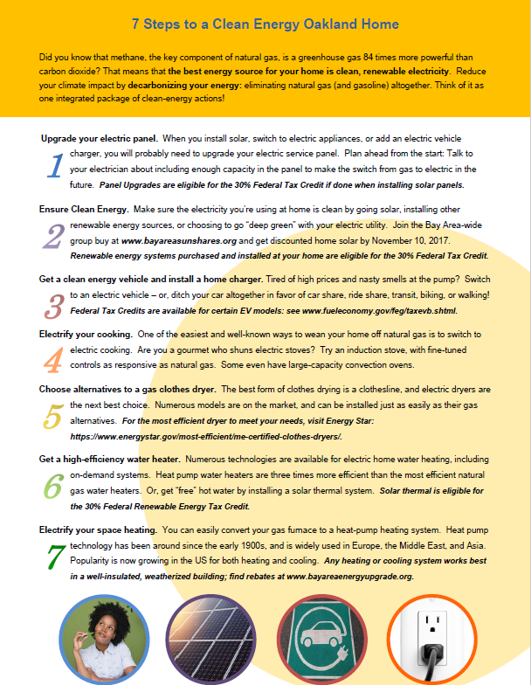
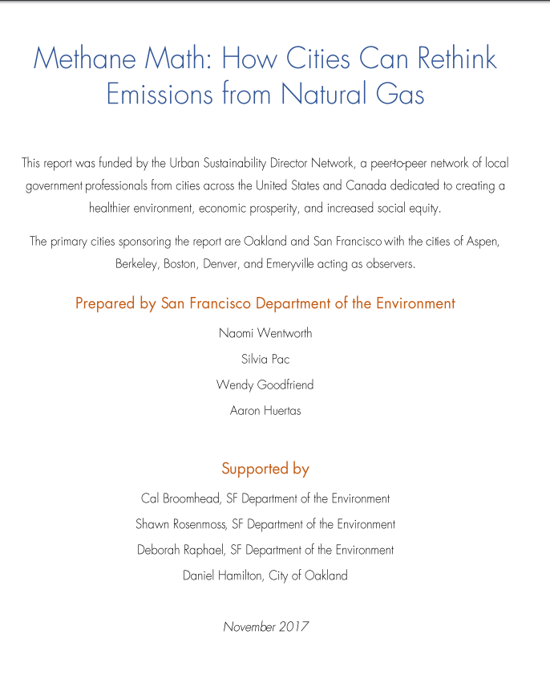
Why Natural Gas?
Burned at power plants and in homes, and leaking system-wide
Short-Lived Climate Pollutant 86 times stronger than CO2 over 20 years
Elimination is critical for 2050 targets
Also increases seismic risk
Methane
Notes:
On being an ambitious plan, and balancing near-term with moonshot

Slide 11
Social, Racial, & Economic Equity
Oakland 2030 ECAP
How do we slow down Climate Change?
How do we adapt to Climate Change?
Local Emissions
Life Cycle Emissions
Urban Forestry
Heat
Drought
Fires
Flooding
Buildings
& Energy
Manufacturing
& Production
Planting Trees
Sea Level Rise
Resilient Buildings
& Housing
Urban Gardens
Transportation
Consumption
Restoring Soil
Waste & Landfill
Upstream energy

