Slide 1


The Search for Oakland’s Next Chief of Police
Staff Searches Ad Hoc Committee:
Chair Milele
Vice Chair Jordan
Commissioner Howell

Slide 2

Timeline
  The Staff Searches Ad Hoc Committee would like to present a brief update and timeline of events in response to concerns over the timeliness of the Commission’s work in this process.
  Goals:
  Quality recruitment ensuring best candidates
  Community engagement and feedback
  Transparency and communication
  Efficiency without compromise to quality

Slide 3
February / March
  Key Dates:
  2/15: Chief LeRonne Armstrong terminated without cause
  3/15: Letter to Mayor Thao requesting meeting to discuss initiating the critical selection process
  3/23: Follow-up email to Mayor Thao urging meeting
  3/23: Chair provides update at Commission Meeting on attempts to initiate the search and meet with Mayor Thao

Slide 4
April
  Key Dates:
  4/3: Second follow-up to Mayor’s office to set meeting
  4/4: Mayor’s Office sets meeting for 4/18
  4/18: Meeting with Mayor and staff to discuss Commission’s role in the search and the next steps
  4/27: Mayor’s staff reaches out to connect Police Commission with search firms. Chair updates Commissioners and public that she has met with the Mayor regarding the process

Slide 5
May
  Key Dates:
5/2: Ad Hoc receives list of five (5) preapproved consulting firms from HR
5/11: At Commission meeting, Chair provides status report
5/15: Ad Hoc meets to discuss research on firms’ experience, qualifications, and commitment to diversity, equity, and inclusions, narrowing down to two (2) firms
5/19: Commission staff meets with HR to discuss next steps to engage search firms
5/24: Ad Hoc is informed that one of the prospective search firms declines
5/25: Remaining search firm agrees to submit proposal and requests meeting
5/25: At Commission meeting, Chair provides status report

Slide 6
June
  Key Dates:
6/5: June 8 meeting cancelled. Commission set to approve selection of search firm at June 22nd Commission meeting
6/6: Ad Hoc, staff, and HR meet with nominee search firm
6/12: Nominee search firm calls Chair with follow-up questions
6/15: Follow-up meeting scheduled with Ad Hoc and search firm
6/22: Commission votes and approves hiring of Byers Group firm

Slide 7
July
  Key Dates:
7/6: Ad Hoc and staff meet with Byers Group to establish process and plan for next steps, including key stakeholder interviews, online survey, and community engagement forums. Weekly meetings set.
7/13: Ad Hoc, staff, and Byers Group plan series of public forums
7/20: Ad Hoc, staff, and Byers Group meet to check in on progress of survey responses, stakeholder interviews, and community meetings
7/27: Dates, locations, and plans for community forums finalized

Slide 8
August
  In addition to the ongoing weekly meetings, the Staff Searches Ad Hoc held a series of public forums both in person and virtually with multilingual options. These forums were in effort to include community voices in the thoughtful and intentional crafting of the candidate profile.
  Following the series of meetings, interviews, and survey responses, more than 350 Oaklanders were engaged. The Ad Hoc provided committee reports at Commission meetings and met with the search firm to discuss results in the drafting of the candidate profile.

Slide 9


Slide 10
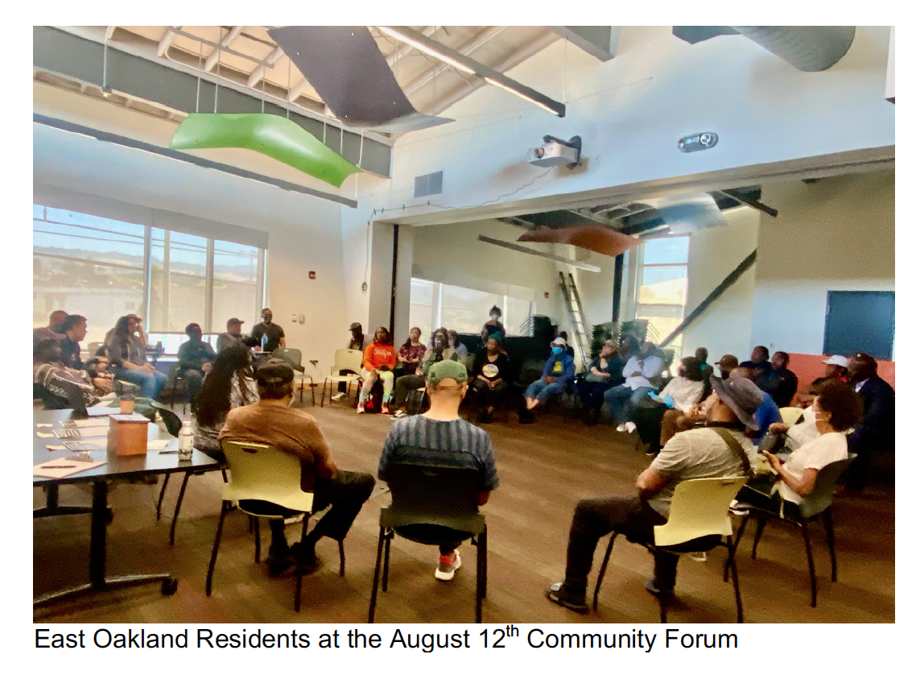
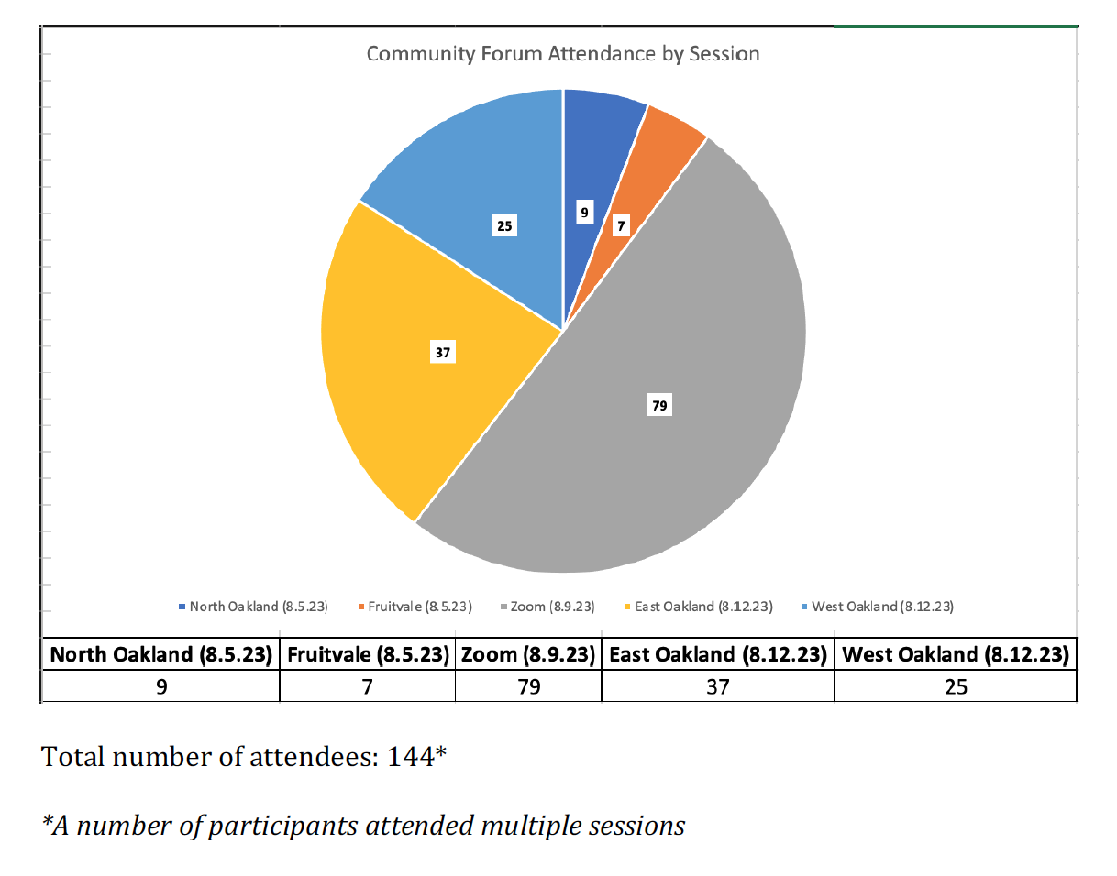
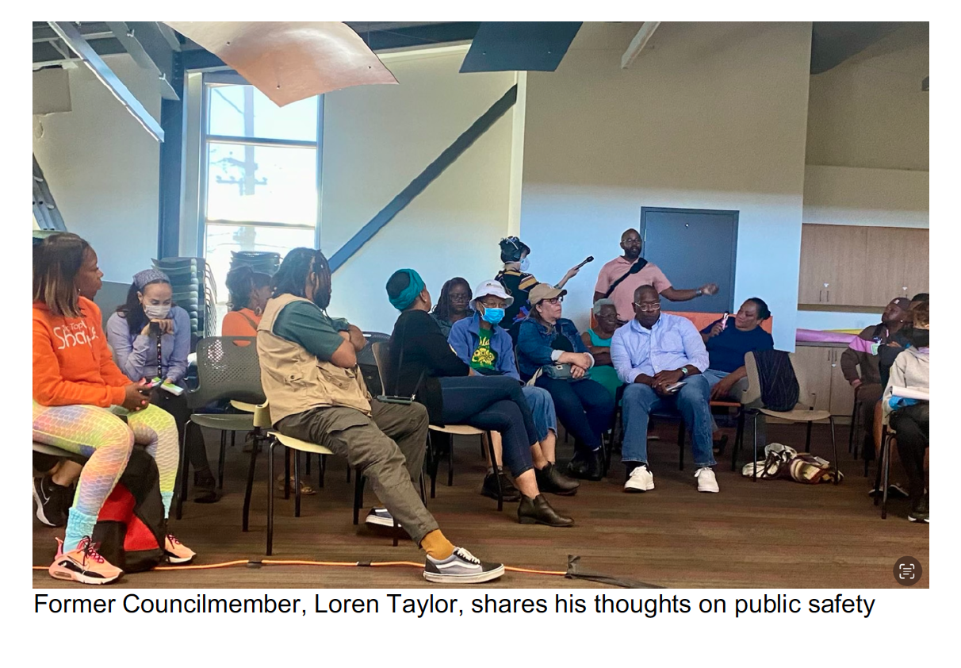

Slide 11
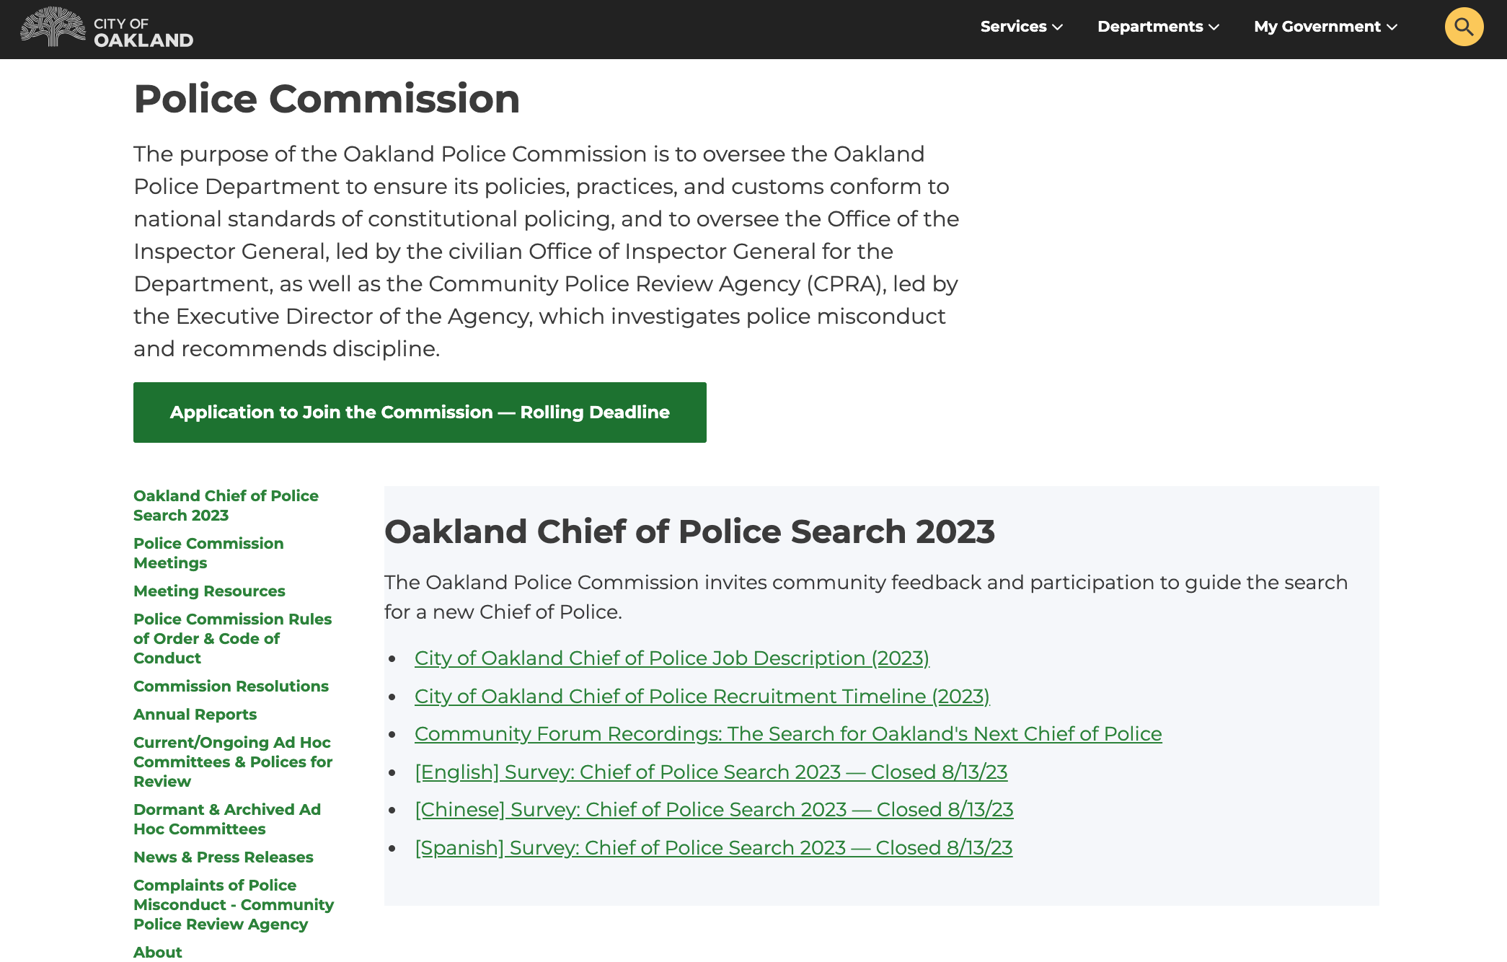
OaklandCA.gov/POLICECOMMISSION

Slide 12
September — Present
  Key Dates:
9/5: City of Oakland Chief of Police 2023 Job Description announced
9/7: Ad Hoc meets with Byers Group to discuss progress
9/14: Ad Hoc, staff, and Byers Group check in and intend to provide update at the 9/14 Police Commission Meeting (cancelled)
9/18: Ad Hoc shares update at 9/18 Police Commission Meeting

Slide 13
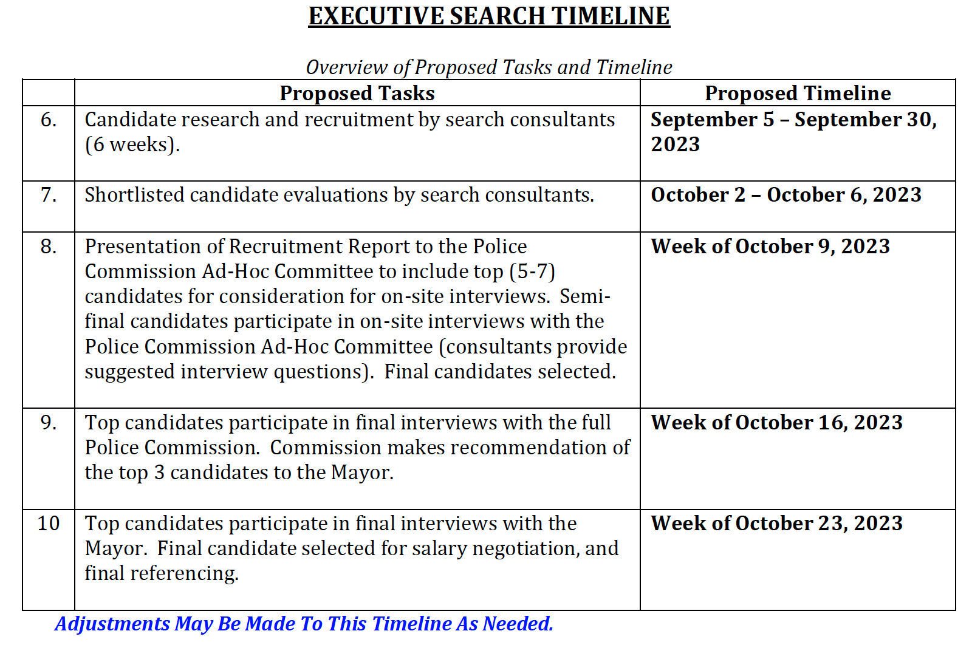
Next Steps

