Slide 1
Bay Area UASI Equitable Community Resilience Project
Local Roadmaps to Community Resilience
City of Oakland
Kickoff Meeting
February 28, 2024, 3:00pm – 4:00pm

Slide 2
Housekeeping
Emergency Management Work Group Meeting – Q4 2023
Please add your name and email to the chat
Request to record our meeting
Participate & ask questions!
Explain any acronyms used
If background noise, please use mute function

Slide 3
Welcome & Introductions

Slide 4
Introductions
Emergency Management Work Group Meeting – Q4 2023
Name
Organization/Agency
Why have you decided to be involved with this project?

Slide 5
Agenda

Slide 6
Agenda
Emergency Management Work Group Meeting – Q4 2023
Welcome and Introductions
Agenda
Meeting Purpose and Outcomes
RCPGP Equitable Community Resilience Project
Local Roadmaps to Community Resilience Overview
Proposed Meeting Schedule
Next Steps
Questions

Slide 7
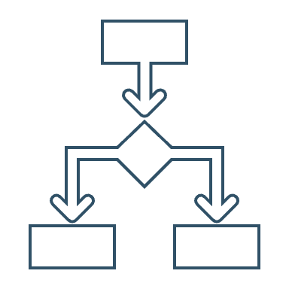
Meeting Purpose and Outcomes

Slide 8
Meeting Purpose
Emergency Management Work Group Meeting – Q4 2023
Discuss Local Roadmaps to Community Resilience tasks to include:
Project milestones
Project team roles and responsibilities
Next steps

Slide 9
Meeting Outcomes
Emergency Management Work Group Meeting – Q4 2023
Understanding of the meetings and activities to complete the Local Roadmap to Community Resilience task;
Clear roles and responsibilities of the project team to include Bay Area UASI staff, consultants, local government and community representatives;
Understand the contents of the Local Roadmap to Community Resilience deliverable;
Identifying project next steps including meeting dates and locations;
Sharing any additional community data for the identified census tract(s);
Addressing any questions from the participating jurisdiction.

Slide 10
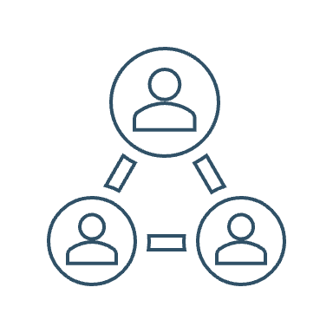
RCPGP Equitable Community Resilience Project

Slide 11
Project Overview
Emergency Management Work Group Meeting – Q4 2023
Funded by FEMA, Regional Catastrophic Preparedness Grant Program (RCPGP)
Improve, build equitable readiness, resilience to disasters in Bay Area with a focus on unique needs of underserved/disadvantaged communities, vulnerable populations
Six project tasks (local and regional)
Two project phases:
Phase 1 (now to August 31, 2024)
Phase 2 (begins Fall 2024)
Phase 2 will include funding resilience projects and technical assistance
Notes:
Target is: vulnerable and disadvantaged communities
Focus is: Equity, Climate Resilience, and Community Readiness
Core Capabilities: Community Resilience, Long-Term Vulnerability Reduction, and Housing
Local Roadmaps to Community Resilience
Local community leaders, emergency managers, urban planners, community groups, and Voluntary Organizations Active in Disasters (VOADs) will engage in a series of comprehensive vulnerability and capacity assessments that better identify the underserved/disadvantaged communities. Each roadmap will include strategies and anticipated funding requirements to address the unique needs, including specific risks & vulnerabilities to climate change.
Customized Local Planning / Technical Assistance
Bay Area UASI jurisdictions will update or create new plans to address localized issues focusing on underserved/disadvantaged communities. Projects may include updating localized, risk-informed mitigation plans to address the needs of disadvantaged communities and other socially vulnerable populations.

Slide 12
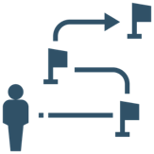
Phase 1 Project Activities
Emergency Management Work Group Meeting – Q4 2023
Local Roadmaps to Community Resilience
Regional Vulnerability Report and Resilience Tool
Regional Roadmaps to Community Resilience Toolkit
Notes:
Regional Vulnerability Report / Regional Resilience Tool Kit
Upon completion of the Local Planning Technical Assistance tasks, the Bay Area UASI will review the completed roadmaps and updated plans to inform a Regional Vulnerability Report summarizing the most critical disadvantaged communities and strategies for improving community readiness throughout the region. This will in turn inform the Bay Area UASI Threats and Hazards Identification and Risk Assessment (THIRA) which drives identification of projects for future funding.
Regional Roadmap to Community Resilience Toolkit
Findings from the Local Planning Technical Assistance will be captured and presented as regional guidance in a “Roadmap to Community Resilience Toolkit”. Bay Area UASI jurisdictions expressed interest in receiving categorized fact sheets and templates which can be implemented as needed and in a customized manner. This regional guidance will consist of best practices, lessons learned, a repository of useful tools, case studies, etc., to support jurisdictions in their efforts to assess and address long-term vulnerability issues facing their underserved / disadvantaged communities and socially vulnerable populations.

Slide 13
Local Roadmaps to Community Resilience

Slide 14
Project Background
Process developed for communities to become more resilient by understanding risks through self-assessment process
Includes the identification of hazards, exposure, vulnerabilities and capacities
Action-oriented process moving community from understanding risk to identifying preparedness and risk reduction actions (projects)
Leveraging the International Federation of Red Cross process
Four key milestones to complete the Local Roadmap to Community Resilience

Slide 15
Project Team
Bay Area UASI
Sponsor
Grant recipient and overall project management
Consultants
Community Representatives
Suhr Consulting & SFCARD
Community
Provide key subject matter expertise; oppurtunity for grant funding
Support project implementation and facilitation; develop deliverables
Jurisdiction
Local Government
Integration with existing projects or programs; oppurtunity for grant funding

Slide 16
Four Milestones to Roadmap Completion

Slide 17
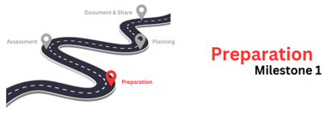
Preparation
Completed:
Choose your community of focus (census tract level)
Introductions of the project team, today’s kickoff meeting
In Progress:
Gather existing data to include hazards, social vulnerability, climate change impacts, etc.
Data is being collected in a geographic information system (GIS) platform specifically for this project (available to all!)
Participate in Community Resilience Training

Slide 18
Community Identified
Which community was chosen?
Why was this community chosen?
CEJST: Click Here

Slide 19
Assessment
Participate in the Community Assessment Workshop (in-person 4 hrs.)
Workshop will include:
Review of community profile and data
Identify community risks (hazards/exposures/vulnerability/capacity)
Prioritizing hazards and identifying how they affect the community

Slide 20
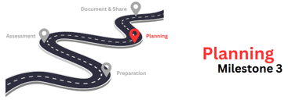
Planning
Participate in the Community Action Planning Workshop (in-person 4 hrs.)
Workshop will include:
Visioning on what the community wants to achieve in the future
Identifying potential solutions/projects to address top hazards and funding needs
After workshop, Draft Roadmap will be developed and shared with project team
Project team will complete feedback via online survey and participate in virtual feedback meeting

Slide 21
Document & Share
Final Roadmap to Community Resilience approved by the project team
Key information will be included into UASI Regional Resilience GIS platform
Invitation to attend UASI Regional Roadmaps to Community Resilience Toolkit roll-out in Summer 2024 (will allow you to replicate in other census tracts!)

Slide 22
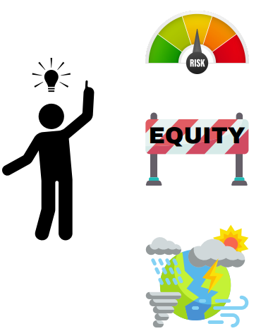
Final Roadmap Deliverable
Collaboratively developed final deliverable that identifies your community priorities.
Contents will include:
Cover Page
Handling Instructions
Stakeholder List
Project Narrative
Community Profile (GIS data and your feedback!)
Strategic Planning Matrix (strategy and projects to address needs)
Conclusion
Appendices

Slide 23
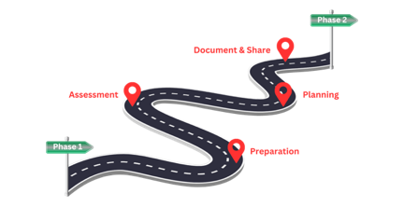
Phase 2 Implementation
Final Local Roadmap to Community Resilience submitted to project team (Phase 1 complete)
Phase 2 includes opportunity to fund projects documented in the strategic planning matrix
Funds from UASI to local jurisdiction or community organizations
Technical assistance for grant writing

Slide 24
Proposed Meeting Schedule

Slide 25
Meeting Snapshot & Timeline
Feb 2024
Kickoff Meeting
March 2024
Community Resilience Training
April/May 2024
Community Action Planning Workshop
April 2024
Community Assessment Workshop
May/June 2024
Feedback on Draft Roadmap
DONE!
In-person or recorded session
In-person Mtg. (4 hours)
In-person Mtg. (4 hours)
Feedback Session (1-2 hours)

Slide 26
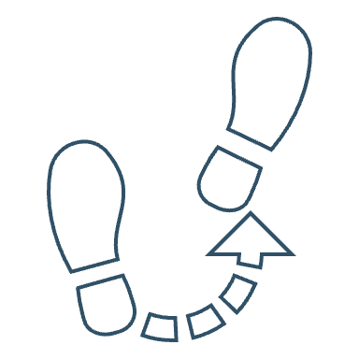
Next Steps

Slide 27
Schedule Meetings & Locations
Meeting | Proposed Dates and Location
Kick-off Meeting | February 28
Community Resilience Primer | In-person or recorded session? Link to Recorded Primer
Community Assessment Workshop (4 hrs. in-person) | Let’s Schedule!
Community Action Planning Workshop (4 hrs. in-person) | Let’s Schedule!
Feedback on Draft Roadmap (1-2 hrs. virtual) | *can be scheduled TBD

Slide 28
Additional Next Steps
Secure meeting locations, if pending
Wendy Suhr will send calendar invitations to all participants for upcoming meetings
Jurisdictional POCs and community partners will share any additional community data (GIS or community profile)
Invite additional stakeholders, community organizations, as needed

Slide 29
Contact Information UASI
Bay Area UASI
Christophe Arnold
UASI Regional Project Manager
Christophe.Arnold@sfgov.org
(415) 272-6451
Bay Area UASI
Meredith Terrell
Community Preparedness Analyst
Meredith.Terrell@sfgov.org
(415) 416-5110

Slide 30
Contact Information Consultants
Suhr Consulting Group
Wendy Suhr
Task Lead
wsuhr@scg-sf.com
(415) 680-6271
SF CARD
Heather Lee
Community Partners Lead
heather@sfcard.org
(415) 410-3639

Slide 31
Questions?

Slide 32
Thank You!

