Slide 1
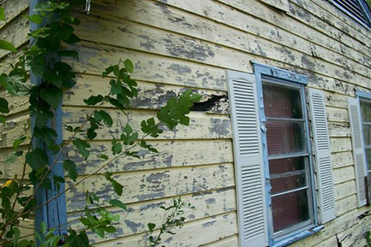
Racial Equity Impact Analysis:
Abating Lead Paint Hazards Equitably
in Oakland & Alameda County
September 8, 2021
Joint Powers Authority
Darlene Flynn
Director, Oakland Department of Race & Equity
Marybelle Tobias
Author, Racial Equity Impact Analysis
Principal, Environmental/Justice Solutions
Bill Gilchrist
Director, Building & Planning

Slide 2
Our Purpose
The cities and counties “shall make reasonable efforts to ensure that the [settlement money] is used to address public health hazards, bodily injury, personal injuries, and property damage related to Lead Paint….Such efforts include but are not limited to: (1) developing or enhancing programs that abate Lead Paint from housing, particularly housing occupied by low-income individuals; (2) providing services to individuals, particularly children, who have been exposed to Lead Paint; (3) educating the public about hazards caused by Lead Paint, and the best means of avoiding exposure to and remediating the harms caused by Lead Paint, including the availability of funding for lead abatement….”

Slide 3
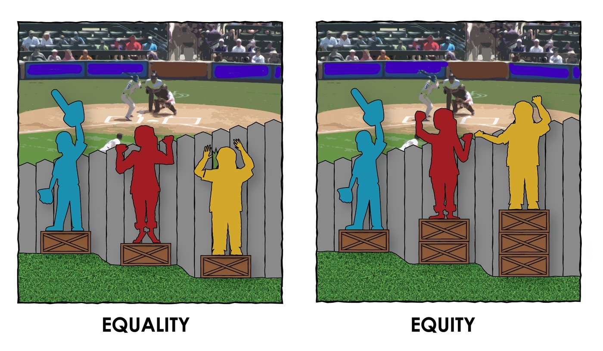
City of Oakland Obligation
City of Oakland, Municipal Code Section 2.29.170:
Specifies that “the City of Oakland will intentionally integrate, on a Citywide basis, the principle of ‘fair and just’ in all the City does in order to achieve equitable opportunities for all people and communities.”
Inequities are defined as “differences in well-being that disadvantage one individual or group in favor of another.
These differences are systematic, patterned and unfair and can be changed. Inequities are not random; they are caused by past and current decisions, systems of power and privilege, policies and the implementation of those policies.”

Slide 4
Criteria for Proposals to Advance Equity
Proposals are data driven, and have an intentional focus on closing racial disparities; outcome focused
Are influenced by perspectives of communities most impacted by disparities;
Remove barriers to access to opportunity and successful life outcomes;
Contain measurements to track that those most impacted by racial disparities are better off as a result of the proposal
(Image Credit: The Justice Collective, Oakland CA)

Slide 5
Racial Equity Assessment
Critically evaluates the existing system for addressing lead paint hazards and assesses the disproportionate burdens placed on marginalized communities, including people of color and low-income communities.
Presents a framework for equitable lead abatement that looks to dismantle and reverse practices that exacerbate inequitable outcomes.
Sheds light on the communities within the City of Oakland and County of Alameda that experience the greatest burdens, so that policy makers can direct a lion’s share of any available funds to address the needs in those communities.
Census-tract-by-census-tract comparison of the disparities facing low-income communities of color in Oakland and Alameda County that increase vulnerability to lead poisoning to identify the areas and demographics that have high burdens across multiple indicators.
Straightforward data-oriented methodology for prioritizing high-risk populations and neighborhoods.

Slide 6
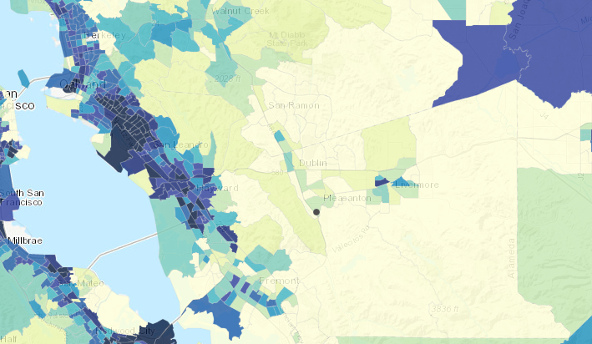
Lead Paint Distribution
There are 116 census tracts in Alameda County with lead risks above the 75th percentile statewide.
The 22 most burdened tracts are all located in Oakland, with the following two located in Hayward.
All 22 census tracts with the greatest lead risk in Alameda County are in the top 5% of census tracts statewide for lead risk.
14 of the 22 tracts also have cumulative burdens above the 75th percentile statewide (designated as disadvantaged communities).
In each of the 22 census tracts with the most lead risk, more than 5 lead poisoned children were found between 2013-2018, with the number per census tract ranging from 5 to 44.
Source: Draft CalEnviroScreen 4.0
Notes:
Source: Draft CalEnviroScreen 4.0 - Lead Indicator

Slide 7
Table 5. Oakland: Predominantly Hispanic/Latinx Census Tracts
CT No. | Neighborhood | Lead Pctl | CT No. | Neighborhood | Lead Pctl
4059.01 | Lower San Antonio 1 | 92.83 | 4086 | Bancroft/Havenscourt 2 | 99.85
4061 | Jingletown/Kennedy Tract | 81.14 | 4087 | Bancroft/Havenscourt 1 | 98.49
4062.01 | Reservoir Hill/Meadow Brook | 97.24 | 4088 | Havenscourt/Coliseum | 98.99
4062.02 | Fruitvale/Hawthorne | 96.13 | 4089 | Fitchburg/Hegenberger | 93.49
4063 | San Antonio/Sausal Creek | 93.83 | 4090 | Oakland Airport | 97.88
4065 | Peralta/Hacienda | 93.88 | 4091 | Brockfield Village | 99.43
4070 | Lower Laurel/Allendale | 89.26 | 4092 | Sobrante Park | 90.56
4071.01 | Harrington/Fruitvale | 90.71 | 4093 | North Stonehurst | 97.71
4071.02 | Jefferson/Fruitvale | 95.34 | 4094 | Elmhurst Park | 97.58
4072 | Fruitvale | 97.02 | 4095 | Woodland/Tassafaronga | 98.33
4073 | Lockwood/Coliseum | 95.43 | 4096 | Webster | 97.28
4074 | Fremont | 99.53 | 4097 | Castlemont | 92.68
4075 | Seminary | 99.37 | 4103 | Cox/Elmhurst | 94.86
4085 | Arroyo Viejo | 96.76 | 4104 | Durant Manor | 86.79

Slide 8
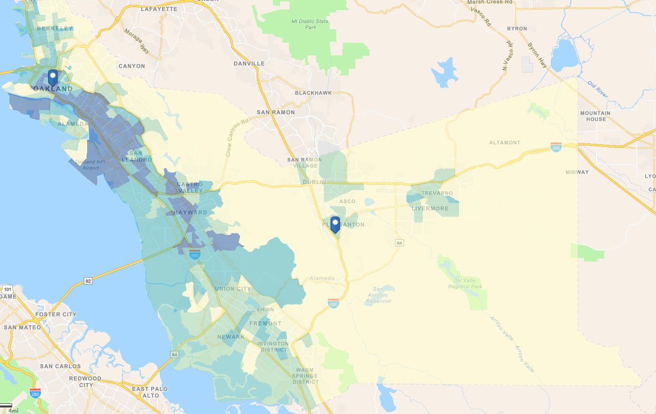
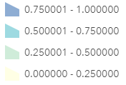
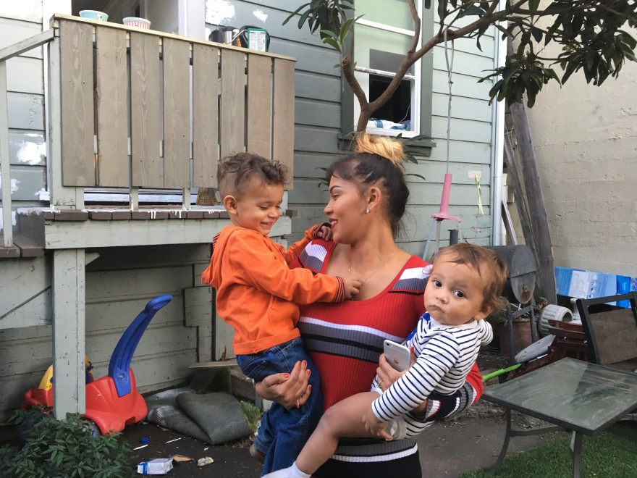
Distribution of Social Vulnerability
Social Vulnerability Index
Source: CDC
Notes:
Anabel Razo holds her two youngest kids in front of the Oakland home that may have been the cause of her son Antonio's lead poisoning. https://www.kalw.org/show/crosscurrents/2018-12-13/living-with-lead-poisoning-in-the-san-francisco-bay-area
Pair SVI with

Slide 9
Distribution of Social Vulnerability
Table 18. Predominant Race/Ethnicity of Most Socially Vulnerable Census Tracts
# | Census Tract No. | SVI Score | Neighborhood / City | Race/Ethnicity
1 | 4059.01 | 1 | Lower San Antonio 1 | Hispanic/Latinx
2 | 4075 | 1 | Seminary | Hispanic/Latinx
3 | 4062.02 | 0.99 | Fruitvale/Hawthorne | Hispanic/Latinx
4 | 4072 | 0.99 | Fruitvale | Hispanic/Latinx
5 | 4089 | 0.99 | Fitchburg/Hegenberger | Hispanic/Latinx
6 | 4030 | 0.98 | Chinatown | Asian
7 | 4339 | 0.97 | Ashland | Hispanic/Latinx
8 | 4063 | 0.96 | San Antonio/Sausal Creek | Hispanic/Latinx
9 | 4065 | 0.96 | Peralta/Hacienda | Hispanic/Latinx
10 | 4086 | 0.96 | Bancroft/Havenscourt 2 | Hispanic/Latinx
11 | 4093 | 0.96 | North Stonehurst | Hispanic/Latinx
12 | 4095 | 0.96 | Woodland/Tassafaronga | Hispanic/Latinx
13 | 4088 | 0.95 | Havenscourt/Coliseum | Hispanic/Latinx
14 | 4062.01 | 0.94 | Reservoir Hill/Meadow Brook | Hispanic/Latinx
15 | 4074 | 0.94 | Fremont District | Hispanic/Latinx
Social Vulnerability Index
Source: CDC
Notes:
Anabel Razo holds her two youngest kids in front of the Oakland home that may have been the cause of her son Antonio's lead poisoning. https://www.kalw.org/show/crosscurrents/2018-12-13/living-with-lead-poisoning-in-the-san-francisco-bay-area

Slide 10
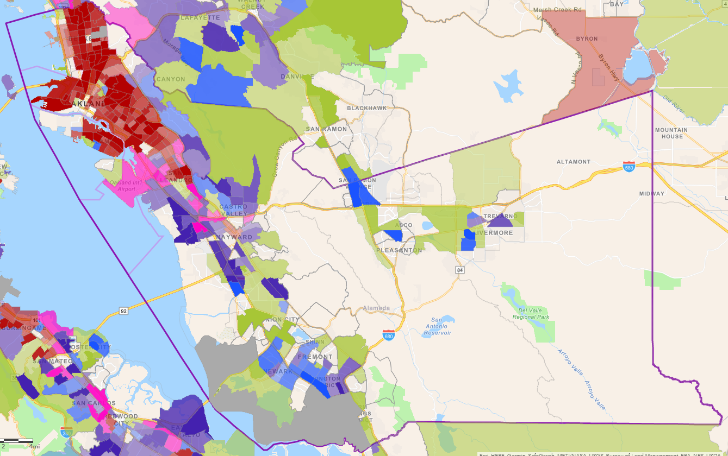
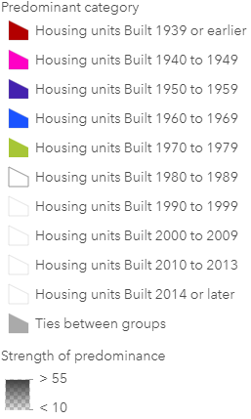
Predominant Age of Housing Units
Census tracts where the majority of units were constructed after 1979 did not receive a color.
Census tracts with the darkest red coloring have the highest percentage of pre-1939 housing units.
Notes:
American Community Survey

Slide 11
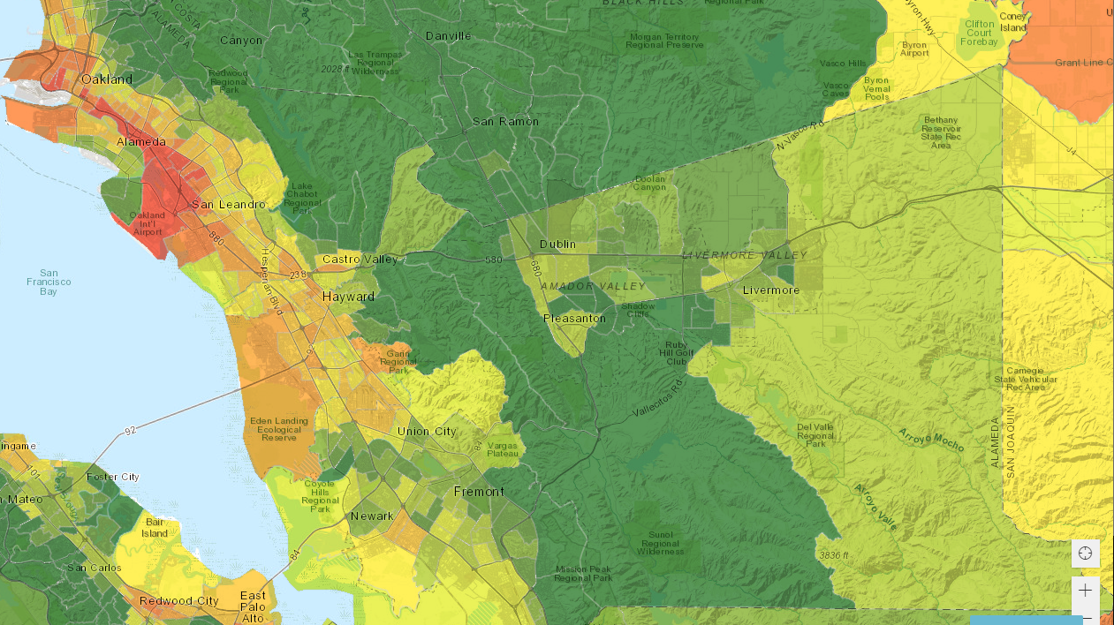
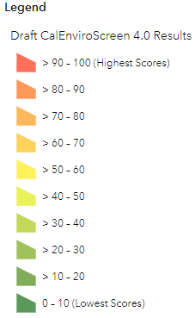
Distribution of Cumulative Burdens
38 Disadvantaged Census Tracts in Alameda County By statewide ranking |  | Percentage
Oakland | 32 | 84%
San Leandro | 3 | 8%
Union City | 1 | 2.6%
Berkeley | 1 | 2.6%
Alameda | 1 | 2.6%
Draft CES 4.0 results: Cumulative Score includes Lead Risk
Source: OEHHA

Slide 12
Census Tracts Ranked by Lead Risk
With No. of Lead Poisoned Children & Cumulative Impact Ranking
Census tracts in East Oakland rise to the top of these three vulnerability indicators, which include metrics for poverty, pre-existing conditions, and age of housing units.
Prioritizing vulnerable communities
Census Tract | ZIP | Neighborhood | City | Lead Pctl | Observed EBLL | Draft CES 4.0 Percentile
4086 | 94605 | Bancroft/Havenscourt 2 | Oakland | 99.85 | 18 | 65.16
4074 | 94601 | Fremont | Oakland | 99.53 | 14 | 77.52
4091 | 94603 | Brockfield Village | Oakland | 99.43 | 5 | 95.83
4075 | 94621 | Seminary | Oakland | 99.37 | 23 | 82.37
4088 | 94621 | Havenscourt/Coliseum | Oakland | 98.99 | 31 | 97.48
Census tract 4088 (Havenscourt/Coliseum)
Ranked in the top 5% of CES 4.0
31 children were found to have lead poisoning between 2014-2017 (CSA)
Life expectancy is 73 years (ACPHD)
Social Vulnerability Index is 0.96 (out of 1) (CDC)
These indicators also demonstrate the importance of not relying solely on BLL data to identify areas for intervention. Use of additional metrics can allow intervention even before exposure occurs.
For example, a census tract with high lead risk and high cumulative burdens but low numbers of Lead Poisoned children, such as 4091 (Brockfield Village) should be an area of focus for targeted lead testing efforts in coordination with community members and community based groups.

Slide 13
Desired Future Outcome
Factors that drive lead hazard impacts and related racial disparities will be addressed through a new lead hazard abatement program with proactive, targeted strategies that meet the needs of the most at risk communities.
A lead hazard abatement program that meets and exceeds primary prevention standards
Equitable governance, community oversight and transparency
Prioritization of communities most impacted by lead risk racial disparities through a geographically phased approach
Ensure strong anti-displacement measures, including funding for tenant relocation and assistance for low-income/affordable housing providers
Comprehensive data collection including measures of impacts of the program disaggregated by race/geographic proxy

Slide 14
Equity Elements
Proactive Inspections Prioritizing Vulnerable Communities
Improve ongoing ability to screen for and eliminate lead hazards through proactive approaches;
Prioritize focus on areas and populations most likely to live in high risk dwellings, primarily low-income residents of older dwellings built before 1978;
Fund rehabilitation and repair activities, including grants/loans for low-income homeowners who provide affordable housing;
Transparency & Oversight
Compile a database of all lead hazards identified within the City of Oakland. Maintain comprehensive and up-to-date records on lead hazards and rehabilitation and remediation efforts;
Oversee and monitor lead abatement efforts to ensure identified hazards are remediated in a timely fashion;
Anti-Displacement
Ensure strong tenant protections and support landlords in providing temporary relocation assistance for tenants;
Workforce Development & Small Business Pipeline
Support workforce development to increase opportunities for members of at-risk communities;
Increase training, certification, and opportunities for small local businesses;
Increase visibility of small local businesses with lead certifications
Public Education & Targeted Outreach
Make education about lead hazards, remediation, and lead testing more widespread and accessible, especially in at-risk areas;
Periodically collect qualitative data on priority community needs in underserved areas; and
Ongoing Equity Evaluation of progress toward addressing lead hazards and closing racial disparities.

Slide 15
Equitable Funding
REIA’s independent evaluation of the quantitative data on racial disparities reveals that around 70% of the most vulnerable census tracts in Alameda County are located in the City of Oakland.
The City is positioning to implement Oakland-specific lead risk abatement equitably in coordination with its Code Enforcement.
Addressing the lead hazards in Oakland may require closer to 60-70% of funding available for lead hazard abatement.

Slide 16
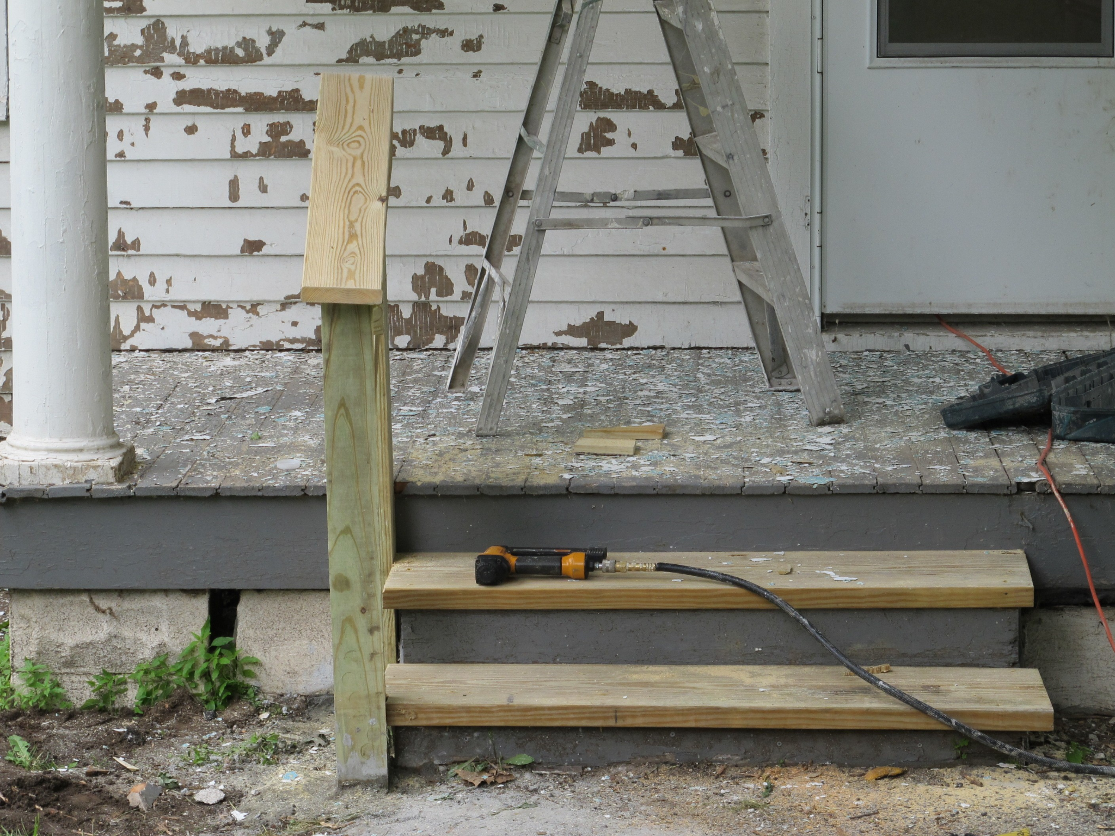
Extreme Concentrations of Risk Disparities in Oakland Require a City Equity Focused Approach
The City’s equity approach will track outcomes and impacts on addressing disparities.
Is anyone better off/did the work make a difference?
Answer the questions:
How would I know if this solution worked?
What is the intended impact?
How would I know if anyone is “better off” as a result of it/it made a difference?
Articulating meaningful measures is the difference between doing business as usual, which has produced racially inequitable outcomes for generations, and being accountable for the impact of our work to fulfill Oakland’s commitment to equity.

Slide 17
City of Oakland Action Areas
Ground truth program design options with community most impacted by unsafe housing conditions;
Identify at-risk areas and vulnerable populations using indicators that demonstrate high levels of burden across multiple issues (increased likelihood of exposure to lead hazards, susceptibility to the impacts of those hazards, and limited capacity to take protective action);
Develop a methodology for prioritizing early and comprehensive proactive inspections and lead abatement activities in these areas. For example, a simple prioritization methodology could target priority areas for early abatement efforts that have high burdens on at least one indicator in each category (exposure, sensitivity, adaptive capacity);
Build and maintain a central mainframe to systematize data collection;
Design tenant protections are essential to any housing policy that contemplates improving the housing stock; the City program(PRIP & Lead Abatement) design will avoid and, at least, mitigate the unintended consequence of displacing tenants; and
Design Low-Income Landlord/Homeowner Assistance element to enable timely rehabilitation and repair; and
Stand up targeted workforce development – build out the Lead Abatement Workforce Training Program, which would “provide oversight of the training and development of a skilled workforce to provide lead abatement services, as proposed by the Oakland Workforce Development Board (OWDB).

Slide 18
City of Oakland Next Steps
The City proposes to issue an RFP for expert consultant to design City of Oakland technical abatement approach to meet State and Local requirements in the context of Oakland’s Place-Based Equity Goals.
1. Key stakeholders engagement
2. Best practice case studies that correlate with Oakland’s program objectives, administration
structure, and potential resources
3. Determining extent and scale of the program to meet specific annual performance metric
4. Analyze Oakland regulatory framework for any necessary adoptions, modifications, removals
5. Prepare final recommendation for program:
6. City administrative structure
Staffing,
Resources
Operating/implementation schedule

Slide 19
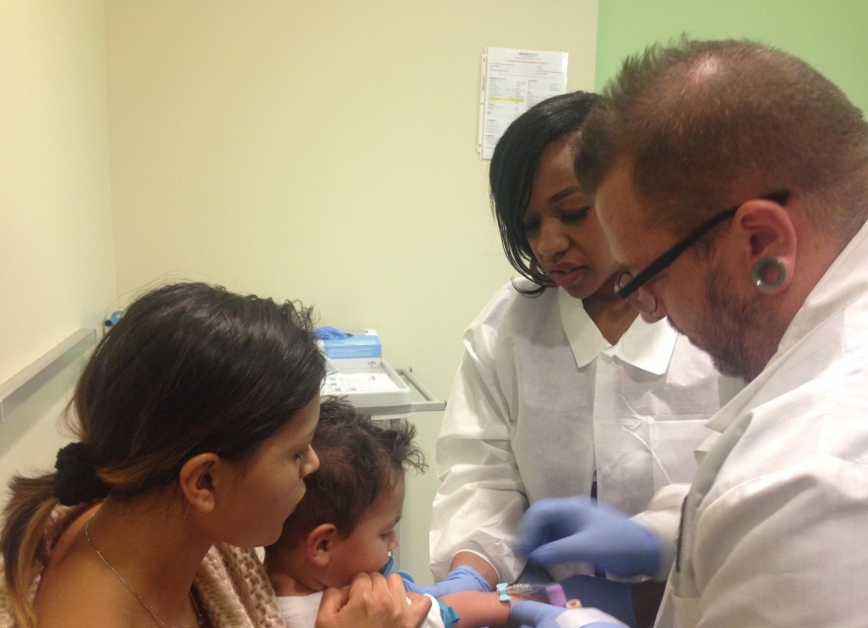
City/County Partnership Outreach and Testing Coordination
The City and County should coordinate to target priority populations and augment outreach efforts to include (a) verified pathways to testing; (b) certification or remediation assistance to ensure environmental inspections lead to abatement of lead hazards; and (c) early-intervention to protect children from lead poisoning.
Proactive Lead Testing. Aim for early and universal blood lead testing to enable early intervention developing new programs and tools to increase screening to ensure every child is tested as early as possible. Strategies include:
Partnering with schools and daycare centers to require and provide lead testing before children enter preschool and kindergarten. Mandatory testing can also be triggered by risk factors that might be able to catch lead problems before BLLs get too high;
Encouraging testing for all pregnant mothers in coordination with local health care providers;
For identified sensitive populations, such as low birthweight infants, inspect their homes for lead hazards and administer lead tests as proactive measures; and
Setting up temporary and/or permanent locations where parents in at-risk neighborhoods can get lead testing for their children. Testing sites could be set up at area schools using criteria for prioritizing the establishment of new testing sites. (Coordinate with OUSD).
Bolster Public Education and Targeted Outreach. Census tracts to target include (a) those with high numbers of lead poisoned children (b) where high percentages of children on Medi-Cal have not received testing.
Create Strong Partnerships. To the greatest extent feasible, partner with local community based organizations, especially those who work directly with community members and/or have a base of community membership.
Targeted Training. Focus on increasing RRP certification for DBEs and creating a pipeline of local businesses that can perform lead abatement.
Notes:
Credit Marissa Ortega-Welch/KALW
Anabel Razo holds her one year old son, Alex, while nurses at Highland Hospital draw his blood to test for lead.

