Slide 1


High Injury Network
2024

Slide 2
Outline
1. Introduction
2. Methodology
3. Maps by Mode
4. 2018-2024 Comparison
5. Geographic Distribution

Slide 3
Introduction
High Injury Network (HIN)
  Foundation for resource allocation decisions at OakDOT related to traffic safety:
    Capital Improvement Plan
    Complex Paving
    Project Development/Grant Applications
    Automated Speed Enforcement Pilot (AB 645)
  Key to Safe Oakland Streets (SOS) goals of reducing and eliminating fatal and severe crashes
  Identify highest density of most severe crashes; Fatal or Severely Injured (FSI)
  Communicate priorities with community

Slide 4
Methodology
ESRI GIS Consultant: “Sliding Window” analysis
  .5 mile segments (.1 added together)
Crash Weighting – 4 crash types: 1 (most severe) – 4 (least)
  Motor Vehicle (1,2 = 3pts; 3,4 = 0pts) – many more crashes overall
  Pedestrian and Bicycle (1,2 = 3pts; 3=1pt, 4 = 0pts) – fewer crashes overall
  Property Damage Only not included
Data Inclusion
  2017-2021 Transportation Injury Mapping System (TIMS)
    Mapped Statewide Integrated Traffic Records System (SWITRS)
  Previous 2018 map used 2012-2016
Post-processing/Quality Control
  Kept segments from 2018 HIN if there was a recent fatality, general cleanup
Notes:
2018 HIN –
HIN 2018:
https://cao-94612.s3.amazonaws.com/documents/ALL-HINs.pdf
used 2012-2016 crashes, 5 years from 2 years ago

Slide 5
Weighting
Crash severity | Weight – MV HIN | Weight- Bike/Ped HIN
Fatal | 3 | 3
Severe Injury | 3 | 3
Other Visible Injury | 0 | 1
Other Complaint of Pain | 0 | 0
Property Damage Only | 0 | 0
{
FSIs
Notes:
2018 HIN –
HIN 2018:
https://cao-94612.s3.amazonaws.com/documents/ALL-HINs.pdf
used 2012-2016 crashes, 5 years from 2 years ago

Slide 6
Sliding Window
CORRIDORIZATION | ITERATION
Half Mile Segments
Notes:
Take care around intersections where major arterials cross minor arterials

Slide 7
Strategies Summarized:
HIN Statistics
HIN Year | # FSIs on HIN | % FSIs on HIN | HIN Total Miles | % of Oakland Streets
2024 | 342 | 63% | 66 | 8%
2018 | 328 | 63% | 64 | 8%
Statewide “Safety Corridor” Requirements – 2023 CA MUTCD
- minimum 25% of Fatal or Serious Injuries (FSIs) captured
- 20% of overall network
- separated by mode
Notes:
Make more readable
2018 – 517 – 64%
2024 – 543 – 60%
844 total roads (centerline)
Typically more than 40%
Statewide Guidance on High Injury Networks - CaliforniaGuidanceHighInjuryNetwork_09022021_Final.pdf - All Documents (sharepoint.com)

Slide 8
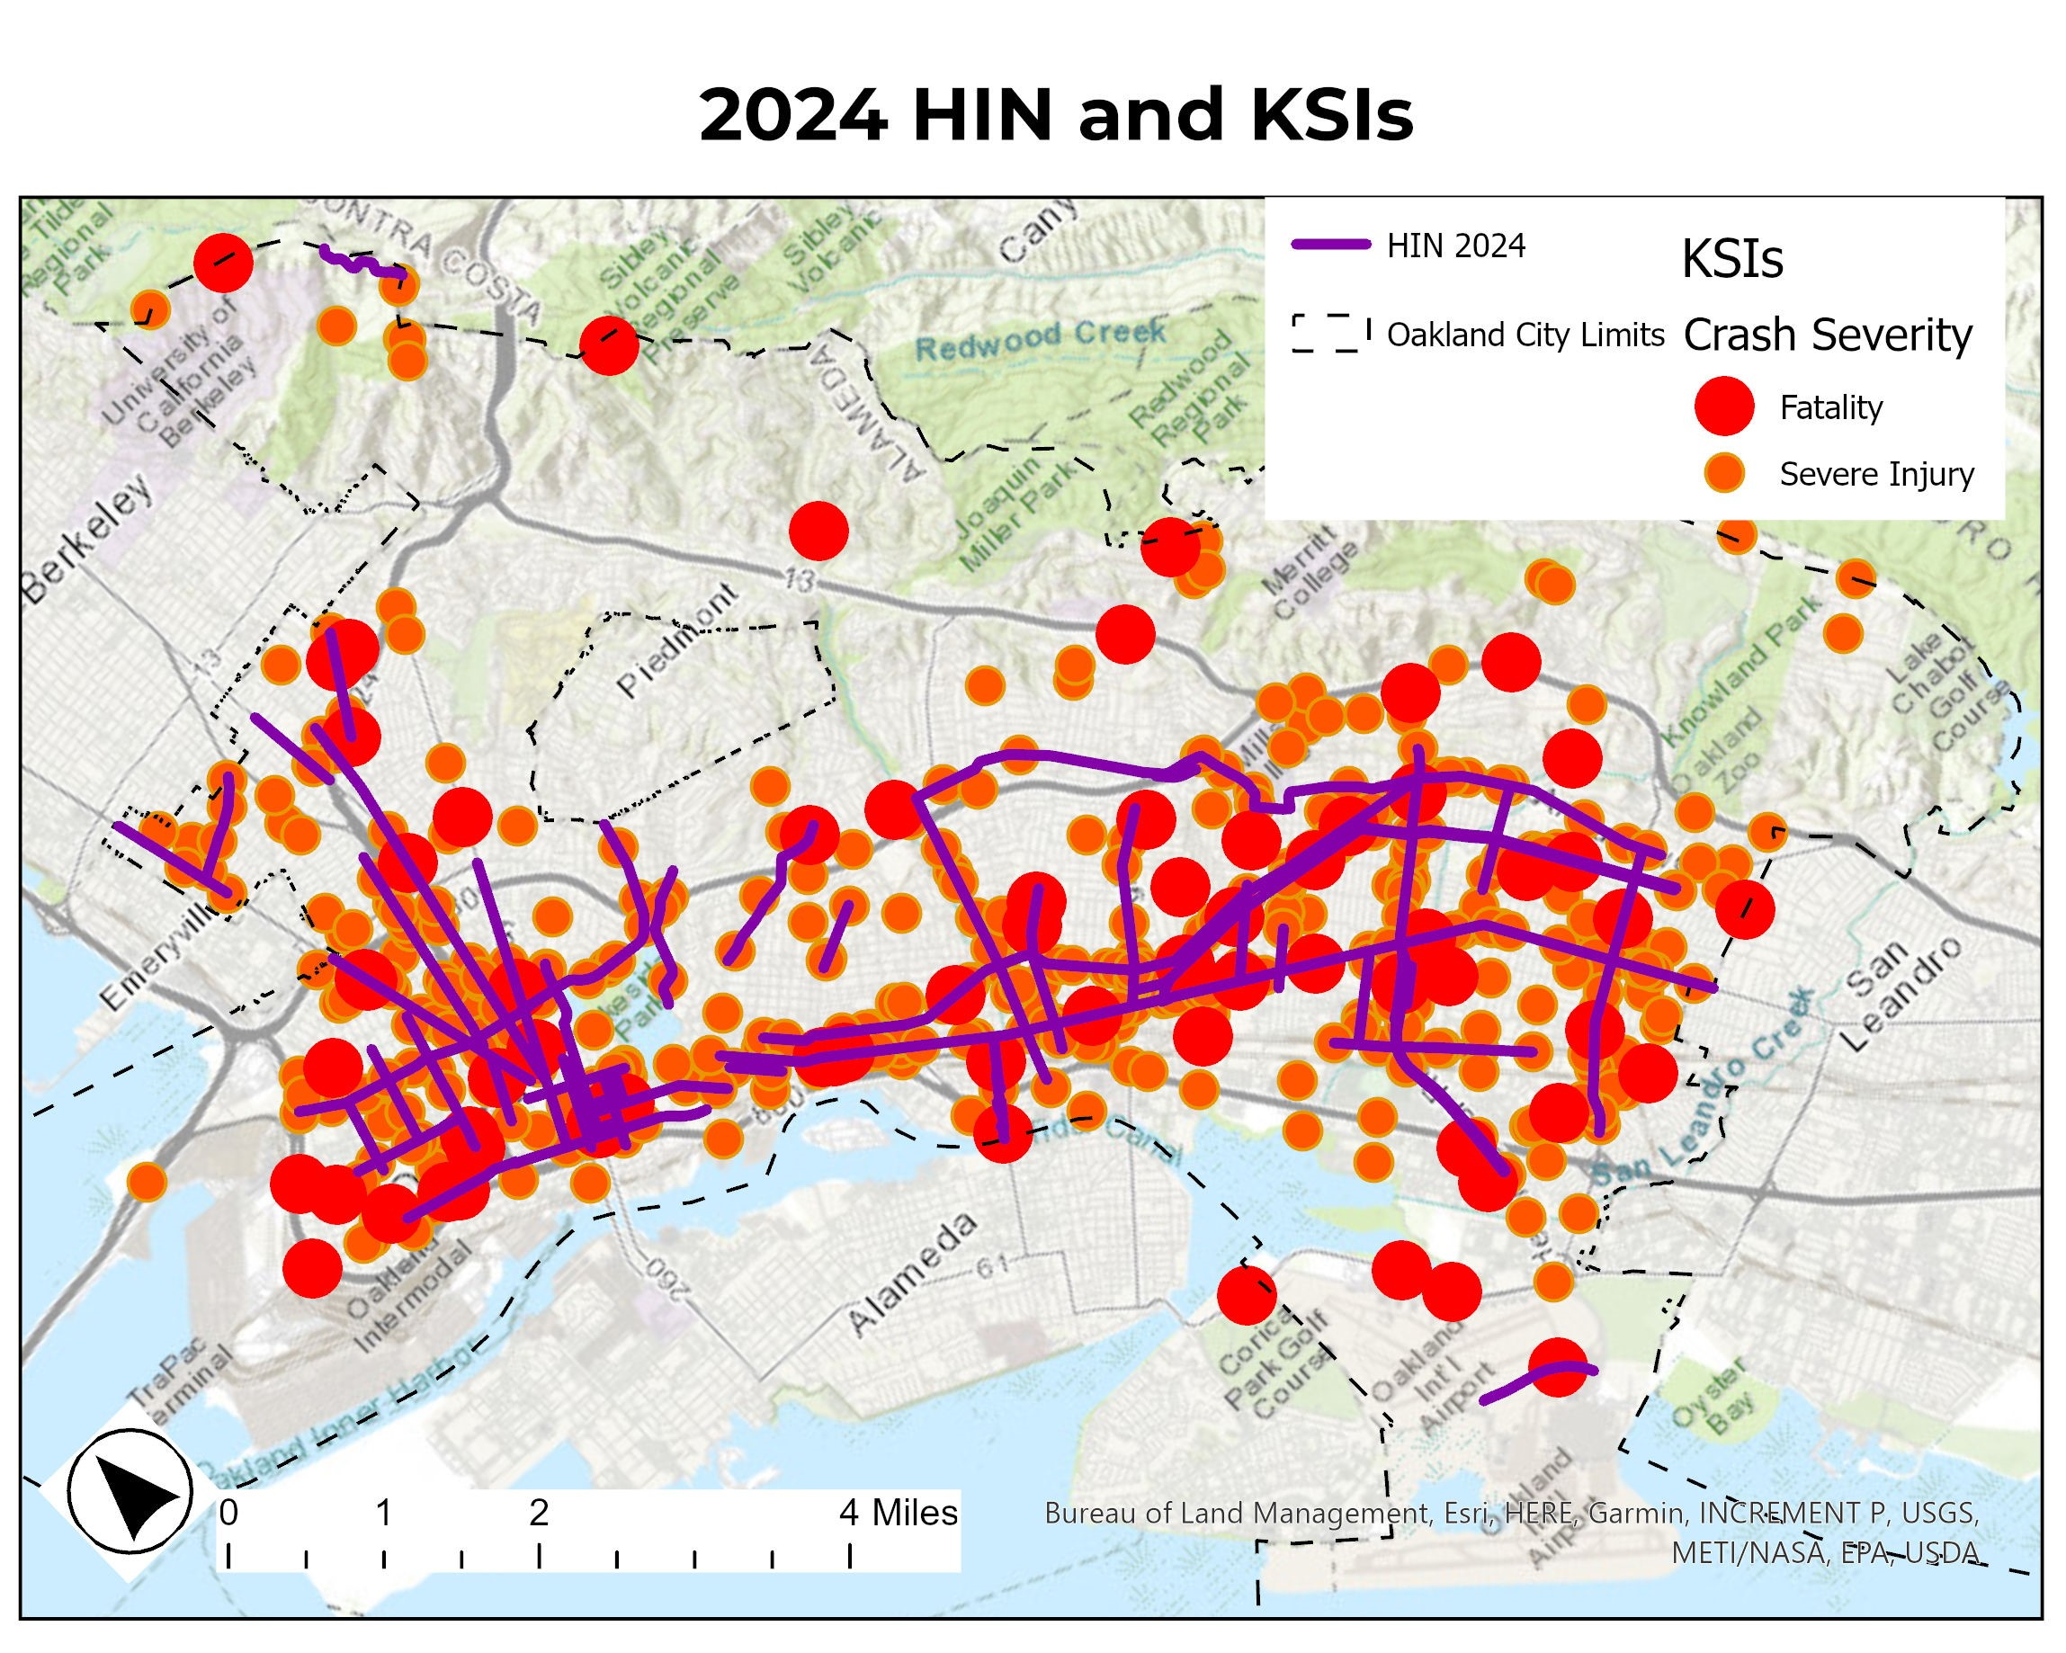
Strategies Summarized:
KSIs Captured
Notes:
Update
Alt text: Map titled: 2024 HIN and KSIs
Shows map of Oakland with Lines going through the flats and Red dots representing KSI crashes, legend shows Crash Severity, Fatality and Severe Injury. Lines and dots concentrated in East and West Oakland

Slide 9
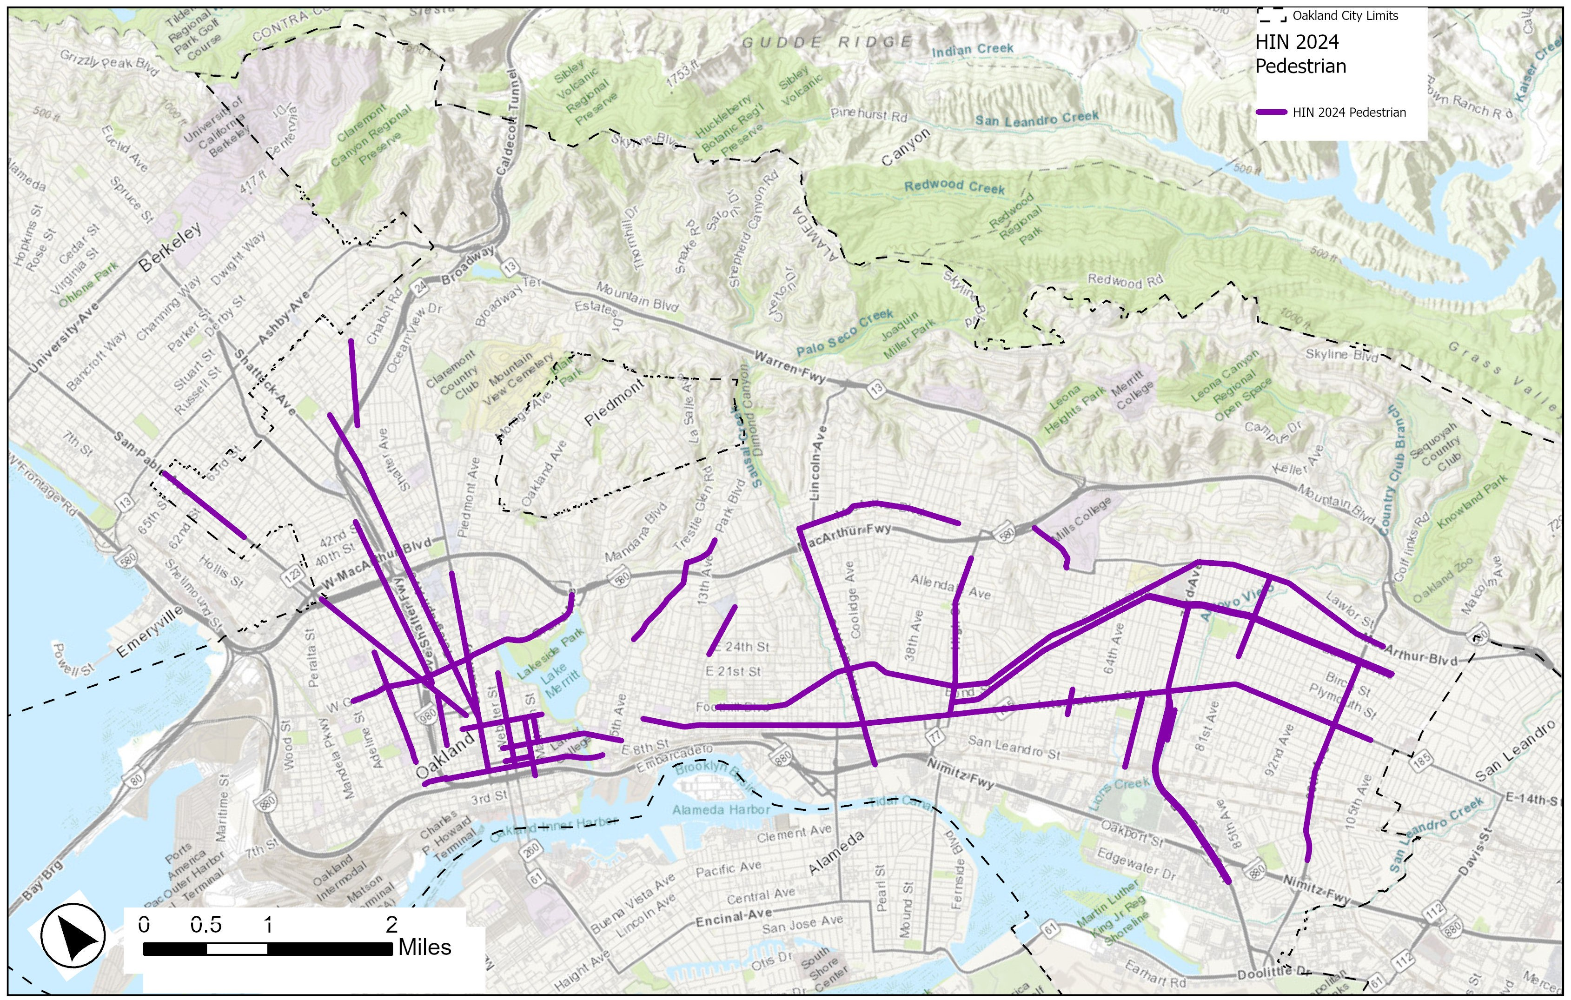
Strategies Summarized:
Pedestrian
Notes:
Alt-Text: Map showing 2024 Pedestrian HIN, lines densely concentrated downtown and in East Oakland. Prominent Streets are International, 98th, 73rd, Bancroft, Foothill, Macarthur in East Oakland and Telegraph and MLK in North Oakland. A web of streets downtown.

Slide 10
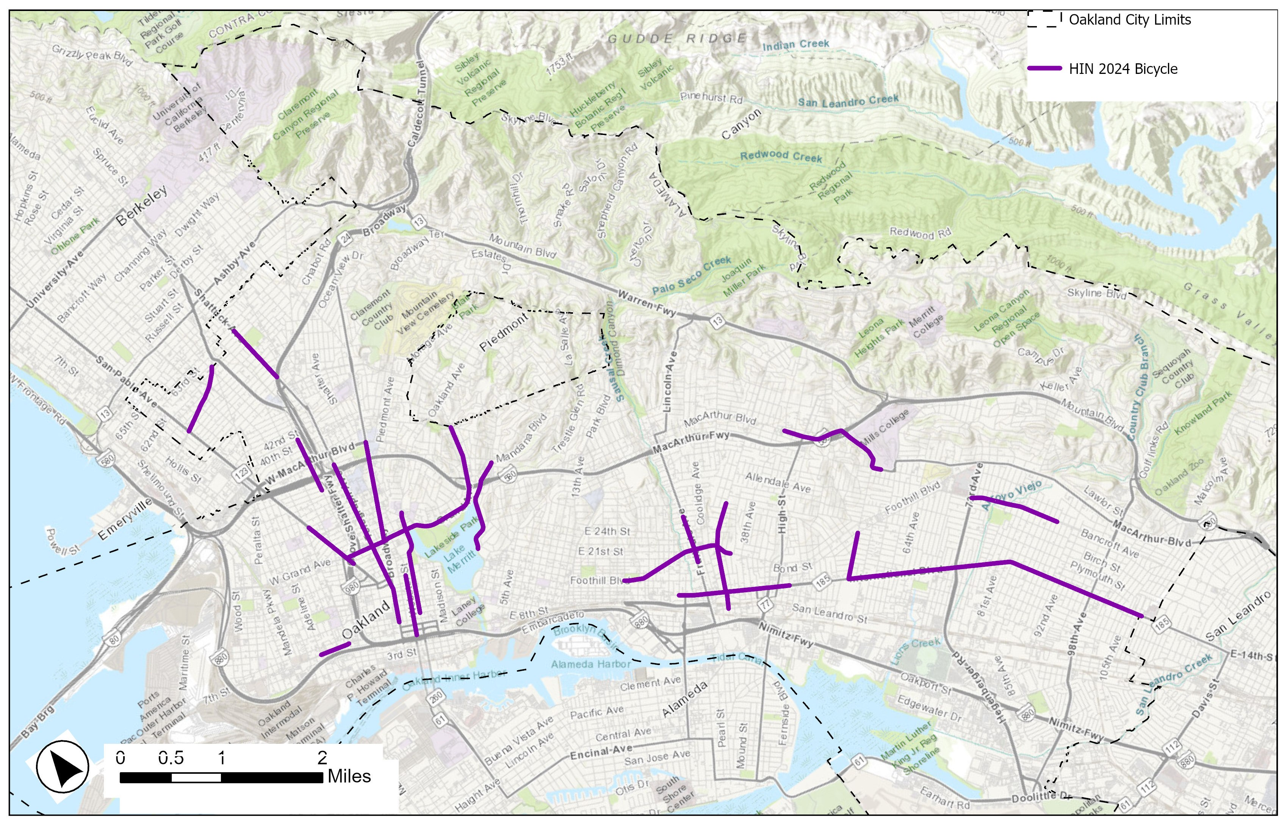
Strategies Summarized:
Bicycle
Notes:
Alt-text: Map of 2024 Bike HIN shows longer segments on International, Bancroft and 35th in East Oakland and Telegraph, Broadway, Grand and Shattuck further north

Slide 11
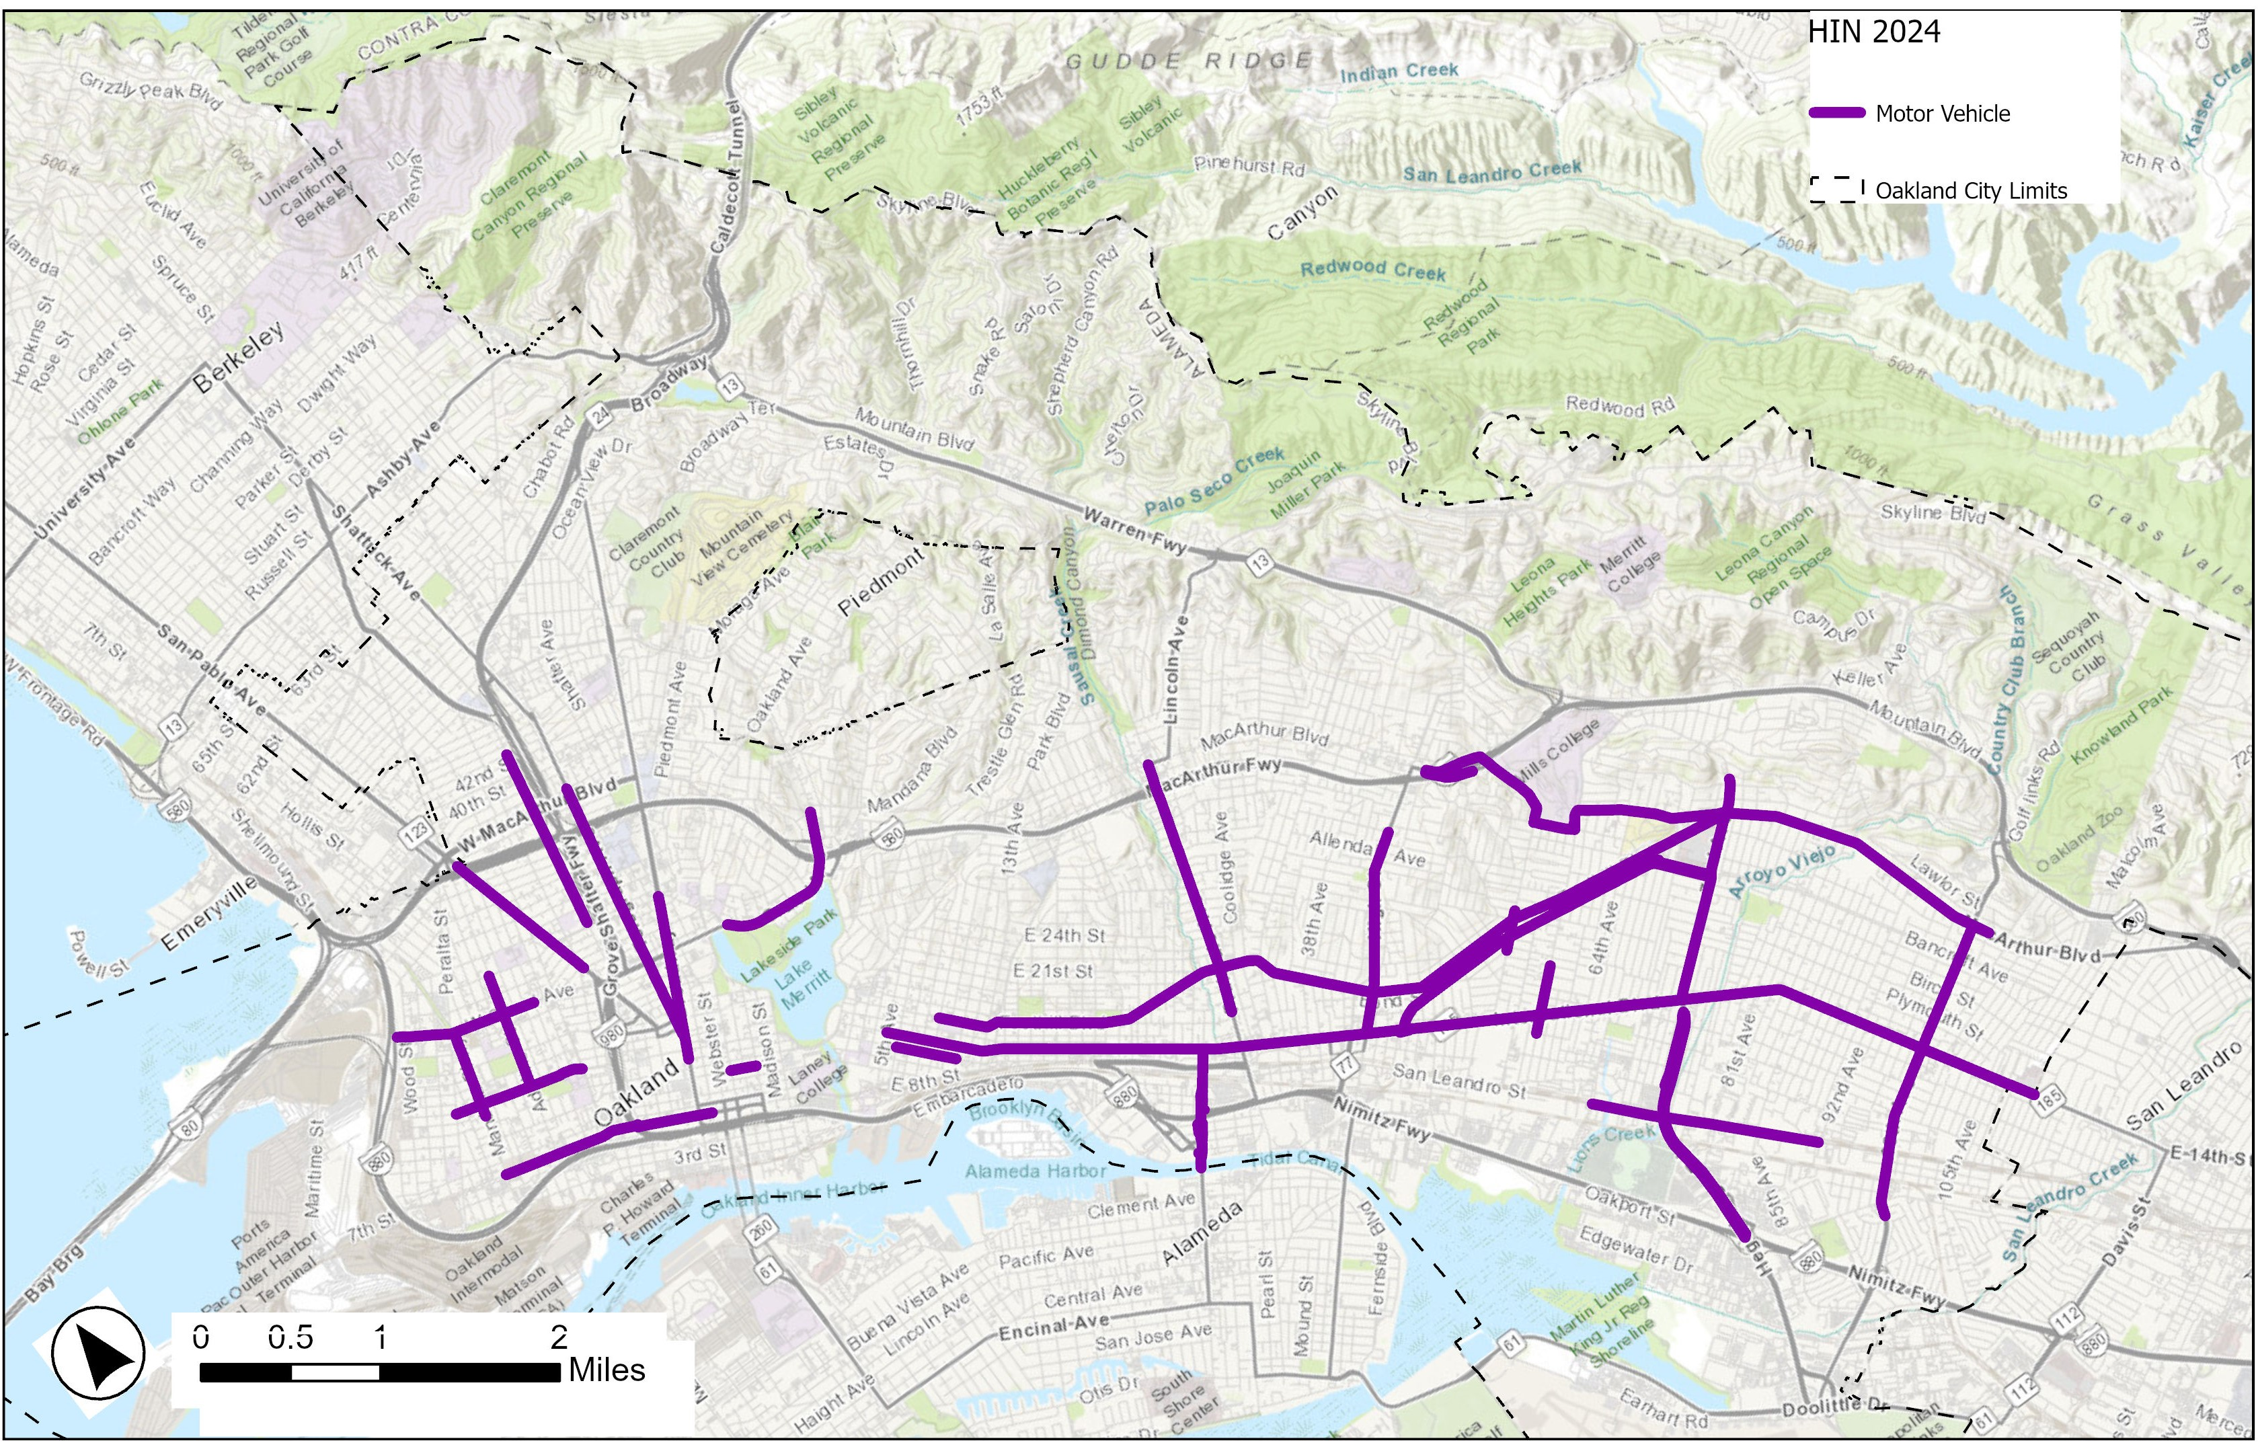
Motor Vehicle
Notes:
The MV HIN has the highest mileage, prominent streets in East Oakland are International, Bancroft and Foothill and Macarthur crossed by Fruitvale, High St, 73rd and 98th,

Slide 12
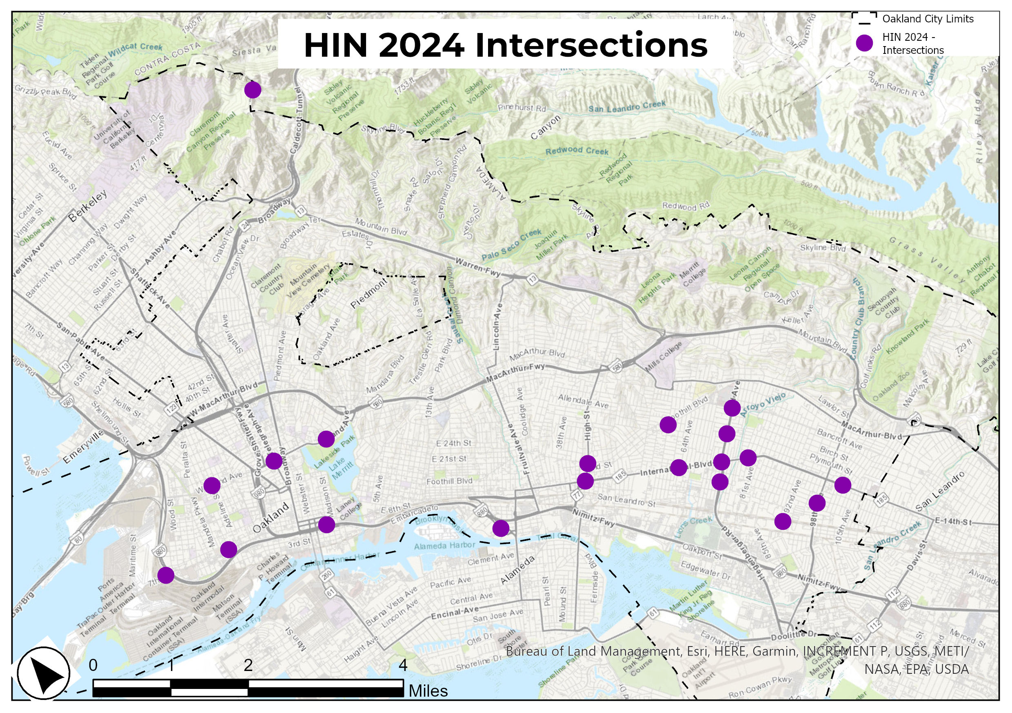
Intersections

Slide 13
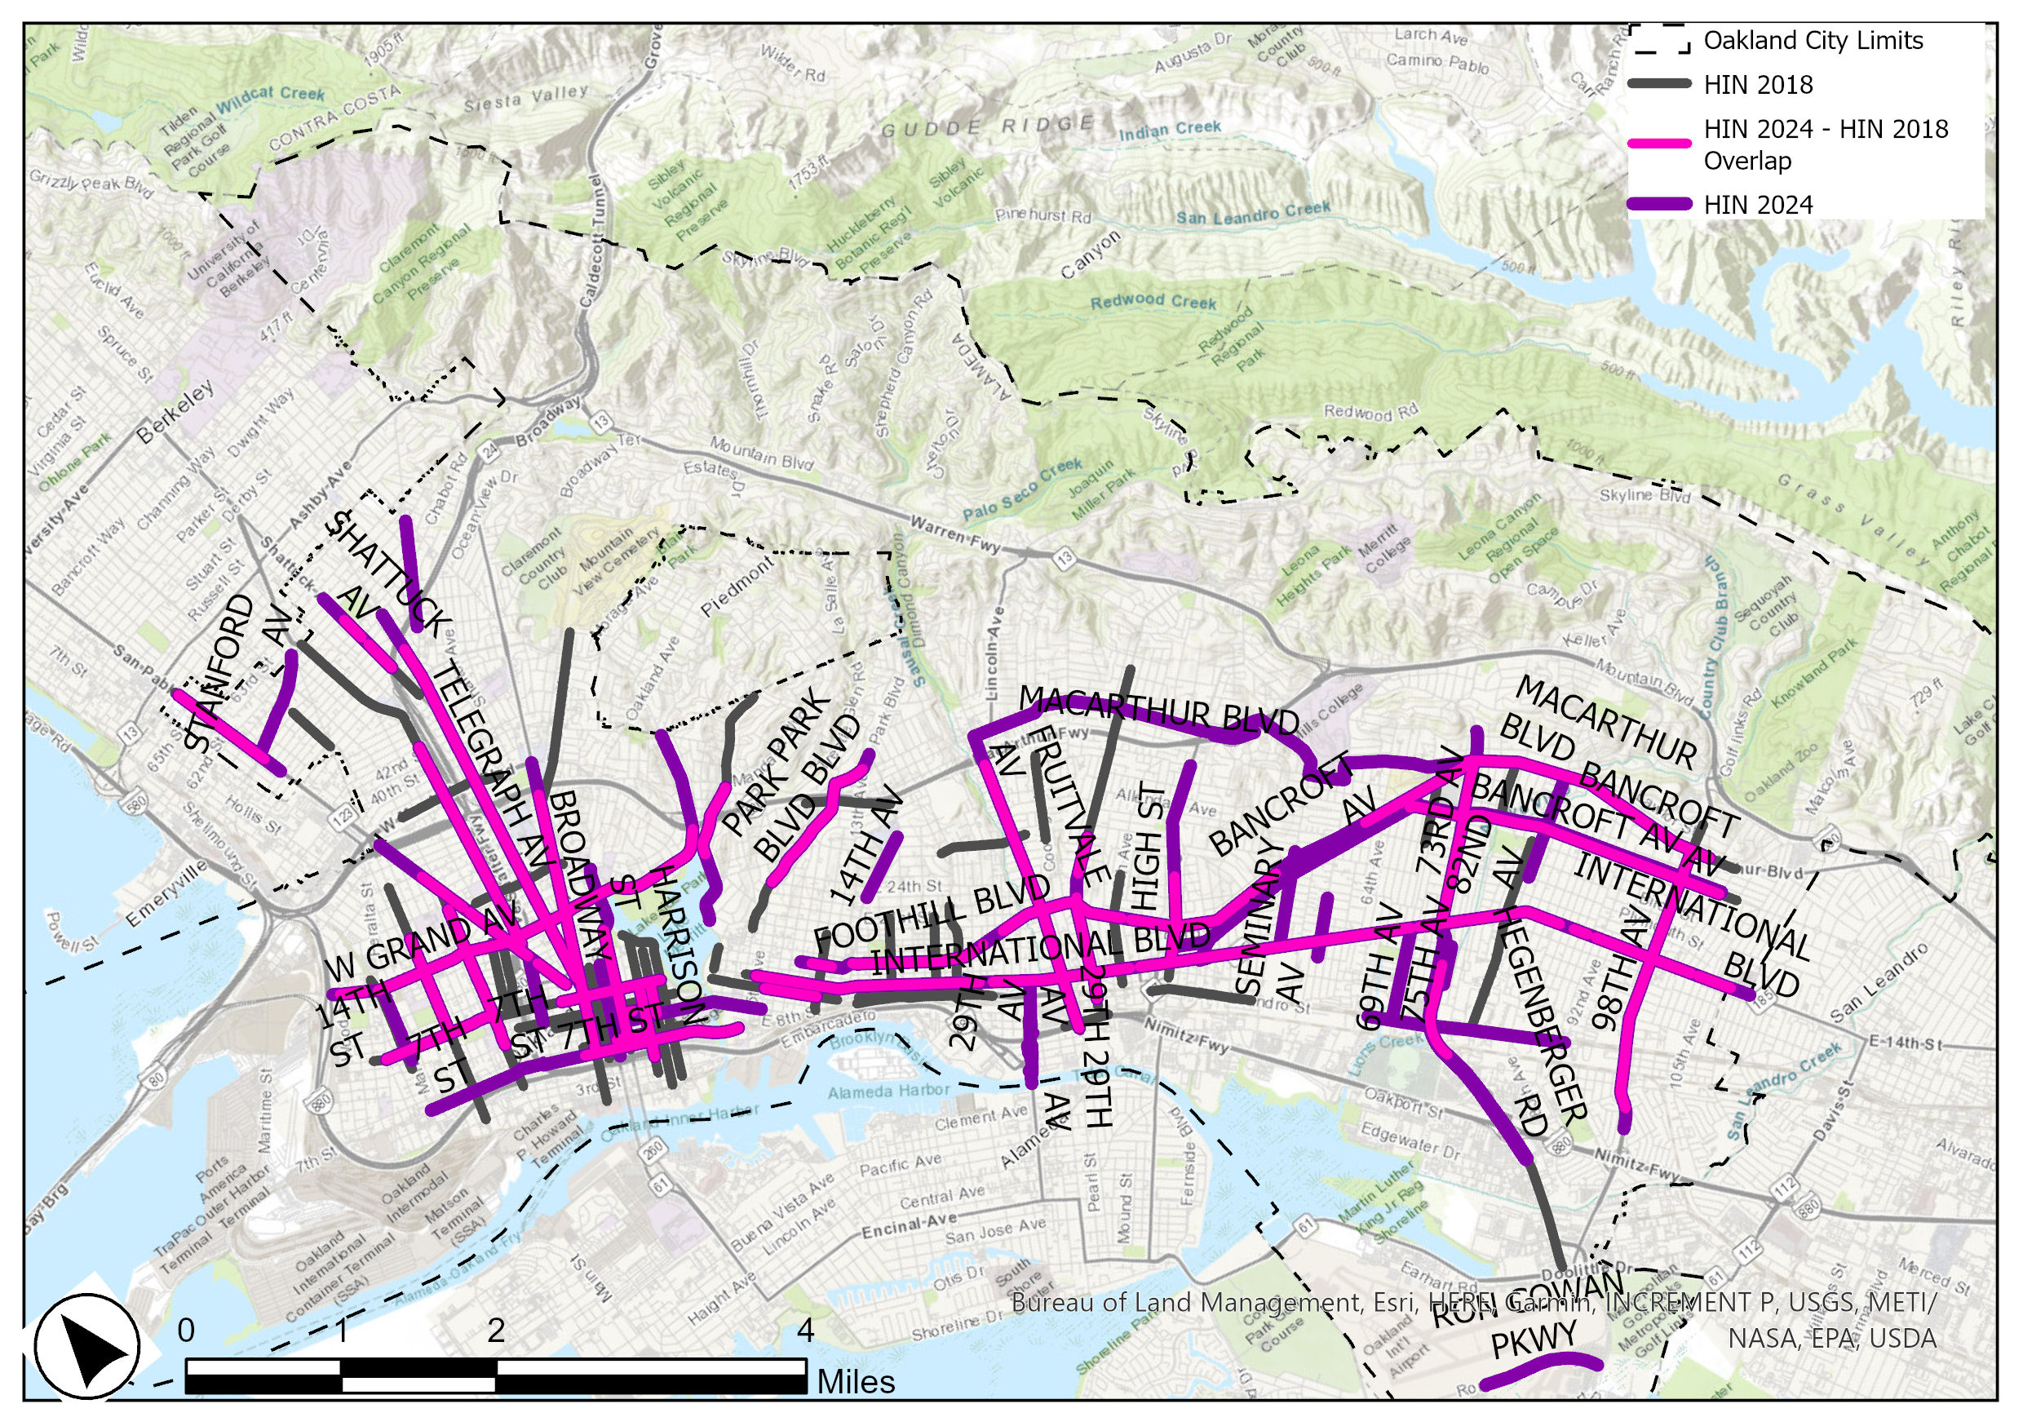
2018-2024 Comparison
 | HIN 2018 | HIN 2024 | Overlapping
Miles | 64 | 66 | 38
Notes:
Prominent streets added, 7th, Claremont, Macarthur, 85th , Seminary
lost Piedmont, Coolidge, 35th 81st

Slide 14
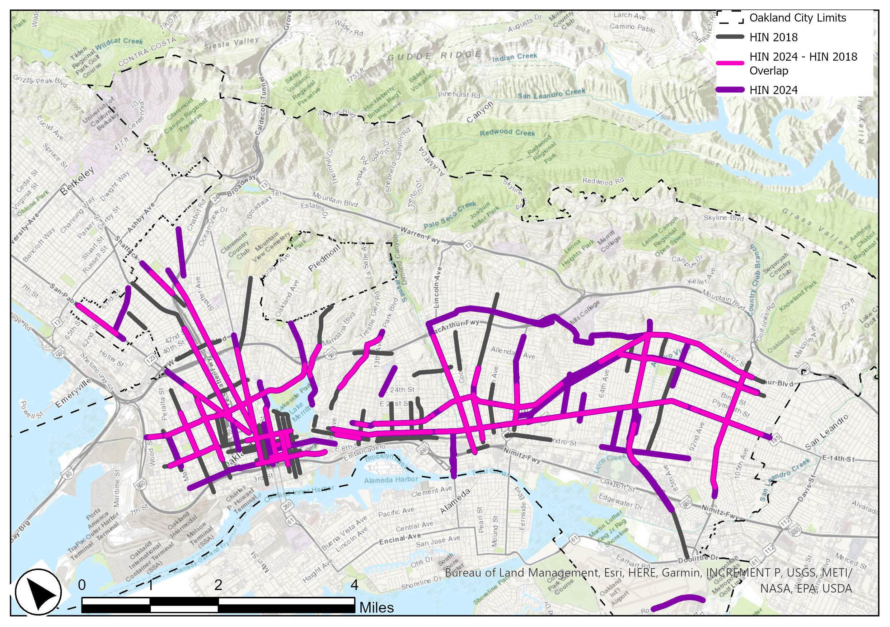
2018-2024 Comparison
 | HIN 2018 | HIN 2024 | Overlapping
Miles | 64 | 66 | 38
Notes:
Prominent streets added, Macarthur, 85th , Seminary
lost Piedmont, Coolidge, 35th 81st
^{Speed Survey 73rd Ave}

Slide 15
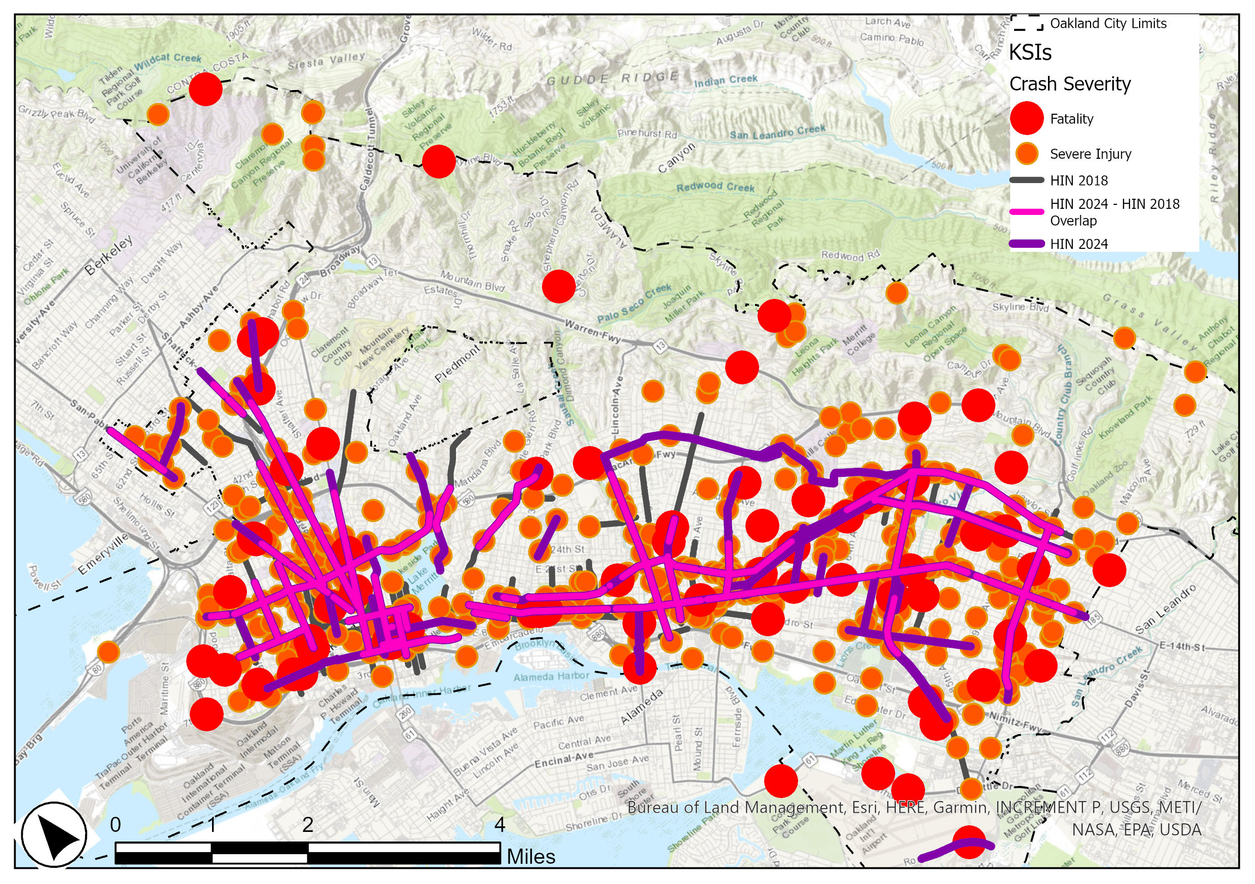
2018-2024 Comparison
 | HIN 2018 | HIN 2024 | Overlapping
Miles | 64 | 66 | 38
Notes:
Prominent streets added, Macarthur, 85th , Seminary
lost MLK, Piedmont, Coolidge, 35th 81^{st,}

Slide 16
2019-2024 Fatalities
Year | Fatalities NW of Lake | Fatalities SE of High St
2017 | 4 | 9
2018 | 2 | 7
2019 | 7 | 7
2020 | 7 | 13
2021 | 4 | 14
2022 | 7 | 15
2023 | 4 | 14
Notes:
Prominent streets added, Macarthur, 85th , Seminary
lost MLK, Piedmont, Coolidge, 35th 81^{st,}

Slide 17
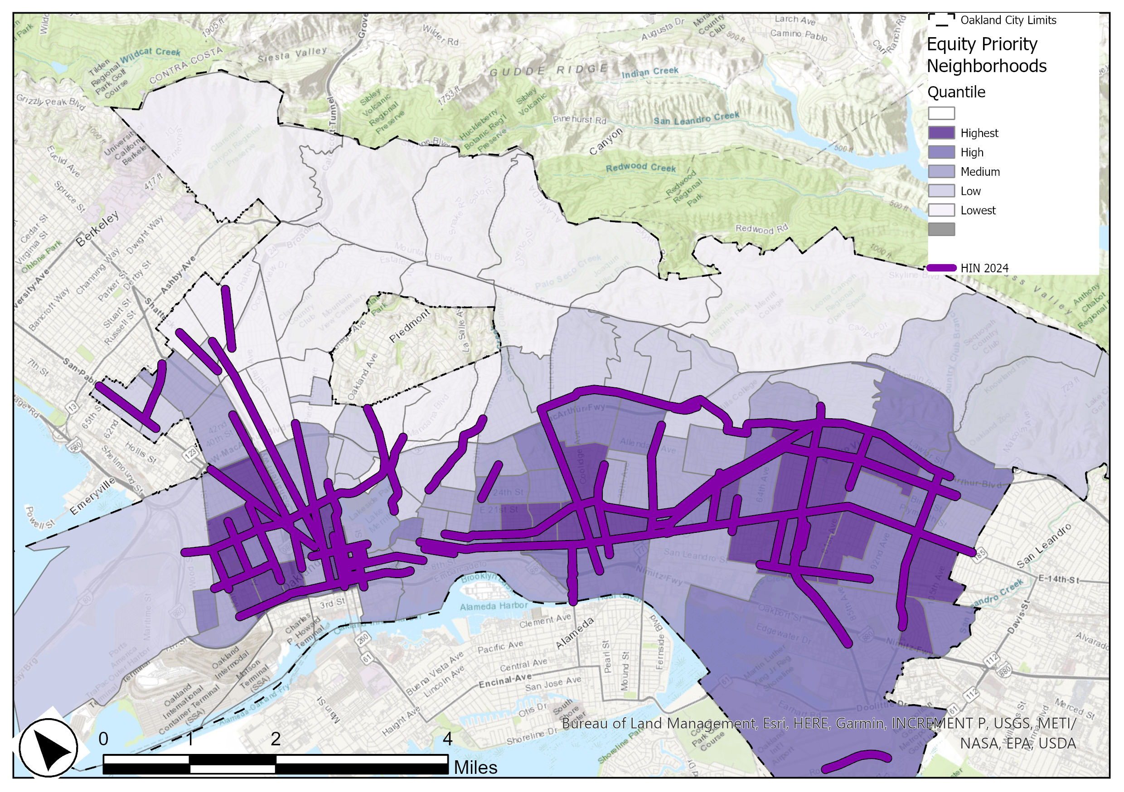
Strategies Summarized:
Priority Equity Neighborhoods
Priority Quintile | 2018 HIN Miles | 2024 HIN Miles | 2018 HIN % | 2024 HIN %
Lowest | 1 | 4 | 1% | 6%
Low | 3 | 7 | 4% | 10%
Medium | 13 | 13 | 20% | 19%
High | 21 | 17 | 33% | 25%
Highest | 26 | 26 | 41% | 39%

Slide 18
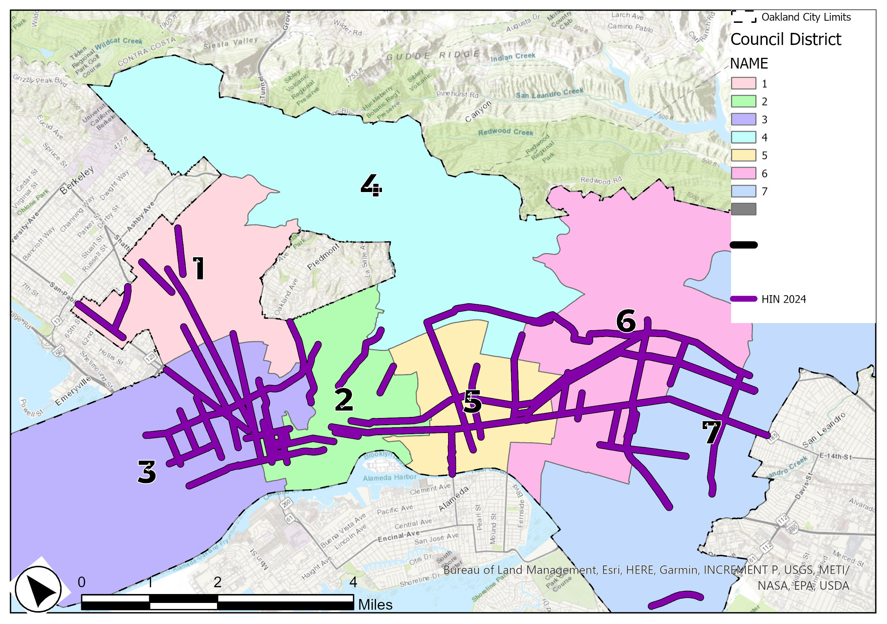
Strategies Summarized:
Council Districts
Council District | 2018 HIN Miles | 2024 HIN Miles | 2018 HIN % | 2024 HIN %
1 | 6 | 5 | 9% | 8%
2 | 16 | 10 | 25% | 15%
3 | 17 | 14 | 26% | 22%
4 | 1 | 3 | 2% | 5%
5 | 11 | 10 | 17% | 15%
6 | 7 | 14 | 11% | 22%
7 | 7 | 11 | 11% | 17%

Slide 19
Next Steps

Slide 20

Thank you!
More info & resources available at: www.oaklandca.gov/SOS
Megan Wier, Assistant Director, OakDOT

