Slide 1
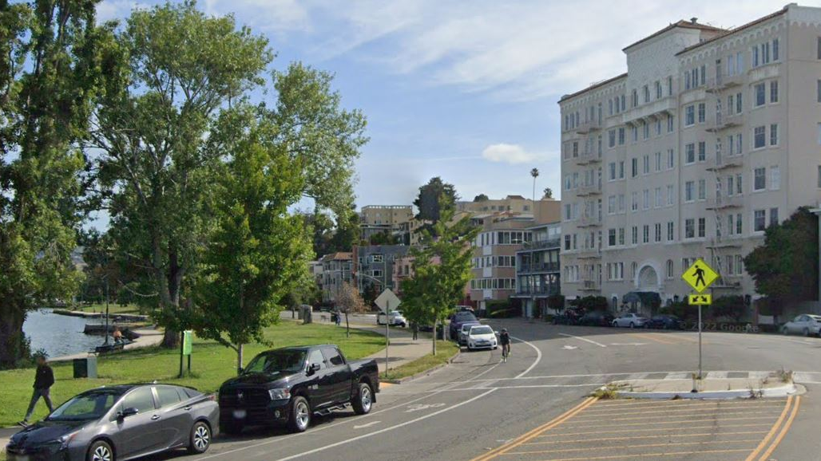
Lakeshore Avenue
Separated Bike Lanes Project
Presentation to PRAC Commissioners
July 31, 2024

Slide 2
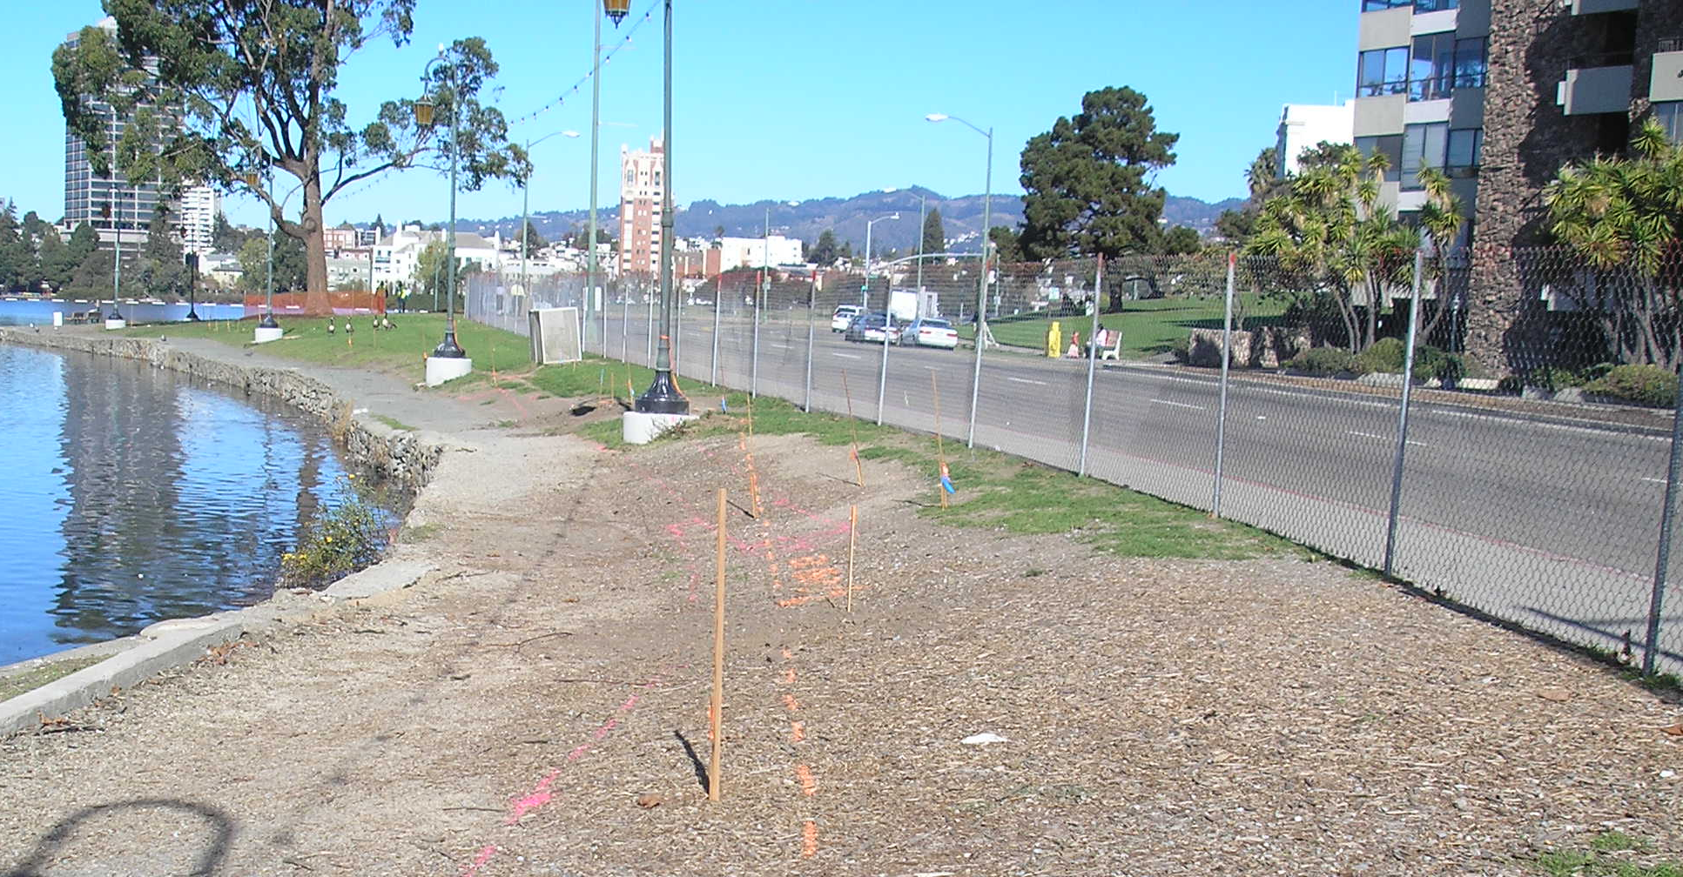
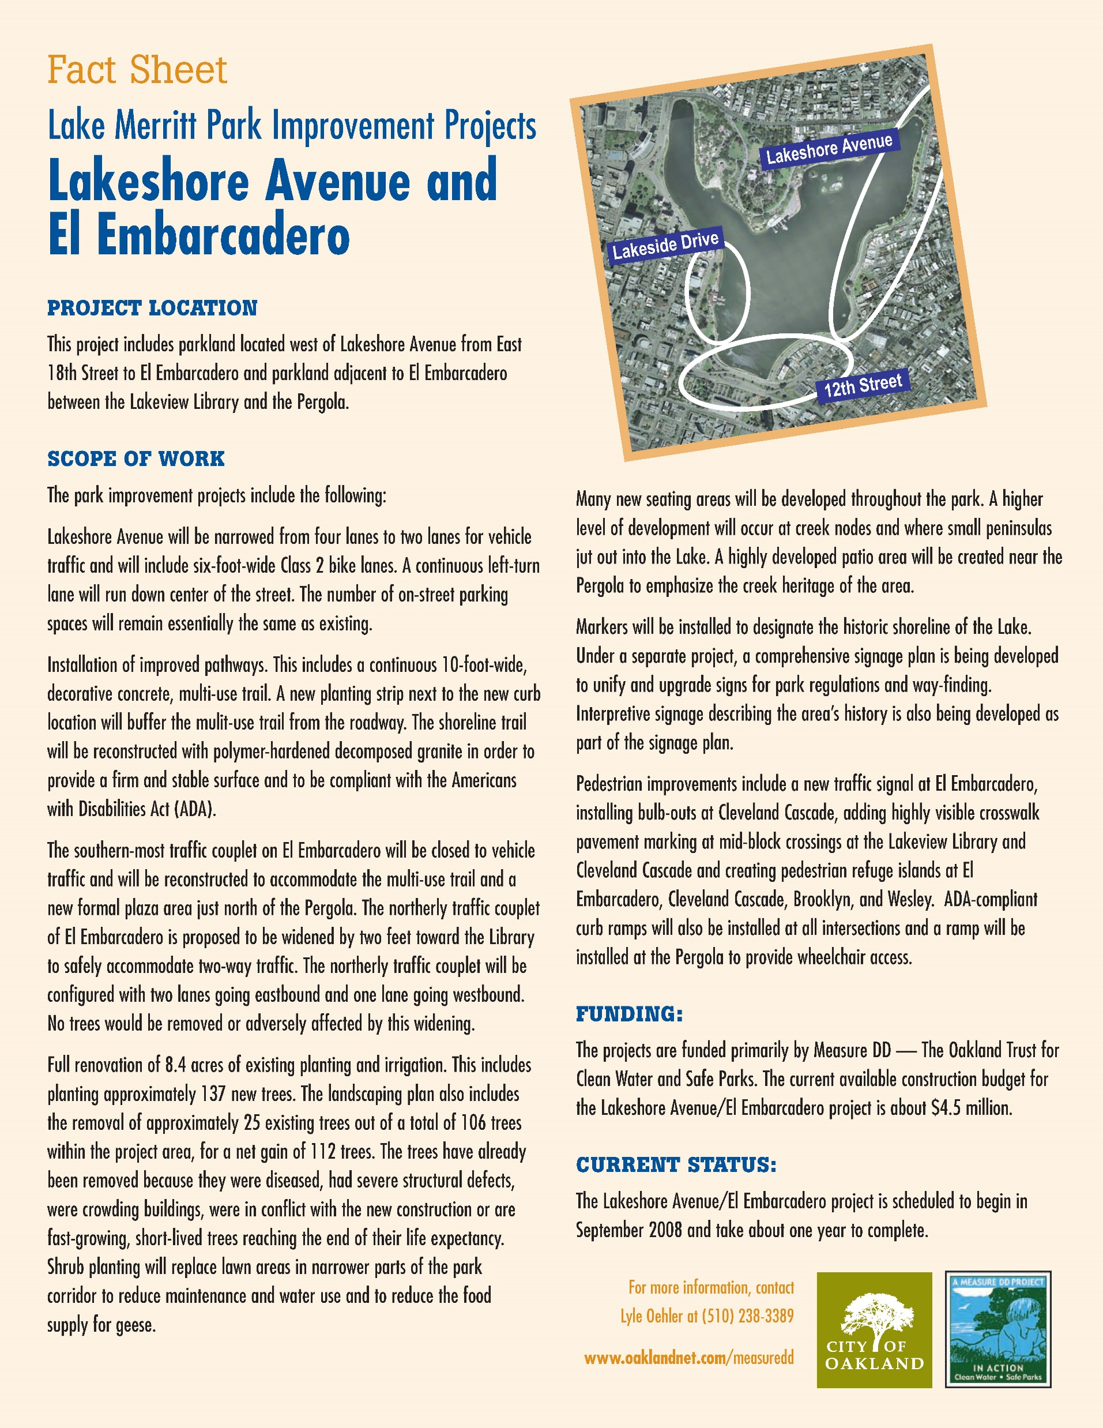
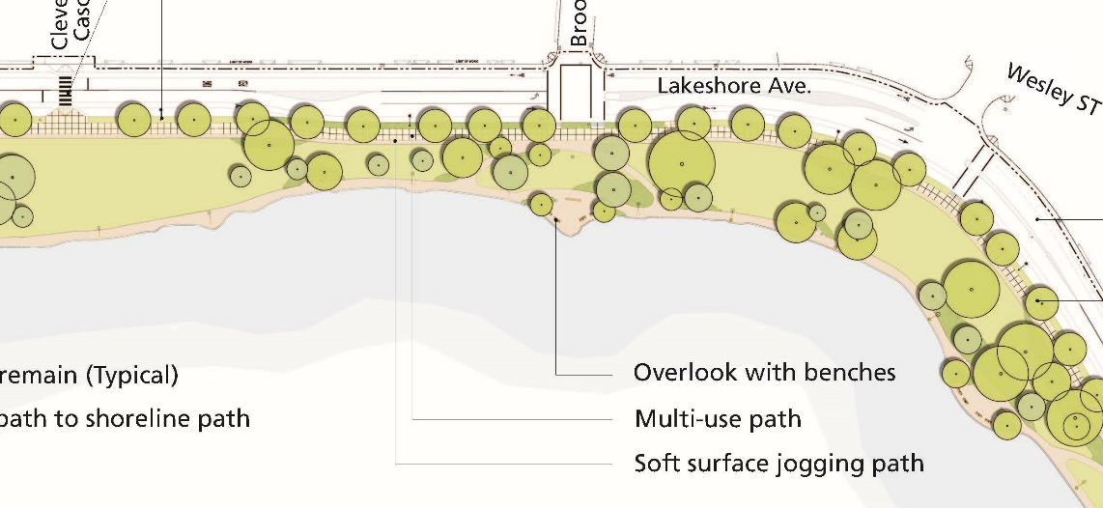
Background
Nov 2008
Notes:
Prior to 2008, Lakeshore Ave was a four lane road with a rough path along the lake edge. Measure DD funded road diet with center turn lane, 6-ft wide bike lanes, 10-ft wide concrete MUP, planting strip buffer, reconstruction of shoreline trail with polymer-hardened DG to comply with ADA.

Slide 3
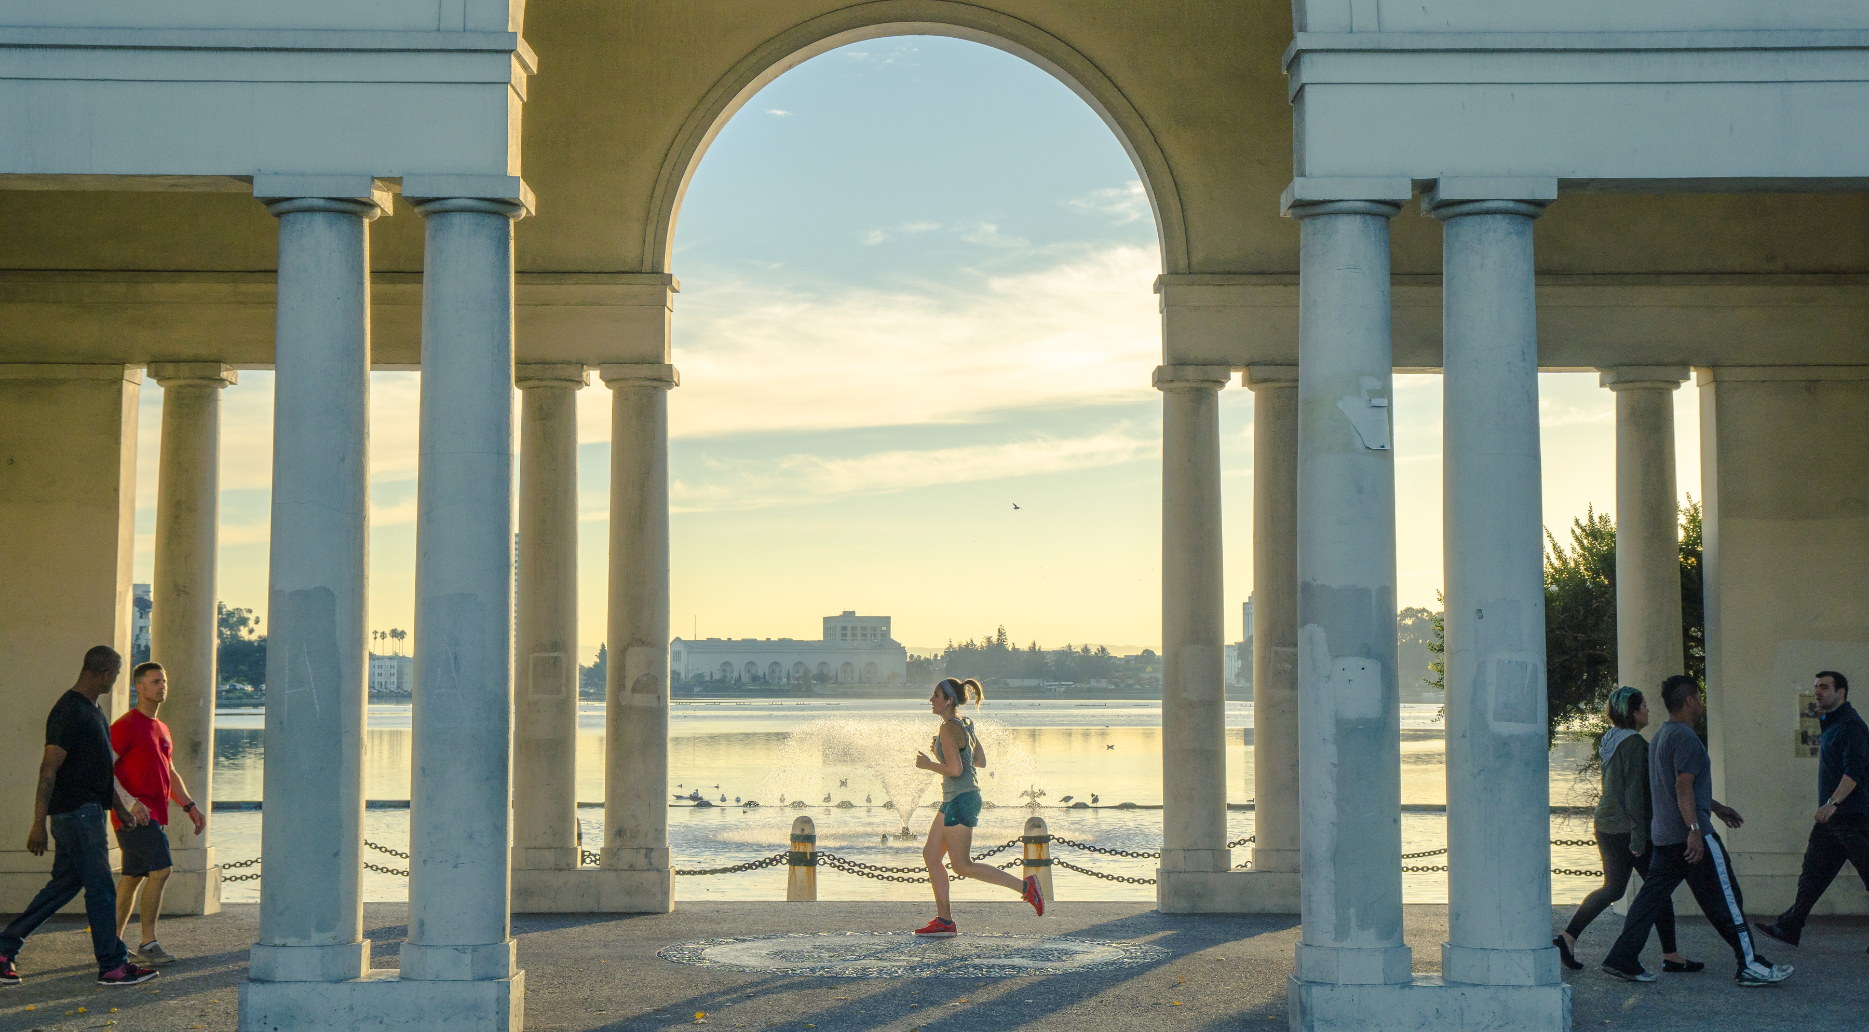
Lakeshore Ave is a Destination
“Lake Merritt is Oakland’s crown jewel, a place of extraordinary beauty where everyone feels at home.”
A well-loved spot grew even more popular during the height of the pandemic, bringing issues such as
Parking availability
Paid parking
Congestion
Road closures
Vending
Partying
Litter
Gentrification
Staff resources
OPD priorities
Notes:
A lot going on outside of transportation corridor. Closest thing we have to a malecón or promenade. Lake is a natural gathering spot. Pandemic made a popular spot even more crucial with other spaces closed. Broad citizen support for vending but also minimizing of large gatherings.
Street vending pilot Oct-Nov 2020, relocated to El Embarcadero; no longer allowed. March 2021 council approved array of rules. Parks Ambassadors pilot for weekends & holidays.
March 2023 parking meter enforcement starts, 3 years after first suggesting. $2/hr; used to be 3 hrs free.

Slide 4
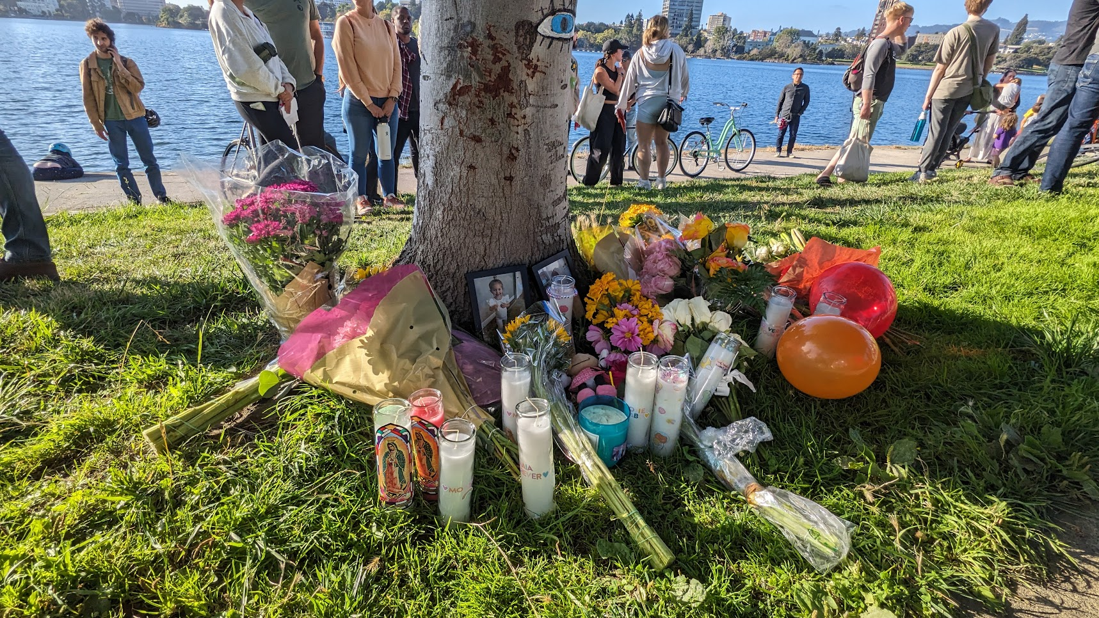
Tragedy, Urgency
Photo Credit: Kuan Butts
August 6, 2023
Four-year old Maia Correia and her father were bicycling on Lakeshore Ave when a driver opening their door into the bike lane caused them to crash.
Maia subsequently succumbed to her injuries.
Notes:
Many people read about this tragedy in the news, but I first heard of it when Maia’s grandmother shared her grief at the August 17 BPAC meeting. This picture is from the vigil held by Bike East Bay, Traffic Violence Rapid Response on Sep 6. We’re grateful that Maia’s family has joined the advocacy community in pushing for safety improvements.
They have spoken out in support of the project to prevent any further tragedies on Lakeshore Ave. It’s taken a highly coordinated effort across multiple departments in the City and multiple agencies to get this project in motion.

Slide 5
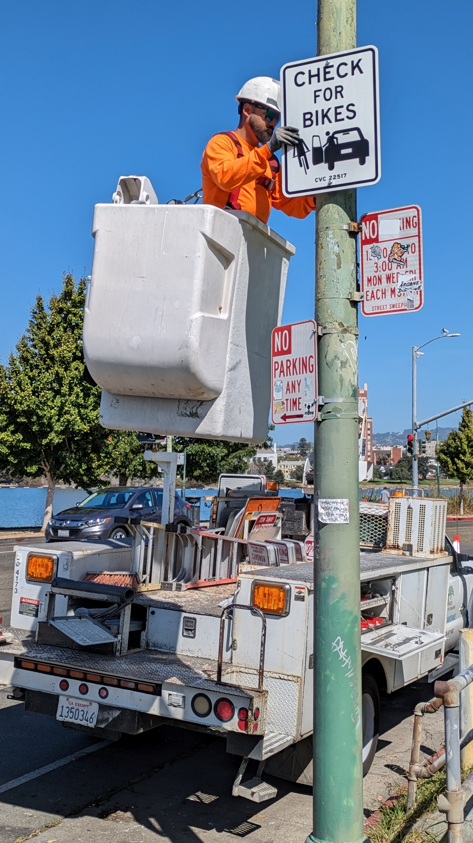


Rapid Response
OakDOT developed and installed signs reminding motorists to “check for bikes” before opening car doors per California Vehicle Code 22517
OakDOT is also acquiring stickers and window clings to hand out at outreach events.
Notes:
In immediate response to this tragedy, OakDOT developed and installed signs reminding motorists to “check for bikes” before opening car doors per California Vehicle Code 22517. The new signs are along Lakeshore Ave between E 18th St and Boden Way and were implemented by OakDOT’s Rapid Response Program that investigates all traffic crashes fatal to pedestrians or bicyclists and seeks near-term design solutions. We are also partnering with Albany Strollers & Rollers to produce window clings to remind people to be careful getting out of their cars. The clings will be in English, Spanish, Chinese, and Vietnamese and will be handed out at outreach events.
22517. No person shall open the door of a vehicle on the side available to moving traffic unless it is reasonably safe to do so and can be done without interfering with the movement of such traffic, nor shall any person leave a door open on the side of a vehicle available to moving traffic for a period of time longer than necessary to load or unload passengers.

Slide 6
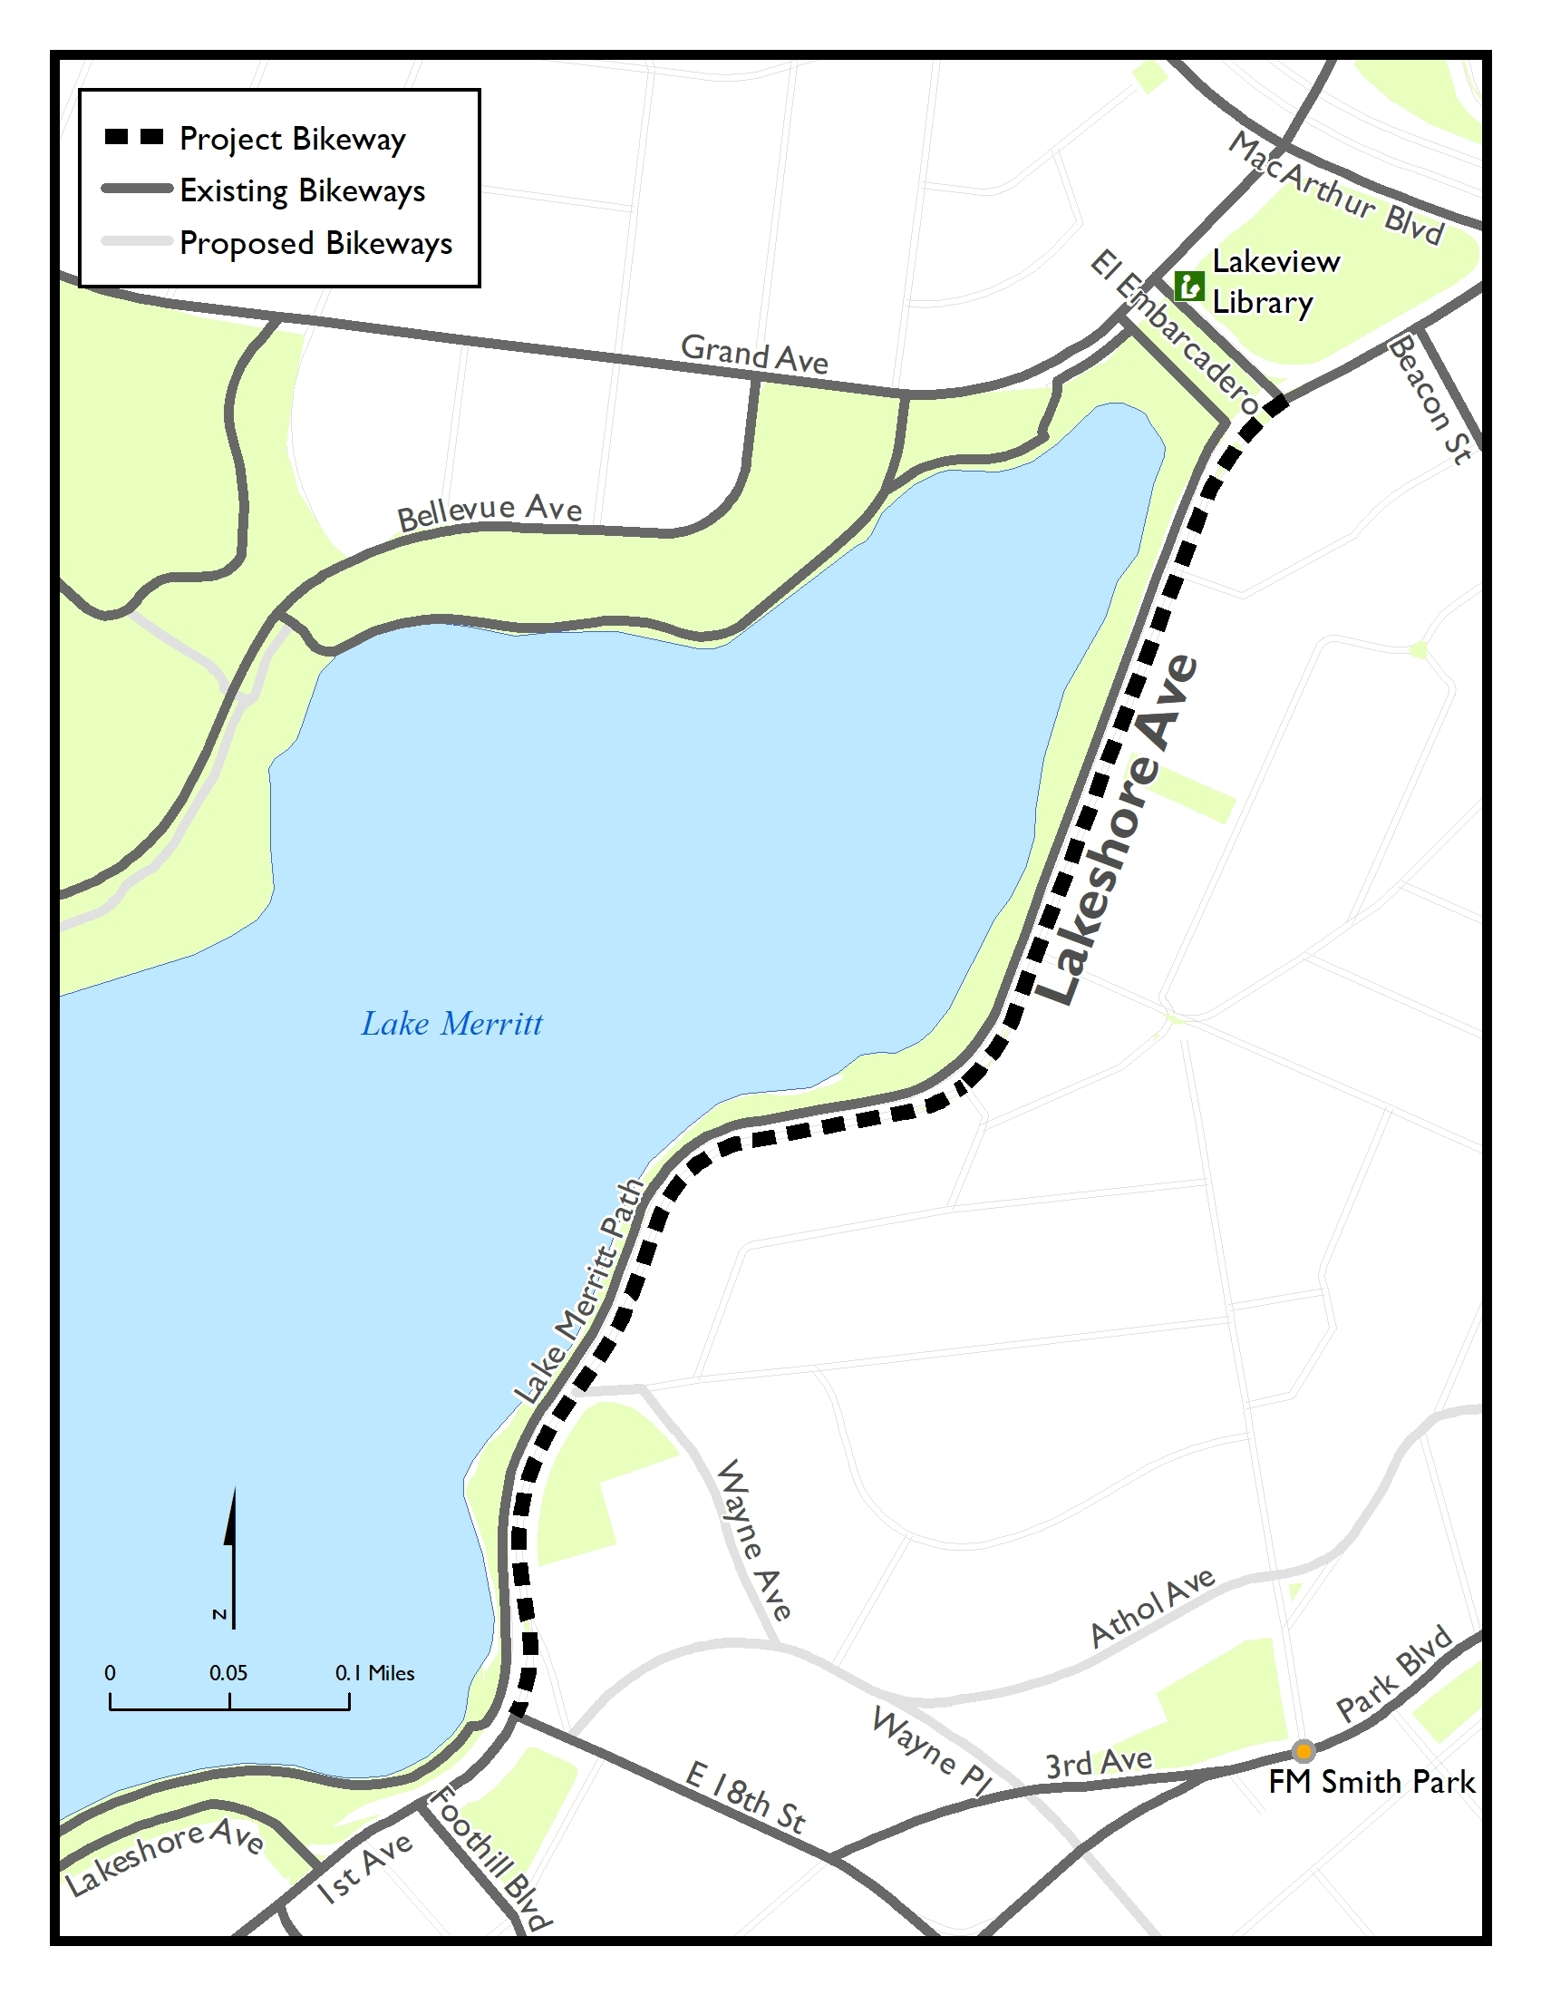
Overview of Current Effort
Separated bike lanes recommended in 2019 Bicycle Plan
Prioritized for resurfacing in 2022 5-Year Paving Plan
Coordination with EBMUD pipeline replacement project offers opportunity to start construction as soon as Fall 2024
Expected construction year: Expedited from 2027 to 2025
Project Goals:
  3 -> 2 lane road diet (removing continuous TWTL)
  Maintain turn pockets where beneficial
  Two-way separated bike lane on the lake side of roadway
  Improve pedestrian crossings (refuge and corner calming)
  Transit improvements including bus boarding islands
  Minimize impacts to parking & expand accessible parking
  Build a usable useable segment within scope of the near-term paving project
Status: Beginning detailed design
Ramping up community outreach
Notes:
Talk through how we got to current project, extents (shown in map), expected year of construction (and expediting two years), project goals and current stage.

Slide 7
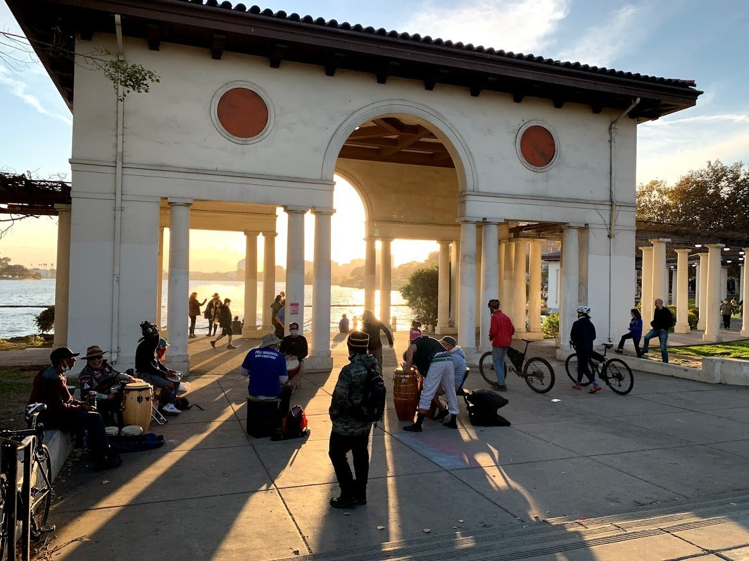
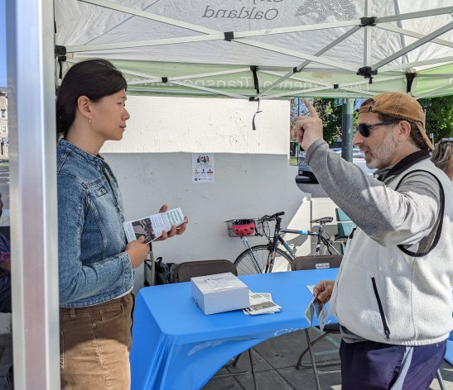
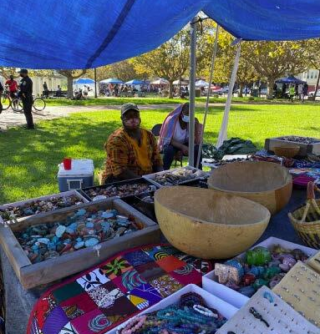
Community Outreach
Intercepts and Tabling
Community Meetings:
March 7: Bicycle and Pedestrian Advisory Committee (Infrastructure Subcommittee)
March 12: Cleveland Heights
Neighborhood Council 15X
March 18: Measure DD Community Coalition
Mailed information and
door-to-door outreach:
April
City and Partner Agency Meetings
April 2: Lake Merritt Working Group
June: Fire Department, AC Transit
July 31: PRAC Commissioners
Lake Merritt Pergola
Vendors
E 18th St Landing
(Photo: Roger Rudick, Streetsblog)
…and more
Notes:
I want to give you an overview of community outreach we’ll be performing in March and April. Even though this is a streets project we’ll also be impacting all the communities that access the east side of Lake Merritt, who have all of the concerns that I listed earlier—we want to make sure that the Lake can still be accessed by everyone.
We have a series of community meetings scheduled.
We met with BPAC and the Correia family last Thursday. It was attended by Bike East Bay and other advocates.
Today, we are here hoping to better understand some of your needs and your ideas about Lakeshore.
Next Monday, we’re meeting with the Measure DD Community Coalition, which was established back in 2003. These appointed community members were heavily involved with the 2008 improvements to Lakeshore and have a lot of knowledge and history around the lake in general.
The Lake Merritt Working Group was established in 2020 when the street vending pilot and parking meter program was first being established. This includes mostly city staff who have done work around the lake in the past few years.

Slide 8
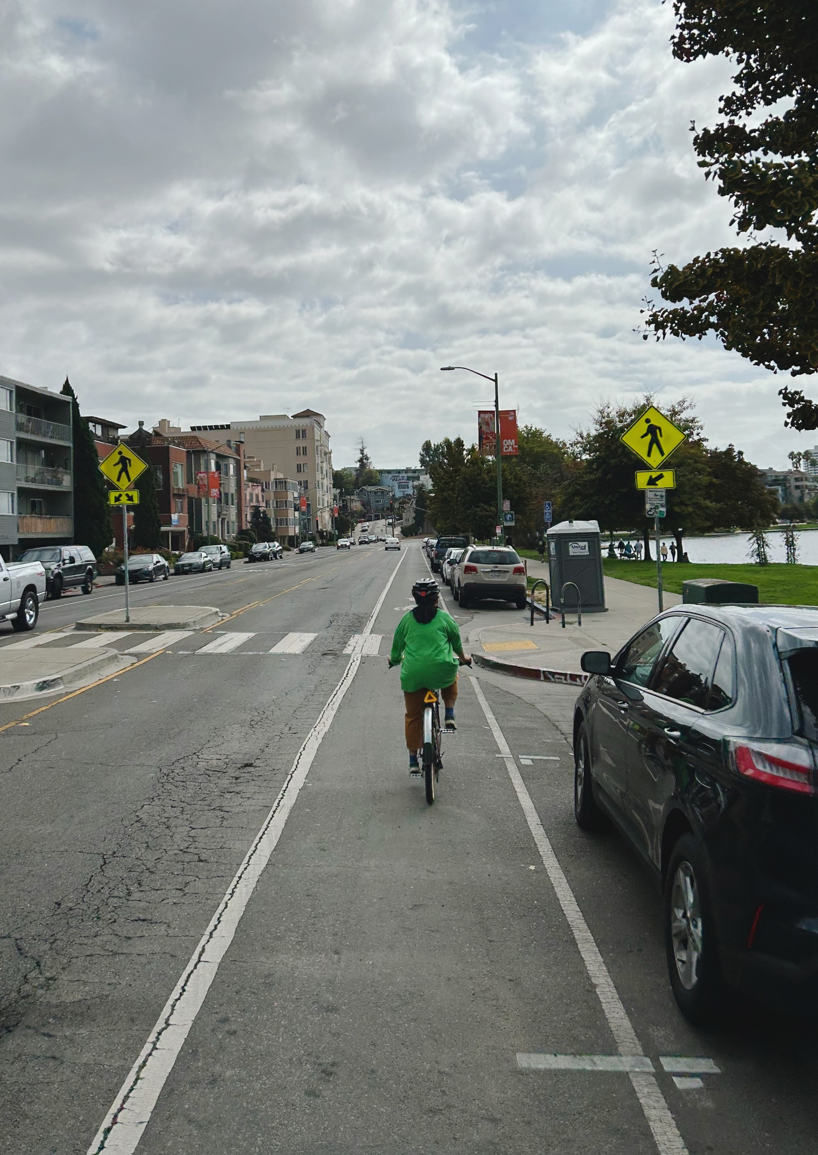
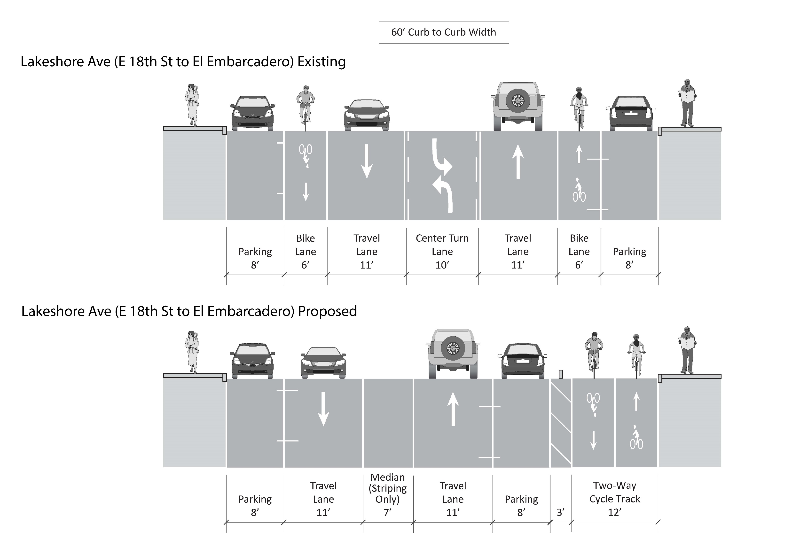
Existing/Proposed Cross-sections
Notes:
Talk through details of cross-section changes. Point to existing conditions photo, setting up next slide…

Slide 9
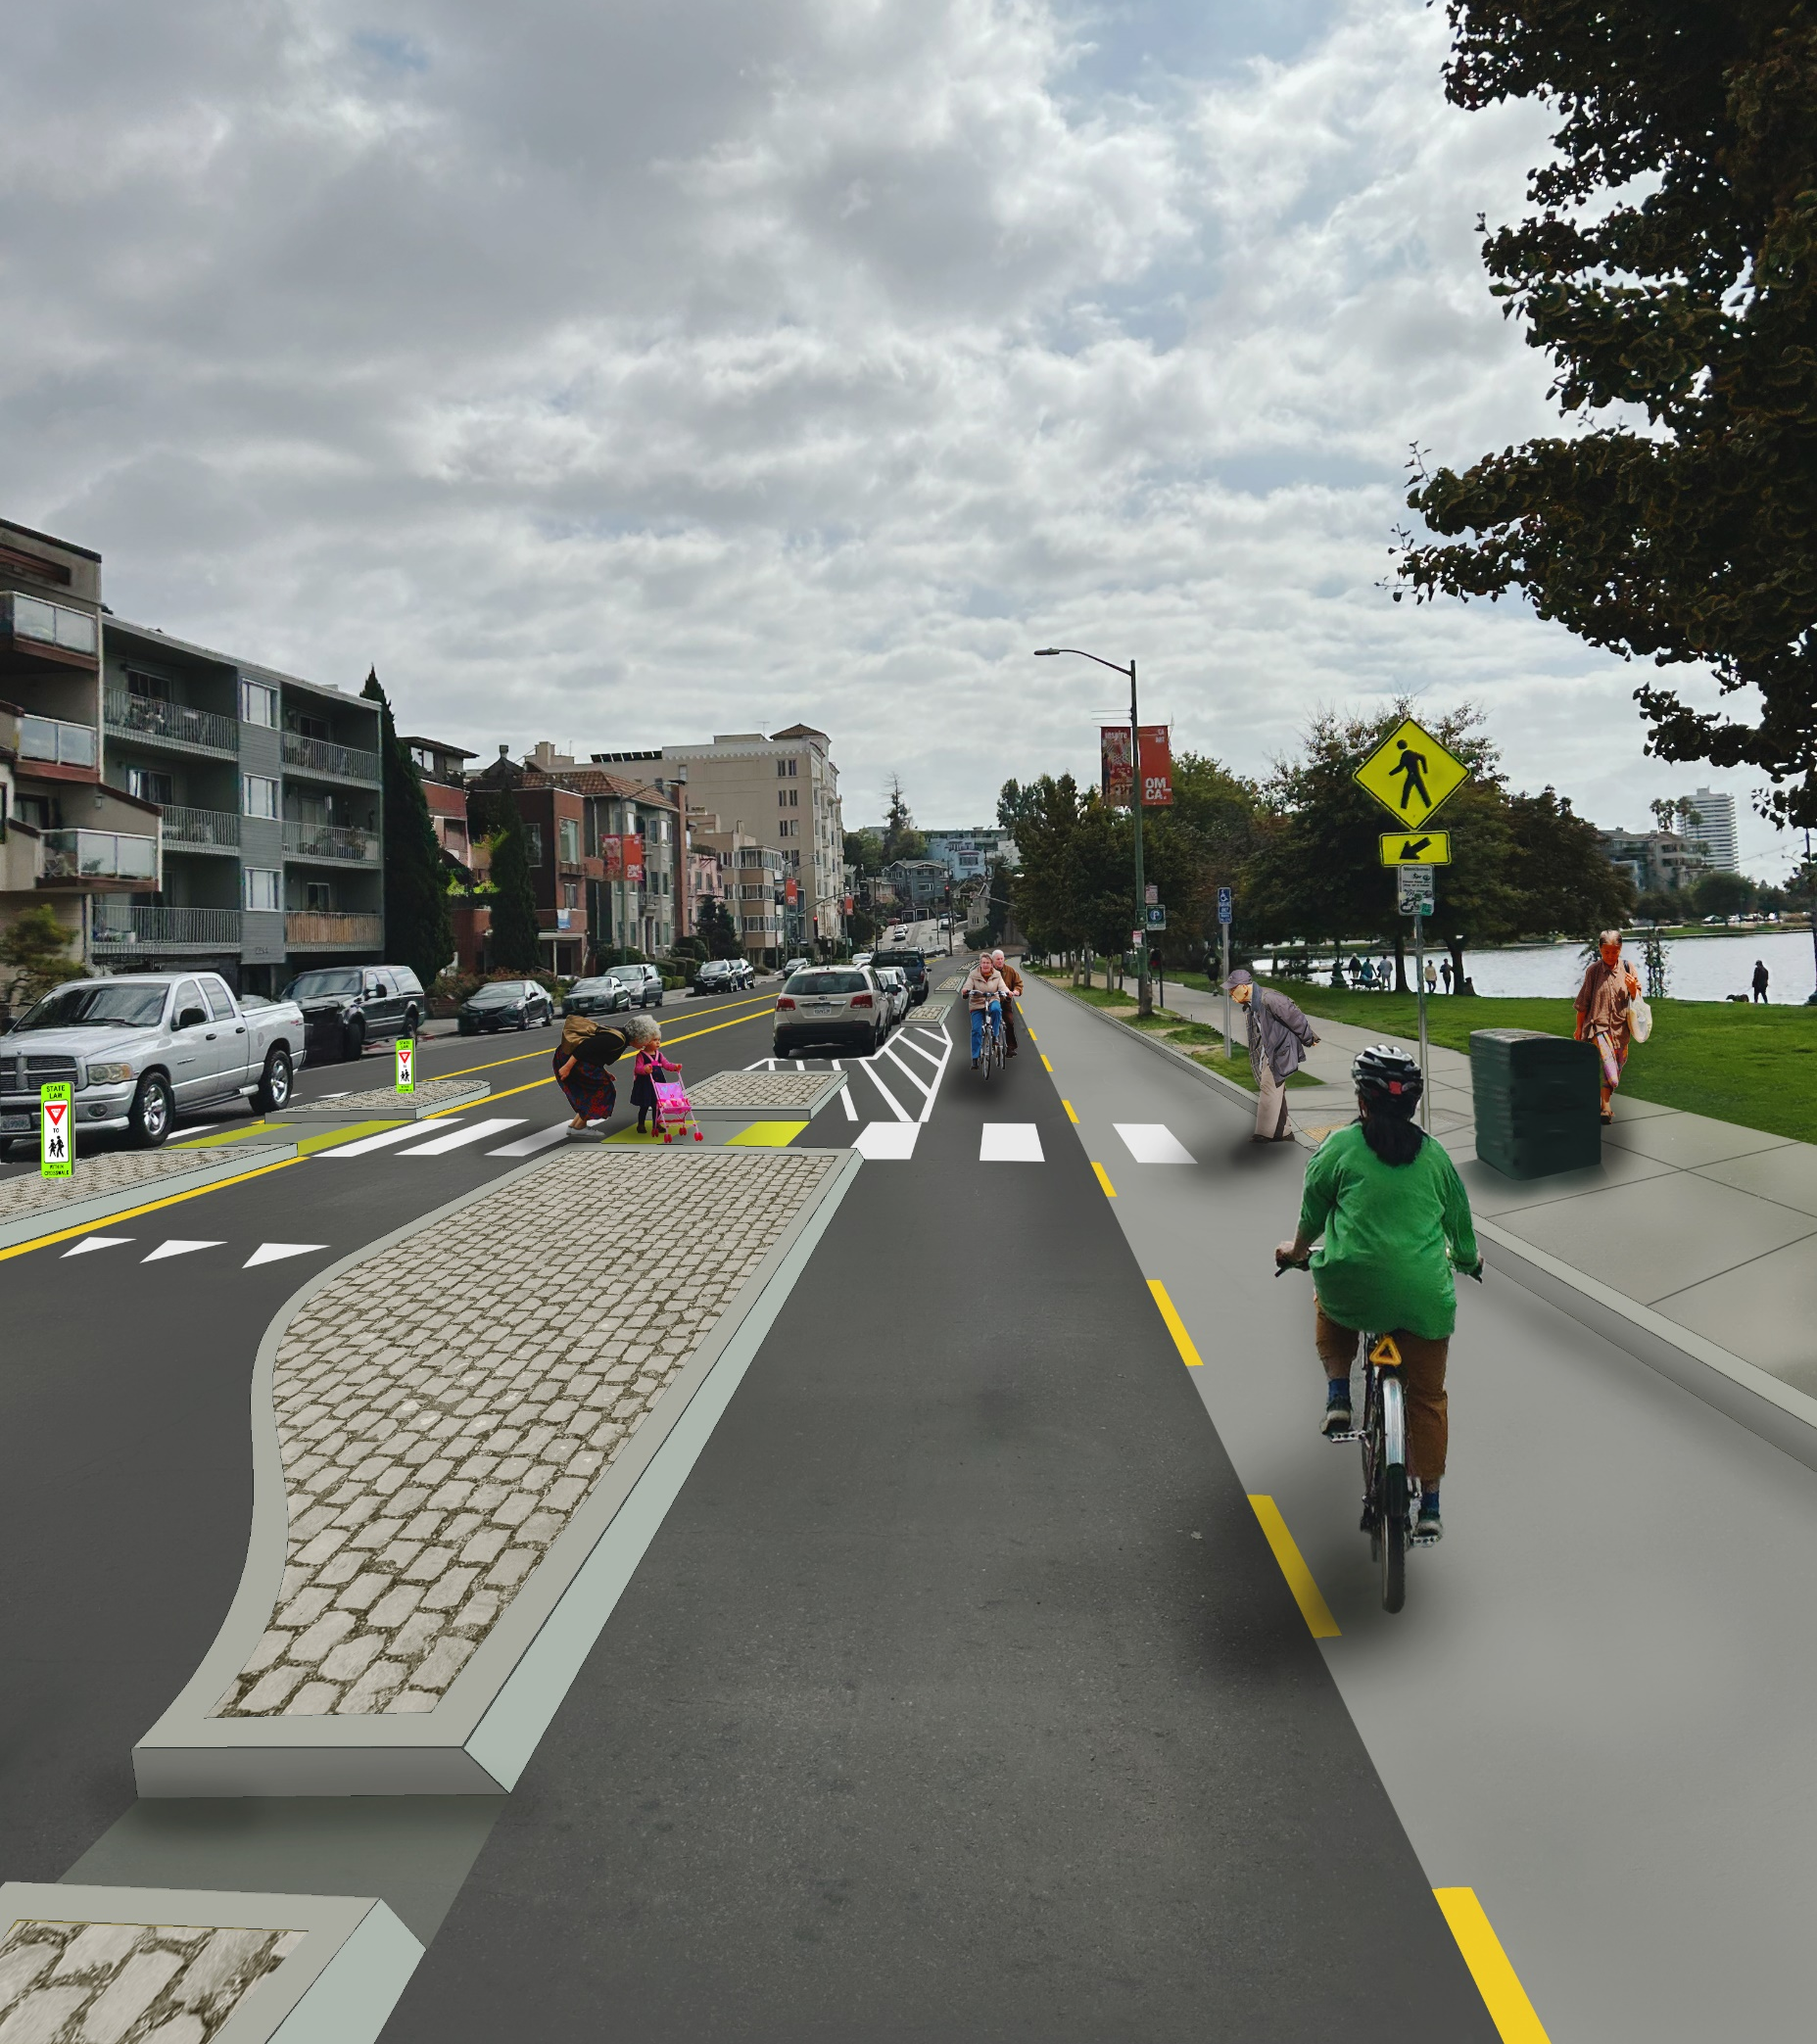
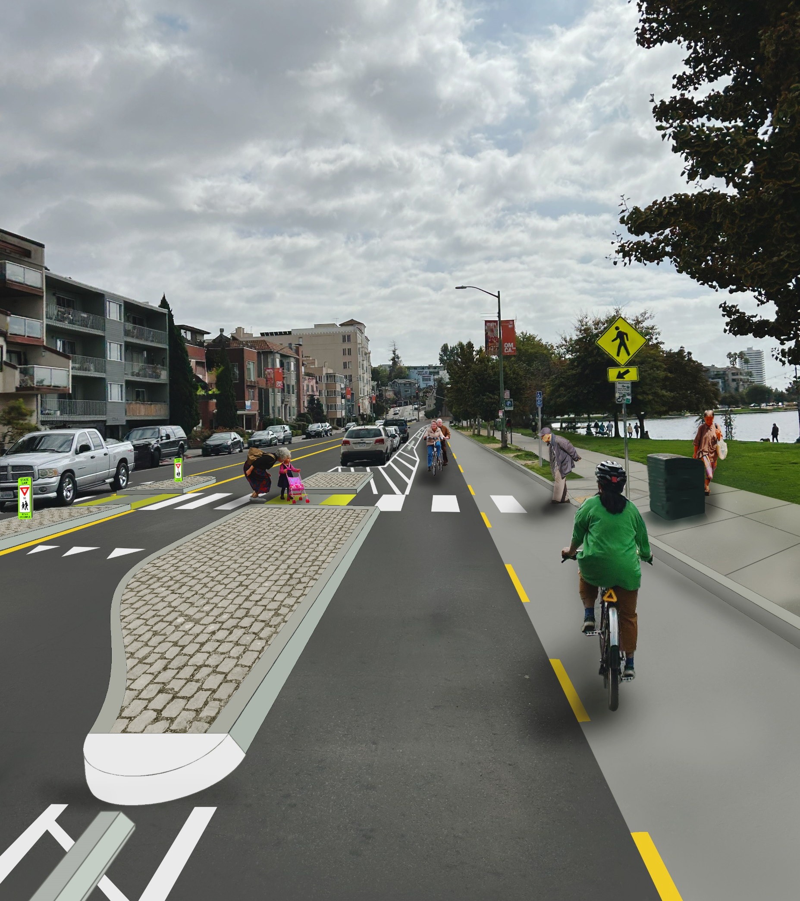
Candidate Treatments
Notes:
Discuss similarities and contrasts between left and right images.
Common to all: Shifting travel lanes away from lake; cycle track and separation (lateral, physical, & parking) separates bikeway and sidewalk from travel lanes; Maintain ped refuge islands (look for opportunities for new refuges; Concrete islands near crossings/intersections;
Alt 1 (left): Concrete separation continues through length of cycle track, with regular breaks to maintain (improve, actually) parking access; Challenges include cost and potential C3 requirements;
Alt 2 (right): between concrete island ‘bookends’ separation changes to buffer striping and wheelstops (and delineators?);

Slide 10
Candidate Treatments
Notes:
Discuss similarities and contrasts between left and right images.
Common to all: Shifting travel lanes away from lake; cycle track and separation (lateral, physical, & parking) separates bikeway and sidewalk from travel lanes; Maintain ped refuge islands (look for opportunities for new refuges; Concrete islands near crossings/intersections;
Alt 1 (left): Concrete separation continues through length of cycle track, with regular breaks to maintain (improve, actually) parking access; Challenges include cost and potential C3 requirements;
Alt 2 (right): between concrete island ‘bookends’ separation changes to buffer striping and wheelstops (and delineators?);

Slide 11
Candidate Treatments
Notes:
Discuss similarities and contrasts between left and right images.
Common to all: Shifting travel lanes away from lake; cycle track and separation (lateral, physical, & parking) separates bikeway and sidewalk from travel lanes; Maintain ped refuge islands (look for opportunities for new refuges; Concrete islands near crossings/intersections;
Alt 1 (left): Concrete separation continues through length of cycle track, with regular breaks to maintain (improve, actually) parking access; Challenges include cost and potential C3 requirements;
Alt 2 (right): between concrete island ‘bookends’ separation changes to buffer striping and wheelstops (and delineators?);

Slide 12
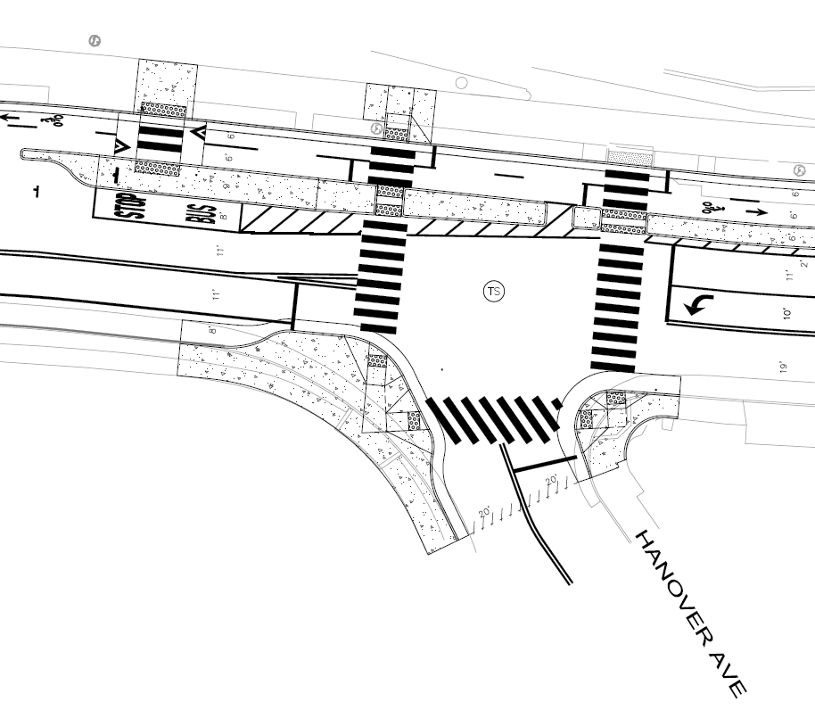
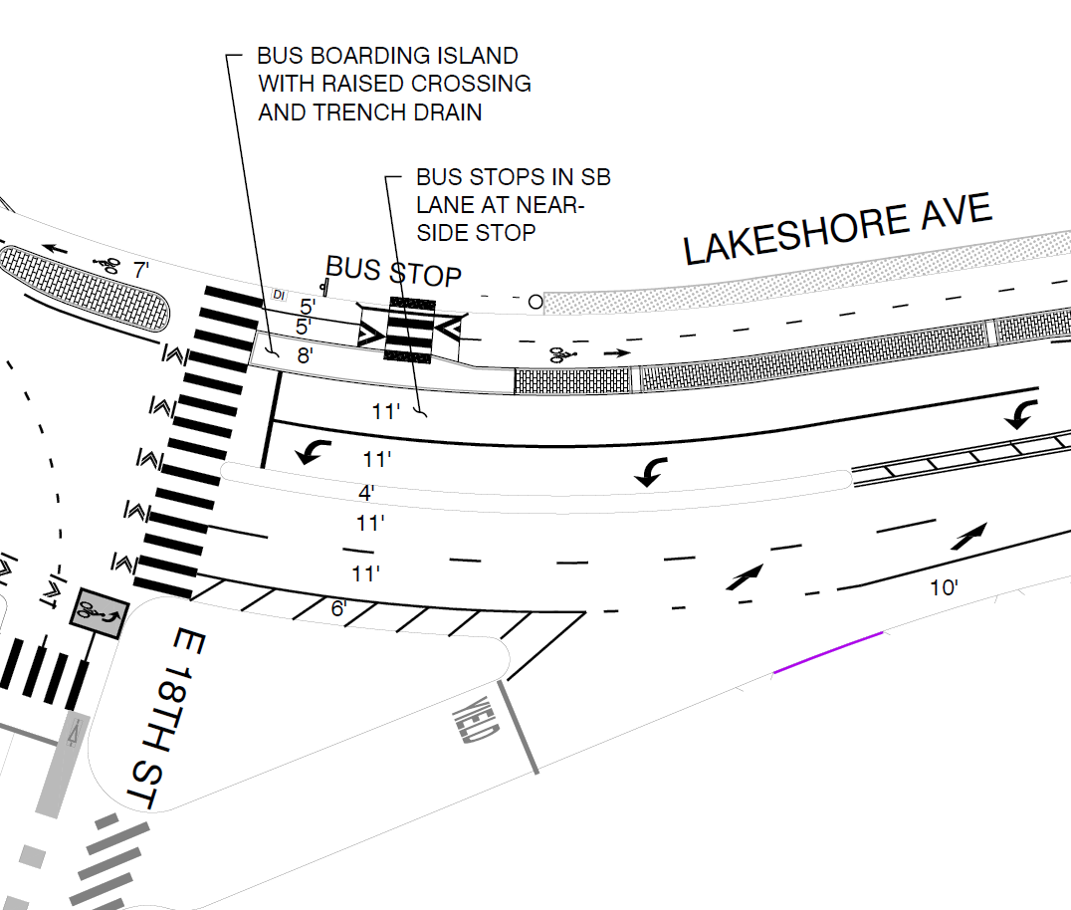
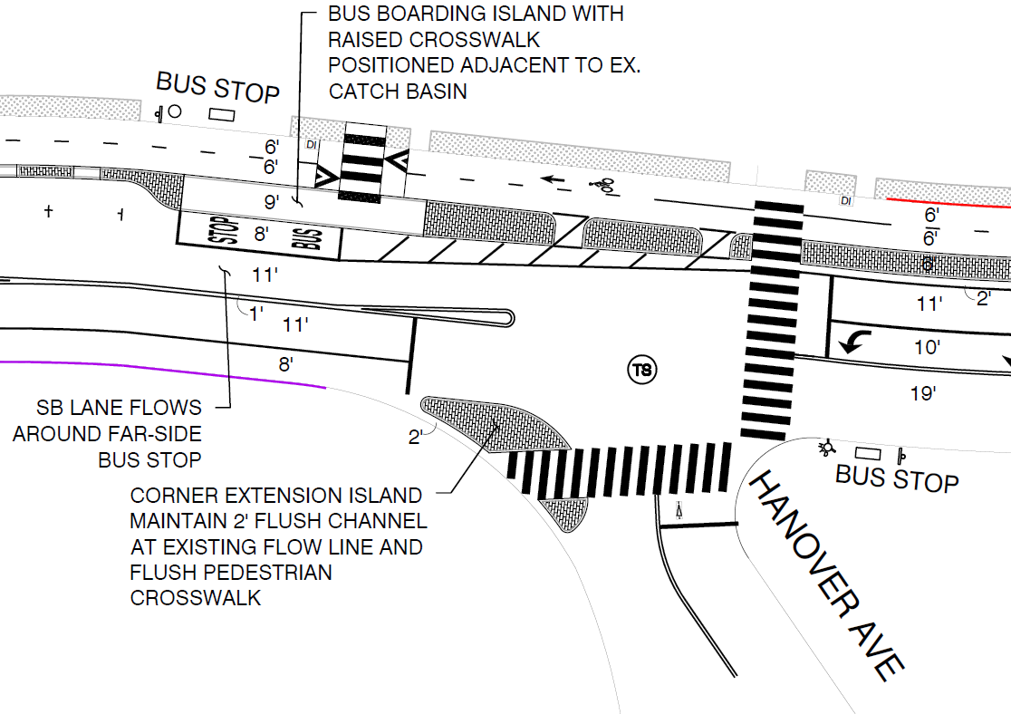
Bus Boarding Islands
BUS BOARDING ISLAND WITH RAISED CROSSWALK ADJACENT TO EXISTING CATCH BASIN
SB LANE FLOWS AROUND FAR-SIDE BUS STOP
CORNER BULBOUT AND CURB RAMPS
EXISTING
BUS STOP
TO REMAIN
POTENTIAL
SLIP LANE CLOSURE
Notes:
Discuss bus stop typologies;
In lane stop at E 18th St (NS), out of lane stops at other SB locations (all FS);
Maintain any existing benches/shelters/trash cans where they are;
Raised connection to sidewalk across cycle track (ala Telegraph in Temescal)

Slide 13
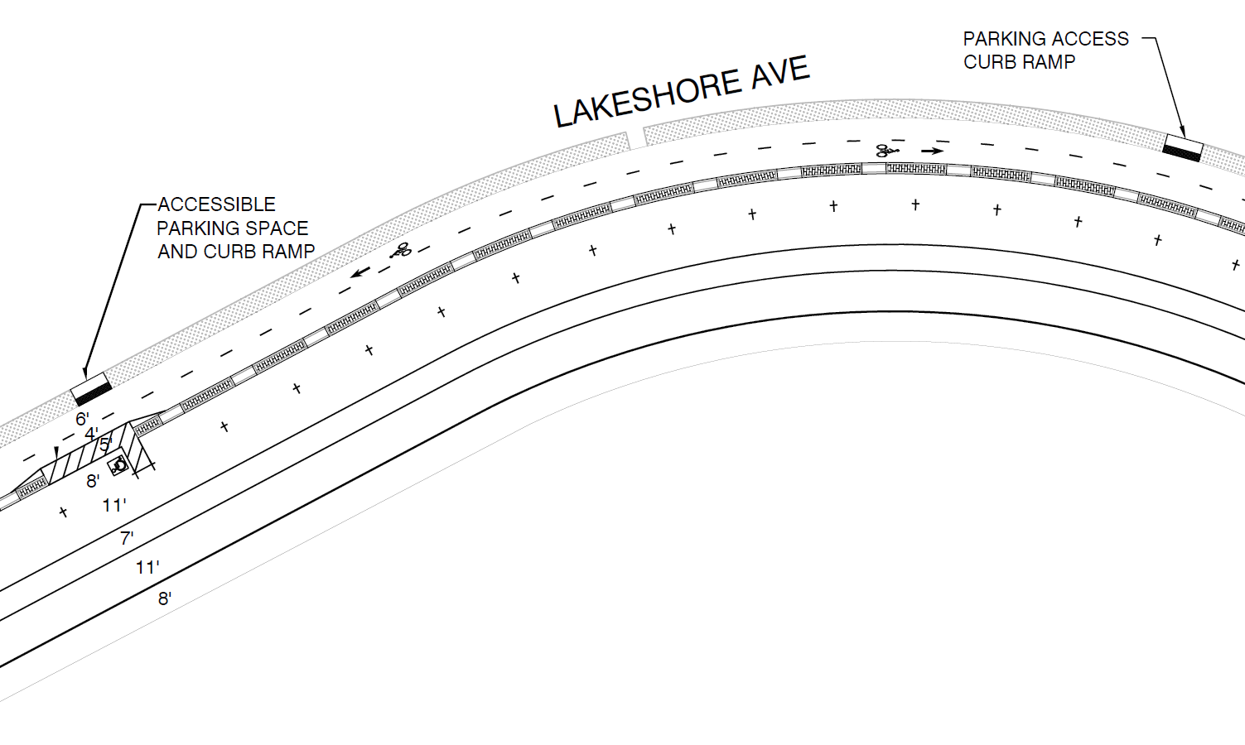
Accessible Parking Improvements
Notes:
Discuss accessible parking improvements:
Existing planted verge;
Breaks in separation centered on each parking stall;
Mid-block curb ramps such that the path of travel from any parking stall to a ramp is =< 150’;
New accessible parking spaces (#based on Accessible Parking Policy, location based on proximity to points of interest, crossings, and clearance from locations where motorists may be inclined to enter the cycle track;

Slide 14
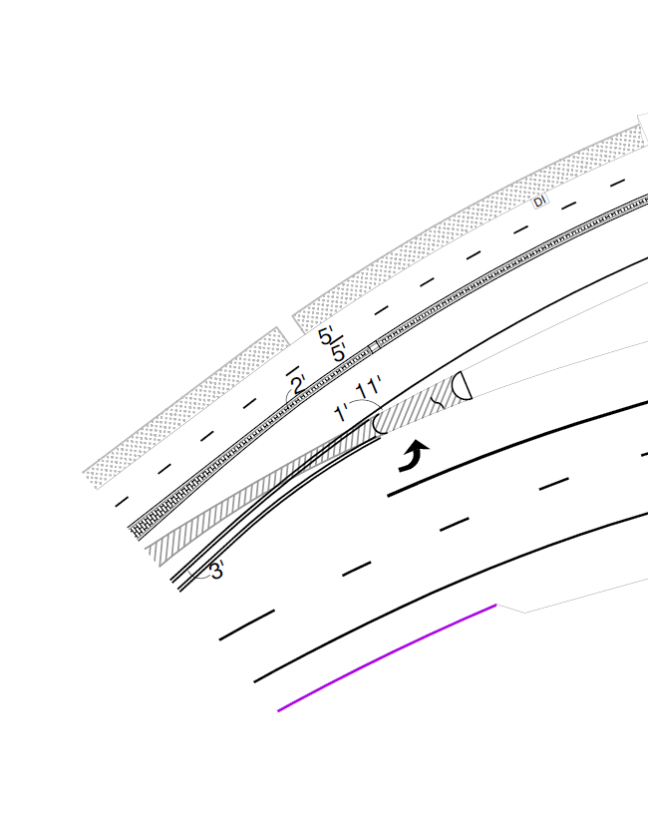
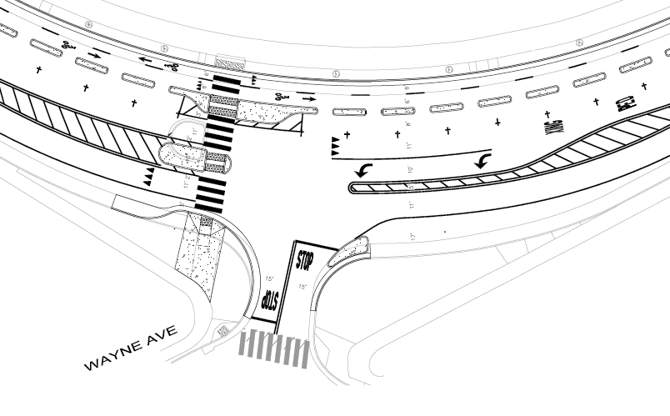
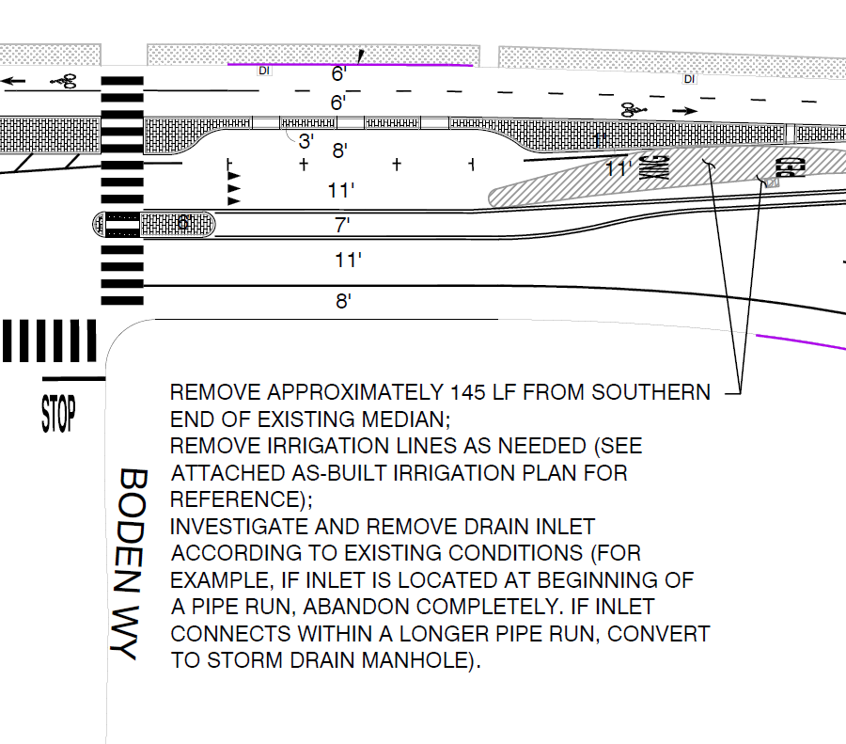
Traffic Median Relocation
EXISTING CURB RAMP WITH
POTENTIAL RRFB INSTALLATION
REPLACE
EXISTING
TRAFFIC
ISLAND
CORNER BULBOUT AND CURB RAMP
Notes:
Discuss
Ped safety islands
Corner islands to calm right turns;
Median modification between Boden and El Embarcadero

Slide 15
Next Steps / Schedule
August 2024 – 95% Plans
September 2024 – 100% Plans
October 2024 – Construction Begins
October 2025 (tentative) - Substantial Completion
Notes:
Discuss
Ped safety islands
Corner islands to calm right turns;
Median modification between Boden and El Embarcadero

Slide 16

City of Oakland, Department of Transportation
Great Streets Delivery
Charlie Ream, Transportation Manager
Jane Mei, Transportation Planner
Christopher Diano, Supervising Engineer
Jason Patton, Senior Transportation Planner

Slide 17
Existing Location Views for Concept Plan Page-Turn
El Embarcadero Intersection
Median south of El Embarcadero
Cleveland Cascade & Driveways
Brooklyn Ave Intersection & Bus Stop
Wayne Ave/Wesley Ave Intersection
Hanover Ave Intersection
East 18th St Intersection

