Slide 1
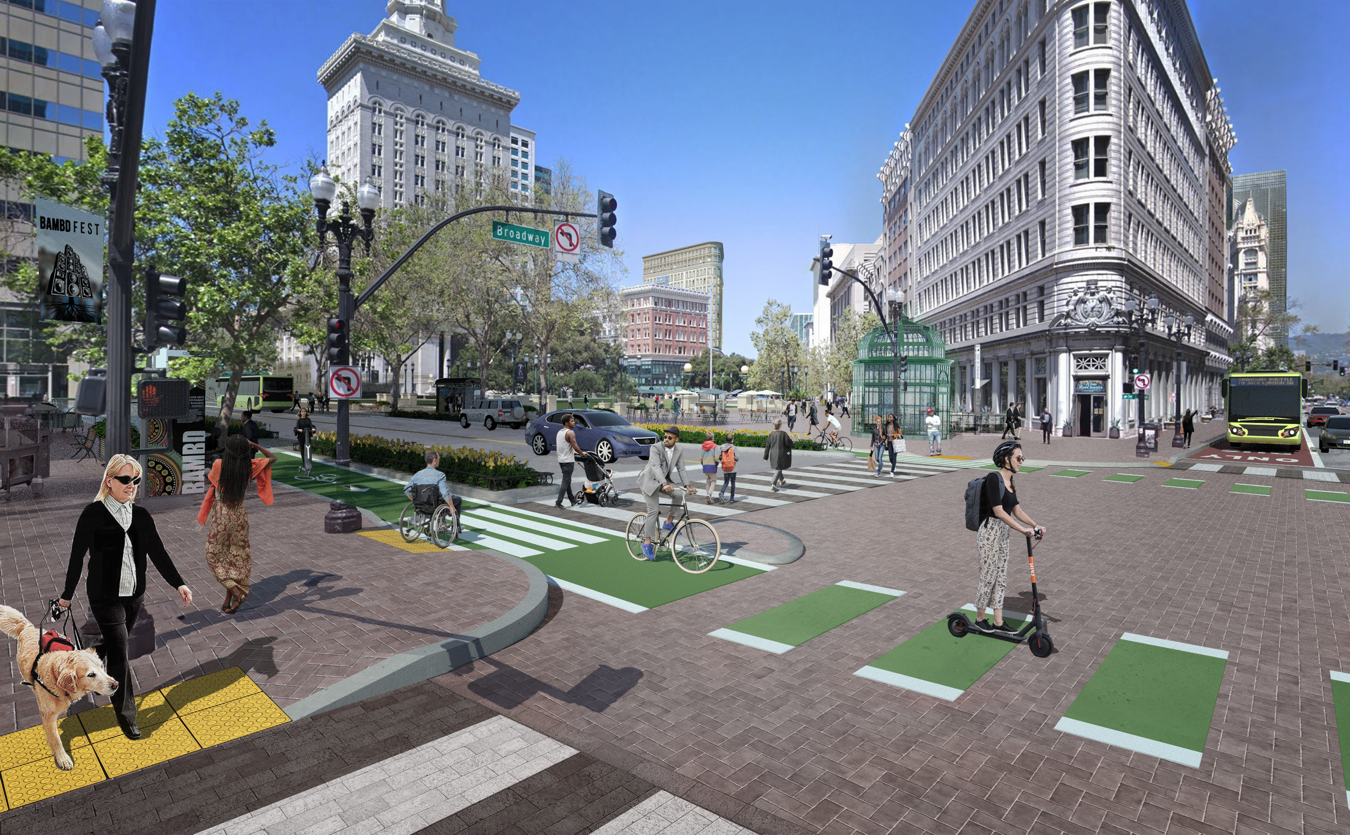
Downtown Oakland Specific Plan (DOSP)
Community Advisory Group Meeting
DOSP Zoning Amendments & EIR
May 9, 2024

Slide 2
AGENDA
Presentation
Process & Timeline
Brief Recap of DOSP
General Plan Amendments and Change Since Draft
Zoning Amendments and Changes since Draft
EIR Findings and Response to Comments
Next Steps
Q&A
The
Downtown
Oakland
Specific Plan
Notes:
Timeline 2019 to 2024 of what we've been working on, the public review, and the history of CAG meetings (include the zoning, but reiterate that we’ll publish it Friday and cover it at the next meeting)
See the CAG folder if you have questions about what meetings have happened
Presentation of what's changed since the prior plan – this is the challenge! – start w/the LPAB report Plan content, but then we should add more summary from the Comments Memo
Handouts
DOSP Handbook (Spanish and Chinese versions are available)
Revised Intensity Maps (w/colors more readable and/or labels)
Comments Memo: This is still not ready, so we will let them know that we will send it

Slide 3
3 | OVERALL PROCESS & TIMELINE
2015-2016
Project Initiation
Existing Conditions Research & Profile Report
10-Day Public Design Charrette & Open Studio
Community Advisory Group (CAG) Launch
Plan Alternatives Report & Comment Memo
Stakeholder Meetings & Online Survey
Youth Summit
2017-2018
Racial Equity Re-Launch
Interviews & Focus Groups
Disparity Analysis
Expanded Outreach & CAG Membership
Social Equity Working Groups & Creative Solutions Labs
Accessibility Survey Collaboration with Senior and Disability Advocates
2018-2019
Plan Drafting & Iteration
Plan Options Report & Equity Assessment
Preliminary Draft Plan & Public Review
Public Review Draft Plan/EIR* & Public Hearings
Initial Zoning Incentive Program (ZIP) analysis
2020-2024
Final Plan, Zoning & Adoption
Final Draft Plan
Draft Planning Code (Zoning) and General Plan Amendments & Public Review
Adoption Hearings for Final Draft Plan & Zoning
Notes:
After hundreds of community meetings and events, dozens of interviews and focus groups, 3 public review drafts, one racial equity impact assessment and over three years of a global pandemic, the City has developed a plan to support the downtown, including responding to conditions exacerbated by the COVID-19 pandemic
Originally anticipated as an urban design and public improvements plan, it has since become a much more comprehensive approach to revitalizing downtown while working to protect Oakland’s longstanding and most vulnerable residents and culture

Slide 4
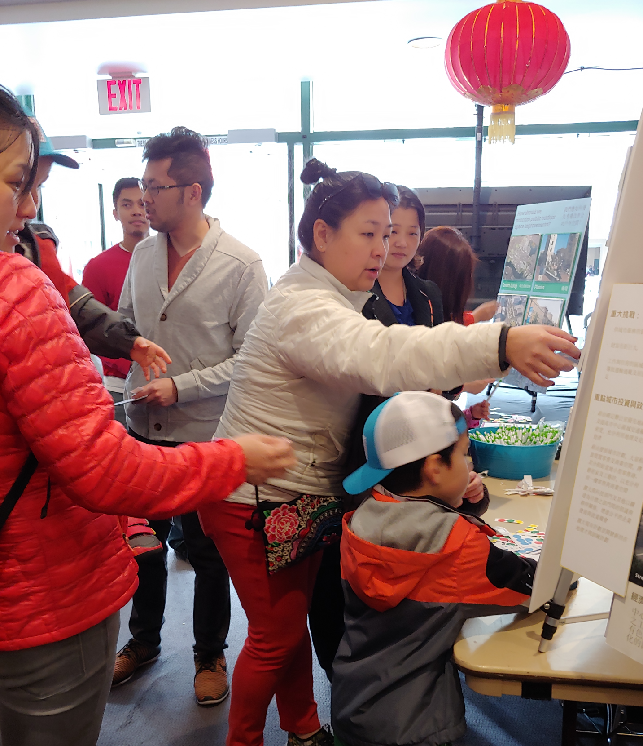
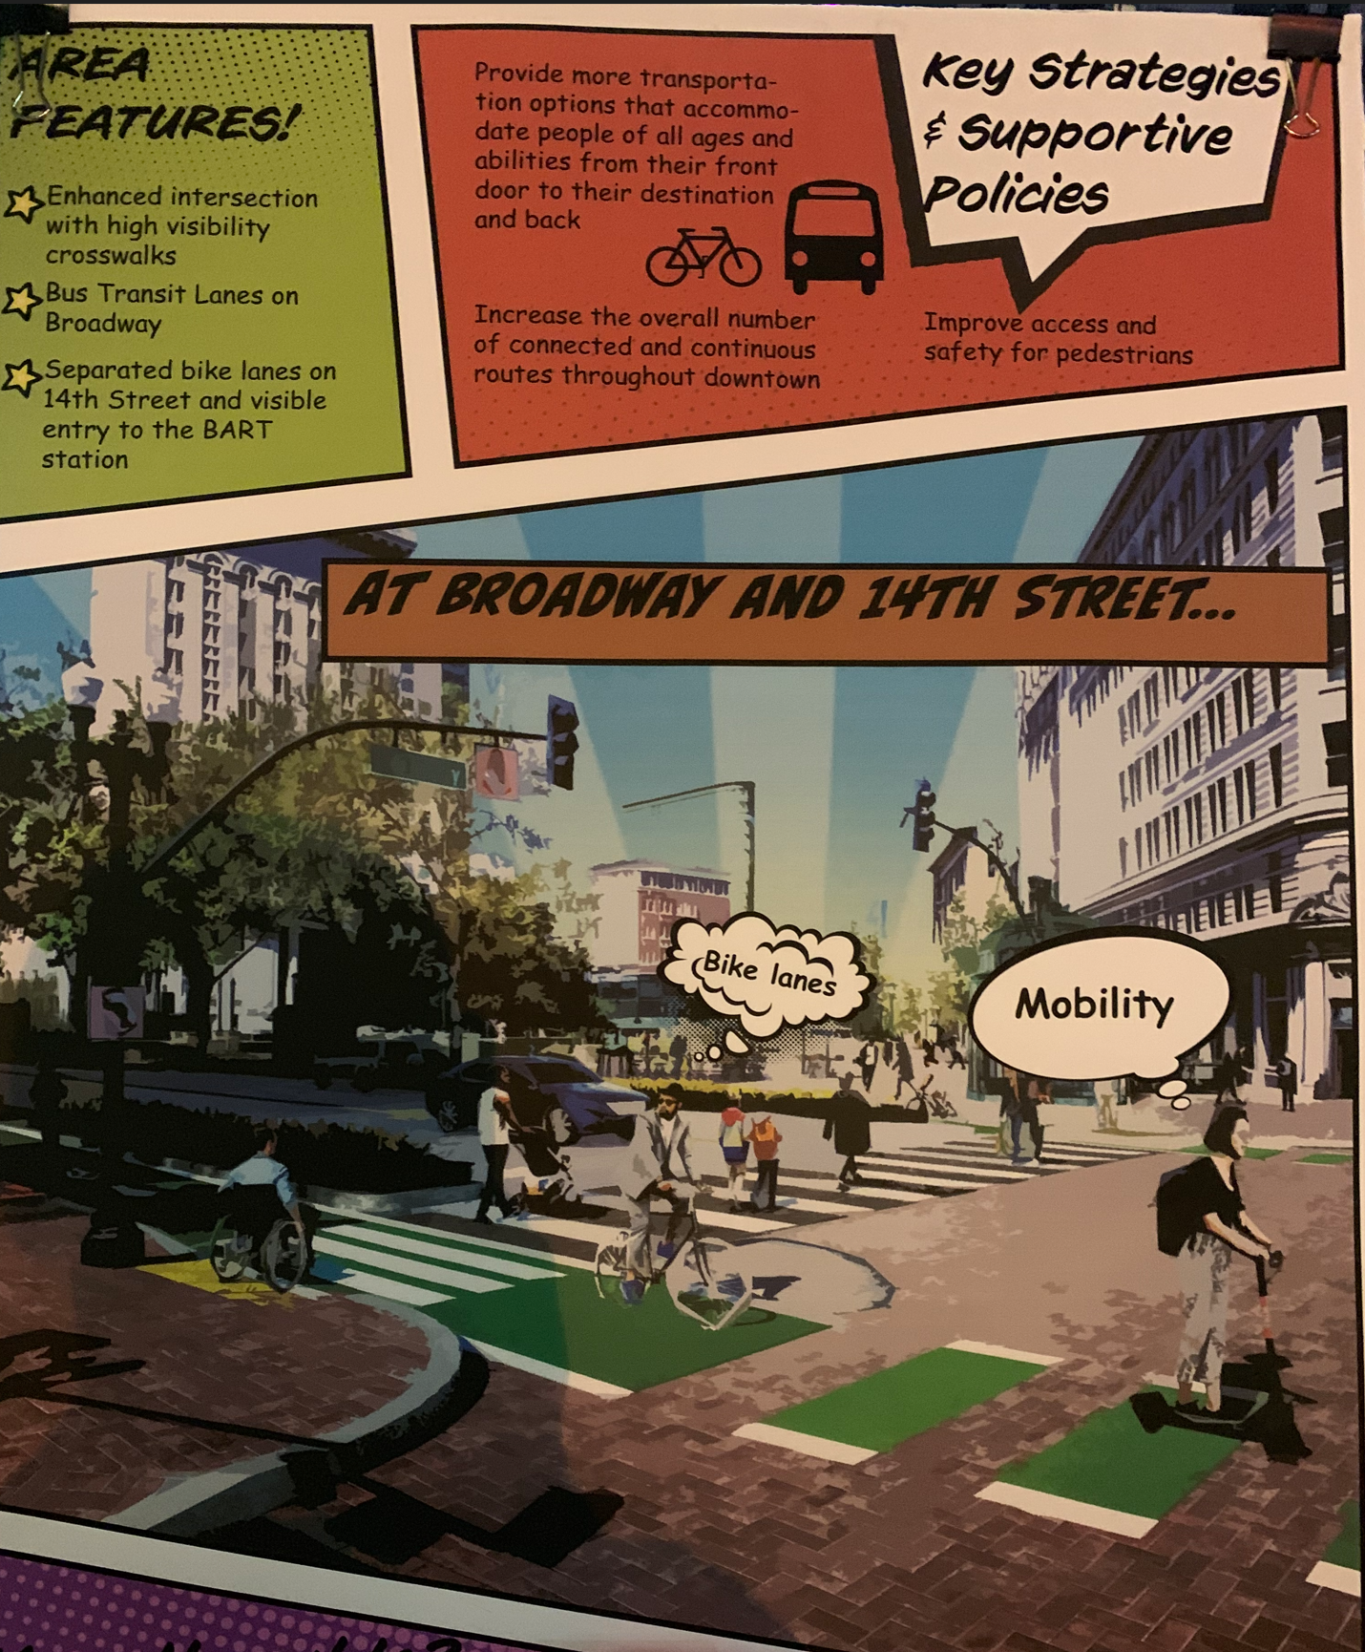
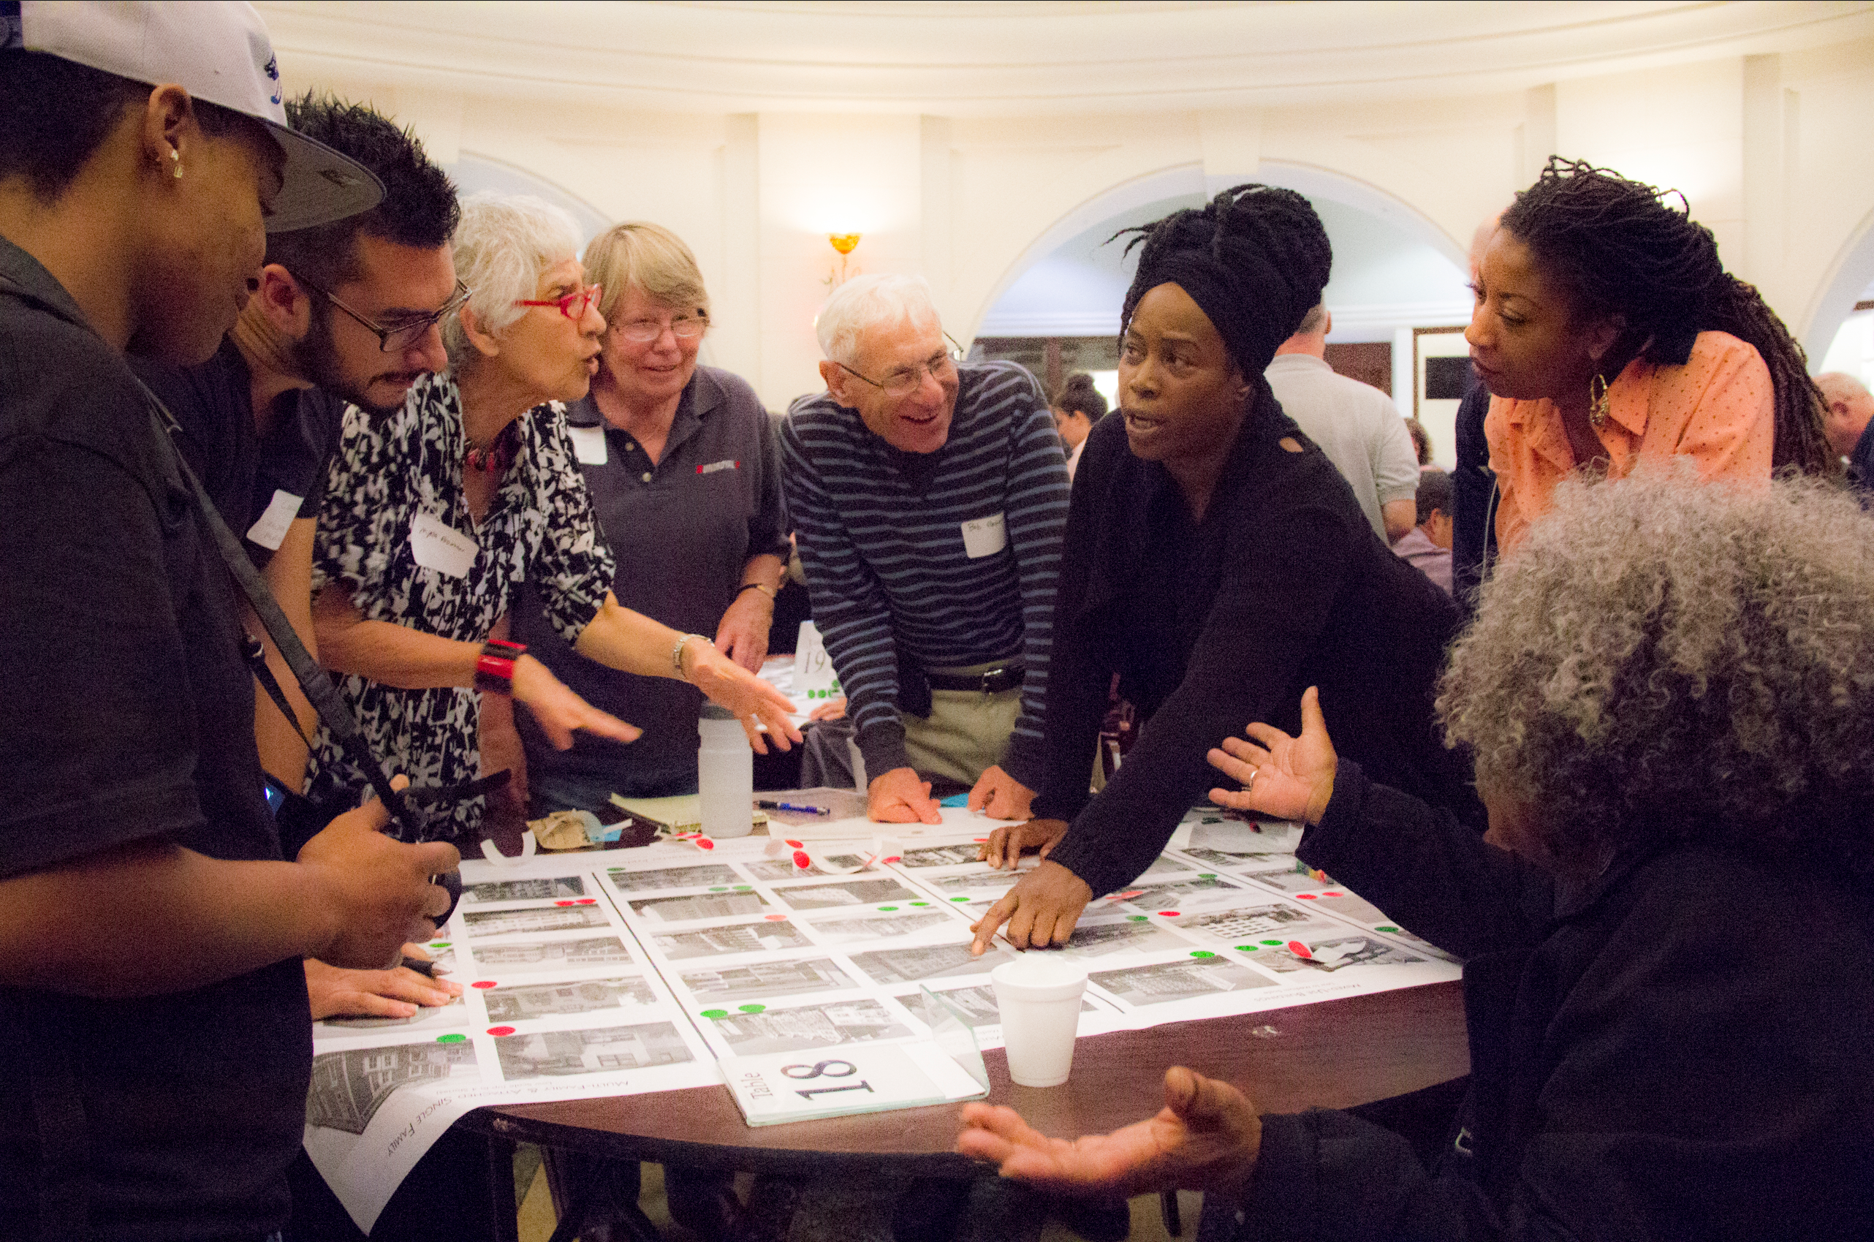
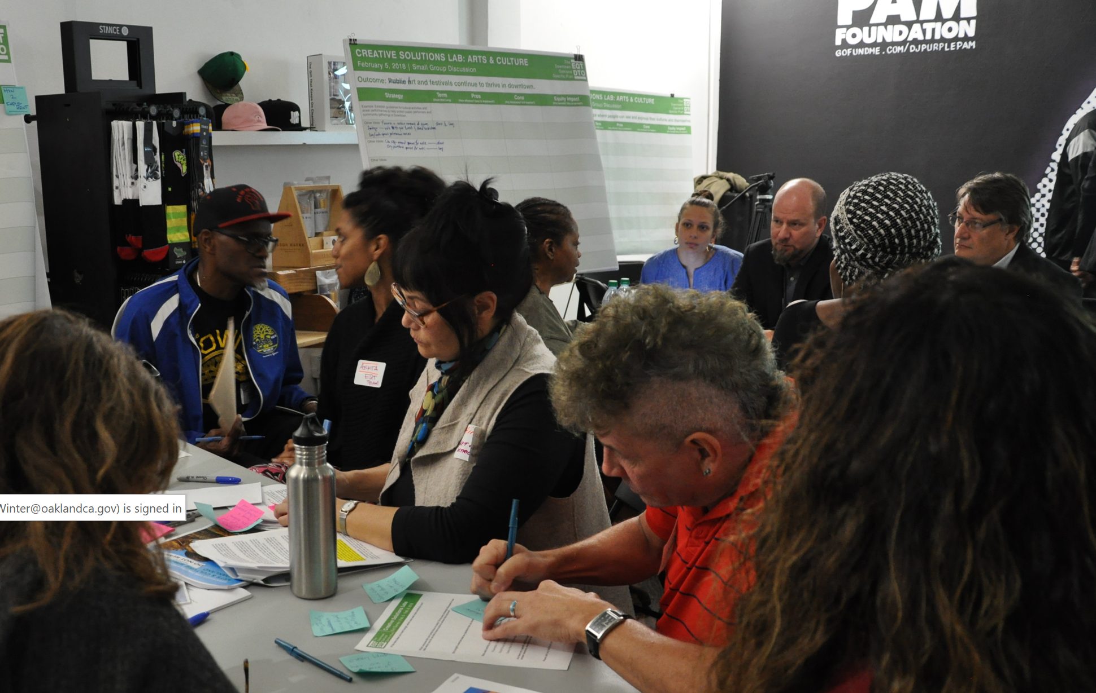
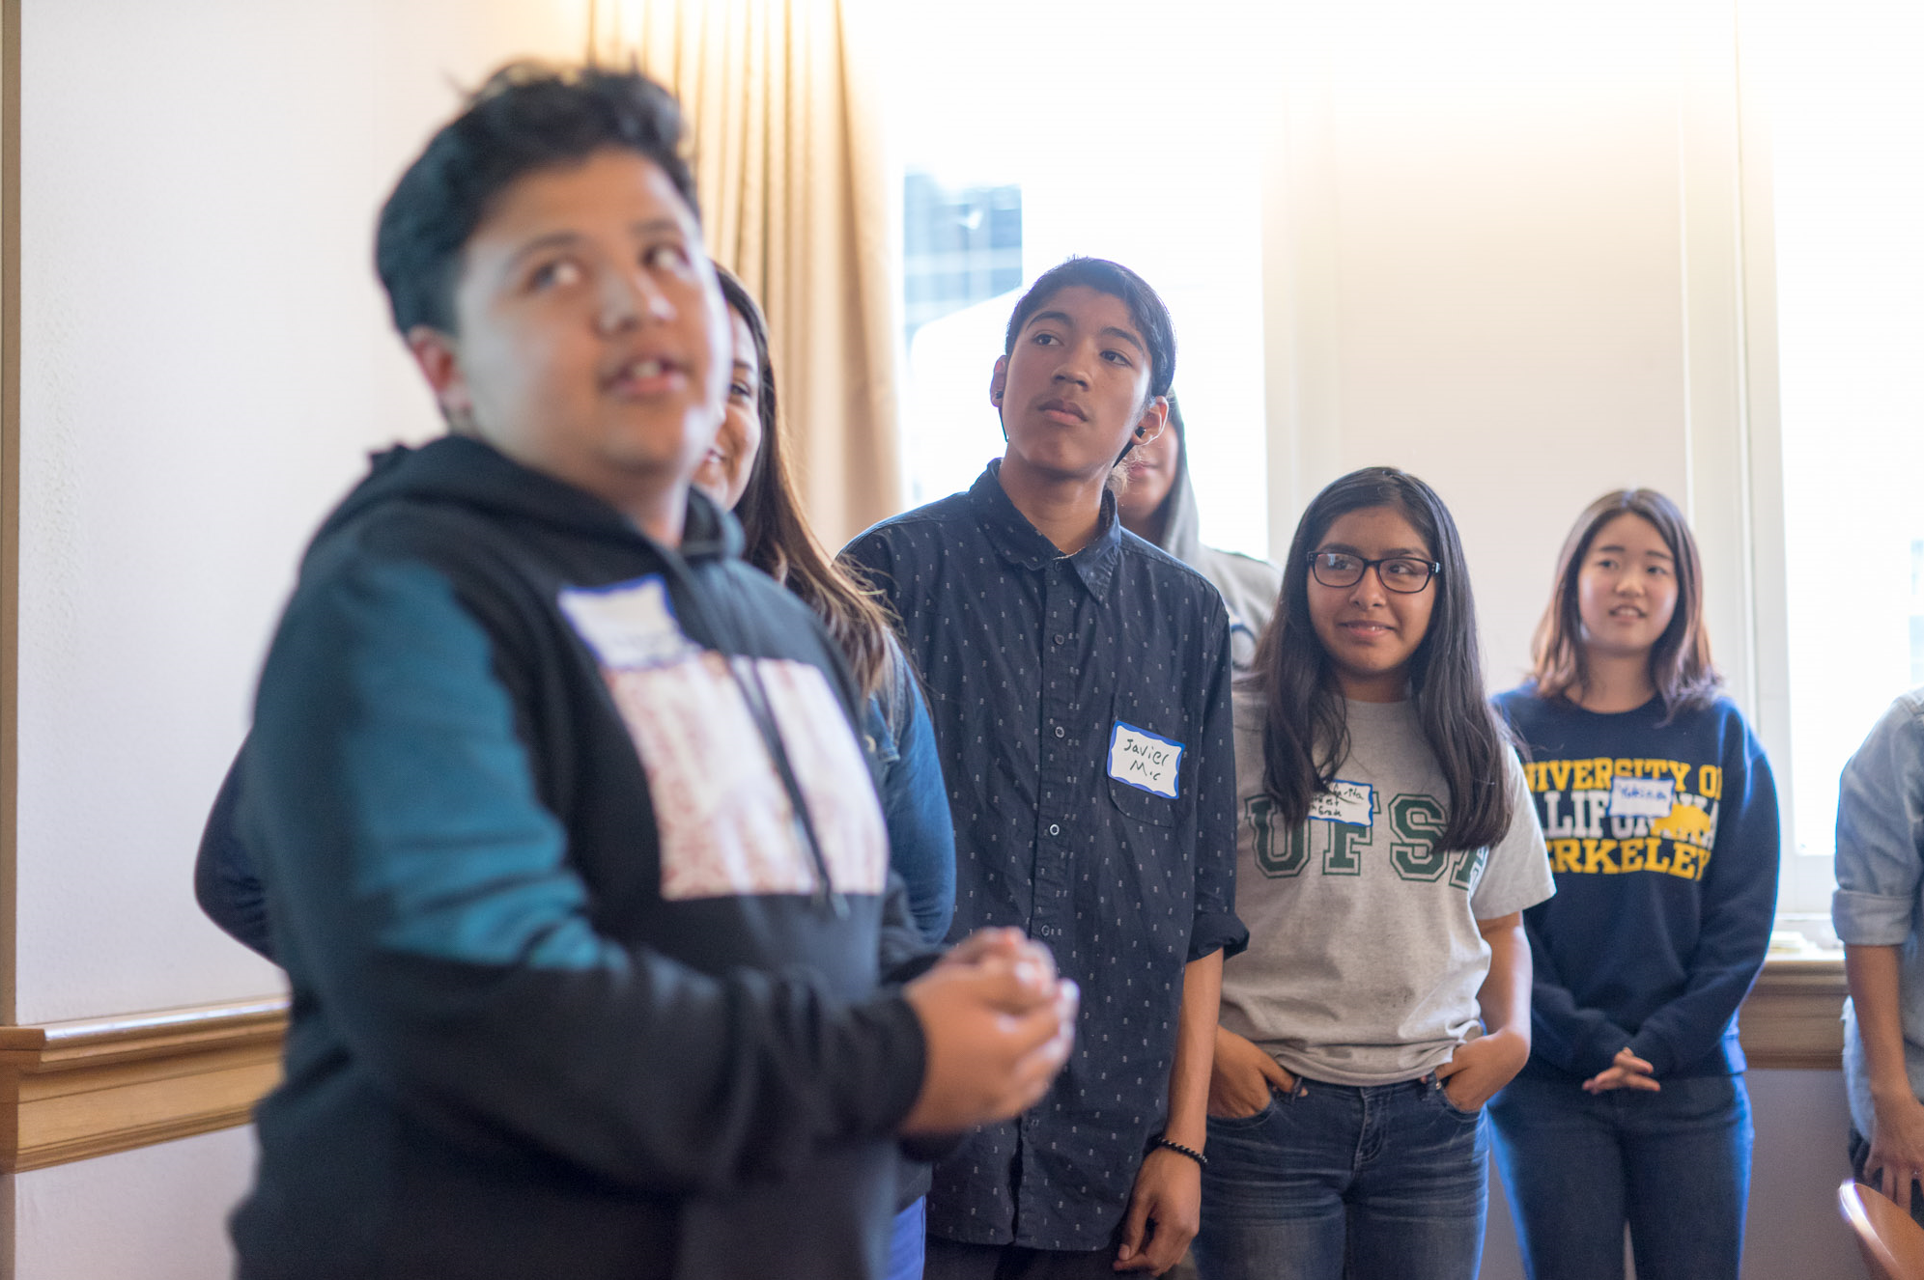
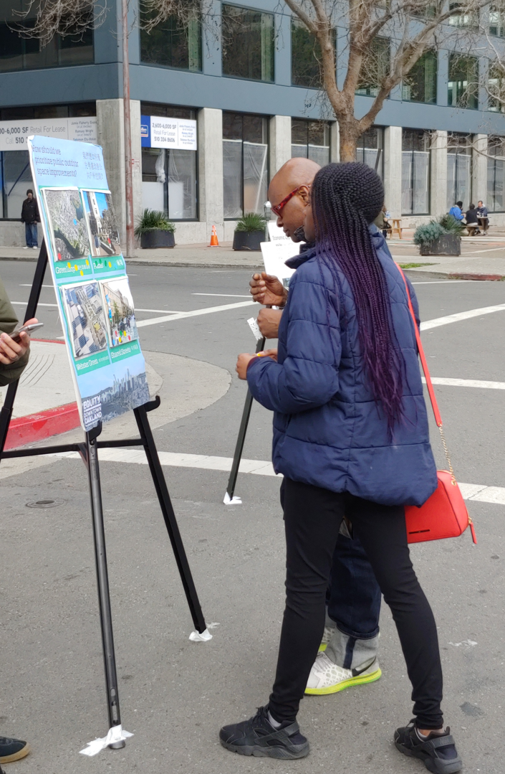
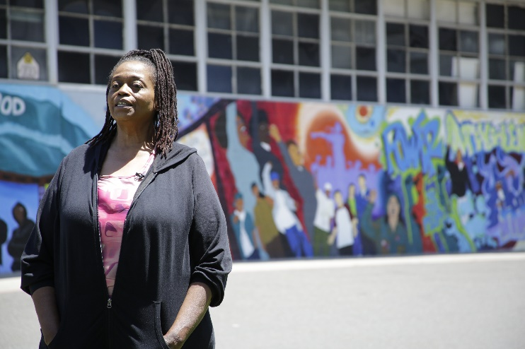
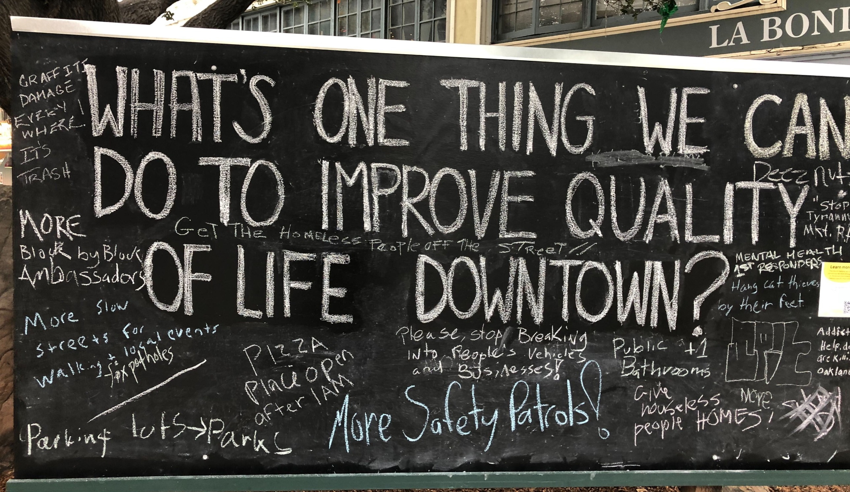
4 | Community Involvement
2015-2016
2017-2018
Racial Equity Re-Launch
2018-2019
Plan Drafting & Iteration
2020-2023
Final Plan, Zoning & Adoption
Project Initiation
Notes:
Design charrette
Youth summit
Creative solutions lab
Interviews, videos & focus groups of community leaders, particularly people of color – what is an equitable downtown?
Reviewing Preliminary Draft Plan at Black Joy Parade and Lunar New Year
Cartoon style info boards at Thursdays at Latham Square reviewing the Draft Plan
Chalkboards with QR codes to reach people about the Draft Zoning – during the pandemic – in addition to many zoom meetings

Slide 5
5 | PLAN REVISIONS & ZONING DEVELOPMENT 2019-2024
2019-2020
Public Review Draft Plan
Public meetings, pop-ups at community events
LPAB, Cultural Affairs Commission, PRAC, BPAC, Commission on Aging, MCPD, Library Commission, ZUC & Planning Commission meetings
4 CAG meetings: Review of Preliminary Draft comments, implementation, how feedback has been incorporated, initial ZIP feasibility study
2020-2021
Plan & CEQA Revision & ZIP Analysis
Reviewing community comments & revising Plan & EIR
Economic analysis for Zoning Incentive Program (ZIP)
3 CAG meetings: Community benefits prioritization, ZIP structure and benefits, housing & implementation strategies
2021-2023
Zoning Drafting & Review
3 community meetings on zoning topics, online survey, targeted meetings w/BAMBD, Chinatown & Jack London
2 LPAB & 3 ZUC meetings
3 CAG meetings: Zoning, policy objectives & affordable housing/ZIP study session
2024
Zoning Revisions & Adoption
LPAB meeting, 2 Planning Commission meetings
2 CAG meetings: plan & zoning
Adoption hearings: CED & Council
Notes:
After hundreds of community meetings and events, dozens of interviews and focus groups, 3 public review drafts, one racial equity impact assessment and over three years of a global pandemic, the City has developed a plan to support the downtown, including responding to conditions exacerbated by the COVID-19 pandemic
Originally anticipated as an urban design and public improvements plan, it has since become a much more comprehensive approach to revitalizing downtown while working to protect Oakland’s longstanding and most vulnerable residents and culture

Slide 6
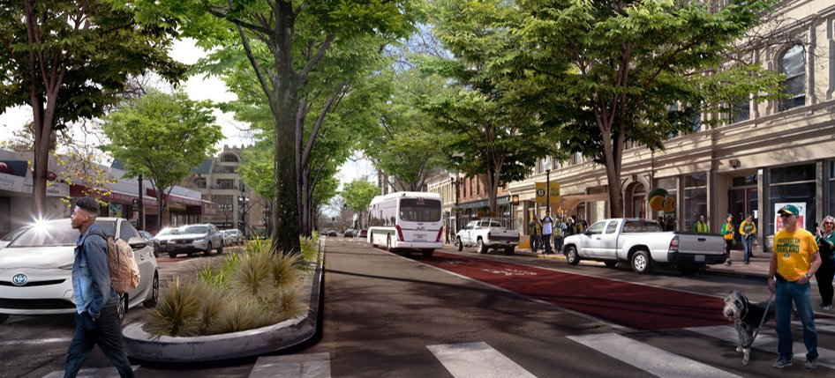
6 | Recap: What WILL THE PLAN DO?
Modernize and broaden the role of downtown
Mixed uses with housing and entertainment, R&D and industrial jobs rather than just office
Increase housing and jobs near transit
Streamline and provide community benefits
Expand funding for public services
One-time development impact fees and more significant long-term tax revenues
Revitalize local businesses and enhance public safety
Stem cultural displacement, fill vacant ground floor spaces
Prepare for climate change and sea level rise
Comprehensive infrastructure and adaptation plans in development projects and regionally
Reconnect West Oakland with Downtown
Thoughtfully re-envision I-980 and repair harm done to Black community
The
Downtown
Oakland
Specific Plan
Notes:
Address monumental shifts in the future of work and the role of downtown: The DOSP aims to protect and grow our industrial jobs near the Port, encourage R&D and biotech with a high density of jobs in the heart of downtown, and continue to build a mixed-use, culturally thriving downtown that supports local businesses.

Slide 7
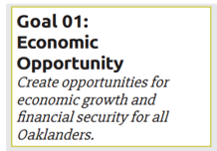
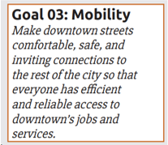
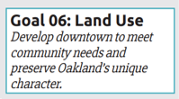
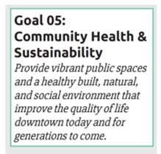
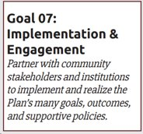
7 | Recap: PLAN GOALS & VISION
Equity is a primary focus of this Plan; all the goals, outcomes, and supporting policies meet a shared vision, consider equity impacts, and aim to reduce disparities – or at the very least, not widen them.
CAG Meeting | MAY 9, 2024
The
Downtown
Oakland
Specific Plan
Notes:
With Equity as a primary focus; the Plan describes a shared community vision for a downtown that serves all Oaklanders and accounts for the needs of those who are currently underserved. Community input shaped six plan goals around the topics of Economic Opportunity, Housing and Homelessness, Culture Keeping, Mobility, Community Health, and Land Use and Urban Design. A seventh goal has been added to address ongoing implementation and engagement following Plan adoption.
all the goals, outcomes, and supporting policies meet a shared vision, consider equity impacts, and aim to reduce disparities – or at the very least, not widen them.

Slide 8
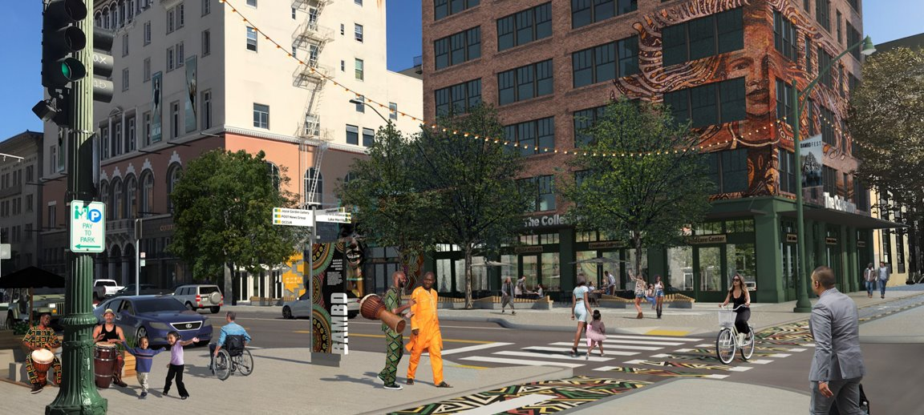
8 | RECAP: How will the DOSP ACHIEVE THESE GOALS?
Sets policy for inclusive implementation, a detailed work plan for multiple city departments, and outcomes monitoring
Short to long term implementation actions
Participation from City, partner agencies and community members
Racial equity impact assessment and measures of success
Ongoing specific plan implementation steering committee to advise and develop partnerships
Immediate and concurrent actions to be adopted with the Plan
Zoning Map and Planning Amendments
General Plan Amendments
Final Environmental Impact Report (EIR)
CAG Meeting | MAY 9, 2024
The
Downtown
Oakland
Specific Plan
Notes:
The EIR reduces barriers (time, money and legal challenges) to development that meets the intent of the DOSP. This will streamline a development process that can take 3-5 years to get housing built, while ensuring new development meets our environmental sustainability goals

Slide 9
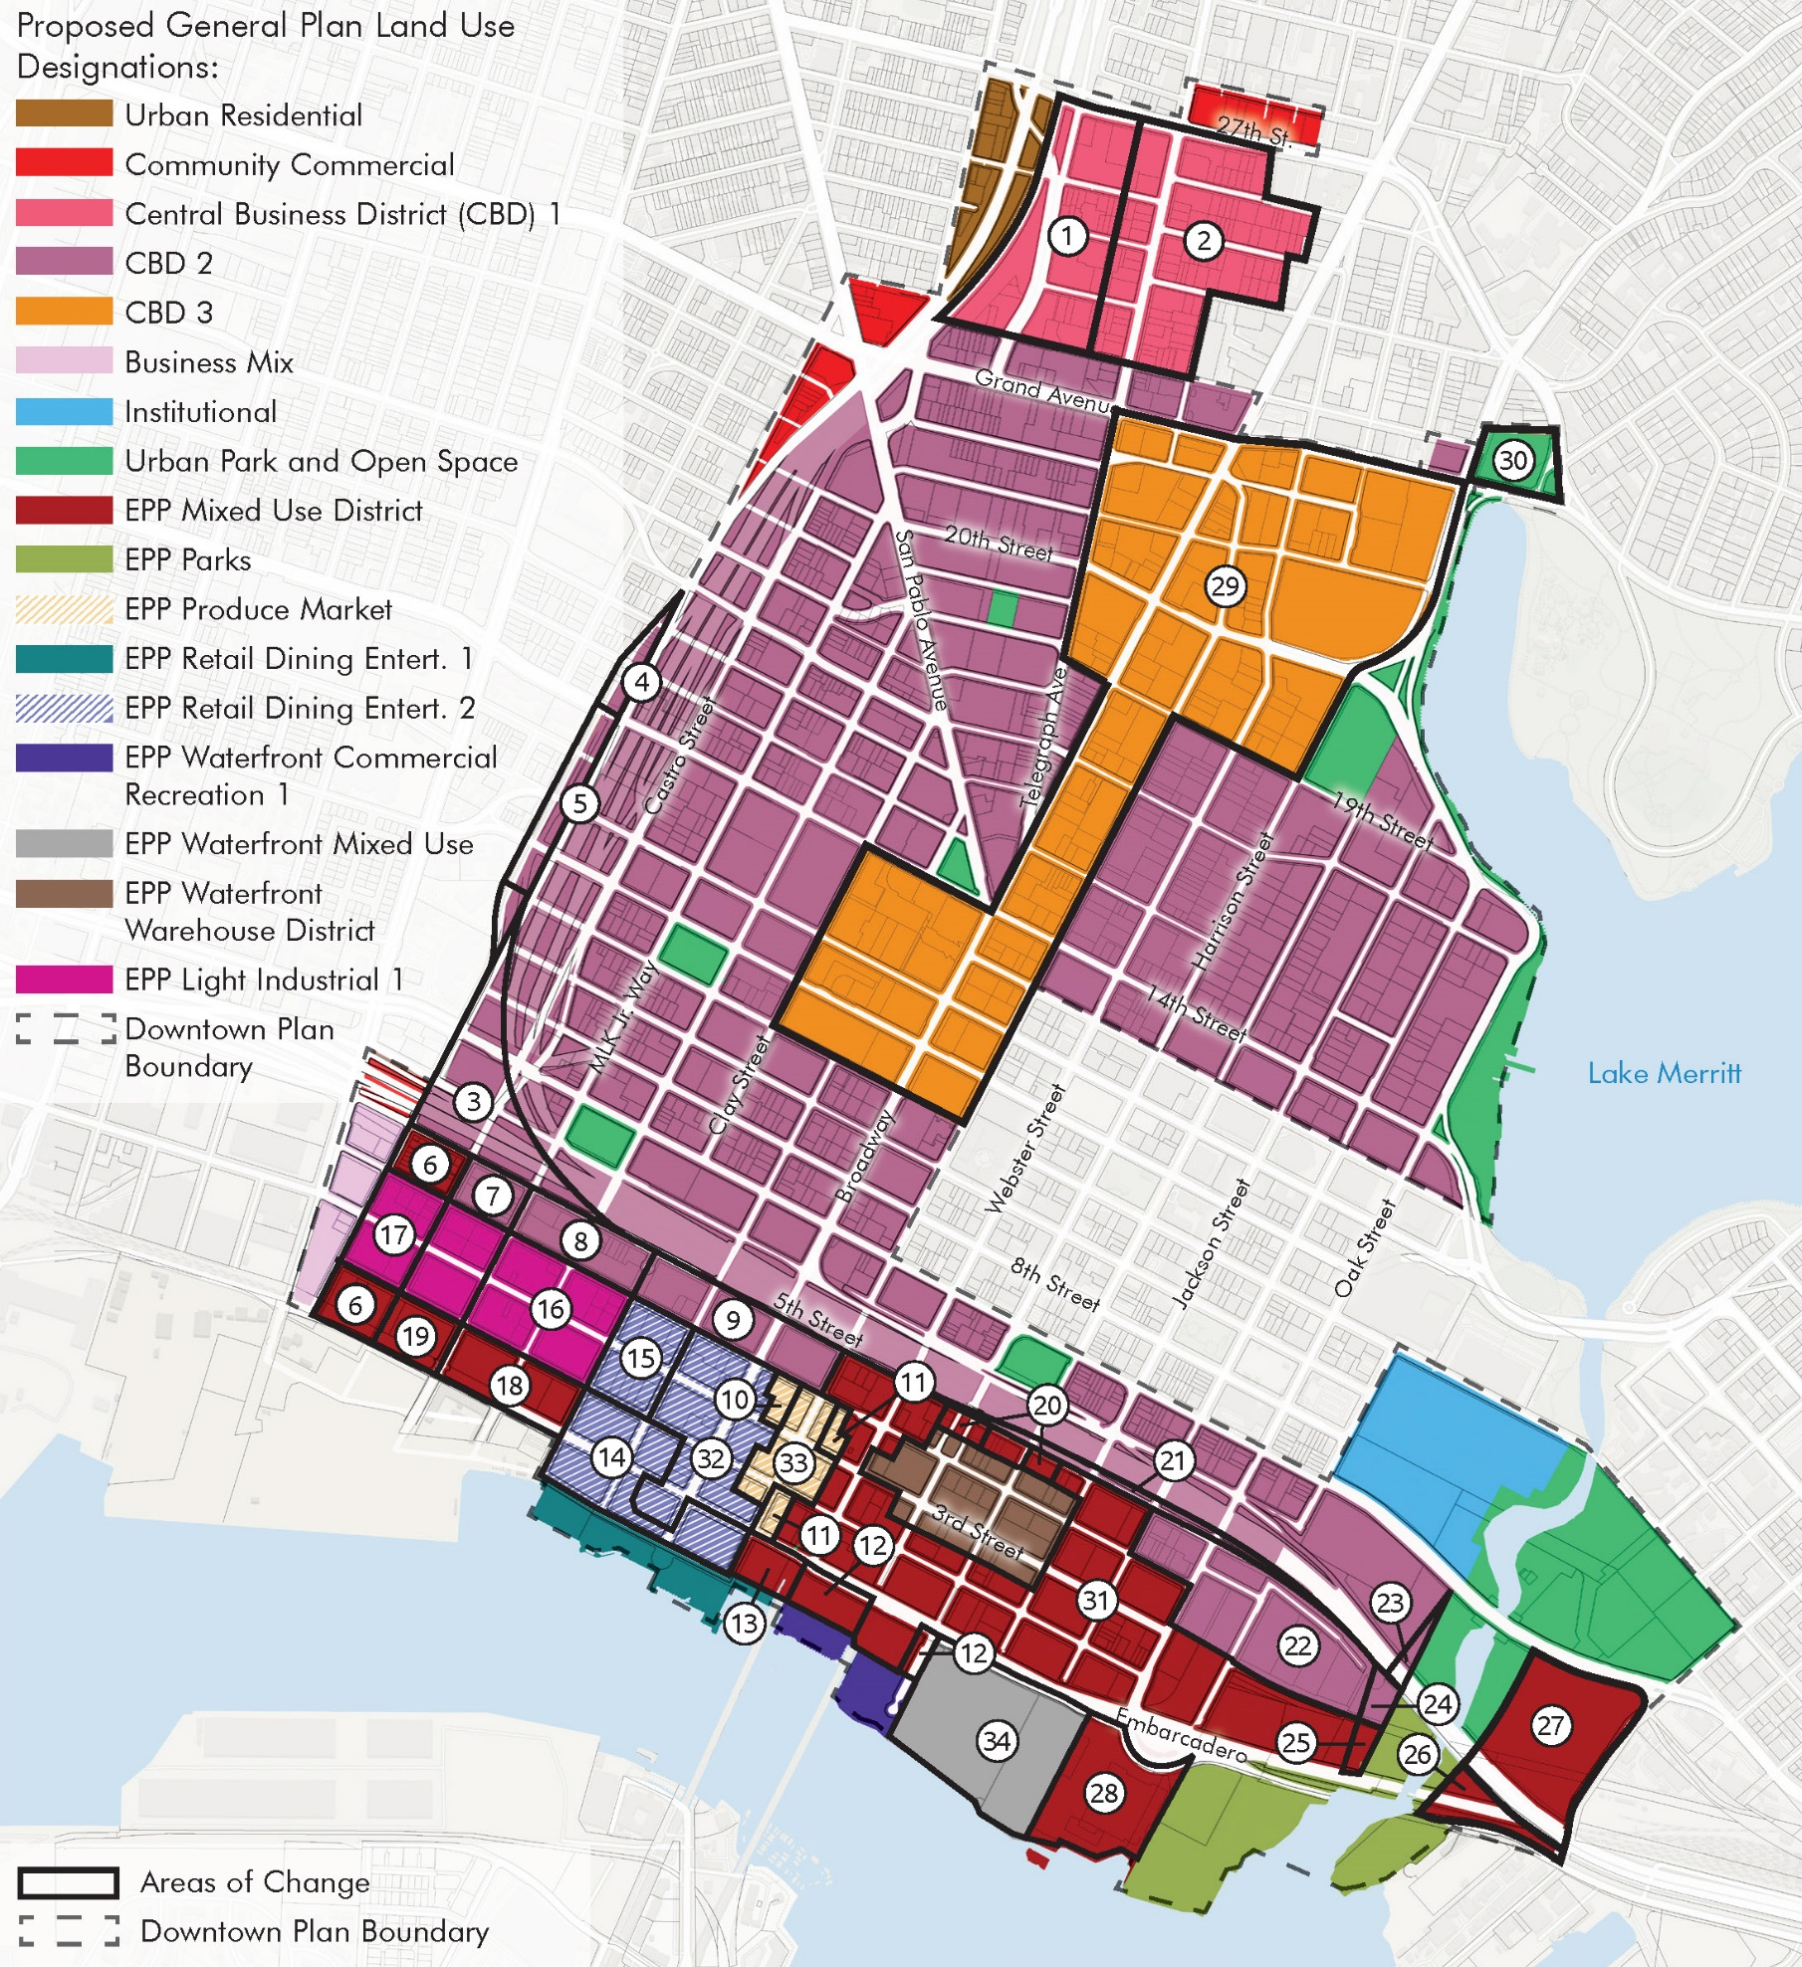
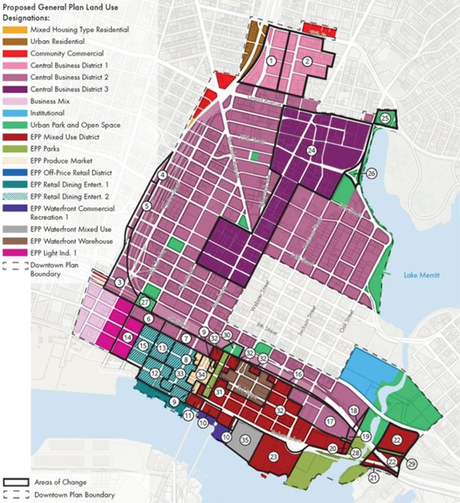
13 | WHAT’S CHANGED: GENERAL PLAN AMENDMENTS MAP
PUBLIC REVIEW DRAFT PLAN
August 2019
FINAL DRAFT PLAN
March 2024

Slide 10
10 | General Plan Amendments: Changes SINCE 2019 DRAFT
Removes Howard Terminal as a Transitional Opportunity Area
Land Use Changes
Two areas; along 6th Street between MLK Jr. Way and Jefferson, and along 6th Street between Webster and Franklin, were identified in the 2019 Draft as Central Business District 2 and are now Urban Park and Open Space
Four blocks, including an EPP Mixed Use District (between 5th and 4th Street, and between 2nd and Embarcadero West) and EPP Light Industry 1 (between 4th and 2nd streets) have been changed to Business Mix
South of 2nd Street to Embarcadero West from MLK Jr. Way to Jefferson was EPP Mixed Use District and is now EPP Light Industry 1
South of 4th Street to Embarcadero West was EPP Mixed Use District/EPP Light Industry 1 and is now Retail Dining Entertainment 2
Along Webster Street south of the I-880, all the way to Water Street has been changed from EPP Mixed Use District to EPP Parks
South of 880 on Harrison Street and south of 880 on Alice Street has been changed from Mixed Use District to EPP Waterfront Warehouse District
South of Embarcadero West between Madison Street to Estuary Park has been changed EPP Waterfront Mixed Use to EPP Mixed Use District west of the Portobello Marina
Increase in overall number of blocks to seven that are designated Industrial west of Broadway
Development Program: increase in flex industrial square footage and removal of opportunity sites in response to public feedback (see next slide)
CAG Meeting | MAY 9, 2024
The
Downtown
Oakland
Specific Plan

Slide 11
11| Zoning: DOSP Goals & Zoning STRATEGIES
DOSP Objective | Zoning Approach
Economic Opportunity | Flexibility in ground floor uses Employment priority overlay zone Preservation of industrial land & industrial transition in western Jack London, R&D uses in central core Zoning Incentive Program below market-rate commercial space benefit
Housing & Homelessness | Increased residential density with community benefits, including affordable housing funds Allowing high-density residential in Victory Court (South Jack London Area) with sea level rise adaptation Permitting high-density efficiency units and work/live units
Mobility, Safety & Connectivity | Green Loop pedestrian/bicycle/landscaping infrastructure improvements Freeway zones to improve pedestrian experience Infrastructure improvements (primarily implemented by DOT)
Culture Keeping | BAMBD Arts & Culture overlay zone to support a thriving district with concentration of relevant activities Arts & Garage District zoning to protect artists & small-scale manufacturers Relaxed rules to permit entertainment and performance venues, revised process for alcohol permits Permitting artisan production commercial activities by right
Community Health & Sustainability | Sea Level Rise overlay zone to require large scale comprehensive sea level rise adaptation plans Green Loop to encourage walking, biking, and use of green/recreational space Standards to protect Lake Merritt Channel for nature and recreation
Land Use & Urban Form | Revised design standards for towers, storefronts, Green Loop and other key frontages Trading of development rights (TDR) program to preserve historic buildings
Notes:
The six topic areas of the DOSP are on the left; racial equity is an overarching goal
Although the DOSP itself contains many implementation strategies, each one of these topic areas also is implemented with zoning strategies that have been included in the Draft Zoning Amendments
These were described more in depth in the Summary of Proposed Changes published with the Draft Zoning Amendments

Slide 12
12 | Zoning: Overview
Updated Land Use Activity Regulations
Zoning Map
Activities Table
Updated Development Standards
Zoning Incentive Program
Transfer of Development Rights Program
Increased height, density and floor area ratio (FAR) in ZIP areas
New Special Districts
Sea Level Rise Overlay
BAMBD Arts & Culture Overlay
Employment Priority Sites
Green Loop & Lake Merritt Channel
Freeway zones to activate underpasses
Updates to Downtown Core Districts
Mixed-Use, Commercial, and Pedestrian Downtown Core Districts
CAG Meeting | MAY 9, 2024
The
Downtown
Oakland
Specific Plan
Notes:
Note: development standards through ODS process
Increased development intensity support housing, job/business growth, meet environmental goals, increase tax revenues to support public services citywide

Slide 13
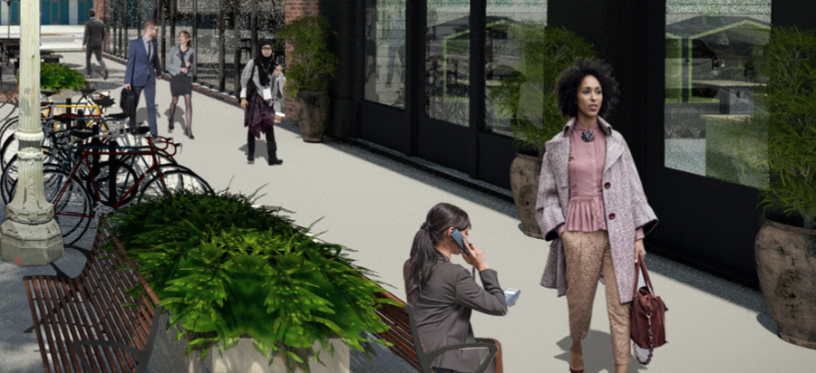
13 | Zoning: Changes to Activities Table
Highlights
Relaxed ground floor and entertainment restrictions
New land use activities such as Artisan Production and Boat and Marine-Related activities
“Artisan Production” commercial use allowed by right throughout the downtown (adopted for GPU Phase 1 amendments)
Reduced restrictions for Group Assembly Commercial activities
Reserve work/live units for active commercial uses
Changes since Draft
Clarifying/allowing Research Services
Conversion of alcohol CUP to special permit
6’ required landscape setbacks for residential facilities
Reducing boundary of D-DT-P the most restrictive pedestrian-oriented zone
CUP required for large office uses greater than 10,000 sf. in the Produce Market area or Art + Garage District (AGD) Zone
Added a setback required for upper-story additions in the AGD and Produce Market zones
In AGD, permitting restaurants in shared cultural space, auto repair or manufacturing (previous proposal permitted with occupation below 50% of total floor)
CAG Meeting | MAY 9, 2024
The
Downtown
Oakland
Specific Plan
Notes:
Highlights of changes to the use tables since the 2022 draft include:
Clarifying the definition of Research Services to encompass more types of activities so more research and development uses such as life sciences are allowed in downtown;
More comprehensively describing what constitutes principal and secondary streets;
Allowing schools and daycare in most areas by right with a pick-up and drop-off plan;
Requiring 6’ landscaped setbacks for residential facilities;
Allowing coworking by right on the ground floor (previously office uses were not permitted);
Increasing threshold for a CUP for Group Assembly from 7,500 sf. to 10,000 sf. to facilitate entertainment uses, while requiring a CUP in residential areas for outdoor Group Assembly;
Requiring a CUP for large office uses greater than 10,000 sf. in the Produce Market area;
In the Art + Garage District Zone:
Permitting restaurants if they are shared with a cultural space, auto repair or manufacturing (previously the proposal was to permit them if they occupy less than 50% of the total floor)
Encouraging arts and cultural activities instead of office uses on the ground floor
Allowing auto uses by right, so long as they are indoors;
Permitting animal care in residential and pedestrian zones;
Allowing indoor storage more broadly in the D-DT-CPW zone;
Reduced loading requirements for work/live facilities;
Added a setback requirement for upper-story additions in the Art + Garage and Produce Market zones;
Requiring a CUP for non-livestock agricultural uses over 20,000 sf.

Slide 14
14 | Zoning: Zoning Incentive Program
Highlights
Developers provide community benefits in exchange for increases in allowable building height, density and/or FAR. The amount of benefit is set by the zoning, based on a financial analysis of the value to be created by the additional development capacity.
Benefits to be provided through the ZIP can either be built on site or provided through fees, in any combination that meets the total amount of required:
On-Site Benefits: Below market-rate (50%) ground floor commercial space, Streetscape improvements, and Public restrooms
In-Lieu Fee: 50% toward preservation, protection and production of affordable housing, 25% toward streetscape improvements, 25% toward employment training, including a set-aside for construction training and apprenticeships
Density bonus can be used “on top of” or after the ZIP program
Benefit amount based on analysis of value capture, including sensitivity analysis based on changed economic conditions
Hausrath Economic Group (HEG) ZIP Economic Analysis & Technical Appendix
Peer reviewed by urban economics and affordable housing development experts
Oakland’s EWD Department and external reviewers from SPUR, Economic & Planning Systems, East Bay Housing Organizations (EBHO) and Street Level Advisors
Notes:
The program allows increased density to meet DOSP goals:
Walkable, transit-rich neighborhoods
Meet State and local goals for housing, including affordable units
Grow Oakland’s economy and tax base to improve public services and fund community benefits citywide
Achieve additional community benefits by capturing some additional value development projects achieve through increased density
The original proposal is that on-site benefits would be at a discount to encourage on-site, but we’re now proposing removing this option for housing to instead encourage fees

Slide 15
15 | Zoning: Zoning Incentive Program
Changes since Draft
Targeted reductions to base height and intensity areas for historic preservation
Removing the Fire Alarm Building and Main Library from the ZIP
Simplification of the ZIP Benefits Table to facilitate use
Requiring that the affordable housing ZIP benefit be provided as an in-lieu fee, and correspondingly eliminating the 10% on-site discount
Allocation of in-lieu fees
Allowing only 50% of the ZIP maximum height and density to be provided through the TDR program
Notes:
The program allows increased density to meet DOSP goals:
Walkable, transit-rich neighborhoods
Meet State and local goals for housing, including affordable units
Grow Oakland’s economy and tax base to improve public services and fund community benefits citywide
Achieve additional community benefits by capturing some additional value development projects achieve through increased density
The original proposal is that on-site benefits would be at a discount to encourage on-site, but we’re now proposing removing this option for housing to instead encourage fees

Slide 16
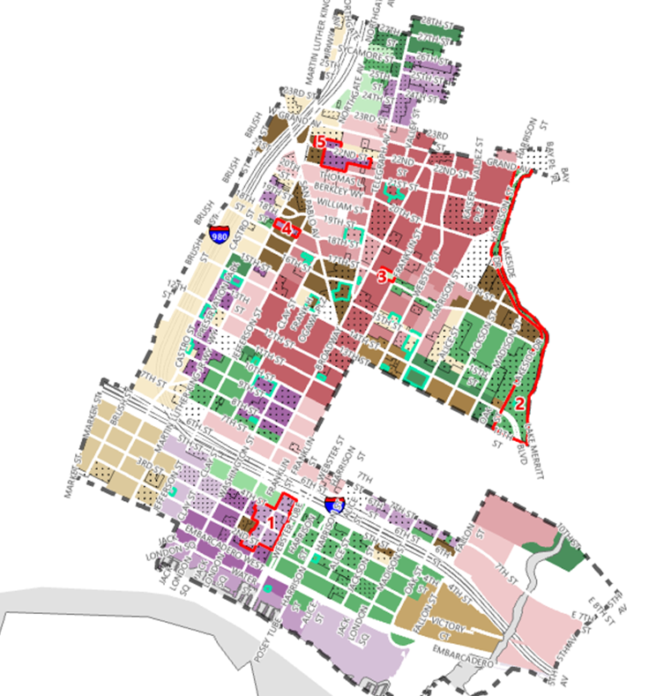
15 | ZONING MAPS:
REVISIONS TO BASE HEIGHT & INTENSITY AREAS
Map Label | Base Height Area Revision
1 | Produce Market: from 5 to 3
2 | Gold Coast: from 10 to 8
3 | Franklin & 17th St: from 5 to 4
4 | 18th Street between MLK and Jefferson: from 18 to 6
5 | 22nd St. Between Telegraph and MLK from: 8 to 5

Slide 17
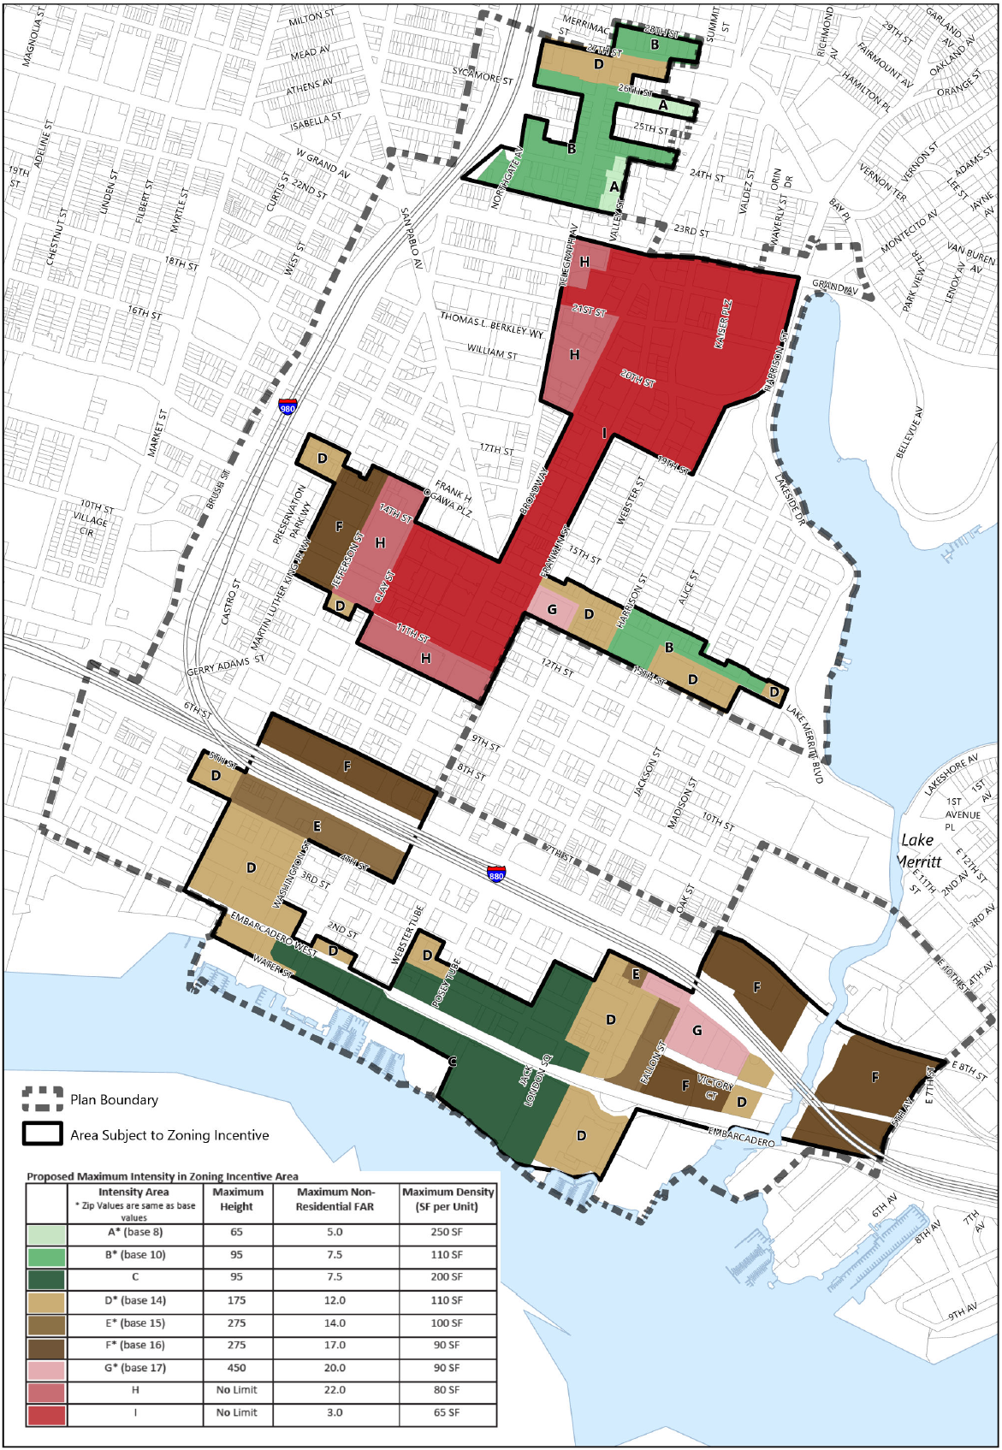
16 | ZONING MAPS: REVISIONS TO ZONING INCENTIVE PROGRAM
Removed Fire Alarm Building and Main Library from the ZIP area
Changes to ZIP Boundary
Changes to maximum height and intensity areas
CAG Meeting | MAY 9, 2024

Slide 18
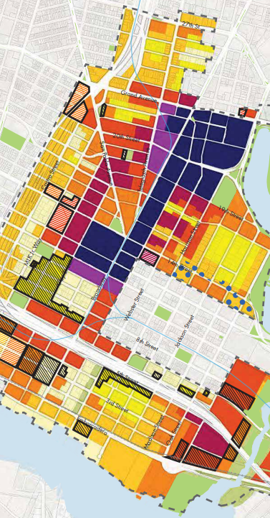
18| Zoning: Transfer of DeveloPment Rights
Highlights
Incentivizes the protection of historic buildings by allowing owners to sell unused development rights for historic properties to owners of sites in less historic areas of downtown.
May include some or all of difference between the existing building’s height, density, and/or floor area and the maximum allowed by zoning
Transfer results in increased dwelling units and/or floor area than would otherwise be permitted at the receiving site
Agreements are set up privately but approved by the City and recorded with the County
TDR rights from a single sending site may be transferred as a group to a single receiving site or in separate increments to several receiving sites
Receiving and sending sites must be within a D-DT Zone:
Receiving sites must be in the ZIP, half of development capacity allowed under the ZIP may be achieved through TDR
The proposed height and bulk for the receiving site must be consistent with the desired character of the block and area
Receiving sites granted added density over the base must be in a location permitting Residential, and a receiving site granted added nonresidential floor area over the base must be at a location that permitting Nonresidential
CAG Meeting | MAY 9, 2024
The
Downtown
Oakland
Specific Plan

Slide 19
19| Zoning: Transfer of Development Rights
Changes since Draft
Expand receiving sites from zones permitting residential uses to all DOSP zones
Allow standalone “A” or “B” Designated Historic Properties as sending sites
Replace the requirement for a Conditional Use Permit to trade development rights with requirement for Design Review approval for construction at the receiving site
Require maintenance agreement for sending site
Prohibition of the demolition of the principal building at the sending site
Clarification: the new density for a receiving site establishes the base density for the purpose of the State Density Bonus Law
Clarification: additional height above the height maximum for the receiving site is based on the average size of dwelling units and can be achieved through the Design Review process
CAG Meeting | MAY 9, 2024
The
Downtown
Oakland
Specific Plan

Slide 20
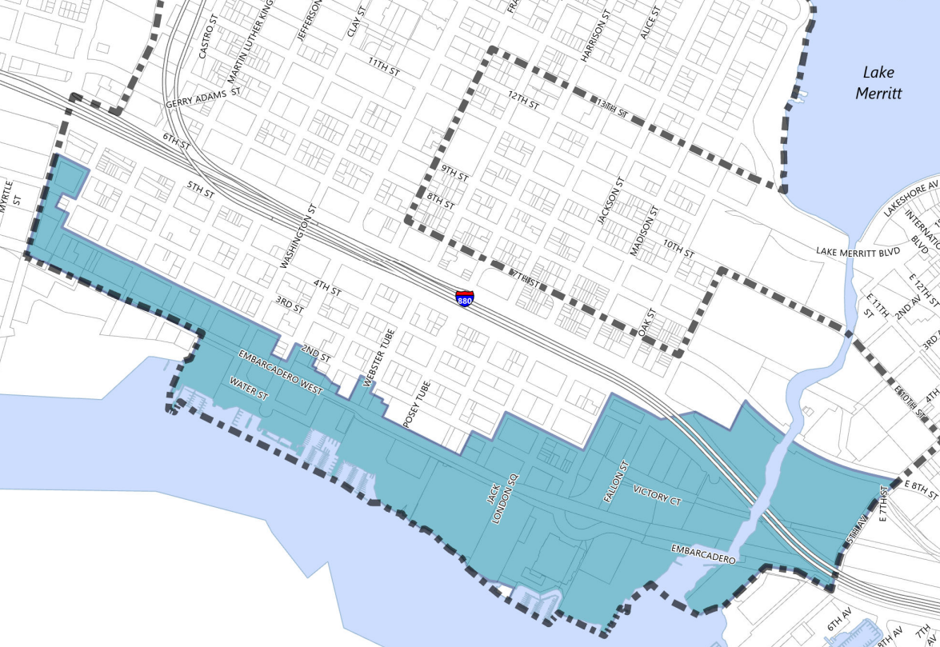
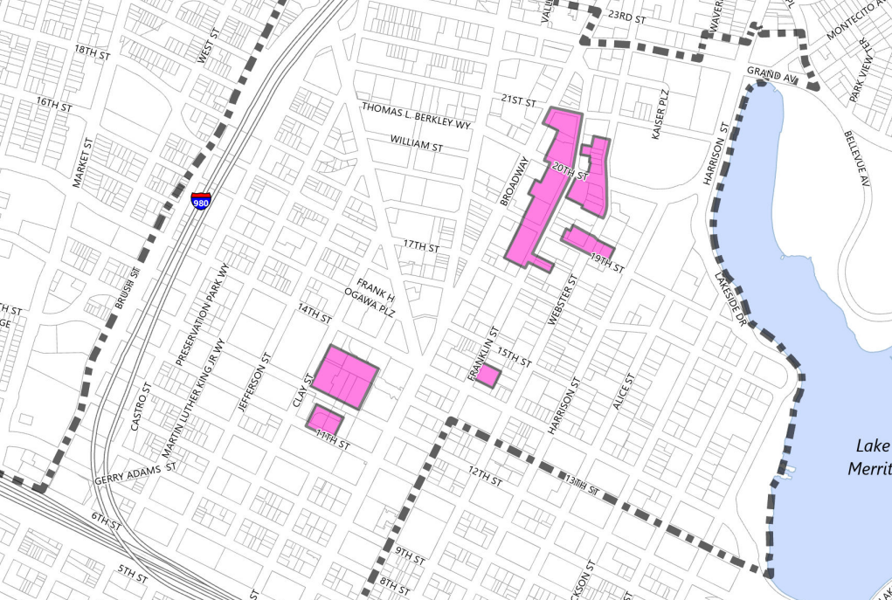
20 | Zoning: Special Districts
Sea Level Rise Combining Zone: Requires Adaptation Plans for new construction, including planned unit development (PUD) and infrastructure upgrades in Victory Court.
Changes: more details on required sea level rise adaptation plans.
I-880 Freeway Zoning: Creates three separate zones within the freeway right-of-way to allow broad uses adjacent to industrial areas while providing a more pedestrian-friendly environment in key pedestrian under-crossings. Prohibits storage uses; requires curb, gutter and landscaping requirements for parking facilities; and encourages Caltrans to allow pop-up stores and recreational uses to activate the spaces under and adjacent to the freeway.
No significant changes
Employment Priority Sites: For projects at designated key sites near transit to establish dwelling units, a project must include at least 40% of the maximum non-residential FAR.
Changes: requirement for non-residential FAR required in order to build residential units reduced from 60% to 40%.

Slide 21
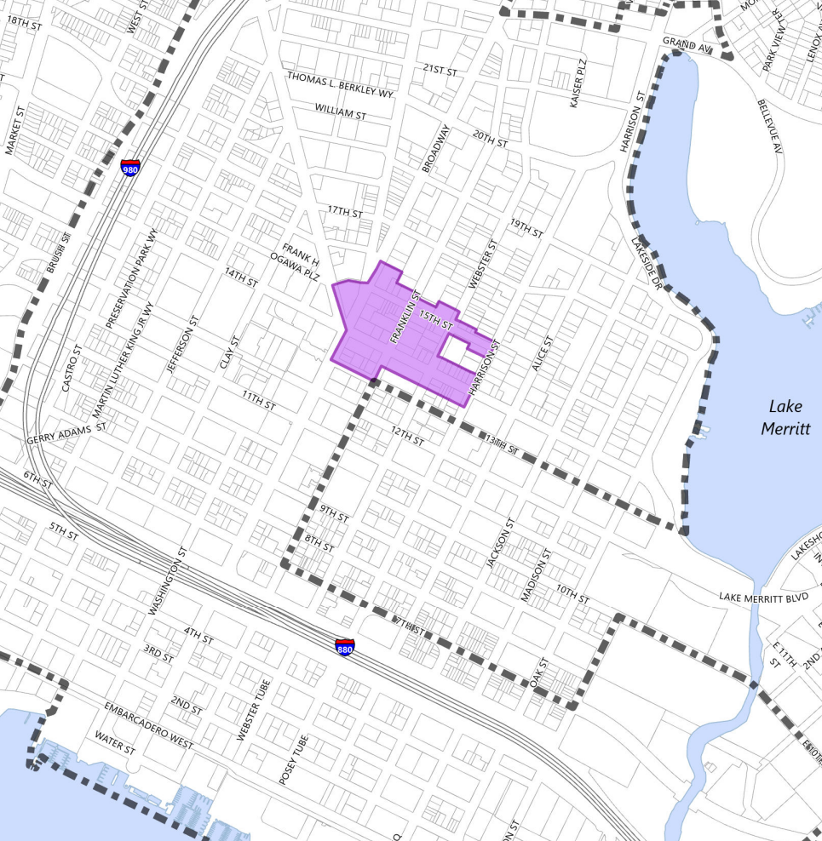
21 | Zoning: Special Districts
Black Arts Movement and Business District (BAMBD) Arts & Culture Combining Zone:
Subsection of the broader BAMBD
Definition of BAMBD Arts & Culture activities is broad; includes many cultural businesses and other institutions
Supported by ZIP below market-rate commercial space benefit & master leasing/tenanting program.
Changes since Draft
Applies to an initial pilot area instead of three nodes
Land use requirements apply to all ground-floor land uses instead of new development only
Instead of requiring 50% of space be dedicated to BAMBD Arts & Culture activities, all ground floor land uses must be BAMBD Arts & Culture Activities to be permitted by right
Other activities are possible with a minor Conditional Use Permit (CUP)

Slide 22
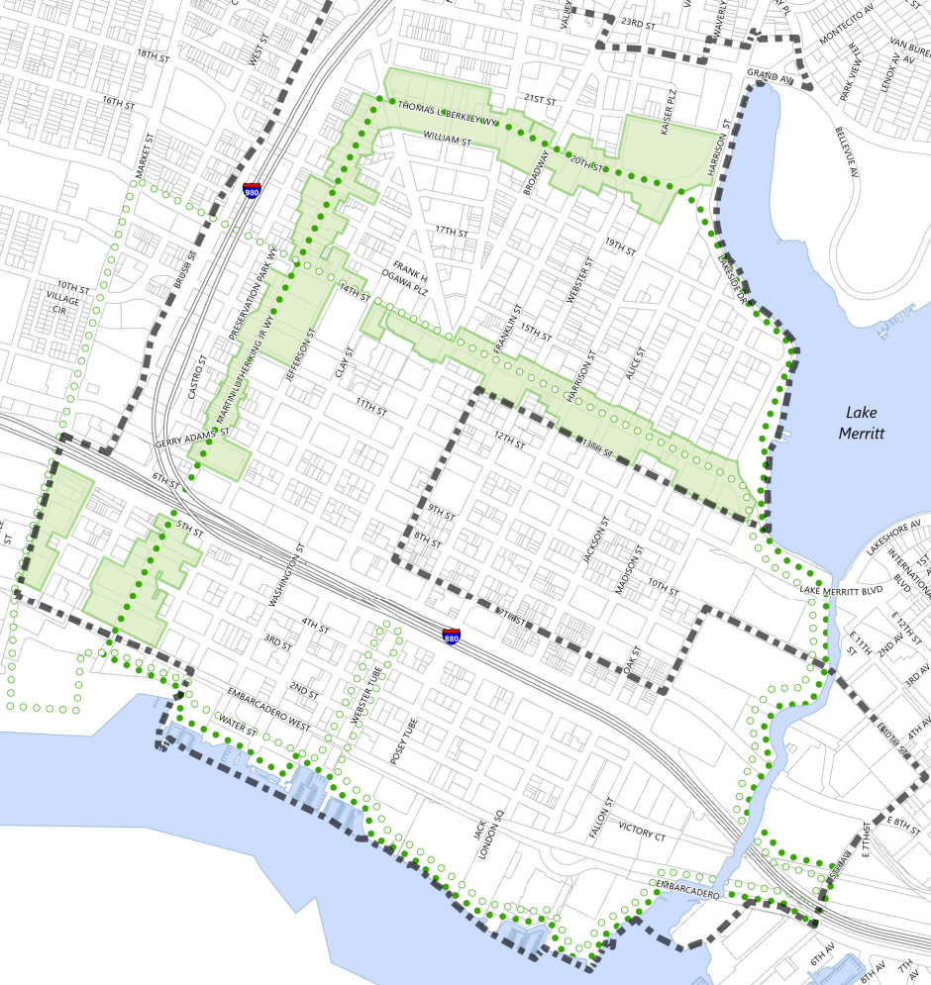
22 | Zoning:
Special Districts
Green Loop & Lake Merritt Channel: Requires frontage and landscaping elements along the Green Loop and a minimum 60’ landscaped setback from the Lake Merritt Channel.
Green Loop includes a series of streetscape and mobility improvements to fill in gaps within the existing network and connect downtown and surrounding neighborhoods with waterfront, cultural and entertainment areas.
No significant changes

Slide 23
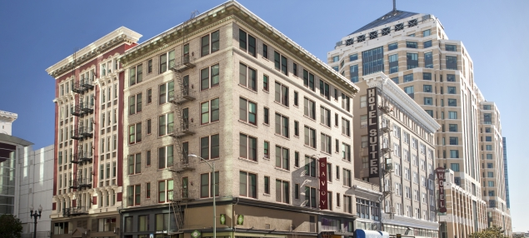
23 | EIR Response to Comments
EIR Response to Comments
Documents comments received on the Draft EIR
6 from governmental agencies
14 from organizations and businesses
3 from individuals
Comments from four public hearings (2019)
Provides written responses
Identifies text revisions to the Draft EIR based on changes to mitigation measures
CAG Meeting | MAY 9, 2024
The
Downtown
Oakland
Specific Plan
Notes:
The following are significant an unavoidable so will go to council to make a finding of overriding considerations
The other ones are less than significant significant or they’re mitigated

Slide 24
24 | EIR Response to Comments: Changes
EIR Findings: Traffic and Transportation
Significant and unavoidable impact(s) even with MM(s) identified:
TRANS-2: Development under the Specific Plan would generate additional multi-modal traffic traveling across the at-grade railroad crossings that would cause or expose roadway users (e.g., motorists, pedestrians, bus riders, bicyclists) to a permanent or substantial transportation hazard.
TRANS-3: The development under the Specific Plan would contribute to the significant degradation of several CMP or MTS segments in 2020.
Cumulative Impact TRANS-1: Development under the Specific Plan together with cumulative development, would generate additional multi-modal traffic traveling across the at-grade railroad crossings that would cause or expose roadway users (e.g., motorists, pedestrians, bus riders, bicyclists) to a permanent or substantial transportation hazard.
EIR Findings: Air Quality
Significant and unavoidable impact(s) even with MM(s) identified:
AIR-1: Operation of some large development projects under the Specific Plan could result in a cumulatively considerable net increase of criteria air pollutants for which the region is in nonattainment.
CAG Meeting | MAY 9, 2024
The
Downtown
Oakland
Specific Plan

Slide 25
25 | EIR Response to Comments: Changes
EIR Findings: Cultural and Historic Resources
Significant and unavoidable impact(s) even with MM(s) identified:
CULT-1: Implementation of the Specific Plan and its associated development is anticipated to result in the demolition, destruction, or relocation of some historical resources either as individual resources and/or as contributors to historic districts.
CULT-2: Alterations to Historic Buildings that could occur under the Specific Plan could change the significance and character of historic resources as a result of the Specific Plan.
Cumulative Impact CULT-1: Implementation of the Specific Plan and its associated development, combined with cumulative development in the Plan Area and citywide, including past, present, existing, approved, pending, and reasonably foreseeable future development, would contribute to a significant and unavoidable adverse cumulative impact to cultural and historical resources.
CAG Meeting | MAY 9, 2024
The
Downtown
Oakland
Specific Plan

Slide 26
26 | EIR Response to Comments: Changes
EIR Findings: Aesthetics
Significant and unavoidable impact(s) with no MM(s) identified:
AES-1: Shadow. Implementation of the Downtown Specific Plan and development that may occur under the Plan may result in substantial new shadow that would shade solar collectors, passive solar heaters, public open space, or historic resources, or otherwise result in inadequate provision of adequate light.
AES-2: Wind Analysis. Implementation of the Downtown Specific Plan and development that may occur under the Plan may result in adverse wind conditions.
Cumulative AES-1: Implementation of the Downtown Specific Plan and development that may occur under the Plan may, in combination with other past, present, and reasonably foreseeable future projects within and around the Plan Area, result in significant cumulative wind and shadow impacts
CAG Meeting | MAY 9, 2024
The
Downtown
Oakland
Specific Plan

Slide 27
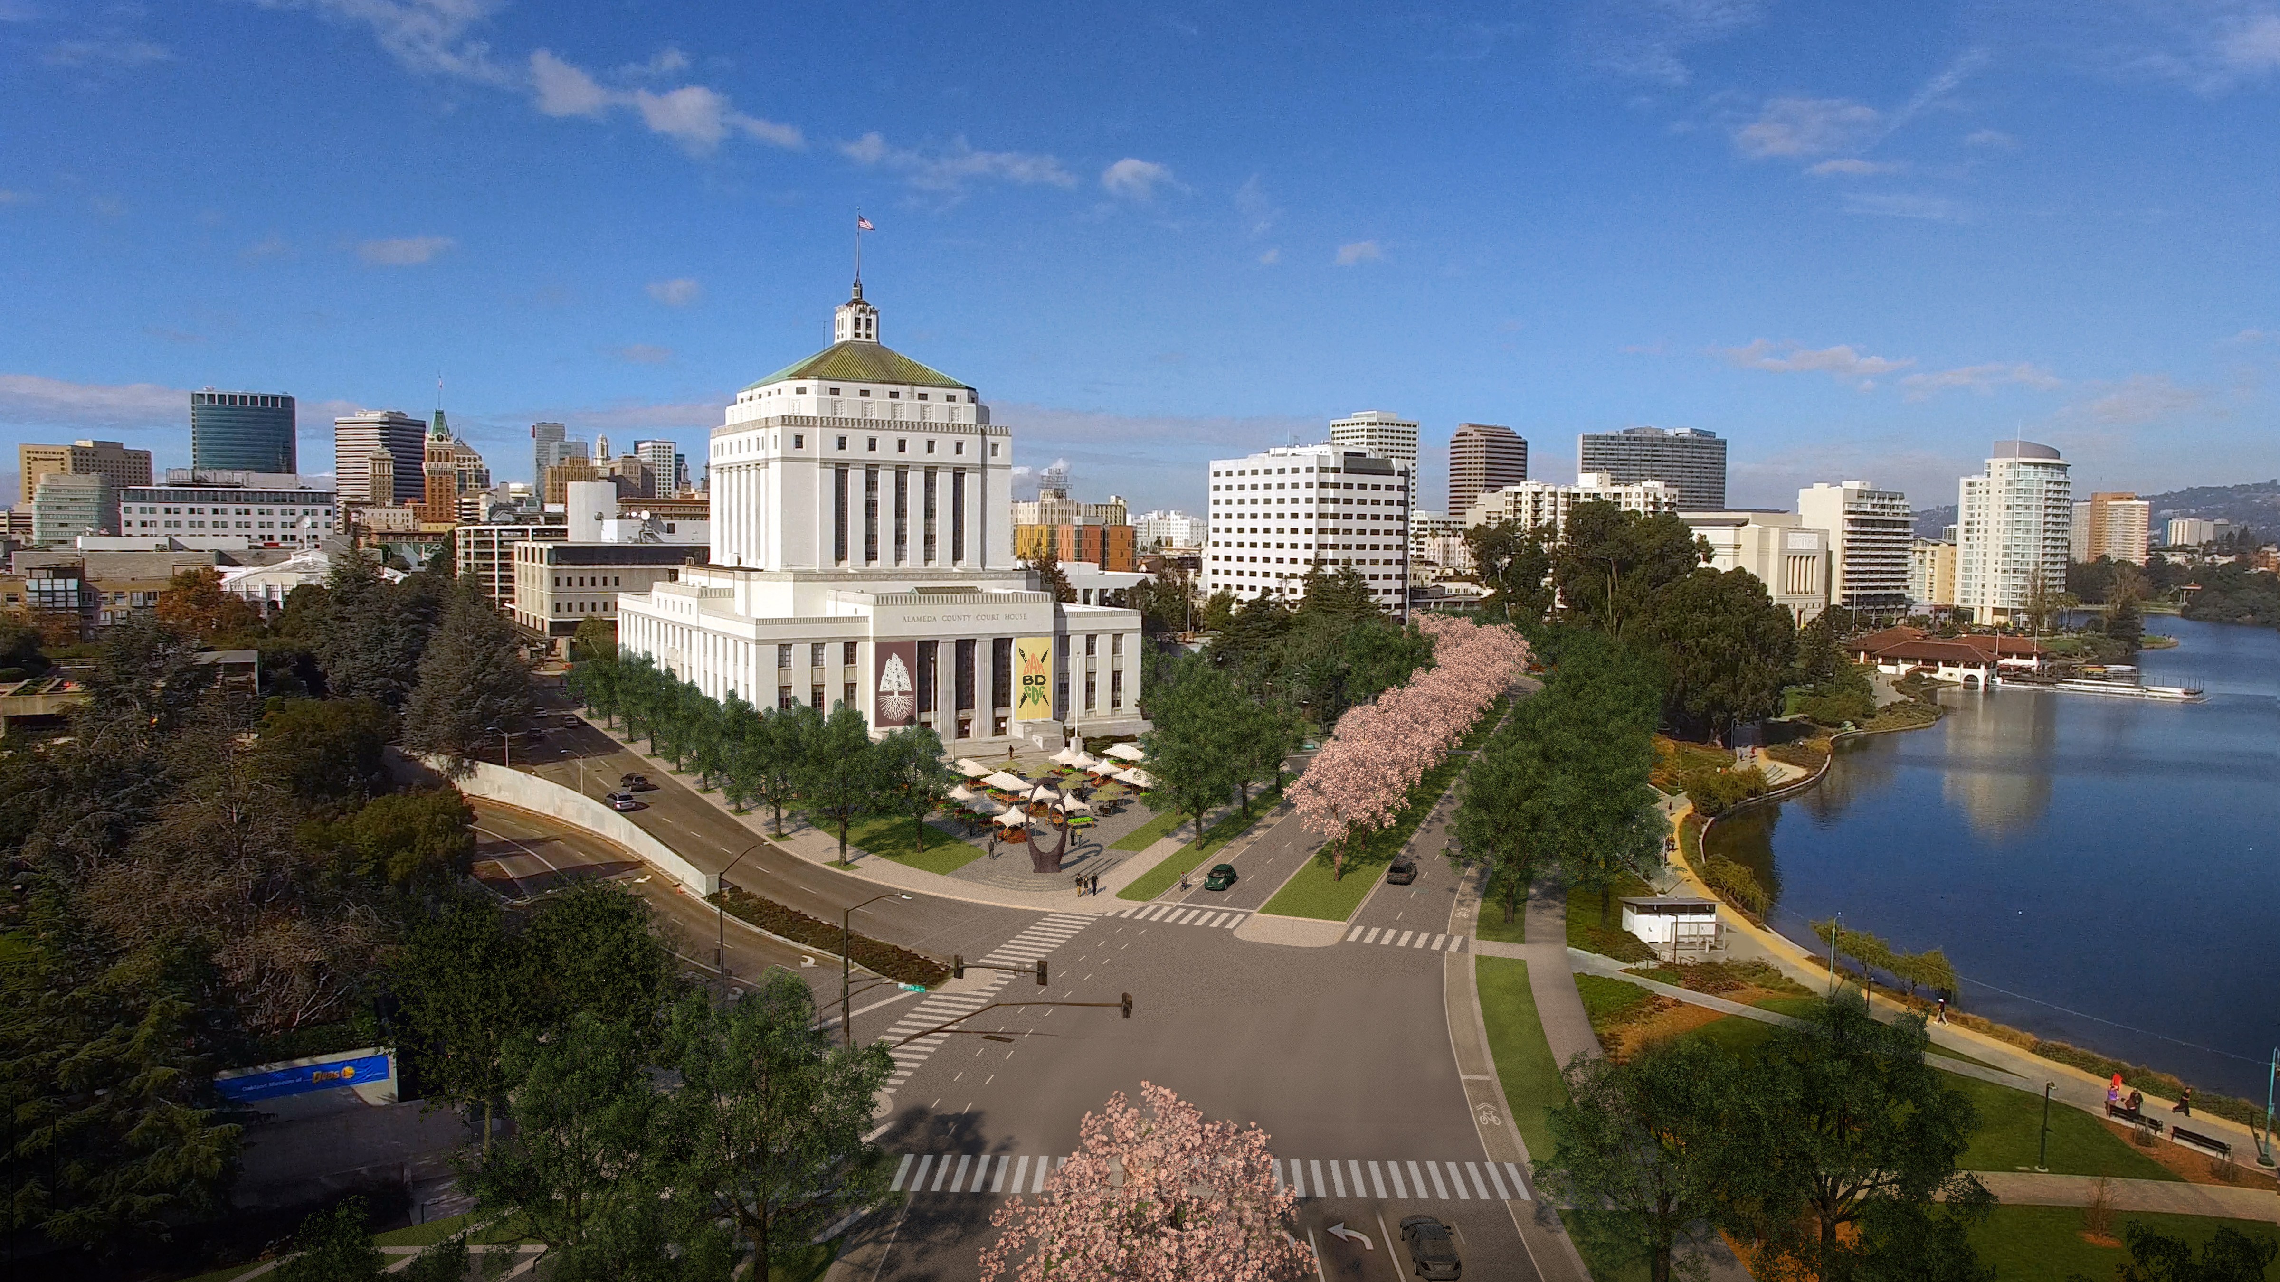
27 | Next STEP: Meetings & Adoption HEARINGS
April 18 and May 9: CAG Meetings
May 6 & June 3: Landmarks Preservation Advisory Board
May 15 & June 5: Planning Commission
June 25: Community & Economic Development Committee
July 2 & July 16 City Council (1st & 2nd reading)
CAG Meeting | MAY 9, 2024
The
Downtown
Oakland
Specific Plan

Slide 28
Downtown Oakland Specific Plan
City Planning Staff
William Gilchrist, Director of Planning & Building
Ed Manasse, Deputy Director of Planning
Laura Kaminski, Strategic Planning Manager
Joanna Winter, Project Manager
Michelle Matranga, Planner (Strategic Planning)
Neil Gray, Planner (Zoning)
Stephanie Skelton, Public Service Representative
Consultant Team
Plan lead: Dover, Kohl & Partners
EIR lead: Urban Planning Partners
Zoning: PlaceWorks
Zoning Economic Analysis: Hausrath Economic Group & EPS

Slide 29
End of presentation; the other slides are just in case we get a question

Slide 30
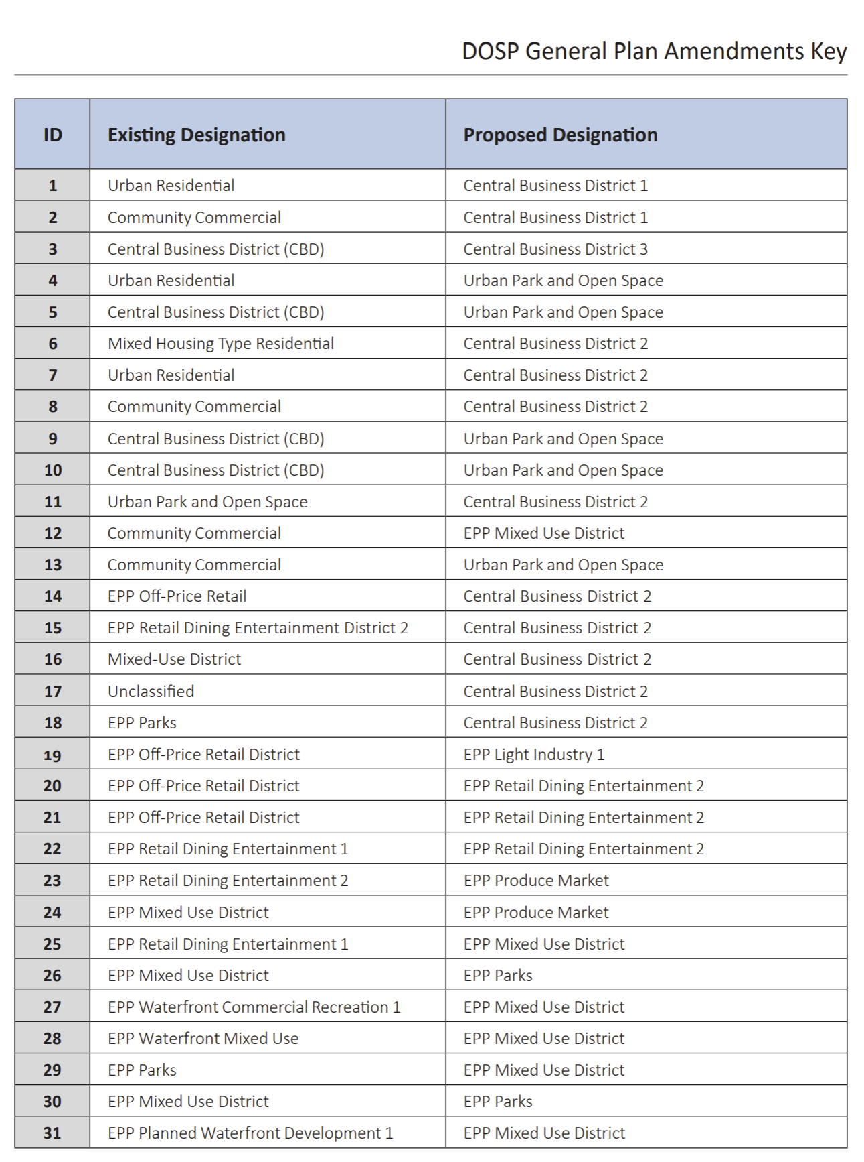
30 | General Plan Amendments

Slide 31
31 | Intensity Map Changes: Changes SINCE 2019 DRAFT
Intensity Map Changes
Clustered increases in area West of San Pablo and between 14th and 15th Street between MLK Jr. Way and Jefferson Street
Several decreases in intensity proposed within the Jack London District, Laney College area, and Old Oakland through the Central Core

Slide 32
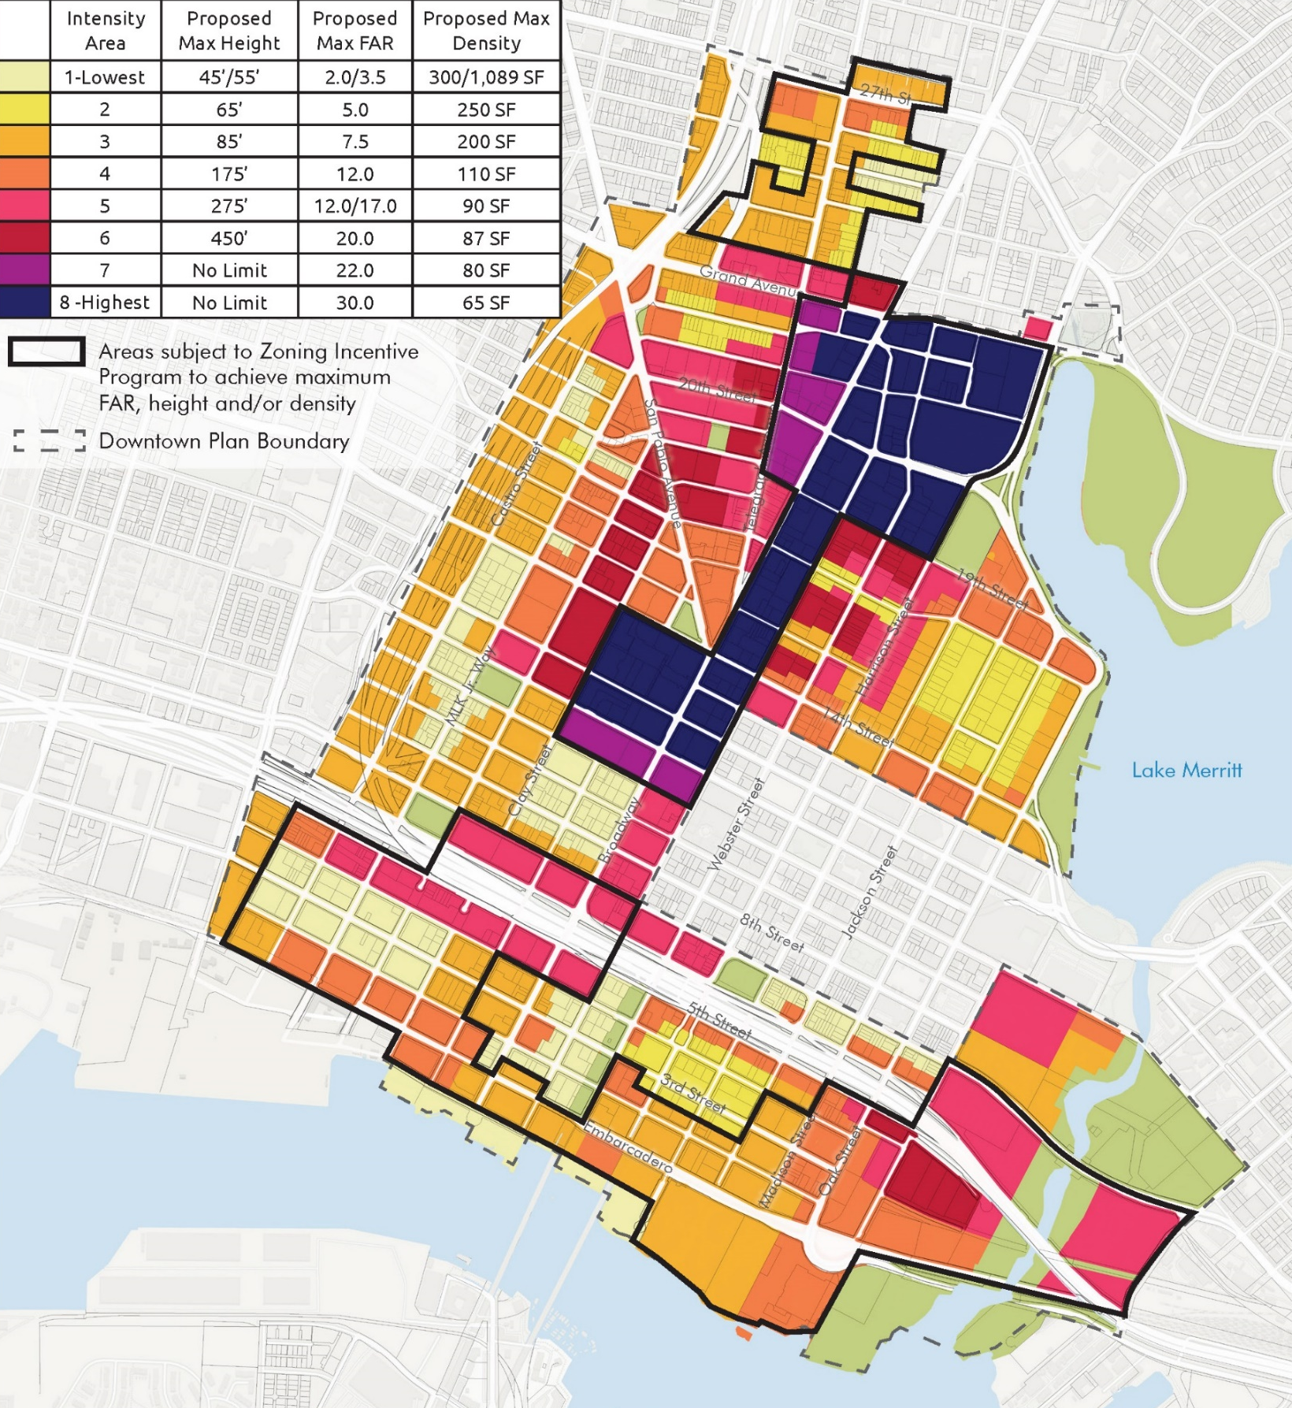
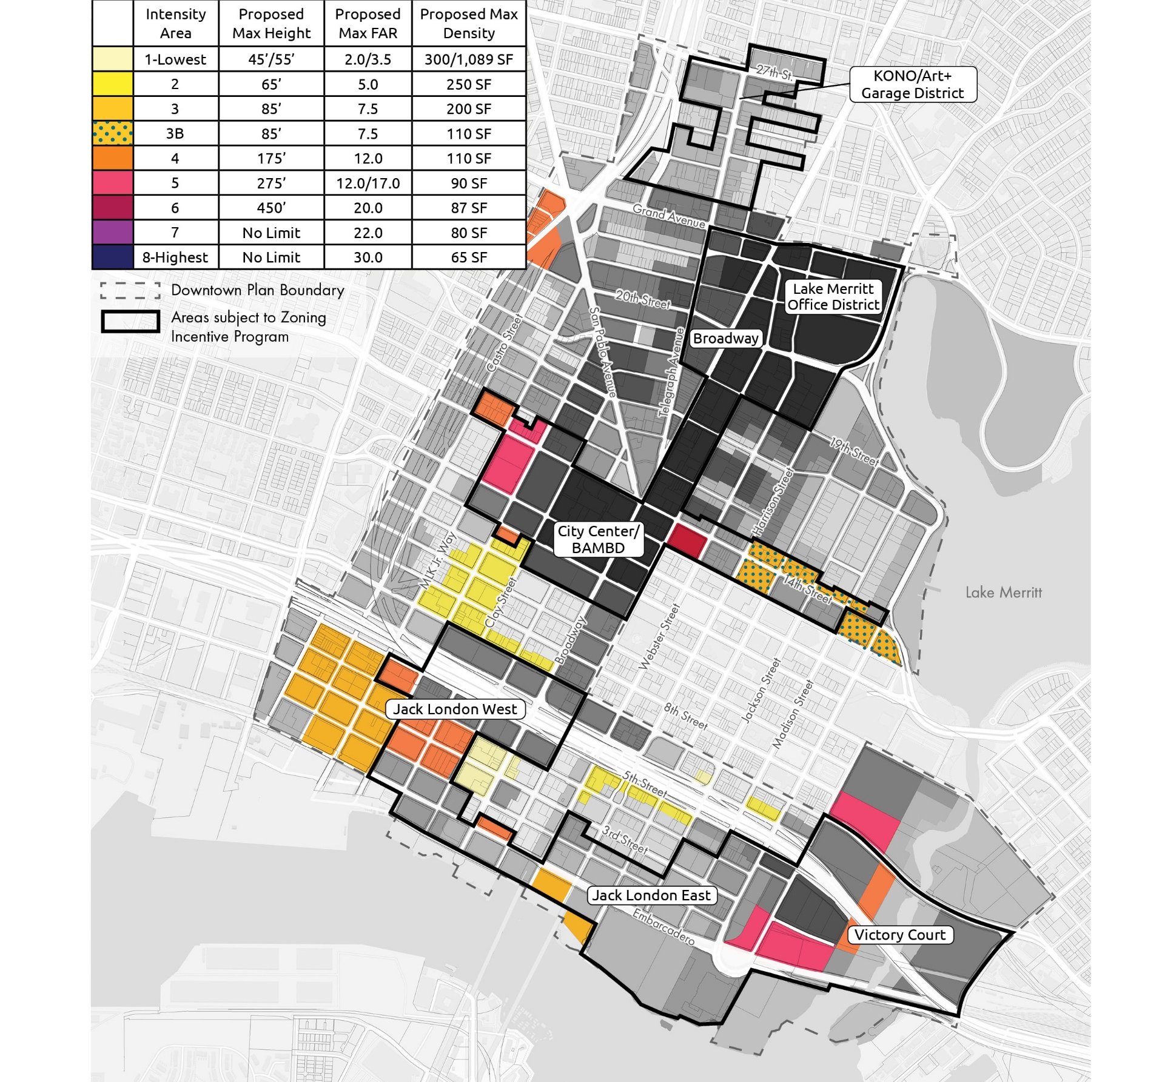
23 | WHAT’S CHANGED: INTENSITY MAP
PUBLIC REVIEW DRAFT PLAN
August 2019
FINAL DRAFT PLAN
March 2024

Slide 33
33 | What's New: Fiscal Analysis of High-Density Development
Hausrath Economic Group (HEG) ZIP Economic Analysis
Technical Appendix: Methodology and Assumptions of Economic Analysis
Peer reviewed by urban economics and affordable housing development experts
Oakland’s Economic and Workforce Development Department as well as external reviewers from SPUR, Economic & Planning Systems, East Bay Housing Organizations (EBHO) and Street Level Advisors
New High-Density Development Downtown Generates Long-term Tax Revenue Benefits Citywide
Tax revenue from new development downtown is many times larger than tax revenue from existing uses on development sites.
The higher the density of new development, the more annual tax revenue generated, per square foot of land.
Net fiscal benefits citywide as new development downtown:
Generates tax revenue to cover the costs of services to the new development, AND
Provides funding for services and other public benefits throughout the city.

Slide 34
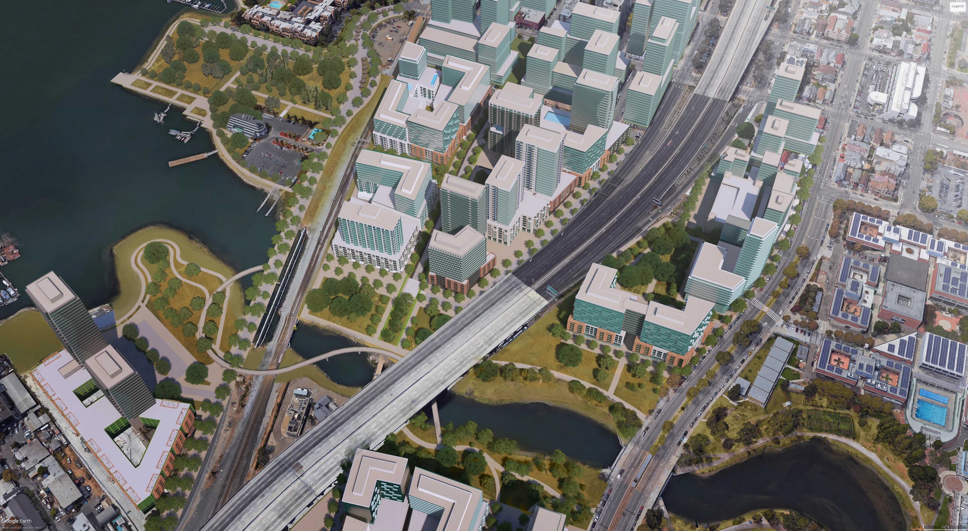
Additional Materials & Analysis Developed by HEG: Analysis of the Benefits of Downtown Development
One-time, Upfront Funds Compared to Value of Annual Tax Revenue Stream for Selected Time Periods: Prototypical High-Rise Residential and Office Development (2020/2022 dollars)
Notes:
Alternate slide to Slide 13: This shows both High Rise Residential and Office on the same chart – But it needs a legend for the One-time & ZIP fees
This long-term tax revenue is many times larger over time than the revenue from one-time fees – both impact fees and ZIP fees.
Consistent w/the prototypes – these are in the CBD – increase in density over the Base is 38%
Tables in report
Max density by prototype

Slide 35
35| Zoning: draft Zoning Amendments
Development Standards, Height and Intensity Regulations & Zoning Incentive Program (ZIP)
Revises building design standards, coordinated with upcoming objective design standards
Increases development intensity to support housing, job/business growth, meet environmental goals, increase tax revenues to support public services citywide
New increased height and floor area ratio (FAR) in certain areas, if participating in the Zoning Incentive Program (ZIP)
ZIP to provide community benefits in return for increased development intensity
Transfer of development rights (TDR) program for historic preservation
CAG Meeting | MAY 9, 2024
The
Downtown
Oakland
Specific Plan

