Slide 1
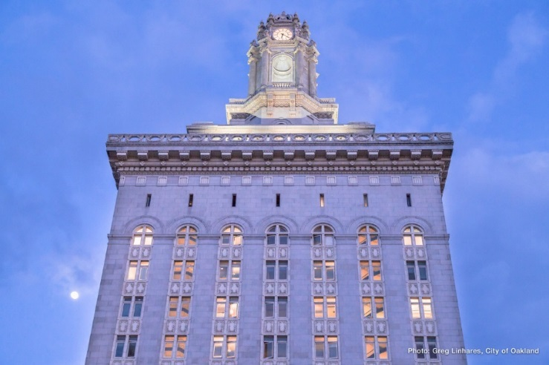

Rules of the Road:
Running for Office in Oakland
Presented by
Public Ethics Commission

Slide 2

Introduction
State Rules – California Fair Political Practices Commission
Local Rules – Oakland Public Ethics Commission
    Jelani Killings: Ethics Analyst – Education Program jkillings@oaklandca.gov
    Suzanne Doran: Lead Analyst – Lead Analyst sdoran@oaklandca.gov
This overview is not to provide legal advice. If you have fact-specific questions, contact the PEC’s advice and assistance line.
Notes:
In addition to state rules for political campaigns, Oakland candidates and campaigns are subject to local campaign rules.
This overview is designed to provide you with information related to Oakland-specific rules on campaign contributions and expenditures, disclosure requirements, and to also provide local campaigns with some best practices.

Slide 3

Training Outline
Local Oakland Campaign Reform Act
Electronic Filing Requirement
Voluntary Campaign Spending Limits
    OCRA Form 301
Local Contribution Limits and Restrictions
    Broad Based Committee
    Aggregation of Contributions
    When Loans and Unpaid Bills Become Contributions
    Required Notice on Fundraising Materials
    Contractor Prohibition
Limited Public Financing Program
Resources

Slide 4
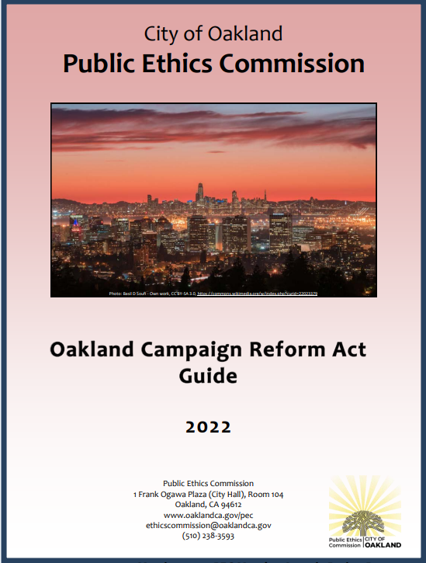
Local Oakland Campaign Reform Act (OCRA)
Local rules in addition to state rules
Must comply with both
OCRA establishes:
  Electronic filing requirements
  Local contribution limits
  Optional expenditure limits
  Contractor contribution restrictions

Slide 5
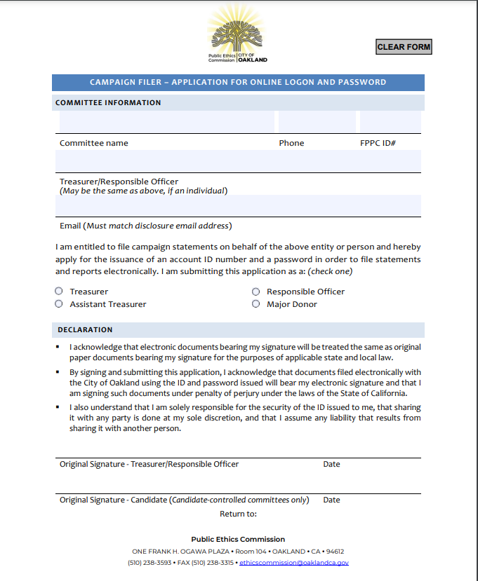
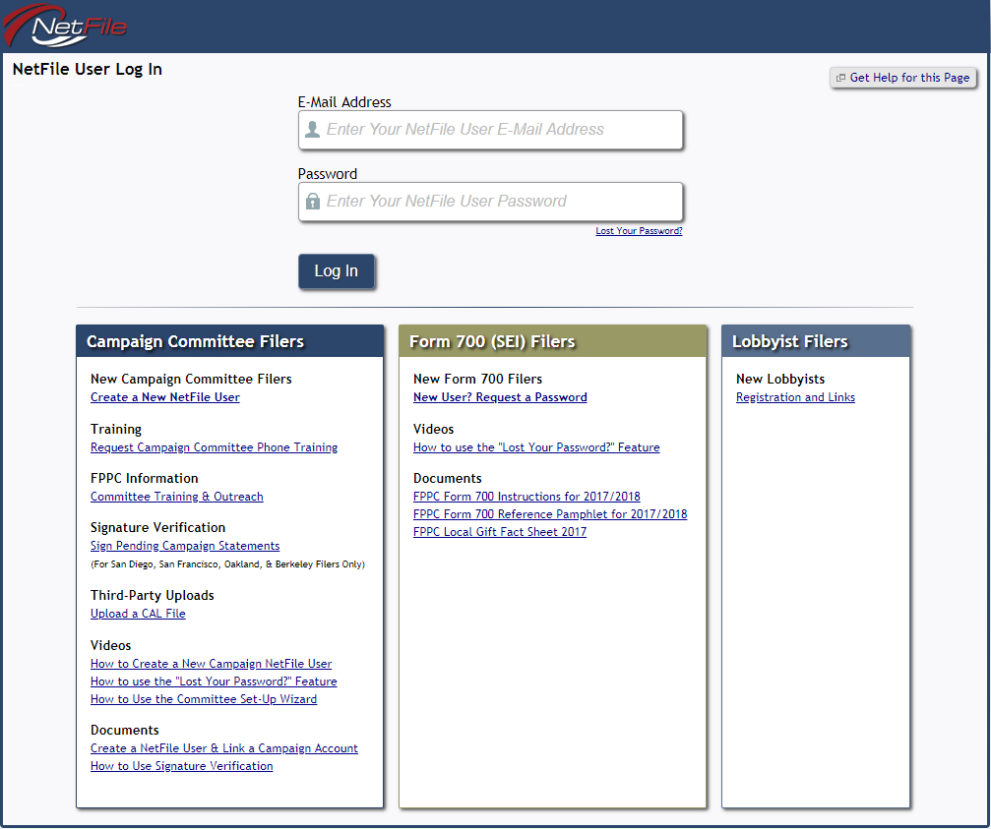
Electronic Filing Requirement
Mandatory electronic filing
File Form 300 along with initial Form 410
Free 30-minute phone training with NetFile
Don’t wait until filing day! Start early and call for assistance early!
Notes:
Electronic filing of campaign disclosure statements is mandatory in Oakland for all campaign committees.
The City of Oakland provides a free, online filing system called NetFile to complete and e-file disclosure statements and reports.

Slide 6
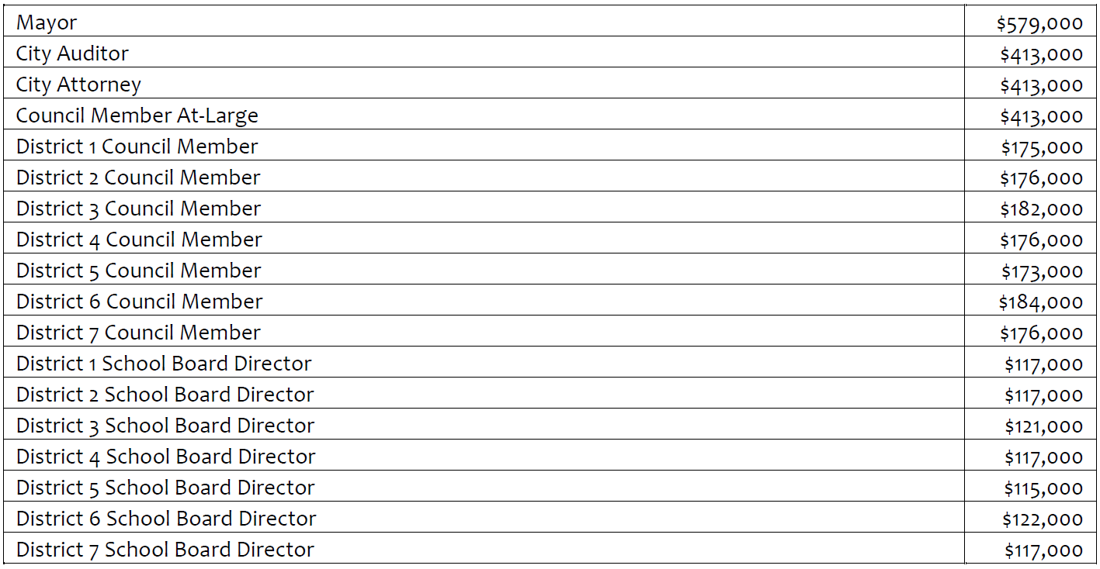
Voluntary Campaign Spending Limits
A candidate can choose one of two roads to take for campaign fundraising and spending:
  Voluntary Accept Spending Limits
      Can raise contributions at a higher amount
      Can spend up to the spending limit for the election
  Don’t Accept Spending Limits
      Not bound by spending limit
      Cannot raise contributions at higher amount
Benefit of agreeing to limit spending = ability to receive contributions in greater amounts than those who don’t.
Notes:
Candidates have a choice whether to limit their campaign spending within pre-set expenditure ceilings.
Expenditure ceilings are set for each City office.

Slide 7

How to Accept Spending Limits
File OCRA From 301 with the Public Ethics Commission before receiving contributions at the higher limit.
Notes:
Candidates must agree to the expenditure ceilings in writing before they begin collecting contributions at the higher amounts.
No later than the time a candidate files papers for candidacy.
Failing to timely file Form 301 can result in a monetary fine from the PEC.

Slide 8
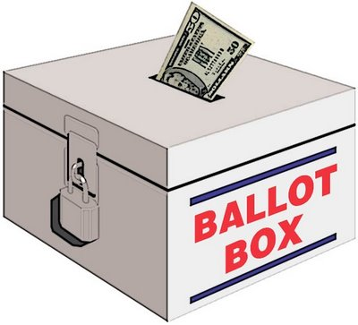
Local Contribution Limits and Restrictions
Candidates agreeing to limit their spending:
    Person - $900 per election
    Broad-Based Political Committee - $1,800 per election
Candidates who do not agree to limit spending:
    Person - $200 per election
    Broad-Based Political Committee - $400 per election
Regardless of whether a candidate accepts or rejects the voluntary expenditure ceiling, any candidate is free to contribute to or loan his or her campaign any amount of money from their own personal funds (beware of LPF rules – see later slide).
Note: Candidates cannot directly or indirectly solicit contributions from City employees or board/commission members unless part of a mass solicitation to the general public.
Notes:
Share definition of person = individuals, businesses, organizations, committees that don’t qualify as BBPC

Slide 9

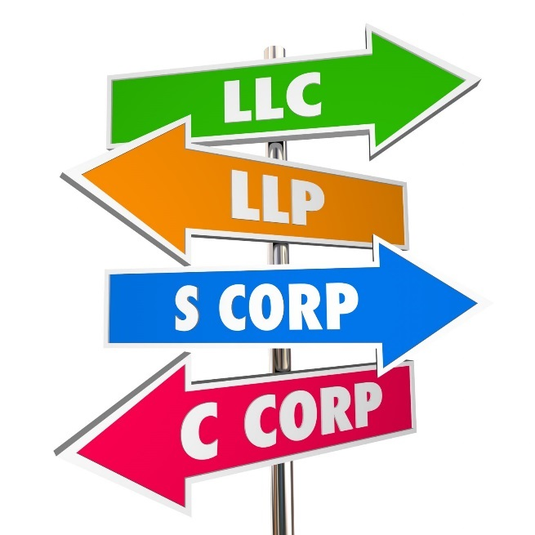
“Person”
“Person” is defined broadly
Includes individuals, businesses, organizations, and any committee that does not qualify as a broad-based political committee

Slide 10
Broad Based Political Committee
What is a broad-based political committee?
  Has been in existence for more than 6 months
  Receives contributions from 100 or more persons
  Makes contributions to 5 or more candidates (not required that all 5 or more candidates be running for City office)
Campaign Tip: Candidates should assume the limit for contributions from “persons” applies unless they know the committee qualifies as a broad based committee
To help determine whether a political committee qualifies as a “broad-based political committee,” candidates can search the filings of state registered political committees using the California Secretary of State’s website at www.sos.ca.gov.

Slide 11
Aggregation of Contributions
Contributions from two or more entities are treated as coming from the same person when:
  The entities share a majority of members on their respective boards of directors
  The entities share three or more, or a majority of officers
  The entities are owned or controlled by the same majority shareholder(s)
  The entities are in a parent-subsidiary relationship
  One entity finances, maintains, or controls the other entity’s contributions or expenditures
Watch out for:
  Same name printed on two separate checks
  Same person signing multiple checks
  Note: Contributions by two individuals married to each other are treated as separate contributions.

Slide 12
When Loans and Unpaid Bills Become Contributions
Loans – must be made in writing, written document must be filed with candidate’s campaign statement
    Commercial = allowable, if terms are same for everyone
    Non-commercial = considered a contribution subject to limits
Extension of credit or unpaid bills become a contribution subject to limits if more than $1,500 and 90 days.
Campaign Tip: If you are not able to pay outstanding bills within 90 days, you should arrange some form of payment schedule in which all vendors are paid something on a regular basis.
Notes:
It is not unusual for candidates to spend more money than they raise before an election. Be careful of a loan or outstanding bill automatically becoming a contribution.
Other than commercial loans, any extension of credit in excess of $1,500 for a period of more than 90 days is treated as contribution subject to the applicable contribution limits.

Slide 13
Required Notice on Fundraising Materials
All campaign fundraising material must include a notice that consists of the following language:
The Oakland Campaign Reform Act limits campaign contributions by all persons (OMC §§3.12.050 and 3.12.060) and prohibits contributions during specified periods from contractors doing business with the City of Oakland or the Oakland Unified School District (§OMC 3.12.140).
The notice should appear on any printed or electronic medium that solicits or explains how to make a campaign contribution.

Slide 14


Contractor Prohibition
Persons negotiating contracts with the City of Oakland or Oakland School Board may not make contributions to Oakland candidates.
    When: This “contractor ban” applies from the time negotiations on the affected contract begin to 180-days (6 months) after the completion or termination of negotiations of the contract.
    Which contracts the ban applies to: The ban applies to contracts that would require City Council or School Board approval.
Campaign Tip: Use the PEC’s contributor verification card to find out from contributors whether they are negotiating a contract with the City or School Board.
See OCRA Guide Appendix IV
Notes:
Have contributor verification card on hand
Mention list of approved City vendors available via PEC website

Slide 15

Enforcement
  Non-filers will be posted online
  Late filer fees will be enforced
  Non-filers will be referred to the FPPC
  Recent Enforcement Actions
Notes:
More than 45 days late

Slide 16
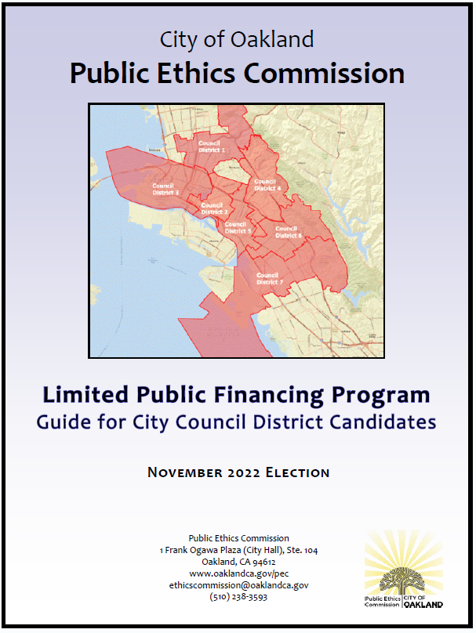
Limited Public Financing Program
Public funding available for District Council candidates (ranges from $10,000 – $25,000)
Program requirements:
    Can’t loan/give personal funds more than 10% of expenditure ceiling
    Must raise contributions and make expenditures equal to 5% of expenditure ceiling
    Must submit required forms, copies of invoices, checks, mailers, etc.
    Attend training (August 23rd or 24th)
Notes:
The Limited Public Financing Program of the City of Oakland provides a limited amount of funding by way of reimbursement to a District City Council candidate’s campaign for certain campaign expenditures. The maximum amount possible is 30 percent of Oakland’s voluntary expenditure ceiling for the office you seek.
The amount of money available depends on the total funds allocated to the program in the City Budget and also the number of candidates running in City Council district races. For the 2018 election, there is a total of $183,000 available for all candidates. The total funds will be divided by the number of City Council district candidates who opt into the program.

Slide 17

Resources
PEC Candidate Binder
    FPPC Campaign Manual
    OCRA Guide
    Limited Public Financing Guide
PEC Advice and Assistance
    (510) 238-3593
    ethicscommission@oaklandca.gov
    PEC Website: www.oaklandca.gov/pec

