Slide 1
Alameda County-Oakland Community Action Partnership
2022-2023 CAP PLAN Presentation www.AC-OCAP.com

Slide 2
What is the Community Services Block Grant (CSBG)?
Federal funding to support local Community Action
Agencies which are governed by the principle of
community self help
Funding is based on a calendar year (Jan-Dec)
Funds are block granted to the States for oversight
and administration
States calculate and distribute funds to local Community
Action Agencies based on the number of people
documented in the US Census as living in poverty
(Governed by State Government Code Section 12725-12729)
2022-2023 CAP PLAN Presentation www.AC-OCAP.com
2

Slide 3
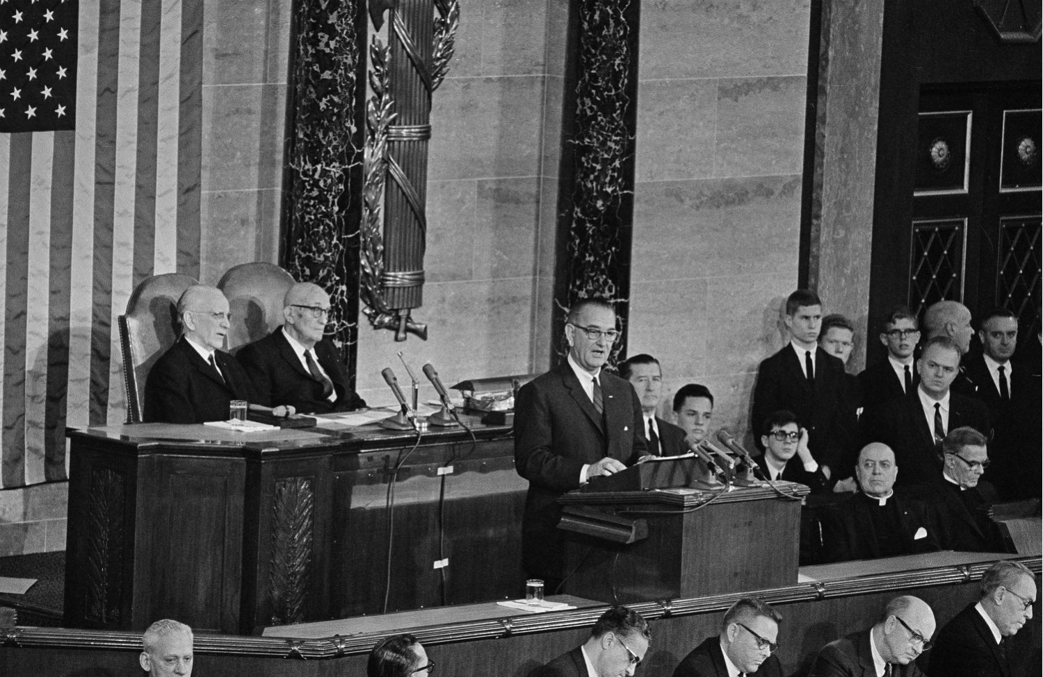
History of Community Action
1964
President Lyndon B. Johnson declares “War on Poverty” and signs the Economic Opportunity Act of 1964, establishing Community Action Agencies
2022-2023 CAP PLAN Presentation www.AC-OCAP.com

Slide 4
History of Community Action, cont’d
1971 Community Action brought Head Start to the City – Department of Human Services
1977 Community Action helped start the Oakland Paratransit for the Elderly (OPED)
1979 Community Action served as advocate to start the City’s Multi-Senior Service Program (MSSP)
1998 Community Action received $2 million dollars to implement a Welfare-to-Work program
2003 Community Action helped secure a $1 million dollar grant for Project Choice (EITC Launched)
2005 Community Action secured $250,000 from USDA for Food Stamp Outreach
2007 Community Action secured $250,000 from HHS for IDA’s
2009 Community Action received $1.2 million in ARRA funding and Bank On Oakland is launched
2011 OCAP expanded throughout Alameda County creating AC-OCAP
AC-OCAP received $176,000 from State Franchise Tax Board to support Alameda County EITC Coalition
2020 AC-OCAP received $1.9 million in Coronavirus Aid, Relief, And Economic Security (CARES) Act Funding
2021 AC-OCAP celebrates 50th Anniversary of Helping People … Changing Lives
2022-2023 CAP PLAN Presentation www.AC-OCAP.com

Slide 5
Alameda County - Oakland Community Action Partnership (AC-OCAP)
VISION STATEMENT
To end poverty within the City of Oakland and throughout Alameda County
MISSION STATEMENT
To improve our community by creating pathways that lead to economic empowerment and prosperity
PURPOSE
The Community Action Partnership has the responsibility to plan,
develop, and execute efforts to alleviate poverty and work toward systemic change to enhance the opportunities for families of low-income throughout Alameda County to achieve self-sufficiency
AC-OCAP’s Self-Sufficiency Definition
Having the means and opportunity to meet a range of individual needs
2022-2023 CAP PLAN Presentation www.AC-OCAP.com

Slide 6
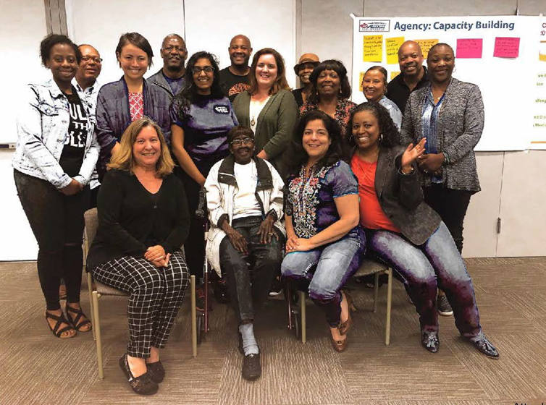
Governance of Community Action Partnership (CAP)
Mandated Three Part Administering Board Structure (18 members)
1. Public Official Representatives (6)
Oakland City Council Members
Councilmember Carroll Fife (District 3)
Councilmember Noel Gallo (District 5)
Councilmember Treva Reid (District 7)
City of Oakland Mayor
Mayor Libby Schaaf
Alameda County Board of Supervisors
Supervisor Wilma Chan (District 3)
Supervisor Nate Miley (District 4)
2. Representatives of private groups and interests (3)
Oakland Rotary
Alameda County Social Services
United Seniors
3. “Not fewer” than 1/3 are democratically elected/ selected from the low-income community (9)
(7) Low-income residents from Oakland
(2) Low-income Alameda County residents
2022-2023 CAP PLAN Presentation www.AC-OCAP.com

Slide 7
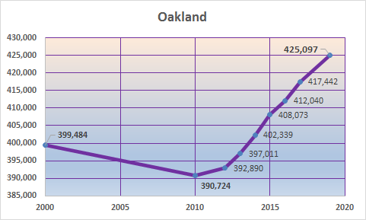
Alameda County’s Community Demographics
Source: US Census 2000 and 2010; ACS 5-Year Estimates - 2008-2012, 2009-2013, 2010-2014, 2011-2015, 2012-2016, 2013-2017,2014-2018, and 2015-2019 – B01003 Total Population
2022-2023 CAP PLAN Presentation www.AC-OCAP.com
Notes:
Oakland 425,097

Slide 8
Alameda County’s Community Demographics
2015 - 2019 American Community Survey:
Alameda County Total Population: 1,656,754; 10.79% increase from 2010
Oakland Total Population: 425,097; 8.9% increase from 2010
Source: U.S. Census Bureau, 2015-2019 American Community Survey 5-Year Estimates – S0101
2022-2023 CAP PLAN Presentation www.AC-OCAP.com

Slide 9
Alameda County’s Community Demographics by Race
Source: US Census Bureau, 2015-2019 ACS 5-Year Estimates – B02001 - Race
2022-23 CAP PLAN Presentation www.AC-OCAP.com

Slide 10
2021 Federal Poverty Guidelines
48 Contiguous States & the District of Columbia
Size of Family Unit or Number in Household | Monthly Poverty Guideline | Annual Poverty Guideline | 200% of Poverty
1 | $1,073.33 | $12,880 | $25,760
2 | $1,451.67 | $17,420 | $34,840
3 | $1,830.00 | $21,960 | $43,920
4 | $2,208.33 | $26,500 | $53,000
5 | $2,586.67 | $31,040 | $62,080
6 | $2,965.00 | $35,580 | $71,160
7 | $3,343.33 | $40,120 | $80,240
8 | $3,721.67 | $44,660 | $89,320
Source: 2021 U.S. Dept. of Health & Human Services Poverty Guidelines https://aspe.hhs.gov/poverty-guidelines
2022-2023 CAP PLAN Presentation www.AC-OCAP.com
Notes:
For a person of (1) 6.70 per hour | 200% $13.41 per hour
2021 California minimum wage is $14 more than 25 employee and $13

Slide 11
Alameda County & Oakland’s Low-Income Community Profile
 | 2000 Below Poverty | % of Total Pop. | 2010 Below Poverty | % of Total Pop. | 2015-19 Below Poverty | % of Total Pop. | Change from 2010
Alameda County | 156,804 | 11.0% | 172,348 | 11.7% | 161,581 | 9.91% | (10,767)
Oakland | 76,489 | 19.4% | 74,335 | 19.3% | 70,358 | 16.7% | (3,977)
Alameda County without Oakland & Berkeley | 60,820 | 6.4% | 79,543 | 8.1.% | 70,786 | 6.4% | (8,757)
AC-OCAP Areas | 137,309 | 9.6% | 153,878 | 10.4% | 141,144 | 9.3% | (12,734)
Berkeley | 19,495 | 20.0% | 18,470 | 18.4% | 20,437 | 19.2% | 1,967
Source: US Census 2000, 2010, and 2015-2019 ACS 5-Year Estimates– S1701
2022-23 CAP PLAN Presentation www.AC-OCAP.com
Notes:
Two scenarios:
1. People are earning more and lifting out of poverty – mandated living wages, not a livable wage
2. People are moving out to less expensive areas (about 11,000 fewer people living below FPL in AC than in 2010 and 4,000, less in Oakland)
- Likely that people are being pushed out

Slide 12
Source: US Census Bureau, 2015-2019 American Community Survey 5-Year Estimates – S1701
Note: Berkeley poverty is overstated due to the number of college students
* Unincorporated areas
2022-2023 CAP PLAN Presentation www.AC-OCAP.com

Slide 13
Residents Living in Poverty in Alameda County by Age
Source: US Census Bureau, 2015-2019 American Community Survey 5-Year Estimates - S1701
2022-2023 CAP PLAN Presentation www.AC-OCAP.com

Slide 14
Source: US Census Bureau, 2015-2019 American Community Survey 5-Year Estimates - S1701
2022-23 CAP PLAN Presentation www.AC-OCAP.com
Notes:
Ideally, the % of total population should be the same or higher than the % of the population in poverty (like you see in White and Asian categories)
- This shows that all POC groups (except Asian) are over-represented in the population living in poverty
NHPI = Native Hawaiian/Pacific Islander
Add Abbreviations AN

Slide 15
Alameda County’s Community Indicators of Poverty
Income | Food Security
Unemployment | Housing
Education | Unhoused Population
Health | Public Safety
2022-2023 CAP PLAN Presentation www.AC-OCAP.com

Slide 16
Annual Income for Family of Four in Alameda County by Type
Two earners making $6.37 per hour
Two earners making $12.74 per hour
$59,737
Living
Two earners making $14.36 per hour
$123,080
Two earners making $29.58 per hour
Source: Insight Center for Community Economic Development’s (ICCED) Family Needs Calculator for 2021
2022-2023 CAP PLAN Presentation www.AC-OCAP.com
Notes:
California minimum wage is $14-13 per hour

Slide 17
Annual Income for Single Wage Earner with Two Children by Type
$21,960
One earner making $10.56 per hour
$43,920
One earner making $21.12 per hour
$59,737
Living
One
One earner making $28.71 per hour
$120,775
One earner making $57.19 per hour
Source: Insight Center for Community Economic Development’s (ICCED) Family Needs Calculator for 2021
2022-23 CAP PLAN Presentation www.AC-OCAP.com

Slide 18
Unemployment Rates by Alameda County City and Unincorporated Area 2019 v. 2020
Source: Employment Development Department
2022-2023 CAP PLAN Presentation www.AC-OCAP.com
Notes:
Note: Compared to 3.8% for 2016

Slide 19
Education – Alameda County High School Graduation Rates for 2019-20
Source: California Department of Education Data Reporting Office 2019-20
2022-2023 CAP PLAN Presentation www.AC-OCAP.com
Notes:
- Overall, Oakland’s dropout rate fell from 20.3% in 2015-16 to 12.5% in 2019-20.
- Latinx students have the highest drop-out rate at 18.9%, compared to only 3.7% of their Asian peers.
- Black/African American students have a drop-out rate of 7.4%, similar to Whites at 7.1%.
- English language learners have one of the highest drop-out rates at 25%, compared to 6.6% of non- English language learners.

Slide 20
Education – Alameda County Students Not Completing High School 2009-10 v. 2017-18 School Years
Source: California Dept. of Education, Cohort Outcome Data (Jun. 2017) & Adjusted Cohort Graduation Rate and Outcome Data (May 2019).
2022-2023 CAP PLAN Presentation www.AC-OCAP.com

Slide 21
Health – COVID-19 Impact
Source: Alameda County Public Health Department, COVID-19 Data Dashboard
2022-2023 CAP PLAN Presentation www.AC-OCAP.com
Notes:
Ideally, the total population should be more than % of covid cases and deaths (White, AI/AN, Asian)
-Latinx: 40% of total Covid cases but only 22% of the population
-Black: only 7.9% of cases but 17% of deaths (not getting treated/tested equitably)
Similarly, % of covid deaths are higher than % of cases for two or more races, Native Hawaiian/Pacific Islander, and Asian groups
Vaccines should have been distributed to those areas that had the most cases in proportion to their population (Latinx and Black communities)

Slide 22
Food Security
The number of individuals receiving CalFresh increased by 14.5% between February of 2020 and February of 2021
According to the Alameda County Community Food Bank, the need for food dramatically increased between 50 and 70% during 2020
11% of Alameda County residents were food insecure in March of 2021
41.7% of Alameda County students and 71.6% of Oakland students qualify for free or reduced-price lunches
2022-2023 CAP PLAN Presentation www.AC-OCAP.com

Slide 23
Housing – Fair Market Rent for Two Bedrooms
in Alameda County
Source: National Low Income Housing Coalition, HUDUser.gov 2021
2022-2023 CAP PLAN Presentation www.AC-OCAP.com
Notes:
The wage needed to rent an average housing unit in Alameda County is $44.79 an hour or $93,000 a year.

Slide 24
Unhoused Population of Alameda County
2022-2023 CAP PLAN Presentation www.AC-OCAP.com
Notes:
The 2019 figure is a 29% increase from 2017.
- 70% of the people counted were Black/African American
- 13% Latinx
- 13% Other
- 11% White
- 1% Asian.
- 15% Veterans
- 14% identified as LGBTQ+
- 14% of respondents reported a history in foster care.
Overall, 731 were unaccompanied youth and young adults (aged 18-24), 80% of those youth were unsheltered.
Families are also impacted, where, in 2019 on any given night in Oakland, the city estimated 120 families are living on the streets or in their cars. According to data reported to the state by school districts, 4,289 Alameda County students (1.9%) were categorized as homeless in 2017-18. Seniors???

Slide 25
Public Safety
Alameda County had 10,580 violent offenses in 2019
There were 657 felony juvenile arrests and 472 misdemeanors in Alameda County in 2019,a ten-year low
Violent Crimes in Oakland increased from 5,831 in 2019 to 5,937 in 2020
Homicides in Oakland increased 36% from 75 in 2019 to 103 in 2020
Source: CA Department of Justice, Crime and Clearances Data
2022-2023 CAP PLAN Presentation www.AC-OCAP.com

Slide 26
Alameda County
Community Survey Results
271 survey respondents indicated they were from a city or area in Alameda County excluding the city of Berkeley
88 respondents resided in the city of Oakland
183 resided elsewhere in Alameda County
The average household size of all the respondents is 3.3
42% of the respondents have household incomes below $40,000
2022-2023 CAP PLAN Presentation www.AC-OCAP.com

Slide 27
Alameda County
Community Survey Results
2022-2023 CAP PLAN Presentation www.AC-OCAP.com

Slide 28
Alameda County
Community Survey Results
2022-2023 CAP PLAN Presentation www.AC-OCAP.com

Slide 29
Alameda County
Community Survey Results
2022-2023 CAP PLAN Presentation www.AC-OCAP.com

Slide 30
2022-2023 CAP PLAN Presentation www.AC-OCAP.com
Notes:
Strategic plan – highlight VALUES and Focus Areas

Slide 31
2020-2022 Funded Programs
AC-OCAP Grantees
Entrepreneurship/Job Training & Employment | Low-Income Housing
Chabot-Las Positas – Tri-Valley Career Center Civicorps Downtown Streets, Inc. Hack the Hood, Inc Lao Family Community Development New Door Ventures Renaissance Entrepreneurship Center Rubicon Programs, Inc. | Alliance for Community Wellness Covenant Hose California Eden Information and Referral, Inc. Fremont family Resource Center St. Mary’s Center
AC-OCAP Programs
Community Development, Financial Literacy, Civic Engagement & Advocacy | Food Security
Housing and Economic Rights Advocates (HERA) Earned Income Tax Credit (EITC) Bank On Oakland 2.0 (BOO 2.0) | Oakland Fund for Children & Youth Summer Lunch Program Oakland Community Housing Services’ Annual Holiday Dinner Safe Passages Alameda County Community Food Bank Oakland HeadStart
AC-OCAP Programs
2022-2023 CAP PLAN Presentation www.AC-OCAP.com

Slide 32
2022-2023 CAP PLAN Presentation www.AC-OCAP.com
Notes:
Strategic plan

Slide 33
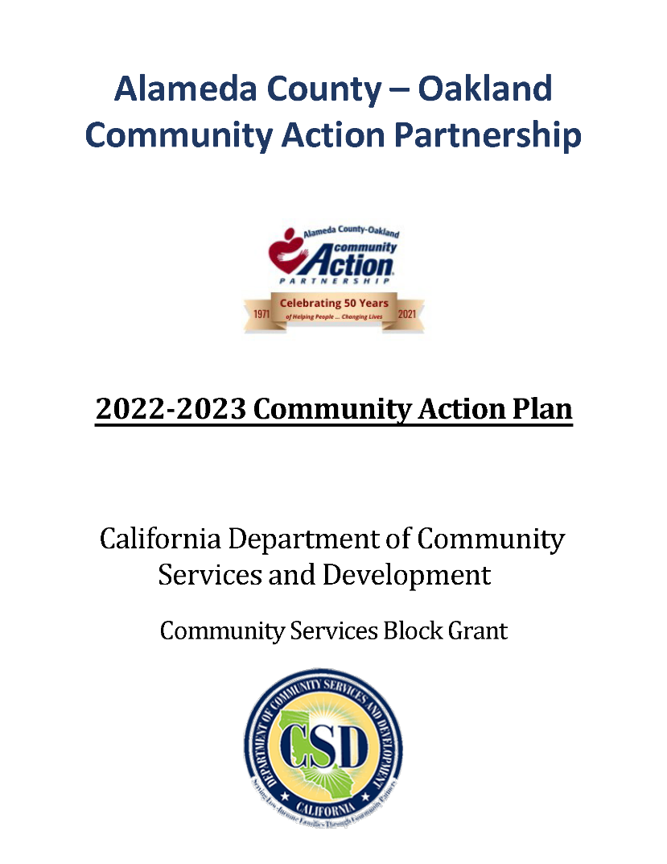
2022-2023 Community Action Plan
CAP Plan
Public Comment Period:
May 24 – June 23, 2021
Email your comments to:
AC-OCAP@oaklandca.gov
2022-2023 CAP PLAN Presentation www.AC-OCAP.com

Slide 34
Now Let’s Hear From You!
What’s missing or what would you
like to see improved?
2022-2023 CAP PLAN Presentation www.AC-OCAP.com

Slide 35
Thank You For Attending
Our Promise: Community Action changes people’s lives, embodies the spirit of hope, improves communities, and makes Oakland and Alameda County a better place to live. We care about the entire community, and we are dedicated to helping people help themselves and each other.
(510) 238-2362
AC-OCAP@oaklandca.gov
AC-OCAP.com
#EndPovertyNowAC
2022-2023 CAP PLAN Presentation www.AC-OCAP.com

