Slide 1
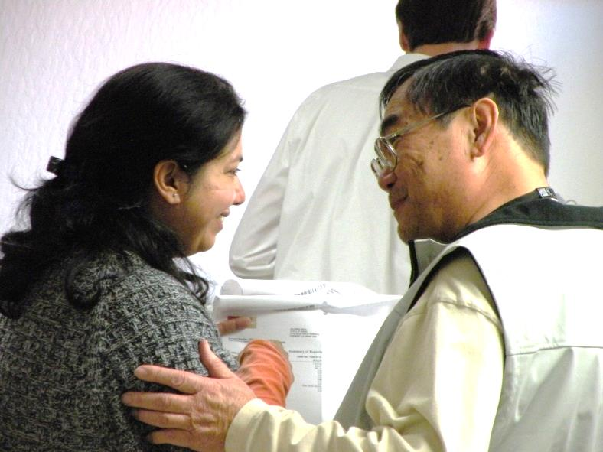
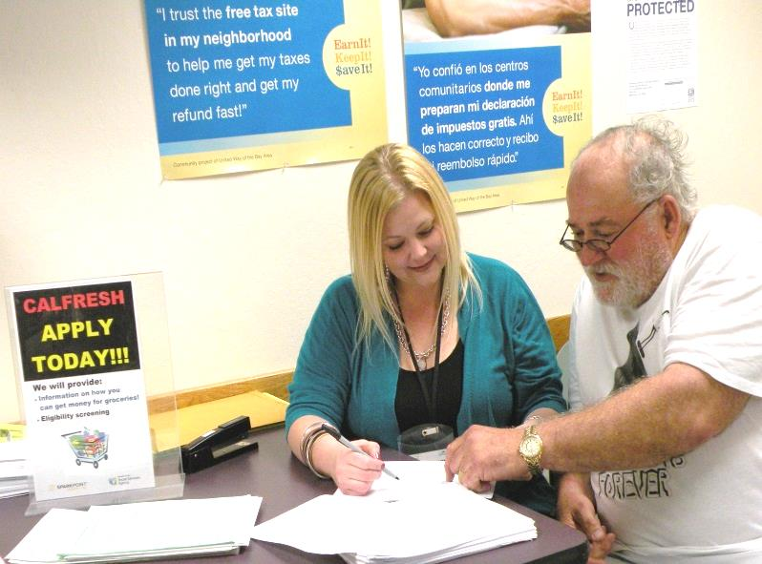
Alameda County-Oakland Community Action Partnership
Appendix I
2020-21 CAP PLAN Presentation www.AC-OCAP.com

Slide 2
What is the Community Services Block Grant (CSBG)?
Federal funding to support local Community Action
Agencies which are governed by the principle of
community self help
Funding is based on a calendar year (Jan-Dec)
Funds are block granted to the States for oversight
and administration
States calculate and distribute funds to local Community
Action Agencies based on the number of people
documented in the US Census as living in poverty
(Governed by State Government Code Section 12725-12729)
2020-21 CAP PLAN Presentation www.AC-OCAP.com
2

Slide 3
A Brief History of Community Action
Community Action Agencies (CAAs) are local private and public non-profit organizations that fight poverty by empowering the poor as a part of the War on Poverty
2018
AC-OCAP served over 64,698 low-income Alameda County residents with housing, employment, legal, food, and wrap-around supportive services
1964
President Johnson signs the Economic Opportunity Act of 1964, creating the CAAs
1977
Community Action helped start Oakland Paratransit for the Elderly (OPED)
1998
Community Action received $2 million to implement a Welfare-to-Work program
2005
Community Action secured $250,000 from USDA for Food Stamp Outreach
2009
OCAP received $1.2 million in American Recovery & Reinvestment Act funding
1971
Community Action brought Head Start to the City of Oakland
1979
Community Action served as an advocate to start the City’s Multi-Senior Service Program (MSSP)
2003
Community Action helped secure a $1 million grant for Project Choice
2007
Community Action secured $250,000 from HHS for 106 IDAs
2011
OCAP expanded throughout Alameda County creating AC-OCAP
2020-21 CAP PLAN Presentation www.AC-OCAP.com

Slide 4
Alameda County - Oakland Community Action Partnership (AC-OCAP)
VISION STATEMENT
To end poverty within the City of Oakland and throughout Alameda County
MISSION STATEMENT
To improve our community by creating pathways that lead to economic empowerment and prosperity
PURPOSE
The Community Action Partnership has the responsibility to plan,
develop, and execute efforts to alleviate poverty and work toward systemic change to enhance the opportunities for families of low-income throughout Alameda County to achieve self-sufficiency
AC-OCAP’s Self-Sufficiency Definition
Having the means and opportunity to meet a range of individual needs
2020-21 CAP PLAN Presentation www.AC-OCAP.com

Slide 5
Governance of Community Action Partnership (CAP)
Mandated Three Part Administering Board Structure
(18 members)
1. Public Official Representatives (6)
Oakland City Council Members
Councilmember Lynette McElhaney (District 3)
Councilmember Noel Gallo (District 5)
Councilmember Larry Reid (District 7)
City of Oakland Mayor
Mayor Libby Schaaf
Alameda County Board of Supervisors
Supervisor Wilma Chan (District 3)
Supervisor Nate Miley (District 4)
2020-21 CAP PLAN Presentation www.AC-OCAP.com

Slide 6
Governance of Community Action Partnership (CAP) cont’d
Mandated Three Part Administering Board Structure
(18 members)
2. Representatives of private groups and interests (3)
Oakland Rotary
Alameda County Social Services
United Seniors
3.“Not fewer” than 1/3 are democratically elected/ selected from the low-income community (9)
(7) Low-income residents from Oakland
(2) Low-income Alameda County residents
2020-21 CAP PLAN Presentation www.AC-OCAP.com

Slide 7
Alameda County’s Community Demographics
Source: US Census 2000 and 2010; ACS 5-Year Estimates - 2008-2012, 2009-2013, 2010-2014, 2011-2015, 2012-2016, and 2013-2017 – B01003 Total Population
2020-21 CAP PLAN Presentation www.AC-OCAP.com

Slide 8
Alameda County’s Community Demographics
Source: US Census Bureau, 2013-2017 ACS 5-Year Estimates – B02001 - Race
2020-21 CAP PLAN Presentation www.AC-OCAP.com

Slide 9
2019 Federal Poverty Guidelines
48 Contiguous States & the District of Colombia
Size of Family Unit | 100% of Federal Poverty Level Monthly Income | 100% of Federal Poverty Level Annual Income
1 | $1,041.00 | $12,490
2 | $1,409.00 | $16,910
3 | $1,778.00 | $21,330
4 | $2,146.00 | $25,750
5 | $2,514.00 | $30,170
6 | $2,833.00 | $34,590
7 | $3,251.00 | $39,010
8 | $3,619.00 | $43,430
For Families/households with more than 8 persons, add $4,180 for each additional person.
Source: 2019 U.S. Dept. of Health & Human Services Poverty Guidelines https://aspe.hhs.gov/poverty-guidelines
2020-21 CAP PLAN Presentation www.AC-OCAP.com
Notes:
The poverty level is based on the number of those below poverty divided by the population whom poverty status is determined. Not necessarily the entire population. 2019 HHS Poverty Guidelines for an individual is $12,060 (around $5.80 per hr.); $20,420 for a family of 3 (around $9.82 per hr.)

Slide 10
Alameda County & Oakland’s Low-Income Community Profile
 | 2000 Below Poverty Level | % of total pop. | 2010 Below Poverty Level | % of total pop. | 2013-2017 ACS Poverty Level | % of total pop. | # Change from 2010
Alameda County | 156,804 | 11.0% | 172,348 | 11.7% | 181,194 | 11.3% | 8,846
Oakland | 76,489 | 19.4% | 74,335 | 19.3% | 77,347 | 18.7% | 3,012
AC w/o Oakland or Berkeley | 60,820 | 6.4% | 79,543 | 8.1% | 82,425 | 7.6% | 2,882
AC-OCAP Served Areas | 137,309 | 9.6% | 153,878 | 10.4% | 159,772 | 9.9% | 5,894
 |  |  | AC-OCAP serves |  | 88.2% |  | 66.7%
Berkeley | 19,495 | 20.0% | 18,470 | 18.4% | 21,422 | 19.8% | 2,952
Source: US Census 2000, 2008-2010 3 Year Estimates, and 2013-2017 ACS 5 Year Estimates – S1701
2020-21 CAP PLAN Presentation www.AC-OCAP.com

Slide 11
Source: US Census Bureau, 2013-2017 American Community Survey 5-Year Estimates - S1701
** - Note: Berkeley poverty is overstated due to the number of college students
2020-21 CAP PLAN Presentation www.AC-OCAP.com

Slide 12
Source: US Census Bureau, 2013-2017 American Community Survey 5-Year Estimates - S1701
2020-21 CAP PLAN Presentation www.AC-OCAP.com

Slide 13
Source: US Census Bureau, 2013-2017 American Community Survey 5-Year Estimates - S1701
2020-21 CAP PLAN Presentation www.AC-OCAP.com

Slide 14
Alameda County’s Community Indicators
Income
Employment
Education
Health
Food Security
Housing
Homelessness
Public Safety
2020-21 CAP PLAN Presentation www.AC-OCAP.com

Slide 15
Household Median Income by Race
Source: US Census Bureau, 2013-2017 American Community Survey 5-Year Estimates – S1903
2020-21 CAP PLAN Presentation www.AC-OCAP.com

Slide 16
Income - Family Thresholds
2019 U.S. Department of Health & Human Services Federal Poverty Guidelines
In Alameda County, the federal poverty level falls short of what it takes for a family to make ends meet. The Self-Sufficiency Standard shows how much a family needs to meet basic needs. The Housing Wage shows the annual income needed to afford a 2 bedroom house or apartment.
$25,750
$21,330
$12,490
In 2018, 9.2% of Alameda County residents (150,895) and 15.3% of Oakland residents (64,305) were living below the federal poverty level
*A family of three for the purposes of this table consists of one adult working full-time and two school-age children
Sources: Federal Poverty Guidelines – https://aspe.hhs.gov/poverty-guidelines; 2017 American Community Survey – https://www.census.gov/programs-surveys/acs;
Self-Sufficiency Standard – https://insightcced.org/2018-self-sufficiency-standard; Housing Wage – http://nlihc.org/oor/california
2020-21 CAP PLAN Presentation www.AC-OCAP.com

Slide 17
Employment – Unemployment Rates
Source: Employment Development Department March 2018 Benchmark
2020-21 CAP PLAN Presentation www.AC-OCAP.com
Notes:
Note: Compared to 3.8% for 2016

Slide 18
Education – High School Drop Out Rates
Source: California Department of Education Data Reporting Office 2017
2020-21 CAP PLAN Presentation www.AC-OCAP.com
Notes:
7.4% of Alameda County high school students did not graduate
12.9% of Oakland high school students did not graduate

Slide 19
Health – Uninsured Residents
Source: US Census Bureau, 2013-2017 ACS 5-Year Estimates – S1501
2020-21 CAP PLAN Presentation www.AC-OCAP.com

Slide 20
Health – Life Expectancy by City in Alameda County
Source: Alameda County Vital Statistic Files, 2010-2012
2020-21 CAP PLAN Presentation www.AC-OCAP.com

Slide 21
Food Security
The USDA’s Low Income 2015 food access map shows
That West Oakland, Hayward, Union City, and Eden are
considered food deserts since they are more than one
Mile or 10 rural miles from a supermarket.
(Source: USDA Economic Research Service, ERSI, 2015)
In Alameda County, 100,280 individuals (45% are
children) received CalFresh in the County, however
only 59% of those who are eligible actually receive
food assistance.
(Source: Alameda County Social Services Agency, 2016)
In Alameda County – 43.9% students qualify for free/reduced cost school meals.
(Source: California Dept. of Education, Year 2017-18)
In Oakland – 74.4% of OUSD students qualify for free/reduced cost school meals.
(Source: California Dept. of Education, Year 2017-18)
2020-21 CAP PLAN Presentation www.AC-OCAP.com

Slide 22
Housing
Income Before Taxes for Full-time Worker @$15/hr = $2,400/mo Average Social Security Retirement Income = $1,461/mo Maximum CalWORKs Aid for a Family of 4 = $936/mo Supplemental Security Income (SSI) in California = $771/mo General Assistance (GA) Grant in Alameda County = $336/mo
Source: National Low Income Housing Coalition, HUDUser.gov 2018
2020-21 CAP PLAN Presentation www.AC-OCAP.com

Slide 23
Homelessness
2020-21 CAP PLAN Presentation www.AC-OCAP.com

Slide 24
Public Safety
Alameda County had 9,923 violent offenses in 2017, a 2.5% increase from 2015
(CA Dept. of Justice, Crime & Clearances Data 2006-2015, 2017)
There were 1,684 juvenile arrests in Alameda County in 2017, a 25.9% decrease from 2014
(CA Dept. of Justice, Arrest Dispositions 2005-2014, 2017)
There were 12,096 individuals on probation in Alameda County in 2016
(Public Safety Realignment in Alameda County, October 2016)
In 2015, adult recidivism rate in Alameda County = 20.3%
(Public Safety Realignment in Alameda County, October 2016)
2020-21 CAP PLAN Presentation www.AC-OCAP.com
Notes:
This is the most current dataset that shows Alameda County cities. In 2009, there were 11,189 violent crimes. The City of Oakland’s crime statistics are remarkably high compared to other jurisdictions in Alameda County, constituting 60% of the violent crimes in the entire county. The Oakland Police Department report that in 2012, there were 131 homicides. Of these homicides, 60% are age 30 and under, and mostly male (86%).

Slide 25
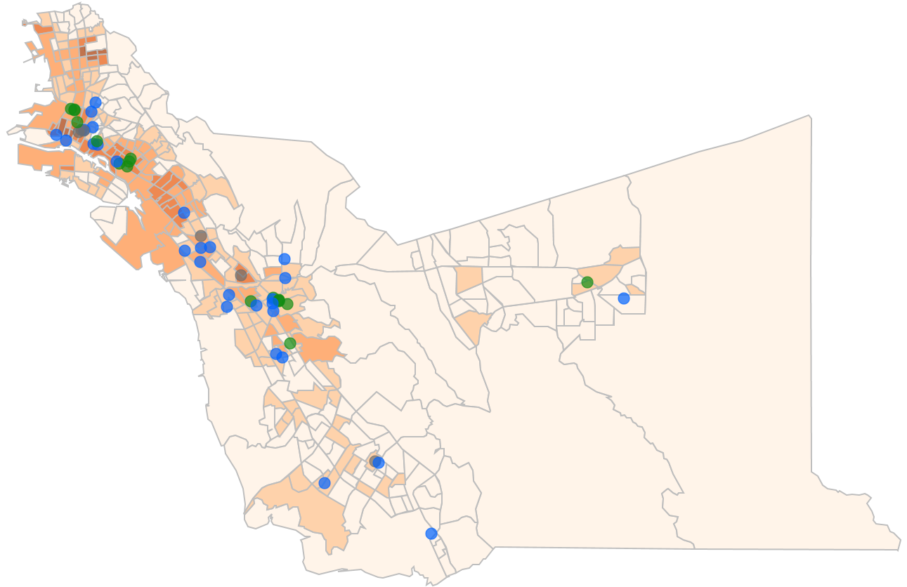
AC-OCAP Grantee Service Sites &
Unduplicated Individuals Served in 2018
Albany
North County
286
Berkeley
Emeryville
Oakland
Service Providers – 2,503
Free Tax Prep Assistance – 7,749
Information & Referral Calls – 11,134
Hunger Programs – 12,120
Piedmont
Alameda
East County
397
Dublin
San Leandro
Livermore
Central County
1,131
Pleasanton
Hayward
Union City
Alameda County
Free Tax Prep Assistance – 15,954
Information & Referral Calls – 13,040
Percent of Population Below Poverty
Fremont
Below 6.9%
6.9% - 14.6%
4.6% - 25%
25% - 39.3%
Above 39.3%
Newark
Program Service Type
South County
368
Housing & Community Development
Legal Assistance
Job Training & Employment Placement
Source: 2013-2017 American Community Survey

Slide 26
2018 Program Participant Demographics
2020-21 CAP PLAN Presentation www.AC-OCAP.com
Source: 2011-2015 American Community Survey, AC-OCAP Plan

Slide 27
Alameda County Factsheet 2018
268 received transitional housing / emergency shelter
258 obtained/maintained permanent housing
170 Obtained Employment
20 Received High School Diploma or GED
24,174 unduplicated information & referral calls answered
88,628 health, housing, and human services referrals provided
3,776 received legal assistance
$11.1 million in Earned Income Tax Credits brought back to low-wage earners
$31.9 million total tax refunds returned to the community
9,000 children and youth served 60,214 lunches and 59,791 snacks at 45 sites during the summer
64,698 total low-income Alameda County residents served
10,020 residents received 62,254 food bags
2020-21 CAP PLAN Presentation www.AC-OCAP.com
Source: 2011-2015 American Community Survey, AC-OCAP Plan

Slide 28
2019 Funded Programs
AC-OCAP Grantees
Job Training & Employment Placement
Hack the Hood
Civicorps
Downtown Streets, Inc.
Roots Community Health Center
Rubicon Programs, Inc.
La Familia Counseling Service
Youth Employment Partnership
Housing & Community Development
AnewAmerica Community Corporation
St. Mary’s Center
Eden Information and Referral, Inc.
Family Emergency Shelter Coalition
Satellite Affordable Housing Associates
Unity Council
AC-OCAP Programs
Asset Building & Financial Education
Housing and Economic Rights
Advocates (HERA)
Earned Income Tax Credit (EITC)
Legal Assistance
Bay Area Legal Aid
Hunger
Oakland Community Housing Services’
Annual Holiday Dinner
Brown Bag
Oakland Fund for Children & Youth
Summer Lunch Program
2020-21 CAP PLAN Presentation www.AC-OCAP.com

Slide 29
2019 Community Survey Highlights
270 individuals participated in the survey, with an average household size of 2.95 (ranging from 1-8), including:
80 individuals at the Fatherhood Summit, with an average household size of 3 (ranging from 1-7)
63 individuals at the Head Start Resource Fair, with an average household size of 4 (ranging from 1-8)
www.AC-OCAP.com

Slide 30
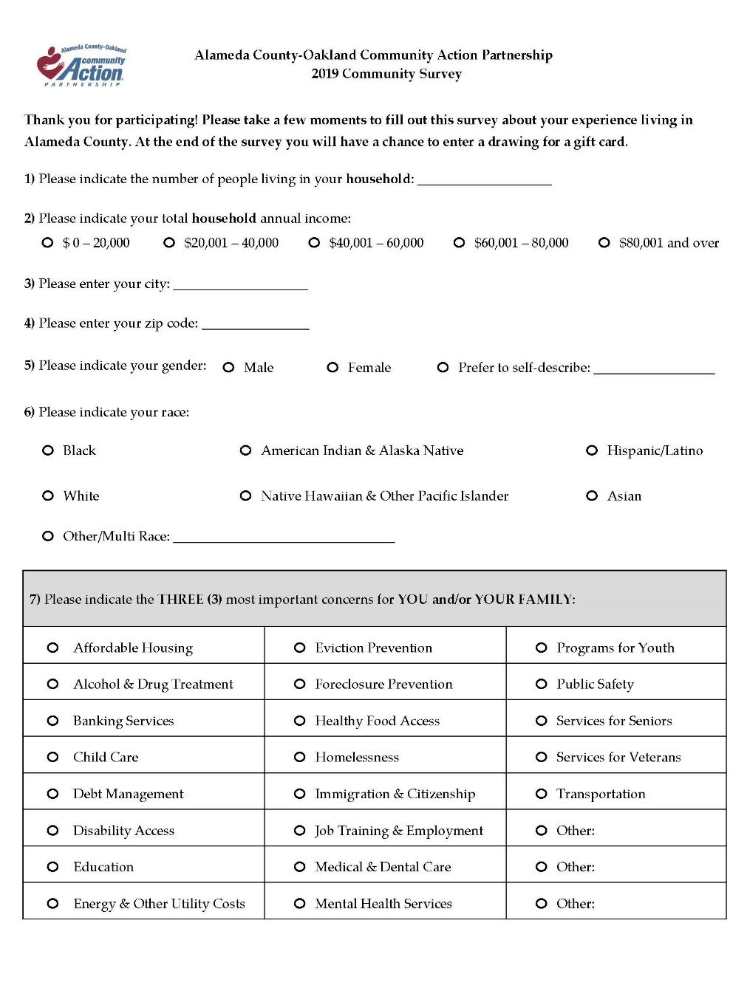
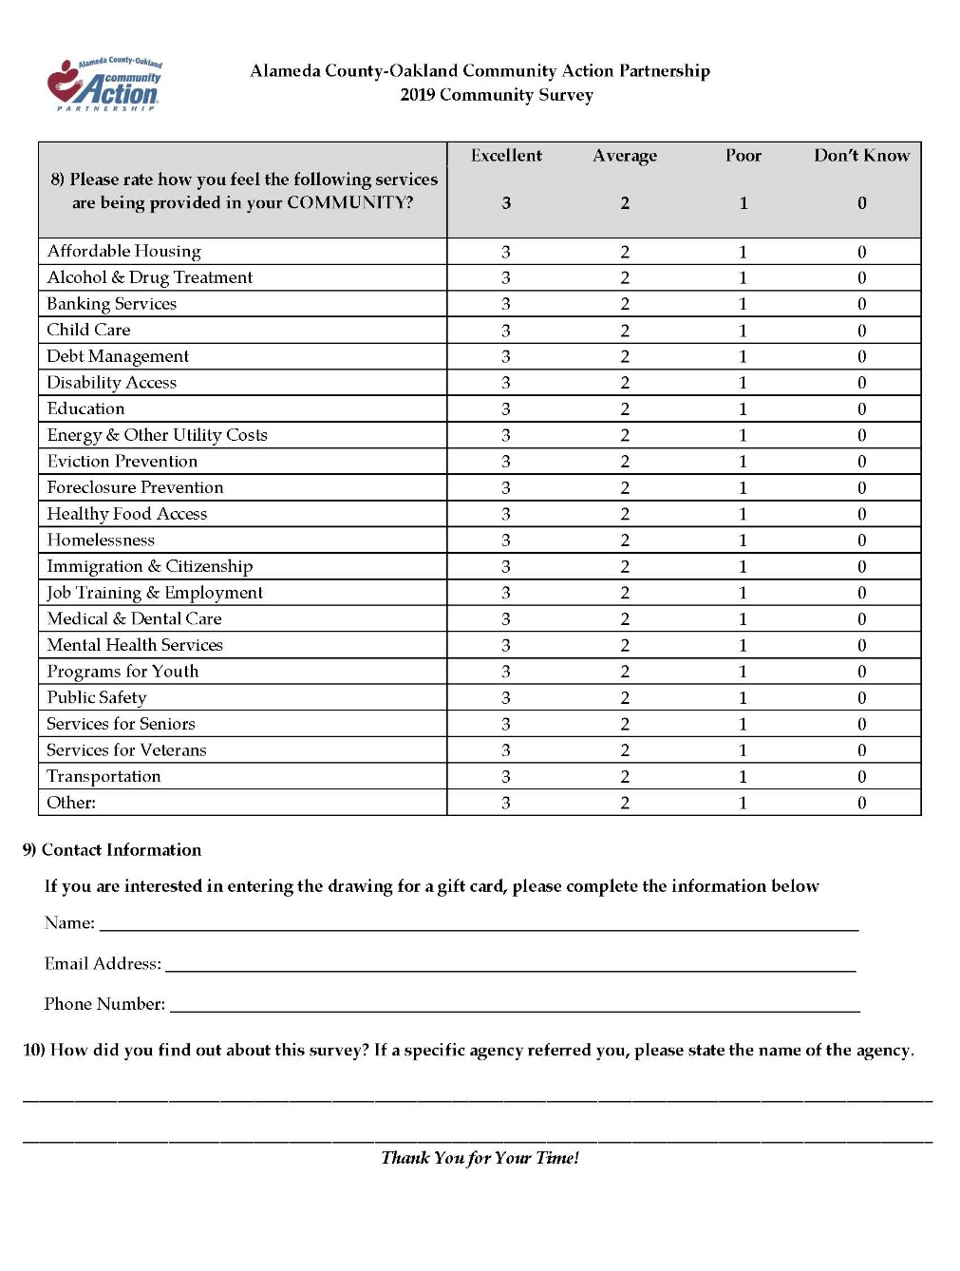

Slide 31
2019 Community Survey Results
51% of respondents (139) have annual household incomes below $60,000
35% of respondents (95) have incomes below $40,000
19% of respondents (51) have incomes below $20,000
www.AC-OCAP.com

Slide 32
2019 Community Survey Results
83% (224) respondents identified themselves as an ethnicity other than White
22% (59) identified themselves as Hispanic or Latino of any race
The largest single racial group was the 41% of individuals who identified as Black (111 individuals)
www.AC-OCAP.com

Slide 33
2019 Community Survey Results
Other includes 2 Newark (0.74%), 1 Albany (0.37%), 1 Emeryville (0.37%)
Unincorporated includes 1 Ashland (0.37%), 6 Castro Valley (2.22%), 4 San Lorenzo (1.48%), 1 “Unincorporated” (0.37%)
www.AC-OCAP.com

Slide 34
Respondents’ Place of Residence
Location | Fatherhood Summit Responses |  | Head Start Responses |  | All Other Responses |  | Total Responses
 | Number | Percent | Number | Percent | Number | Percent | Number | Percent
Alameda | 1 | 1.00% | 1 | 1.59% | 6 | 4.69% | 8 | 2.96%
Albany | 0 | 0.00% | 0 | 0.00% | 1 | 78.00% | 1 | 37.00%
Ashland | 0 | 0.00% | 0 | 0.00% | 1 | 78.00% | 1 | 37.00%
Castro Valley | 4 | 5.00% | 1 | 1.59% | 1 | 78.00% | 6 | 2.22%
Dublin | 2 | 3.00% | 0 | 0.00% | 2 | 1.56% | 4 | 1.48%
Emeryville | 0 | 0.00% | 0 | 0.00% | 1 | 78.00% | 1 | 37.00%
Fremont | 1 | 1.00% | 0 | 0.00% | 4 | 3.13% | 5 | 1.85%
Hayward | 6 | 8.00% | 0 | 0.00% | 8 | 6.25% | 14 | 5.19%
Livermore | 0 | 0.00% | 0 | 0.00% | 8 | 6.25% | 8 | 2.96%
Newark | 0 | 0.00% | 0 | 0.00% | 2 | 1.56% | 2 | 74.00%
Oakland | 52 | 65.00% | 58 | 92.06% | 76 | 59.38% | 186 | 68.89%
Pleasanton | 0 | 0.00% | 0 | 0.00% | 7 | 5.47% | 7 | 2.59%
San Leandro | 8 | 10.00% | 1 | 1.59% | 8 | 6.25% | 17 | 6.30%
San Lorenzo | 2 | 3.00% | 1 | 1.59% | 1 | 78.00% | 4 | 1.48%
Union City | 4 | 5.00% | 0 | 0.00% | 1 | 78.00% | 5 | 1.85%
"Unincorporated" | 0 | 0.00% | 0 | 0.00% | 1 | 78.00% | 1 | 37.00%

Slide 35
2019 Community Survey Results
www.AC-OCAP.com

Slide 36
2019 Community Survey Results
www.AC-OCAP.com

Slide 37
The Promise of Community Action
“Community Action changes people’s lives, embodies the spirit of hope, improves communities, and makes Oakland and Alameda County a better place to live. We care about the entire community, and we are dedicated to helping people help themselves and each other”
2020-21 CAP PLAN Presentation www.AC-OCAP.com

Slide 38
Future CSBG Funding
CSBG Reauthorization/Legislation
2019 CSBG Funding: $1.347 million
Challenges
Lack of Funding for Safety Net (ACA, HUD, Immigration)
Provides $7.43 per person
($1.347mil/181,194 individuals in poverty)
2018-19 CAP PLAN Presentation www.AC-OCAP.com

Slide 39
Alameda County - Oakland Community Action Partnership (AC-OCAP)
 | AC-OCAP’s 2020-2023 Strategic Focus Areas
Family | Entrepreneurship/Job Training & Employment Placement | Support employment-focused programs and services that provide entrepreneurship/job training and employment placement opportunities which include education/GED and internships or micro-enterprise/self employment opportunities for adults, youth 16 and older, foster youth, seniors, re-entry population, veterans, and the homeless; and Provide wraparound/bundle services that assist low-income individuals and families with support in the areas such as Behavioral Health/Covered CA, Food Security/Cal Fresh, Banking/Financial Services, Earned Income Tax Credit, and other income support services as it relates to entrepreneurship/job training & employment placement.
Family | Housing & Community Development | Support programs and services that provide safe temporary shelter (including emergency/transitional, or hotel/motel vouchers), or safe and affordable housing (including permanent or stable housing) or home ownership opportunities for adults, youth 16 and older, foster youth, seniors, re-entry population, veterans, and the homeless; and Provide wraparound/bundle services that assist low-income individuals and families with support in the areas such as Behavioral Health/Covered CA, Food Security/Cal Fresh, Banking/Financial Services, Earned Income Tax Credit, and other income support services as it relates to low-income housing.
2020-21 CAP PLAN Presentation www.AC-OCAP.com

Slide 40
Alameda County - Oakland Community Action Partnership (AC-OCAP)
 | AC-OCAP’s 2020-2023 Strategic Focus Areas
Community | Civic Engagement | Support programs and services that increase public awareness and expand partnerships with small businesses, Chambers of Commerce, as well as engaging non-profit and public agencies in the issue of poverty and other issues that affect Alameda County’s low-income population.
Community | Advocacy | Support programs and services that mobilize, empower and promote low-income individuals and the community to take action in the areas of housing, transportation, seniors, education, employment, veterans, immigration, and other areas that impact low-income families.
Agency | Capacity Building | Support programs and services that foster agency capacity-building in the areas of fund development, board development, social media outreach, and community building.
2020-21 CAP PLAN Presentation www.AC-OCAP.com

Slide 41
Community Needs
1. What are some of the challenges in providing for your family?
2. What’s missing from existing services that you would like to see
added or improved?
3. Lastly, in your opinion, what do we need to do to work towards ending
poverty?
2018-19 CAP PLAN Presentation www.AC-OCAP.com

