Slide 1



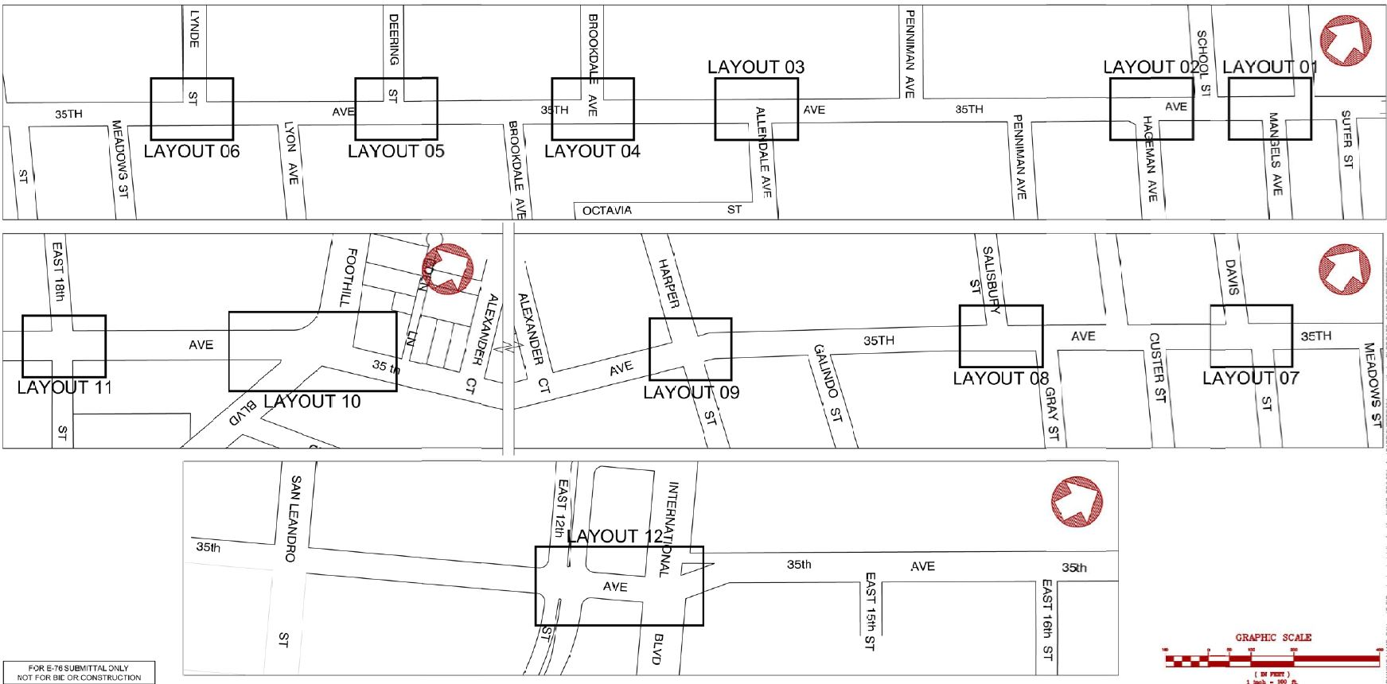











Project Location: 35th Ave HSIP8
Project Name: HSIP8 – 35th Ave (from East 12th St to I-580)
Background
Aims to make corridor safer for pedestrians and all users through corridor-wide crossing enhancements
Community requests
Senior safety area, pedestrian high-injury intersection, high pedestrian demand
Class II bicycle lanes
Posted speed 25 MPH, critical speed 32 MPH (85th percentile)
Improve movement of goods and people to spur economic development and growth
Location
Land use: residential/commercial
Transportation and access issues: pedestrians/bicyclists
Issues: unsafe vehicular speed, traffic conflicts with pedestrians/bicyclists
Parallel corridor to two major freeways (I-580 and I-880)
2018
Lead Division Name: TRAFFIC CAPITAL PROJECTS
Street Map

Slide 2
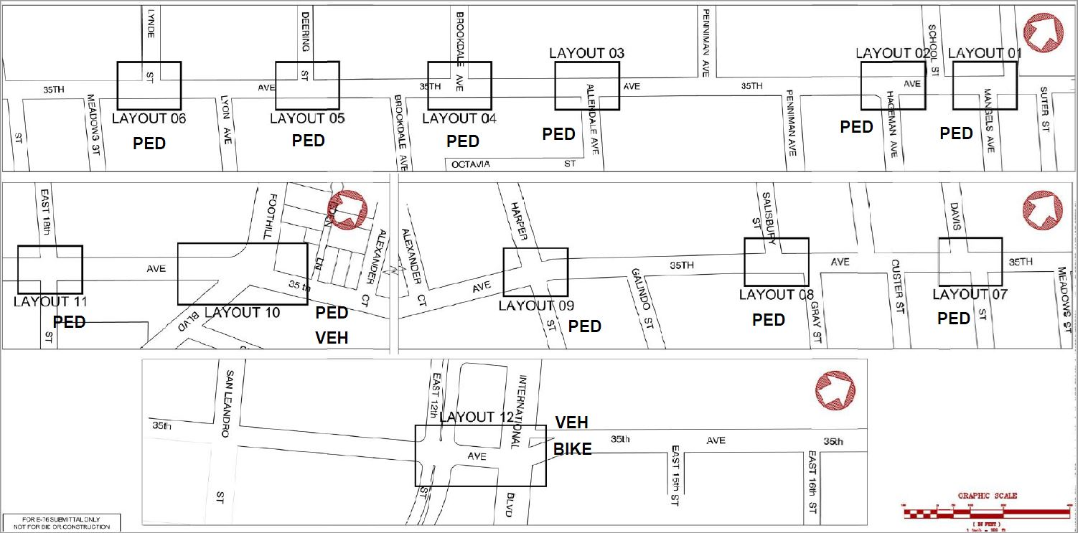

Project Location: 35th Ave (Cont.)
PED – Improvement for pedestrians
BIKE – Improvement for bicyclists
VEH – Improvement for Vehicle
BUS – Improvement for Transits
Work Plan
2018
Lead Division Name: TRAFFIC CAPITAL PROJECTS
Project Timeline
Start date [1/2018]
Phases that have been completed : PE Authorization in progress
Construction Completion planned for [5/2021]
PED – Improvement for pedestrians
BIKE – Improvement for bicyclists
VEH – Improvement for Vehicle
Improvements
Install Rectangular Rapid Flashing Beacons
Install or upgrade crosswalk
Install High Intensity Activated Crosswalk Beacon
Install pedestrian countdown devices
Upgraded traffic signal mast arm and controllers
Left turn signal phase
Reallocation of road space
Benefits
Alerts oncoming traffic of pedestrian crossing
Safer pedestrian crossing
Efficient traffic flow through use of upgraded signal arm
Traffic Signals
Control speeding, making right of way clearer and reduce ambiguity
Combine collision-reduction benefits of HAWKs and RRFB’s
Classification
Protected left turn phase at Foothill Boulevard
Class II bicycle lanes between International and East 12th St
Budget
Total Project Cost: $2,903,800.00
Scope
Install new or enhanced crosswalks at 11 locations
Install 3 HAWK signals
Install 7 RRFB’s
Upgrade Signals- Traffic Control
Buffered bicycle lane

Slide 3
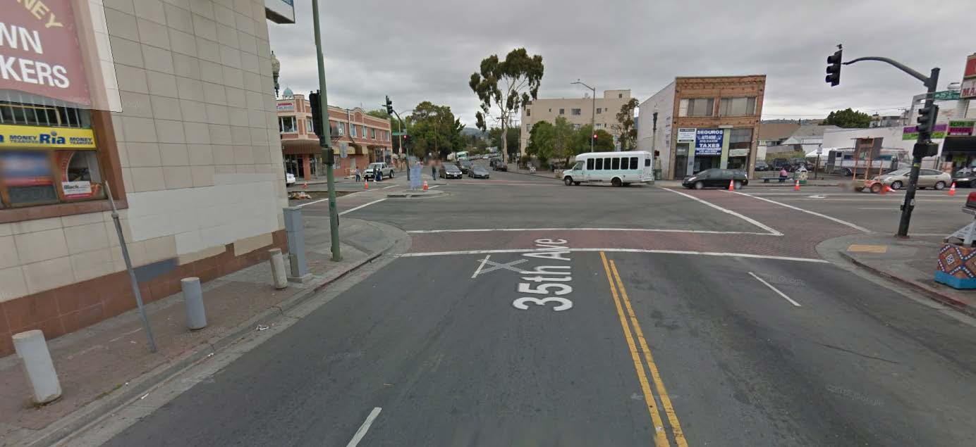
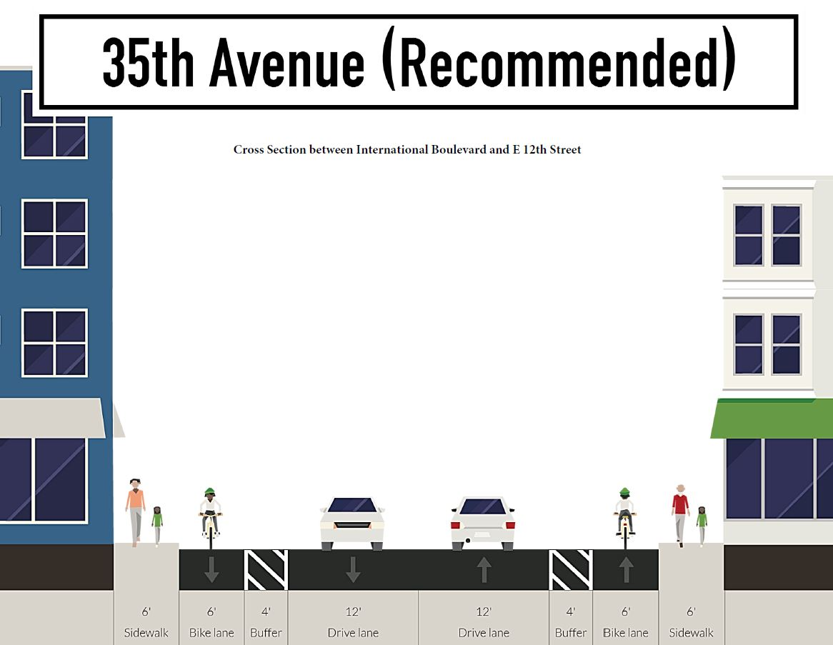
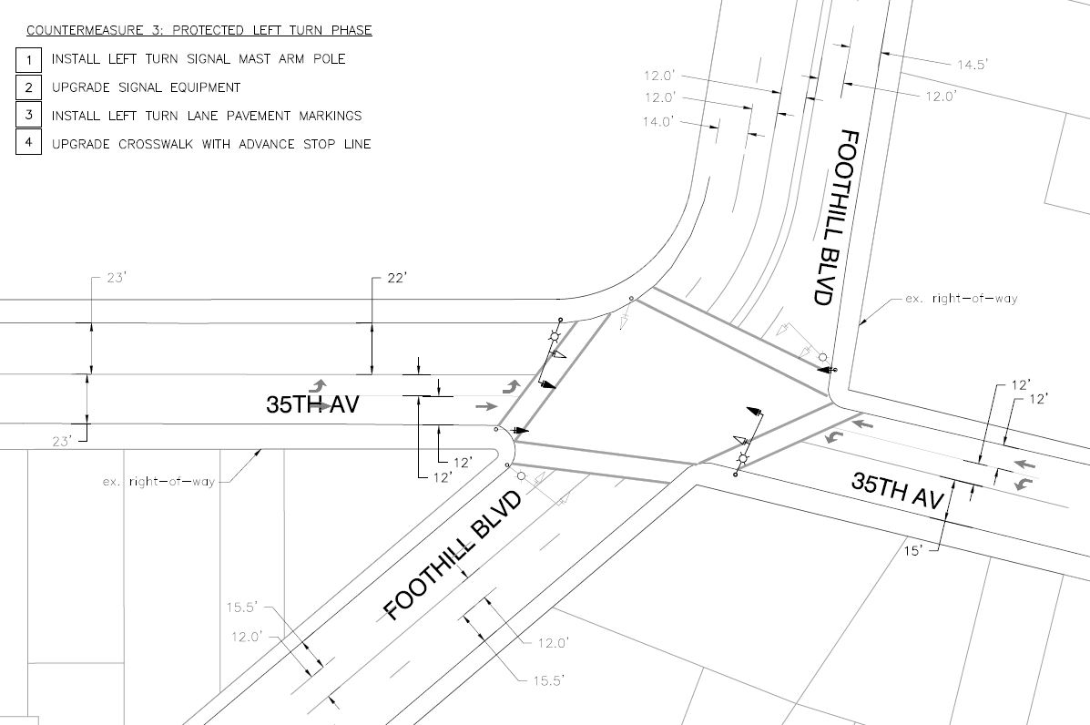
Project Location: 35th Ave (Cont.)
Existing Conditions Photo – 35th Ave and E 12th St (Foothill Blvd)
2018
Proposed Conditions Photo – 35th Ave and E 12th St (Foothill Blvd)
Lead Division Name: TRAFFIC CAPITAL PROJECTS

Slide 4
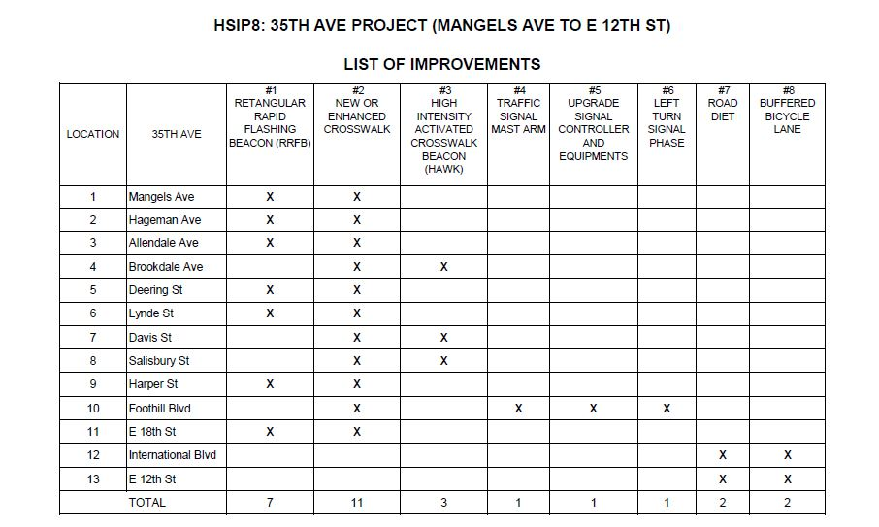
Project Location: 35th Ave (Cont.)
2018
Lead Division Name: TRAFFIC CAPITAL PROJECTS

