Slide 1
15-01 Community Policing ad hoc
5/26/22 Oakland Police Commission

Slide 2
History
Initial 15-01 draft prepared in 2018 by OPD, SSOC, and CPAB
Committee formed in May 2021
Bi-weekly Saturday meetings since July 2021

Slide 3
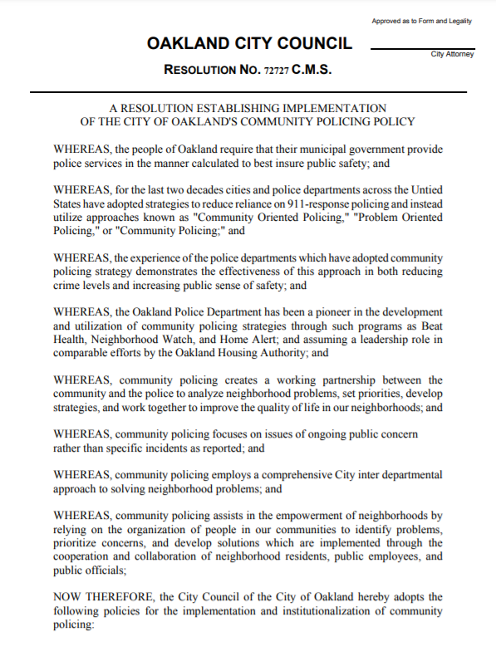
Community Policing in Oakland
On June 11, 1996, Oakland adopted Resolution 72727 establishing Community Policing as “… the public safety policy of the City of Oakland.”
Notes:
Speaker notes:
This policy established 57 distinct Beats in Oakland consisting of 5-7000 people. Each Beat was to have a Neighborhood Crime Prevention Council (NCPC) with an assigned Problem Solving Officer and non-sworn Neighborhood Services Coordinator.
Link to resolution:
https://cao-94612.s3.amazonaws.com/documents/79235-CMS.pdf

Slide 4
Community Policing in Oakland
On November 4, 1997, Resolution 72727 was amended to create the Community Policing Advisory Board (CPAB).
Notes:
Speaker notes:
The CPAB is an advocate for Community Policing helping to bring block and neighborhood groups together as a Citywide voice for Community Policing. The CPAB has the authority to certify NCPC’s in compliance with Resolution 72727 and decertify those out of compliance (Resolution 79235, Section 5.5).

Slide 5
Community Policing in Oakland
On April 13, 2005, Oakland adopted Resolution 79235 outlining four principles.
Notes:
Speaker notes:
The four principles were (1.21) Its purpose is to reduce crime, enhance public safety, and to improve quality of life, (1.2.2) It is a peer level partnership between the community, the Police Department and other City agencies, (1.2.3) In contrast to the 911 emergency response system, it addresses long term, chronic problems, using proactive, collaborative problem solving methods, (1.2.4) It fosters a geographically based crime prevention effort on three levels: at the block level, the neighborhood level and the Citywide level.

Slide 6
Ad Hoc Composition
Commissioners Harbin-Forte, Howell, Hsieh
OPC Chief of Staff Rania Adwan
OPD: A/Cpt. William Febel, A/Lt. Ronald Johnson
City: Joe Devries, Deputy City Administrator

Slide 7
Ad Hoc Composition
12 Community Advisors / Participants: Mariano Contreras, Creighton Davis, Jose Dorado, Candice Elder, Omar Farmer, Paula Hawthorne, Cathy Leonard, Pastor Bob Jackson, Pastor Anthony Jenkins, Reginald Lyles, Wilson Riles, Pastor Jackie Thompson

Slide 8
Overarching Themes
Every OPD officer is a Community Policing officer, requiring officers to receive training in cultural diversity and competency, active listening, and effective community engagement.
Push towards non-law enforcement responses to community identified problems

Slide 9
Push Towards Non-Law Enforcement Responses
Section B.1. NSCs take on Community Priorities that are less serious in nature.
Section D.3. Specific Roles: Coordinate with other City, county, and state agencies to resolve problems.
Section D.7. Professional Development: Training that focuses on identifying and utilizing community resources and organizations, local government functions, and crime prevention through environmental design (as opposed to enforcement)

Slide 10
Issues Highlighted
CRO turnover and service interruption
CRO training
Protecting CRO time for assigned beats
CRO focus on community directed projects

Slide 11
Addressing CRO Turnover and Service Interruption
Section D.8. Tenure: Minimum 3 years, expected 5 years in the CRO program.
Section D.5: Reassigning CROs outside of their assigned beat requires Area Commander approval and the reasons reported to CPAB/SSOC/OPC annually.

Slide 12
Addressing CRO Training
Section D.6. Data Collection and Dissemination: Requiring biannual meetings between CROs and NSCs to develop best practices.
Section D.7. Professional Development: List of trainings to be administered, developed in and presented in collaboration with the community.

Slide 13
Protecting CRO Time for Assigned Beats
Section D.2. General Roles: Drawing CROs away from their assigned duties and beats is greatly disfavored
Section D.5. CROs should not be assigned to more than two Neighborhood Councils unless staffing and crime data dictate otherwise.

Slide 14
CRO Focus on Community Directed Projects
Section D.3. Specific Roles: Maintain at least one project centered on a Neighborhood Council Priority, per assigned beat.

