Slide 1
West Oakland 14th St - Road Diet Project Concept
Draft
By Jesse Boudart, Charlie Ream, Jane Mei, & David Pené
July 11, 2024
Bicycle and Pedestrian Advisory Commission
Infrastructure Committee

Slide 2
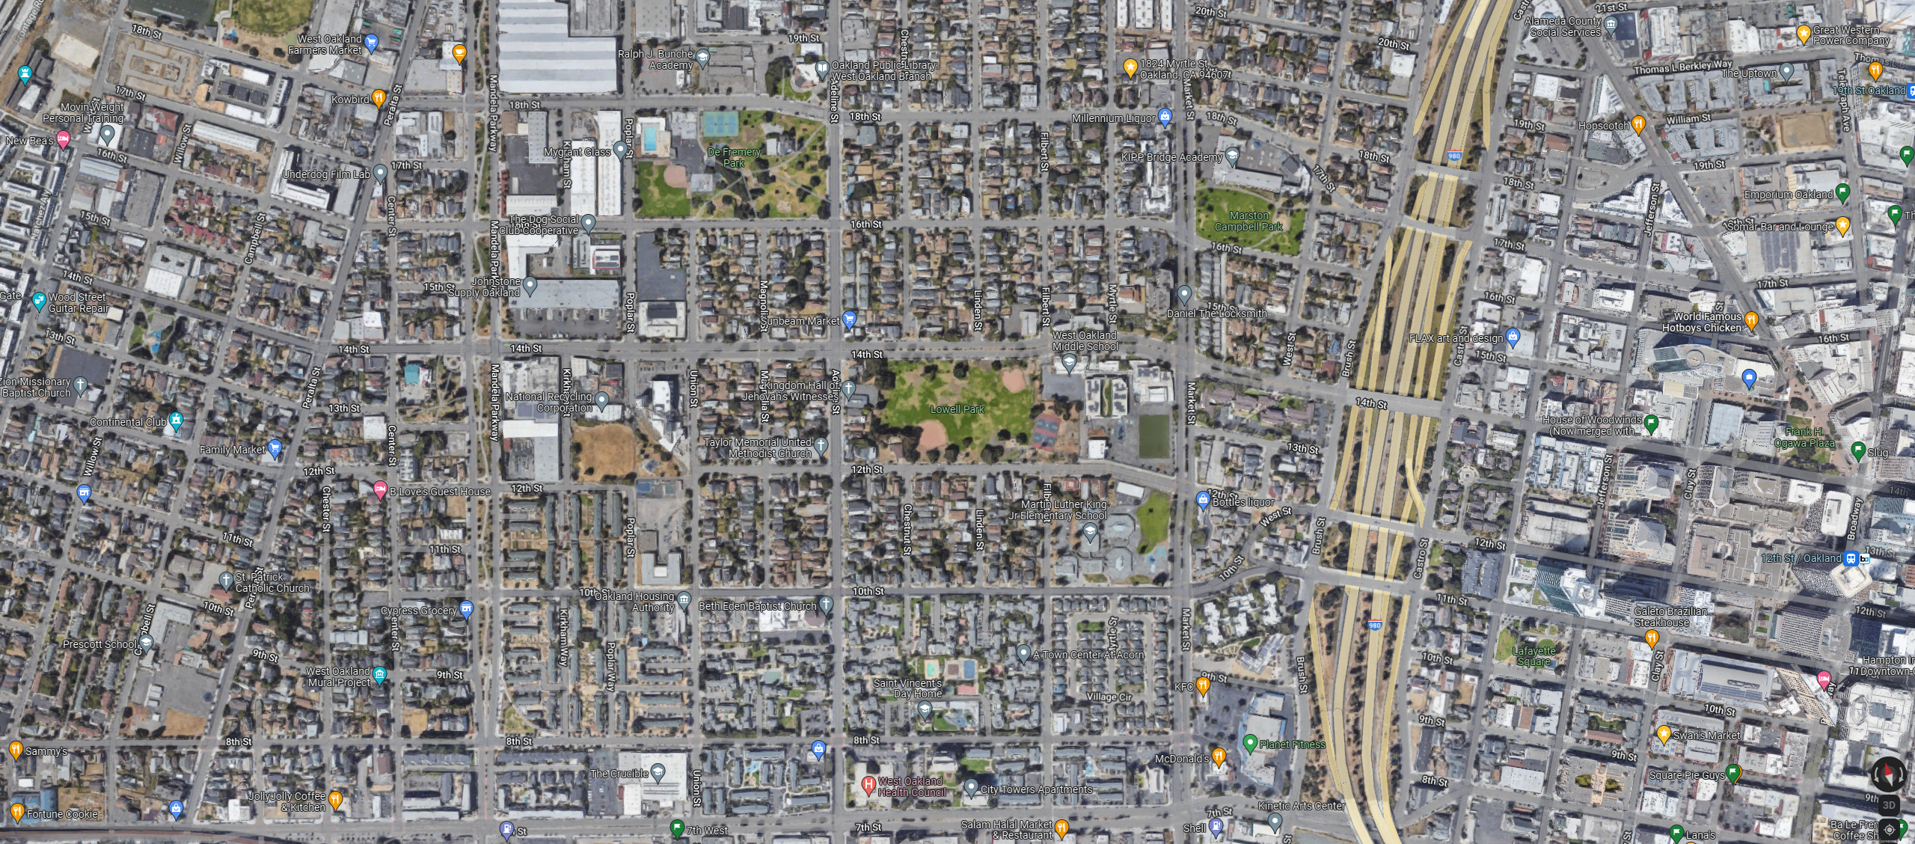
West Oakland 14th St – Project Location
N
14th St
Proposed Road Diet Project
Mandela Pkwy
Adeline St
Brush St
Market St
Total Project Length = 0.75 Miles

Slide 3
West Oakland 14th St – Project Location
Route 88
Route 36
N
Existing bikeway
Future bikeway
Bus Stop Enhancement Project
(floating bus stop)
Existing bike lanes
14th St
Bus Route 14
14th St Safety Project – under construction now
Existing path and bike lanes
Existing bike lanes
Proposed Road Diet Project
Mandela Pkwy
Adeline St
Brush St
Market St
Existing bike lanes
Total Project Length = 0.75 Miles
Notes:
Existing bike lanes on 14th, Mandela, Adeline, Market
Buses on 14th, Adeline, Market
Upcoming projects on 14th Street downtown, and a separate bus stop project at Filbert (by West Oakland Middle School)

Slide 4
West Oakland 14th St – Project Location
N
High Injury Network 2024
Fatal or Severe Crashes
August ‘22 Fatal Crash
14th St
Proposed Road Diet Project
Mandela Pkwy
Adeline St
Brush St
Market St
Total Project Length = 0.75 Miles
Notes:
2014-2023
Mandela: 4 fatal/severe crashes including 1 death
Poplar: 1 fatal crash (2022)
Magnolia: 1 severe crash
Adeline: 2 fatal/severe crashes including 1 death
Market: 1 severe crash

Slide 5
West Oakland 14th St – Project Location
N
HSIP 10 Project
(Signal, RRFB, & geometric upgrades)
14th St
Proposed Protected Intersection
Proposed Road Diet Project
Mandela Pkwy
Adeline St
Brush St
Market St
Total Project Length = 0.75 Miles
Notes:
HSIP funding allows additional improvements for a section, mostly at Adeline

Slide 6
West Oakland 14th St – Existing Conditions and Precedent
Portland, Oregon
Existing Conditions – 14th St & Filbert St

Slide 7
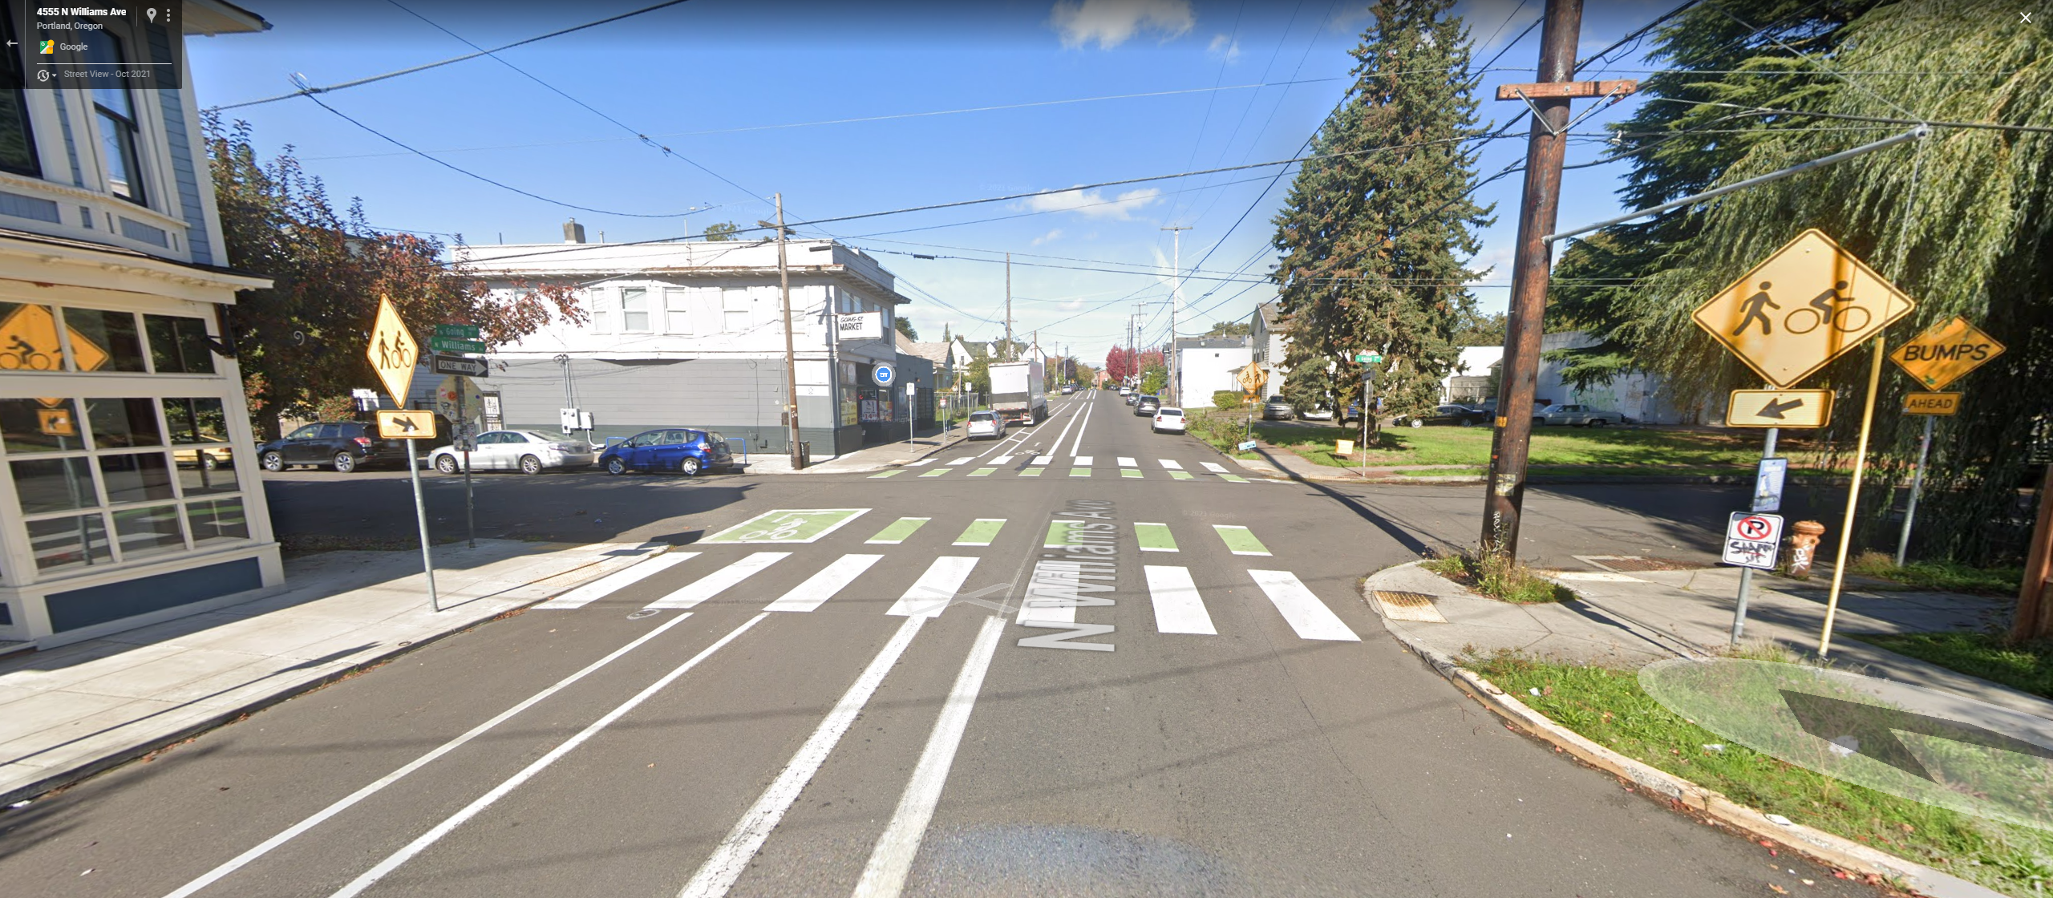
West Oakland 14th St – Existing Conditions and Precedent
Notes:
Minimal 45 degree markings to eliminate bumpiness and reduce cost/complexity
Crossings (like shown) have additional warnings/signage
Portland, Oregon
Portland, OR – N Williams Ave & NE Going St

Slide 8
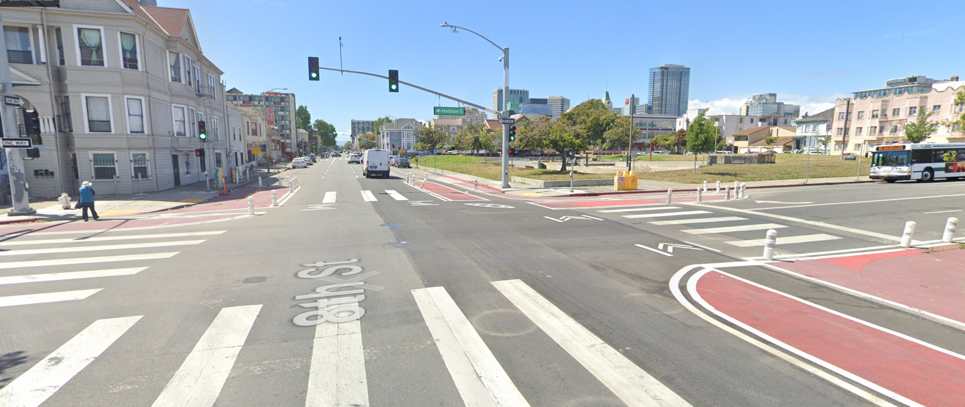
West Oakland 14th St – Existing Conditions and Precedent
Oakland, CA – 8th St and Madison St (near Lake Merritt BART)
Notes:
https://goo.gl/maps/HVuskL9YyBSwPhjr8

Slide 9
West Oakland 14th St – Sample Cross Sections
Existing
14th Street
Peak Hour Traffic Volumes (PM)
850 vehicles per hour
(2015 traffic count, total in both directions)
14th Street
Total Vehicle Capacity
3400 vehicles per hour
(850 vehicles per hour per lane)
300% excess capacity
This encourages speeding, aggressive driving, and other unsafe behaviors.

Slide 10
West Oakland 14th St – Sample Cross Sections
Draft
Existing
Buffered or Flexpost Bike Lanes
Shared Bus/Bike Lanes

Slide 11
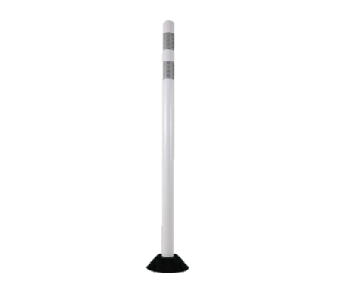
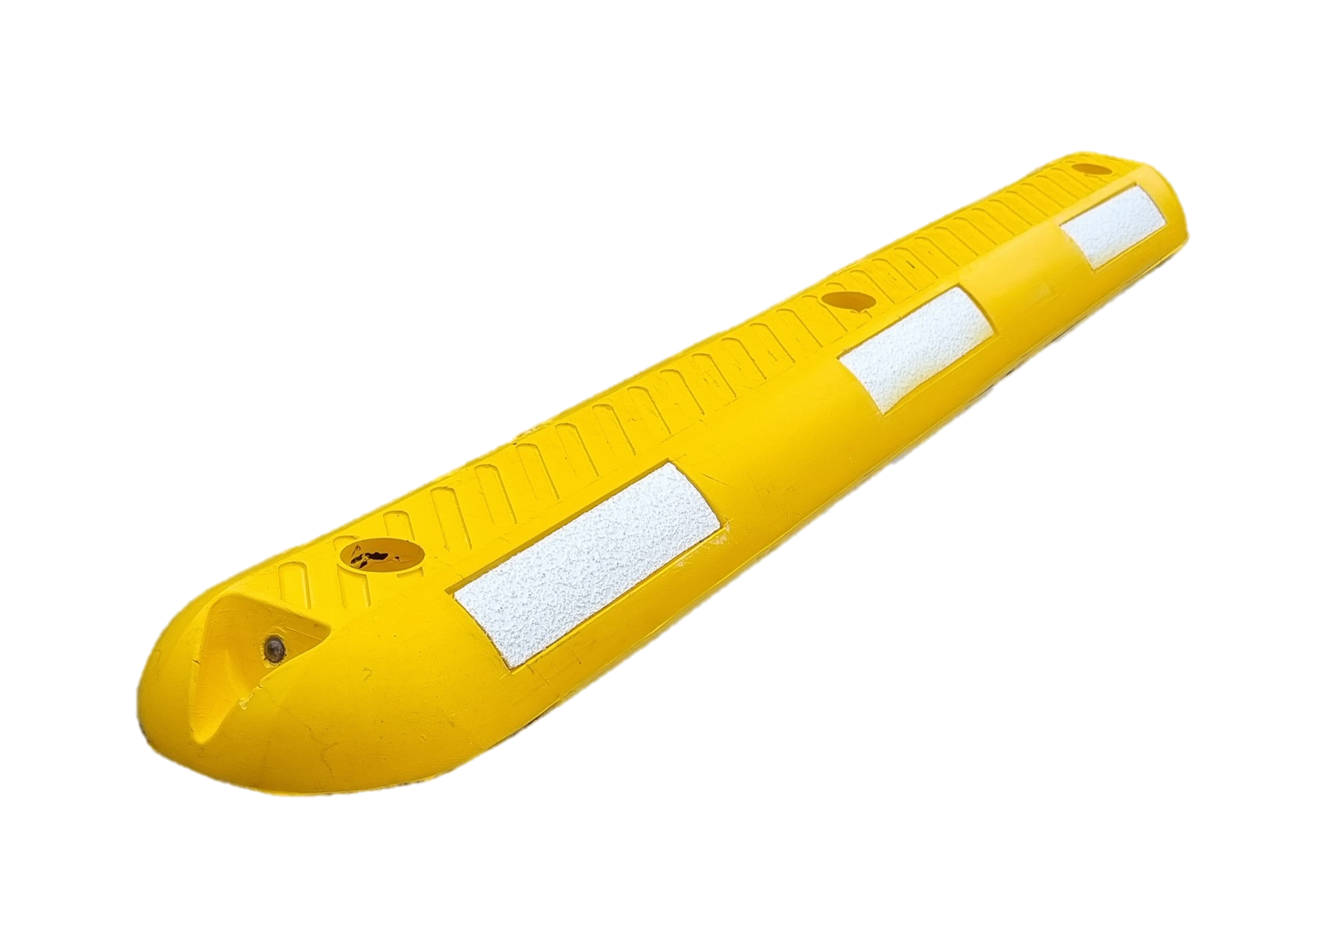
West Oakland 14th St – Sample Cross Sections
Draft
Existing
Buffered or Flexpost Bike Lanes
Flexpost
Mountable delineator
Buffered bike lanes are more easily traversable by emergency vehicles and for parking
Vertical separation (concrete or flexpost) will be focused at pedestrian priority intersections

Slide 12
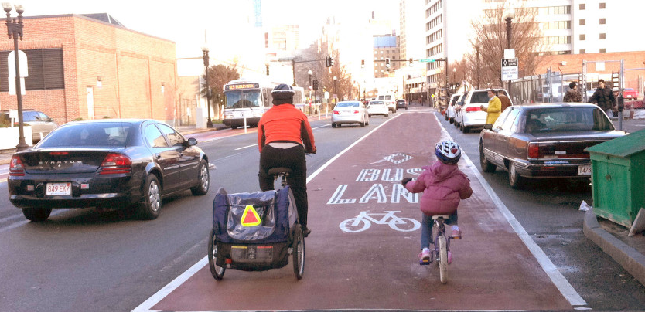
West Oakland 14th St – Sample Cross Sections
Draft
Existing
Example from Boston (Image source: NACTO)
Buses and bikes may share a 16 ft bus/bike lane
16’ Shared Bus/Bike Lanes

Slide 13
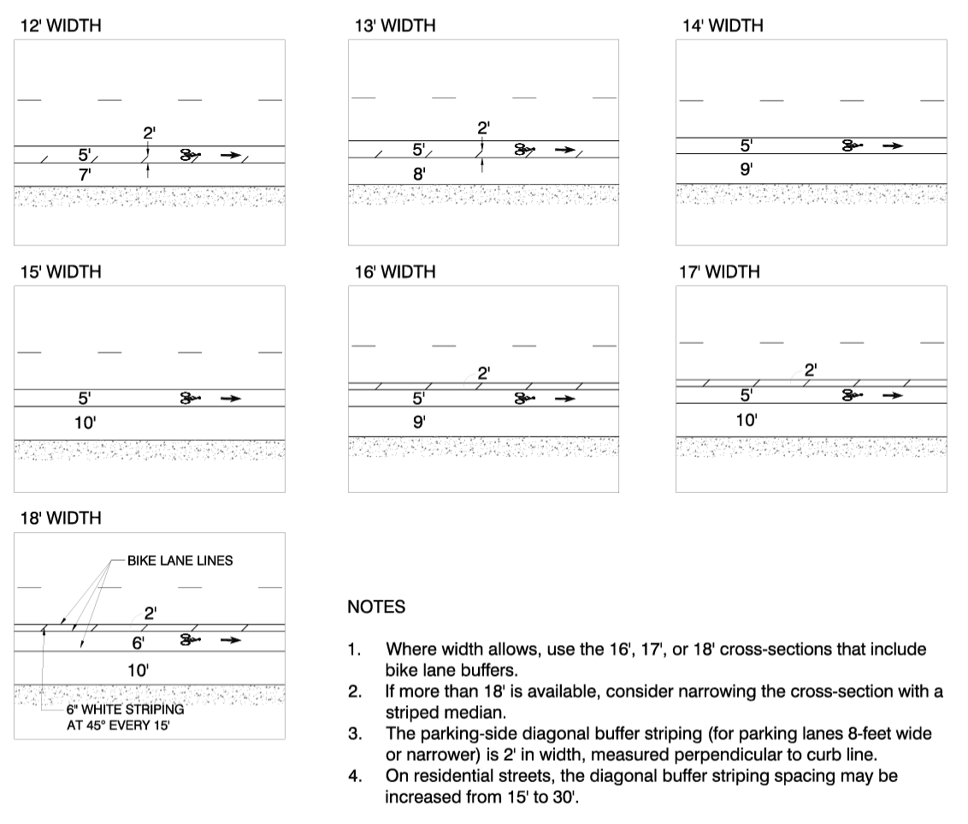

Slide 14
West Oakland 14th St – Road Diet Schedule - Draft
Summer 2024
65%-95% Design
Outreach
Fall/Winter 2024
100% Design – Bid Documents
2025
Construction

